Slide 1


Design and Co-ordinated control of Robots
1PI14EE001
1PI14EE005
1PI14EE022
Guide : M J Venkatrangan
Project ID : 18EEI15A

Slide 2
Problem Statement and Objectives
To co-ordinate a set of robots to accomplish a series of individual tasks by a central control unit.
Task chosen/ Application : The transport of objects in a controlled environment .
The emphasis is on the co-ordination of the set of robots to accomplish the tasks efficiently. The project is not of the scale to be used immediately in industries.

Slide 3
Proposed Methodology
Breakdown the goal into multiple individual tasks like 1. grid development 2. literature survey to get ideas to go about the project 3. modeling of the path of objects to minimize the time of operation and developing a user interface for command. 4. study of various test cases and mathematical modeling and arrive at a solution for an objective function with constraints 5. test the sensors and understand how to incorporate them 6. communication module ( Zigbee ) to be tested and programmed to be used efficiently 7. procurement of components and assembly of robot and object

Slide 4
Progress
Development of a reference grid along with the code.
The size of the cell of the grid will be finalized once design of robot is complete.
Code has been written to provide a straight line path between a given start point and end point.
Detection of an intersection point has also been done in case the paths of robots intersect.
Development of few test cases for a generalized algorithm.

Slide 5
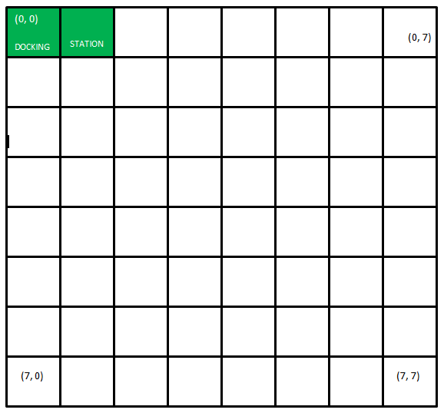

Slide 6
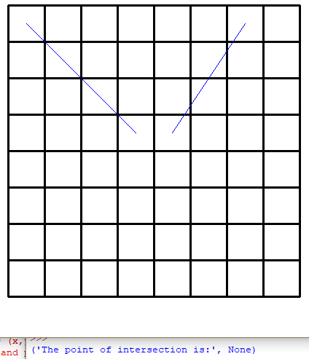
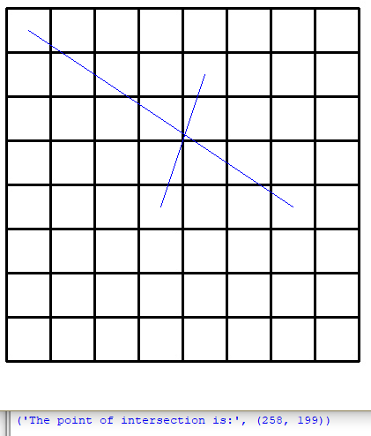

Slide 7
Block Diagram
INPUT
CENTRALISED SYSTEM
SLAVE 1 & SLAVE 2
EXECUTE
FEEDBACK
THE INPUTS ARE:
*NUMBER OF OBJECTS.
*OBJECT’S INITIAL LOCATION.
*INITIAL LOCATION OF THE SLAVES.
*DESIRED DESTINATION OF THE SLAVES.

Slide 8
Test Case : 1
Single object and two slaves
*Slaves(s1 & s2), Object(Ob), End point(E.P)
E.P
s1
d1
COMPARISON:
here , d1 > d2
so, s2 operates s2
d2

Slide 9
Test Case : 2
Two objects and two slaves with a common end point
*Slaves(s1 & s2), Object(o1 & o2), End point(E.P)
E.P
s1 d1 g1 g2 o2
o1
Comparisons:
*d1 & (d2+g2+g1)
*d2 & (d1+g1+g2) d2
s2

Slide 10
Process Chart
Centralised System
Feedback 1
Feedback 3
Feedback 2
Feedback 4
Command 1
Command 2
Command 3
Command 4
S1
S2

Slide 11
ROBOT DESIGN
3 wheeled robots - two driven by dc motor and a caster wheel.
DC motor - 150rpm dc motors.
Motor Control board - l293d.
Wheel diameter - 65mm.
Microprocessor - arduino nano
Robot size - approximately 20x10 cm.
Gripping action with 2 DOF by 2 servo motors.
Communication module : Zigbee module
Position sensing : imu 6050.

Slide 12
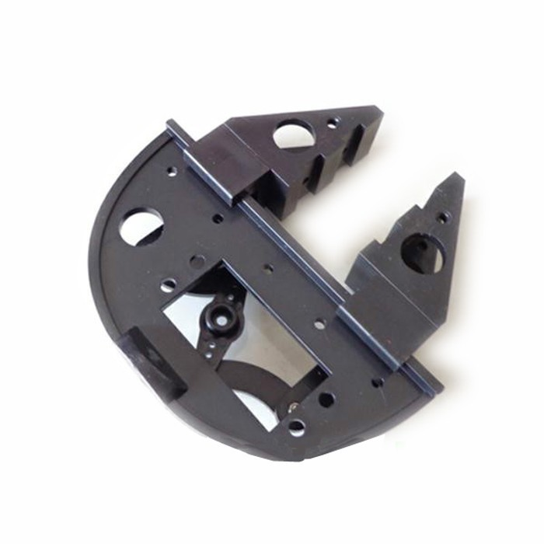
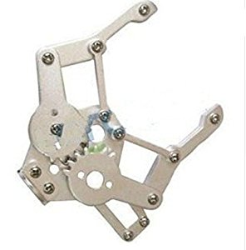
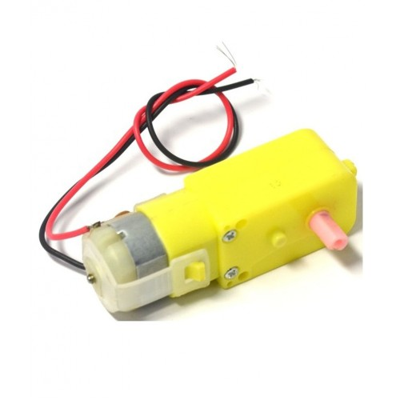
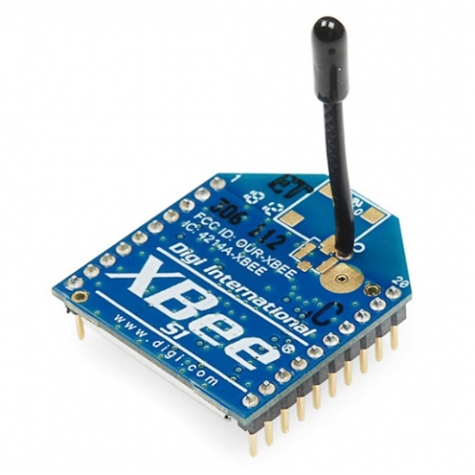

Slide 13
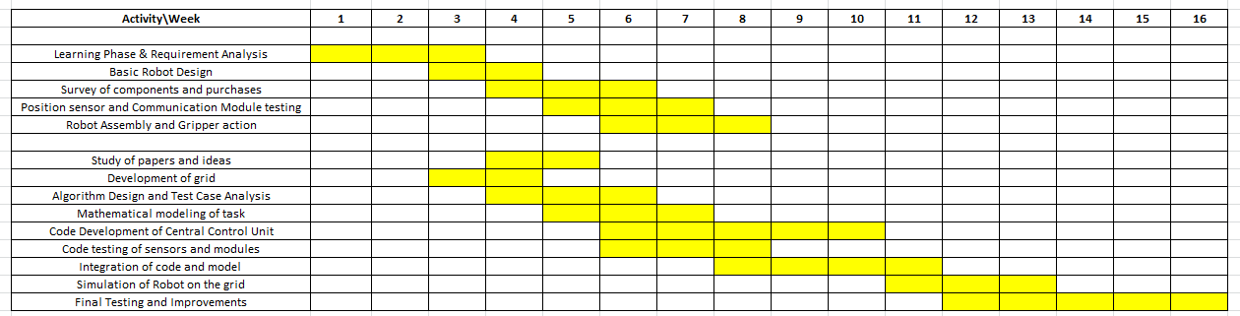
Timeline
Proposed timeline for project completion

Slide 14
Goals for next steps
Full completion of literature survey and incorporation of ideas into the making of the algorithm
Analysis of test cases and mathematical modeling
Design of the model
Understand how best to use the zigbee modules for the communication and arrive at a flowchart for continuous communication between the central system and robots
Start testing of the components and write codes to understand and incorporate data read by the sensors

Slide 15
QUESTIONS
?

Slide 16
THANK YOU

