Slide 1
About Pennylane
Pennylane is an open-source, cross-platform Python library designed for quantum computing, quantum machine learning, and quantum chemistry research. Its core purpose is to help users create, simulate, and optimize quantum circuits, making quantum programming accessible and flexible.
Key Features:
Quantum Circuit Construction: Pennylane lets you easily build quantum circuits using simple Python functions.
Hybrid Quantum-Classical Workflows: It integrates seamlessly with machine learning frameworks like PyTorch, TensorFlow, and JAX.
Automatic Differentiation: You can calculate gradients of quantum circuits, a powerful mechanism for training quantum models using techniques like backpropagation.​
Device Independence: Through a plugin system, Pennylane supports simulators (including local, cloud, or GPU-backed) and various real quantum devices from different vendors, creating portability and reproducibility.

Slide 2
Project Overview
Generate random bits via qubit measurement in superposition using pennylane.
Compare quantum randomness with classical pseudo-random generation.
Apply statistical tests to validate randomness quality.
Demonstrate quantum advantage in cryptographic applications.

Slide 3
Topics & Concepts
Quantum Superposition: Qubits exist in both 0 and 1 states simultaneously
Hadamard Gate: Creates equal superposition (50-50 probability)
Measurement Collapse: Observation yields deterministic 0 or 1
Statistical Randomness: Testing for uniformity and bias detection

Slide 4
Tools & Libraries
Pennylane: Quantum computing framework (qubit simulation, gates, measurement)
NumPy: Classical pseudo-random generation (randint, statistical utilities)
SciPy: Chi-square statistical test implementation
Python Math: Error function for monobit test calculation

Slide 5
Quantum RNG: Theory
Quantum Superposition: A qubit exists in both |0⟩ and |1⟩ states simultaneously until measured.
Measurement Collapse: When measured, the qubit "collapses" to either 0 or 1 with equal probability (50-50). This fundamental quantum indeterminacy is truly unpredictable.

Slide 6
Method 1: Quantum RNG Implementation
import pennylane as qml
dev = qml.device("default.qubit", wires=1, shots=1000)
@qml.qnode(dev)
def quantum_random_circuit():
qml.Hadamard(wires=0)
return qml.sample(wires=0)
random_bits = quantum_random_circuit()
Print(random_bits)

Slide 7
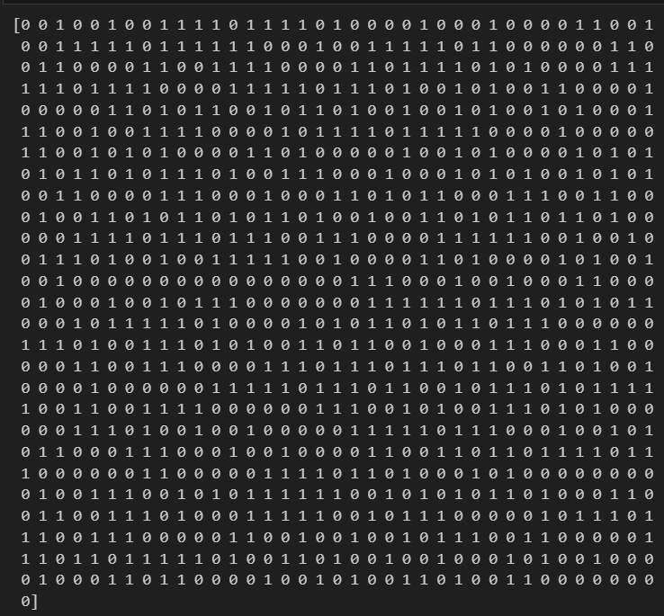
Method 1: Quantum RNG Implementation

Slide 8
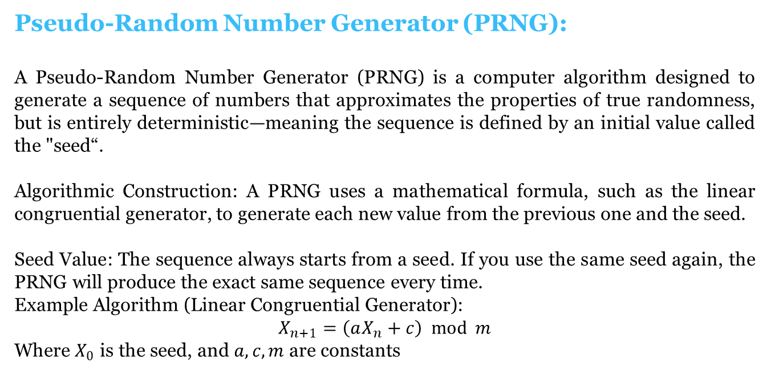
Classical RNG: Theory
Pseudo-Random Number Generator (PRNG):
A Pseudo-Random Number Generator (PRNG) is a computer algorithm designed to generate a sequence of numbers that approximates the properties of true randomness, but is entirely deterministic—meaning the sequence is defined by an initial value called the "seed“.
Algorithmic Construction: A PRNG uses a mathematical formula, such as the linear congruential generator, to generate each new value from the previous one and the seed.
​
Seed Value: The sequence always starts from a seed. If you use the same seed again, the PRNG will produce the exact same sequence every time.
Example Algorithm (Linear Congruential Generator):
$$X_{n+1}=\left(aX_{n}+c\right) mod m$$
Where $X_{0}$ is the seed, and $a,c,m$ are constants

Slide 9
Method 2: Classical RNG Implementation
import numpy as np
classical_bits = np.random.randint(0, 2, size=1000)
print(classical_bits)

Slide 10
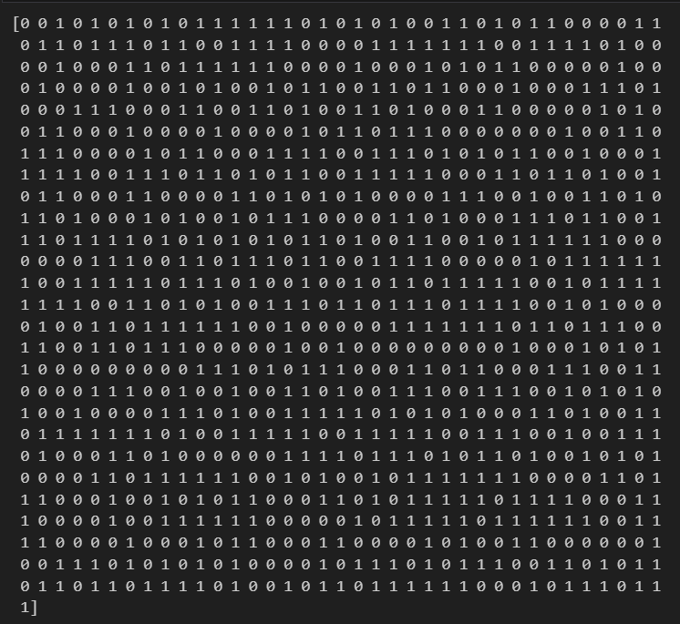
Method 2: Classical RNG Implementation

Slide 11

Chi-Square Test
Tests if observed frequency of 0s and 1s matches expected distribution. Detects systematic bias.
Formula: χ² = Σ(observed - expected)² / expected
Decision: p-value > 0.05 = PASS (random) | p-value < 0.05 = FAIL (biased)

Slide 12
Chi-Square Test: Purpose
Tests frequency distribution of 0s and 1s
Detects systematic bias in the bitstream
Compares observed counts against expected 500-500 split
Fundamental test: No bias = true randomness
Part of NIST SP 800-22 standard for RNG validation

Slide 13
Chi-Square Test Implementation
from scipy.stats import chisquare
import numpy as np
def chi_square_test(bits):
counts = [np.count_nonzero(bits == 0), np.count_nonzero(bits == 1)]
chi2, p_value = chisquare(counts)
return chi2, p_value
quantum_chi2, quantum_p = chi_square_test(random_bits)

Slide 14
Monobit Test
Examines if count of 1s and 0s is approximately equal. Maps bits to ±1 and calculates normalized sum.
s = 2·Σ(bits) - n → Normalized: s_obs = |s| / √n
p-value = erfc(s_obs / √2) Using complementary error function

Slide 15
Monobit (Frequency) Test: Purpose
Validates unbiased distribution of 0s and 1s
Maps bits to ±1, calculates normalized sum
Detects if sequence tends toward 0s or 1s
Mathematical rigor using complementary error function
Industry standard: First test in NIST validation suite

Slide 16

Monobit Test Implementation
def monobit_test(bits):
n = len(bits)
s = 2 * np.sum(bits) - n
s_obs = abs(s) / np.sqrt(n)
p_value = np.math.erfc(s_obs / np.sqrt(2))
return p_value
quantum_monobit_p = monobit_test(random_bits)

Slide 17
Results
Chi-Square Test
Quantum RNG | Classical RNG
Statistic: 0.004 | Statistic: 0.484
p-value: 0.9495709711511051 | p-value: 0.4866160457640505
PASS | PASS
Decision Criteria
p-value > 0.05: PASS
p-value < 0.05: FAIL
Monobit Test
Quantum RNG | Classical RNG
p-value: 0.9495709711511051 | p-value: 0.4866160457640506
PASS | PASS

Slide 18
Results
While both methods passed statistical randomness checks, their security implications are different. Quantum randomness is fundamentally unpredictable and cannot be reconstructed, making it ideal for high-security uses like cryptographic key generation. Classical RNG, though statistically random, can be reversed or predicted if the algorithm and seed are exposed, making it less secure for cryptography. This demonstrates that quantum RNG is better suited for applications where absolute unpredictability is critical.

