Slide 1
Healthiest Fast Food Chain
Aditya Gulati
Dec 2023

Slide 2
Introduction
According to a CNN article written in 2018,”Here’s how much fast food Americans are eating”, recent research from the US Centers for Disease Control and Prevention shows how common fast food has become in American diets. It also shows how many people consume it.
The National Center for Health Statistics released a data brief that states that between 2013 and 2016, over 37% of US adults ate fast food on any given day.
In the United States, an estimated 84.8 million adults, or 36.6% of the population, eat fast food on any given day.

Slide 3
Fast food is often heavy in calories, fat, salt, and sugar. These ingredients, when consumed in excess, increase the risk of heart disease, high blood pressure, obesity, and Type 2 diabetes.
A 2013 data brief from the National Center for Health Statistics stated that between 2007 and 2010, fast food accounted for 11.3% of the total daily caloric intake of US people.

Slide 4
Main Objective
Which American fast-food chain restaurant has the healthiest menu?

Slide 5
Dataset
The dataset is about nutritional values of different fast food items from fast-food chain restaurants.
Dataset includes items from six fast-food chains.
Dataset is from a public platforms so before following the analysis step first we need to process it and make it suitable for analysis.
Few columns such as Calcium, Vit A and Vit B have many NA values. Using them might affect the accuracy of the findings.

Slide 6
Analysis

Slide 7
We must first define what constitutes healthy and unhealthy food.
In this instance, the food's calories and nutritional value should be taken into account.
A food should be regarded as healthy if it is low in calories and high in protein and fiber.
Food would be deemed unhealthy if it contained a high quantity of cholesterol along with a high calorie intake.

Slide 8
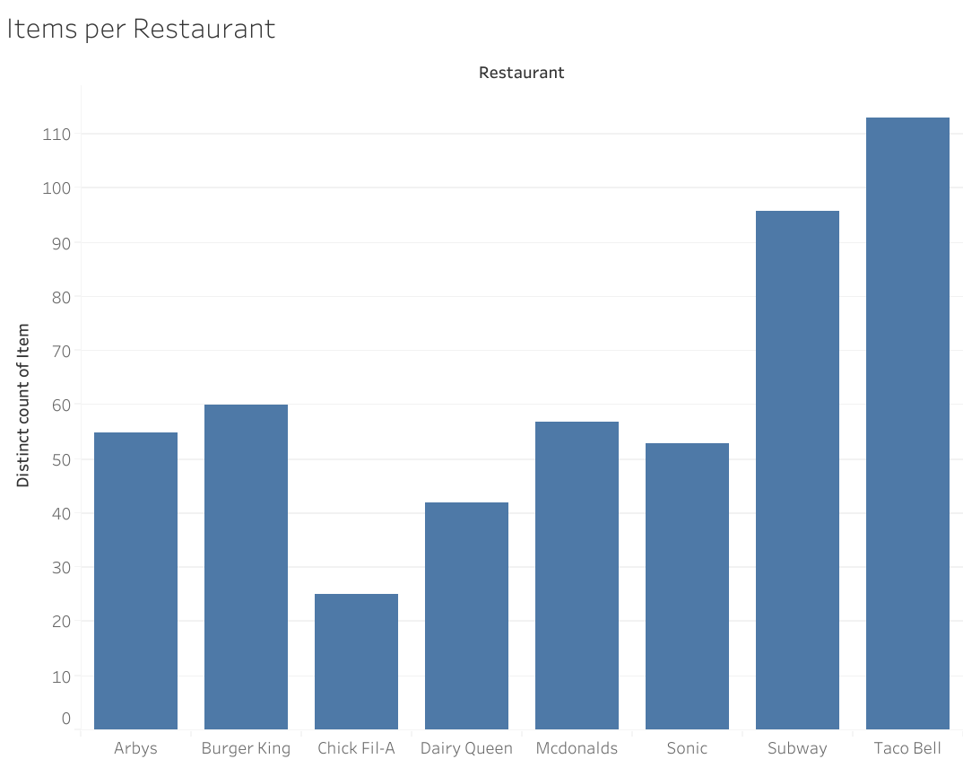
Checking how many items each restaurant include.
This would help in deciding what calculation should be used in the analysis.
There is big gap between the number of items per restaurant.
It will be best if we use average as the calculation for the analysis.

Slide 9
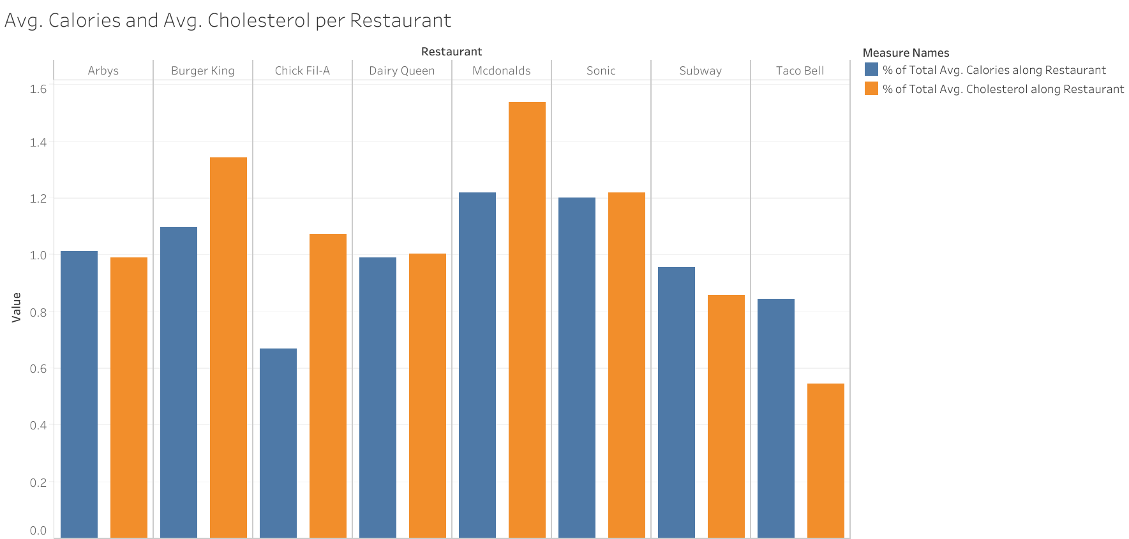
Examining whether the average cholesterol and calories exhibit a comparable trend.
Range of value of cholesterol and calories varies, so we are using percentage of total calculation to normalize the values.
In the most of the restaurants, avg. calories and avg. cholesterol are similar.
Mcdonalds, Burger King and Sonic are the restaurants with highest percentage of avg. calories and avg. cholesterol.

Slide 10
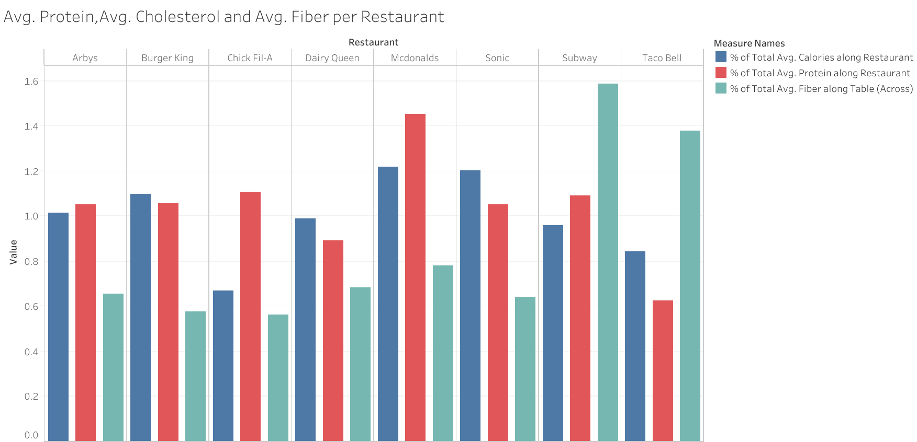
Checking if avg. protein or avg. fiber increase with avg. cholesterol
Avg. Protein value usually increases with avg. cholesterol unlike avg. Fiber.
Mcdonalds have highest level of protein but also have highest level of calories.
Chick Fil-A have second highest level of protein and
Subway and Taco Bell have highest level of

Slide 11
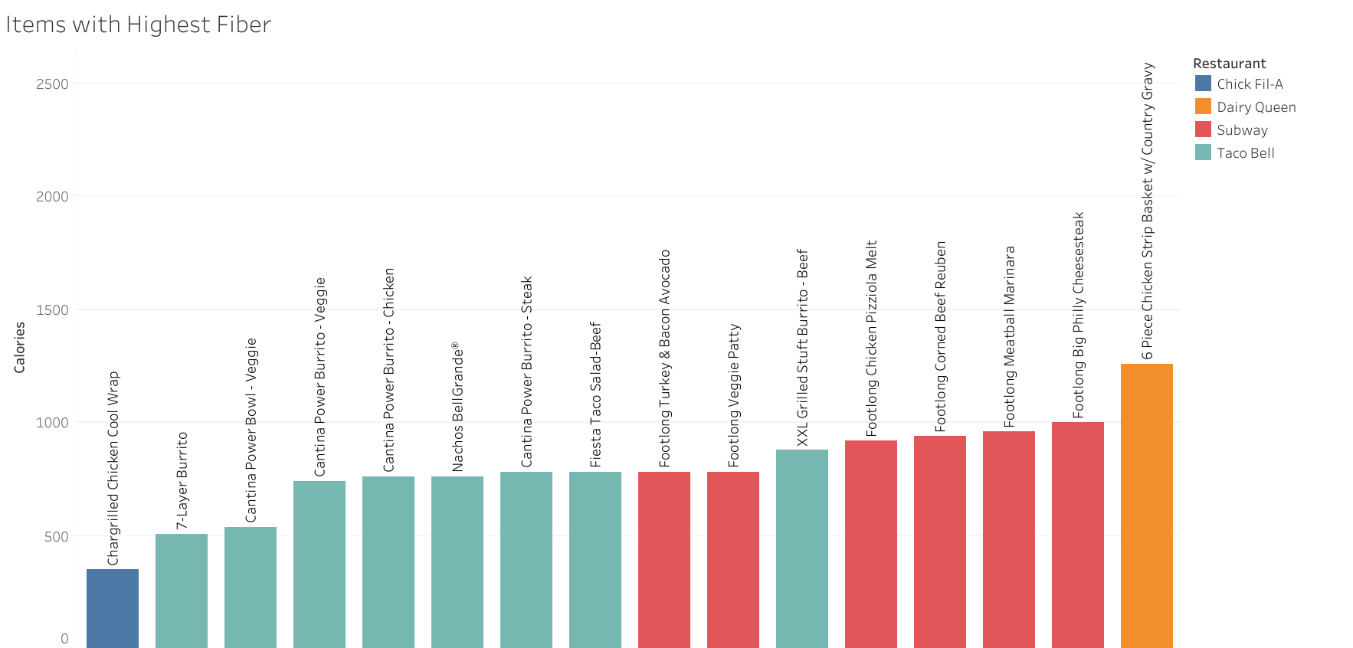
Graph shows items with highest Fiber with colour represents to which restaurant they belong.
Chick Fil A have the high fiber item with lowest calories in the entire dataset.
Subway and Taco Bell have the highest number items with high fiber.

Slide 12
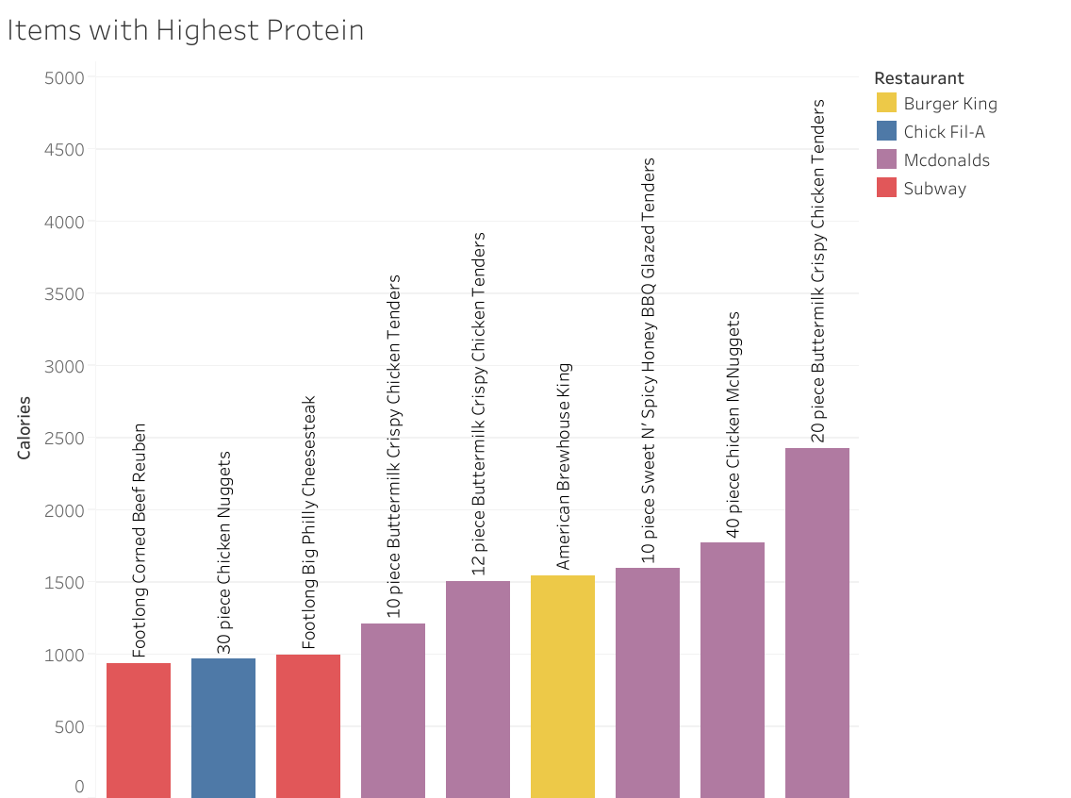
Similar to the previous graph, finding out the items with highest protein.
Mcdonalds have highest number of high protein items
Subway has the high protein item with lowest calories

Slide 13
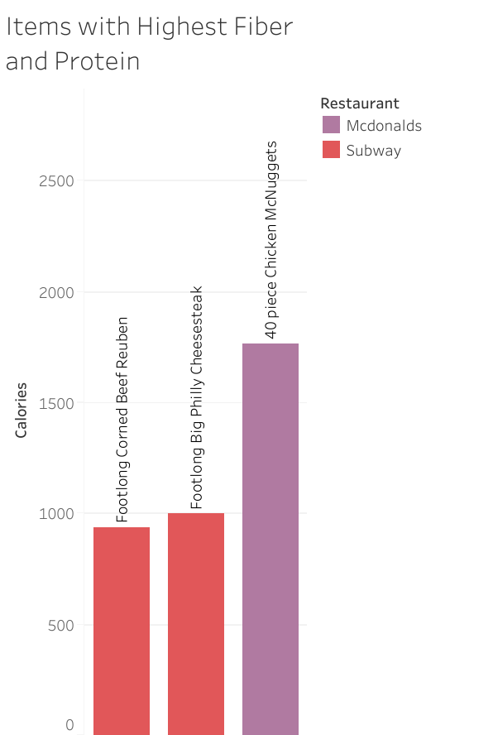
The Graph is the intersection of the previous two graphs.
The first two items can be considered the healthiest item in the dataset.The third is high in fiber and protein but have huge calorie intake.
Both item belong to the Subway.

Slide 14
Findings

Slide 15
Subway and Taco Bell can considered as the healthiest food chain restaurant in US.
Taco Bell has most variety of health food items compared to Subway, though Subway has the healthiest food item on their menu.
Mcdonalds, Sonic and Burger King can be considered as unhealthiest food chain.

Slide 16
Limitations

Slide 17
Dataset had columns with many NA values which had to removed.
Those columns could have provided with more accurate findings.

