Slide 1

Robotic Process Automation (RPA)

Slide 2
What is Robotic Process Automation?
Robotics Process Automation(RPA) allows organizations to automate task just like a human being was doing them across application and systems.
RPA can be used to automate workflow, infrastructure, back office process which are labor intensive. These software bots can interact with an in-house application, website, user portal, etc.

Slide 3
AGENDA
What is Robotic Process Automation?
Why Robotic Process Automation?
Example of RPA
Differences between Test Automation and RPA
RPA Implementation Methodology
Best Practices of RPA Implementation
General Use of RPA
Application of RPA
Robotic Process Automation tools
Benefits of RPA

Slide 4
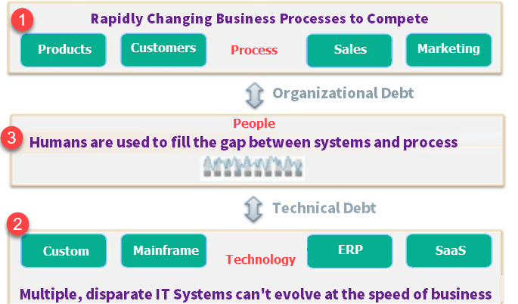
Why Robotic Process Automation?

Slide 5
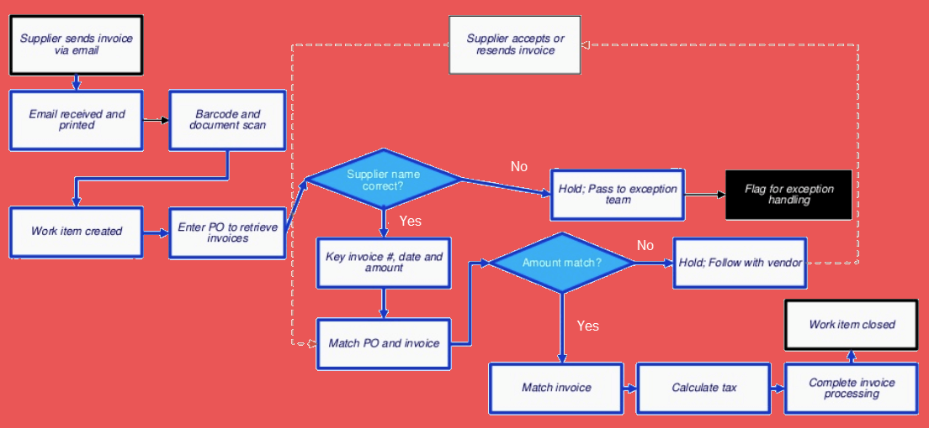
Example of RPA

Slide 6
Example of RPA
Description | Can be Automated via RPA?
Open invoice email from the supplier and print it for records | Yes
Barcode Scanning | Manual
Create work item in a legacy software system | Yes
Enter PO to retrieve Invoices | Yes
Check supplier name is correct or not? | Yes
Key Invoice, Data and Amount | Yes
Check if Amount is matches or not? | Yes
If amount match is yes the Matched Invoice, Calculate Tax | Yes
Complete Invoice Processing | Yes
Work Item Closed | Yes

Slide 7
Differences between Test Automation and RPA
Parameter | Test Automation | RPA
Goal | Reduce Test execution time through automation | Reduce headcount through automation
Task | Automate repetitive Test Cases | Automate repetitive Business processes
Coding | Coding knowledge required to create Test Scripts | Wizard-driven, and coding knowledge not required
Tech Approach | Supports limited software environment. Example: Selenium can support only web applications. | Supports a wide array of software environments
Example | Test cases are automated | Data entry, forms, loan processing, is automated
Application | Test Automation can be run on QA, Production, Performance, UAT environments | RPA is usually run only on production environments
Implementation | It can automate a product. | It can automate a product as well as a service.
Users | Limited to technical users. | Can be used across the board by all stakeholders.

Slide 8
RPA Implementation Methodology
Planning/Analysis
Development/Bot Development
Testing
Support & Maintenance

Slide 9
Best Practices of RPA Implementation
One should consider business impact before opting for RPA process
Define and focus on the desired ROI
Focus on targeting larger groups and automating large, impactful processes
Combine attended and unattended RPA
Poor design, change management can wreak havoc
Don't forget the impact on people

Slide 10
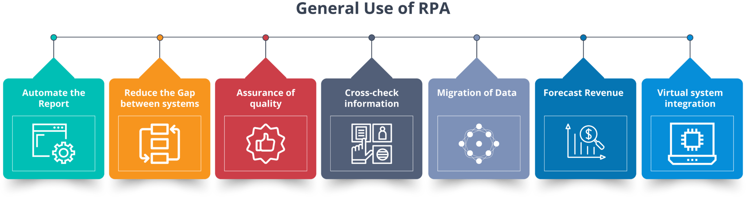
General Use of RPA

Slide 11
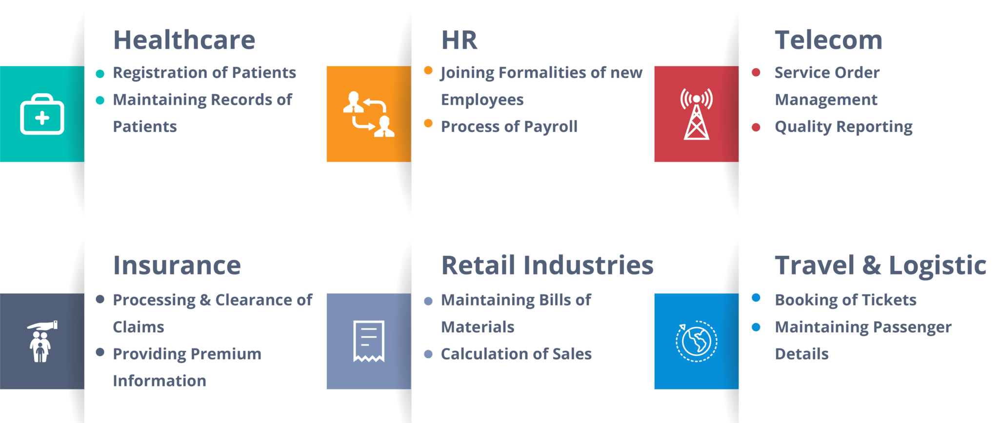
Application of RPA

Slide 12
Robotic Process Automation tools
Selection of RPA Tool should be based on following 4 parameters:
Data: Easy of reading and writing business data into multiple systems
Type of Tasks mainly performed: Ease of configuring rules-based or knowledge-based processes.
Interoperability: Tools should work across multiple applications
AI: Built-in AI support to mimic human users
Popular Robotic Automation Tools: Blue prism, Automation AnyWhere, UiPath etc..

Slide 13
Benefits of RPA
Large numbers of the process can easily have automated.
Cost are reduced significantly as the RPA takes care of repetitive task and saves precious time and resources.
Programming skills are not needed to configure a software robot. Thus, any non-technical staff can set up a bot or even record their steps to automate the process.
Robotic process automation support and allows all regular compliance process, with error-free auditing.
The robotic software can rapidly model and deploy the automation process.
The defects are tracked for each test case story and the sprint.
Effective, seamless Build & Release Management
Real time visibility into bug/defect discovery
There is no human business which means there is no need for time for the requirement of training.
Software robots do not get tired. It increases which helps to increase the scalability

Slide 14
Project (Robotic Process Automation)

Slide 15
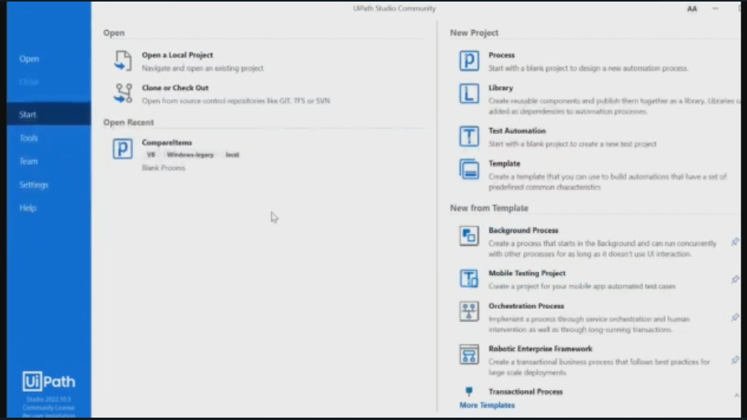
Ui-path – replication task

Slide 16
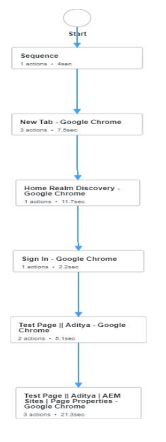
Bot training sequence

Slide 17
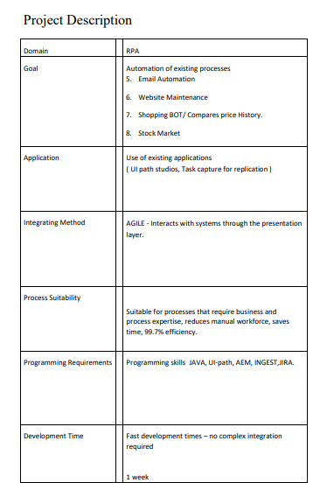

Slide 18
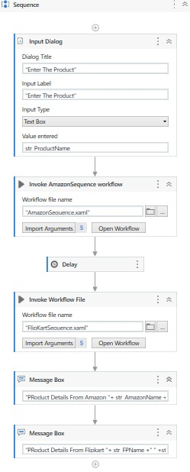
UI-Path flow chart

Slide 19
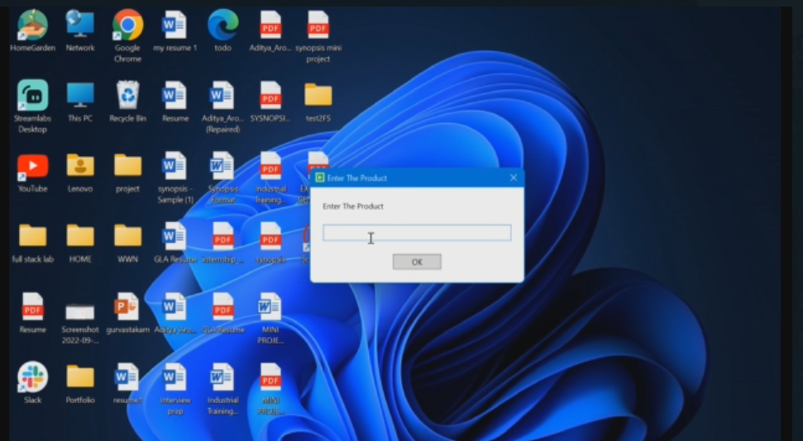
Bot triggered

Slide 20
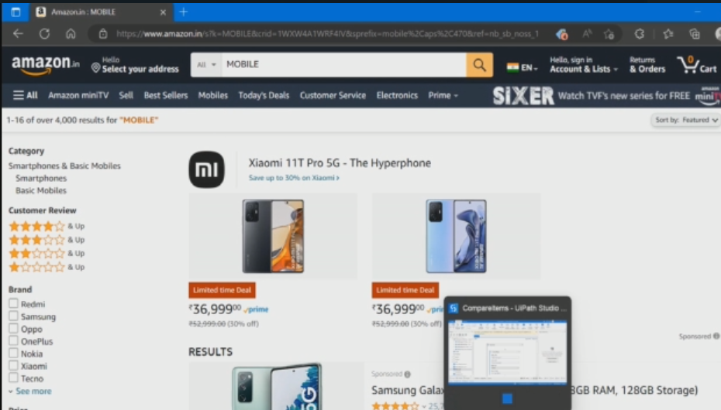
Bot under processing

Slide 21
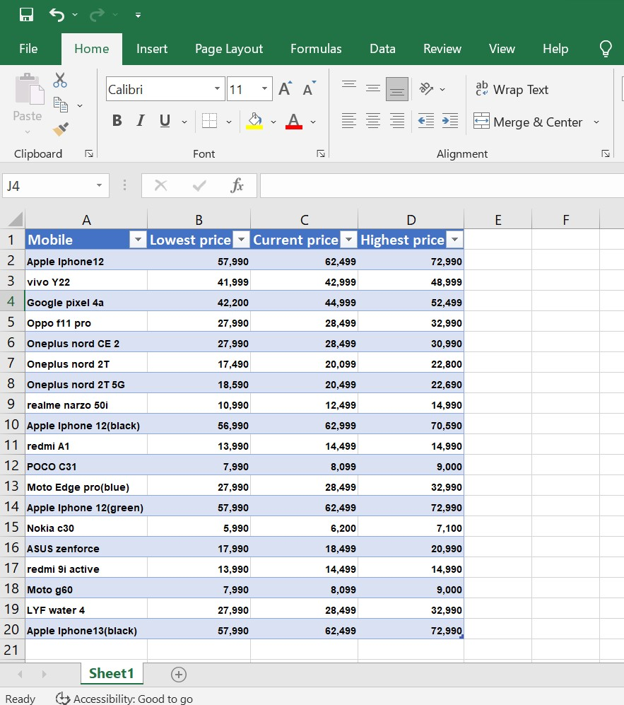
EXCEL CSV GENERATED BY BOT

Slide 22
Disadvantages of RPA
The bot is limited to the speed of the application
Even small changes made in the automation application will need the robots to be reconfigured.

Slide 23
Thank You

