Slide 1

Restaurant Table Reservation & Waitlist System
Available
Reserved
Case Study 70 · Java Programming
Aditya Sunil Chouksey | 150096725070
B.Tech CSE (2025-29), Semester III
Occupied
Notes:
[0:00 - 0:20] Good morning. I'm Aditya Sunil Chouksey. My case study is a Restaurant Table Reservation and Waitlist System, built in Java with a Swing interface.

Slide 2




The problem
Double bookings
Two parties promised the same table
GOAL
Wasted big tables
A couple seated at a six-seater
Seat by the rules - and tell the host who is next
Walk-ins skipped
Guests forgotten or seated out of turn
Notes:
[0:20 - 1:00] A restaurant host juggles three things: guests who booked, guests who just walk in, and tables that are free, held or occupied. Done on paper, tables get double-booked, a couple ends up at a six-seat table, and walk-ins get skipped. My system applies the seating rules automatically and tells the host exactly who should get a table the moment it frees up.

Slide 3
Objectives and modules
6
objectives
Table Setup
Availability Notification
1
5
Reservation Booking
Reservation Search
7
modules
2
6
Waitlist Management
Seating Reports
3
7
14
Java concepts
Table Assignment
4
Notes:
[1:00 - 1:40] The brief gave six objectives, seven modules and fourteen Java concepts. Every one is implemented - each module is a tab or a service in the application, and I will show most of them live in a minute.

Slide 4
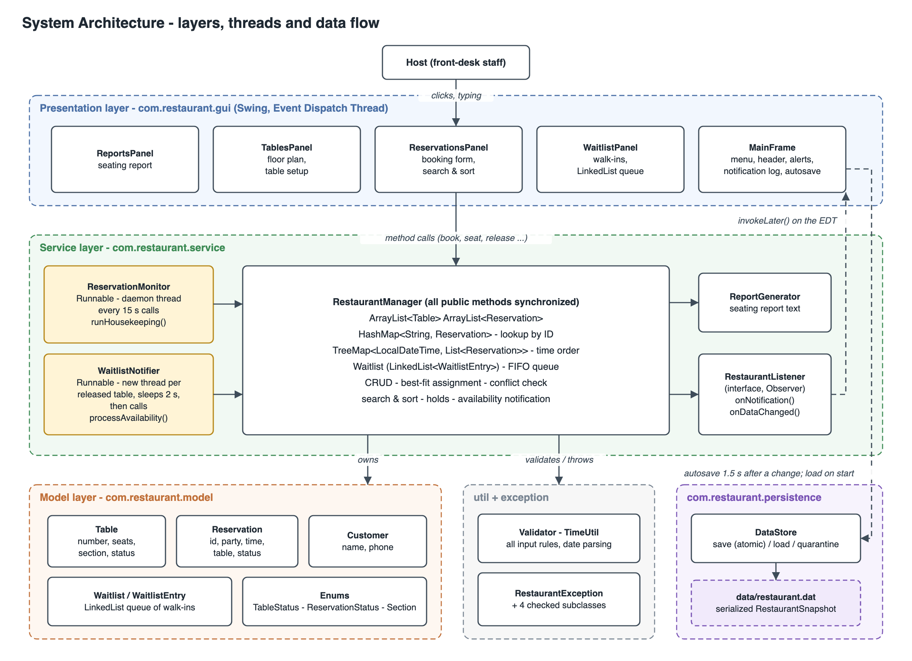




Architecture
GUI → Service → Model
The Swing screens only collect input and show results
One decision-maker
RestaurantManager holds every rule
Two background threads
Notifier (waits 2 s) and monitor (every 15 s)
Saved automatically
data/restaurant.dat, restored on restart
Notes:
[1:40 - 2:30] The code is in layers. The Swing GUI only collects input and shows results; every rule lives in one service class, RestaurantManager. Two background threads - a notifier and a monitor - call the same manager, and data is saved automatically to a file. Because the rules are separate from the screen, they are easy to test.

Slide 5
Data structures
ArrayList
All tables and reservations
keeps everything
HashMap
Reservation ID → reservation
O(1) lookup
TreeMap
Bookings sorted by start time
"who is due in 30 min?"
LinkedList
The walk-in waitlist
first come, first served
TableStatus enum
AVAILABLE
RESERVED
OCCUPIED
Notes:
[2:30 - 3:20] I chose each collection for one question. The ArrayList keeps everything. The HashMap finds a booking by its ID instantly. The TreeMap keeps bookings sorted by time, so I can ask who is due in the next half hour. And the waitlist is a LinkedList, because guests join at the end and are served first-come-first-served - exactly what the brief suggests. Table status is an enum: available, reserved, occupied.

Slide 6
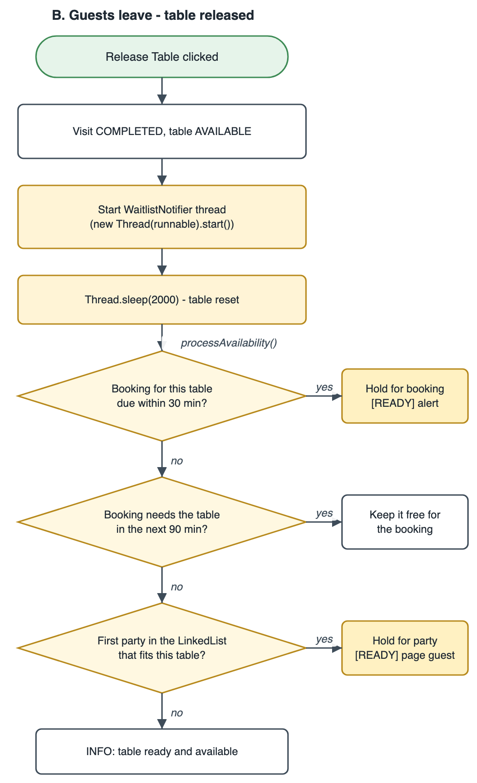
Key algorithms
1
Best fit
Smallest table that fits the party
2
No double booking
Each party blocks its table for 90 min
3
Fair queue
First waiting party that fits gets the table
4
Notification
Release → thread waits 2 s → hold → alert
Flowchart 2 - table released
Notes:
[3:20 - 4:00] Three rules drive the system. Best fit gives a party the smallest table that fits. Every party blocks its table for 90 minutes, so two bookings can never overlap. And when guests leave, a background thread waits 2 seconds while the table is reset, then gives it to the booking due next or to the first waiting party that fits - and alerts the host. Let me show you. (Switch to the application for the live demo.)

Slide 7
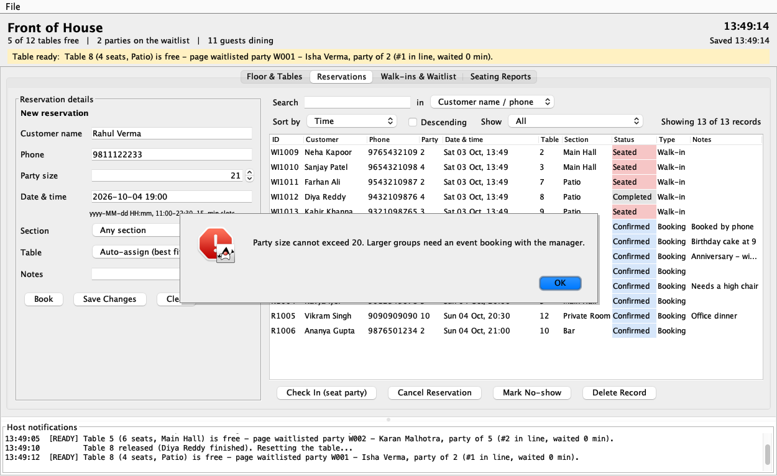

Testing and results
16 / 16
test cases passed
Every module and every validation rule
Errors explain the fix: "15-minute slots", "cannot exceed 20"
Background notification verified at about 2 s
Real screenshot: party of 21 typed into the booking form
All data restored after a restart
Notes:
[8:30 - 9:00] I tested the finished system against sixteen cases covering every module and every validation rule - including the background notification and restoring data after a restart. All sixteen passed. Bad input never crashes the program; it gets a message that explains the rule.

Slide 8



Conclusion and future scope
6
objectives met
7
modules built
14
Java concepts used
Plus realistic rules: best fit, a fair queue, held tables and autosave
Next steps
Database
Several front desks share one reservation book
SMS paging
Waiting guests are notified automatically
Join tables
Seat very large groups together
Notes:
[9:00 - 9:40] To conclude: the system meets all six objectives, all seven modules and all fourteen Java concepts in the brief. With more time I would move the data to a database so several front desks can share it, page waiting guests by SMS, and allow tables to be joined for large groups.

Slide 9

Thank you
Questions?
Aditya Sunil Chouksey | 150096725070
Notes:
[9:40 - 10:00] Thank you. I'm happy to take questions - and I can show anything in the application or the code.

