Slide 1
Operational Analysis And Investigating Metric Spike

Slide 2
Project Description
This project focuses on analyzing operational and user engagement data to uncover trends, identify inefficiencies, and investigate metric anomalies.
The findings will help improve operations, understand user behavior, and support data-driven decision-making.

Slide 3
Approach
Database Setup Imported the database into MySQL Workbench and verified the structure for accuracy.
Query Development Wrote SQL queries to answer key business questions, focusing on marketing and operational metrics.
Data Analysis Validated query outputs and extracted actionable insights aligned with business goals.
Results Summary Consolidated findings to support strategic decisions in product, marketing, and development.

Slide 4
Tech-Stack Used
Database:
MySQL Workbench (8.0.39): User-friendly and efficient for managing databases and running SQL queries.
Programming:
SQL: Essential for extracting, analyzing, and interpreting data.
Other Tools:
PowerPoint/Word: Used to create a clear and professional report/presentation.
Why These Tools?
Selected for their ease of use, compatibility, and ability to efficiently perform data analysis and reporting.

Slide 5
JOB DATA ANALYSIS
Case Study - 1

Slide 6
Agenda JOB DATA ANALYSIS
Frequency of jobs reviewed
Throughput Analysis
Language Share Analysis
Duplicate rows Detection

Slide 7
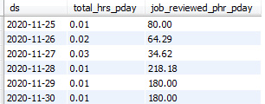
1. Frequency of Jobs reviewed Task : Calculate the number of jobs reviewed per hour for each day in November 2020
Query:
SELECT
ds, ROUND(SUM(time_spent)/3600,2) AS total_hrs_pday, ROUND((COUNT(job_id)/(SUM(time_spent)/3600)),2) as job_reviewed_phr_pday
FROM job_data
GROUP BY ds
ORDER BY ds;

Slide 8
Insights
The total_hrs_pday metric reveals the total hours spent reviewing jobs each day.
The job_reviewed_phr_pday metric highlights the number of jobs that can be reviewed per hour.
Lower no. of total_hrs_pday points out that less time was spent reviewing jobs that day

Slide 9
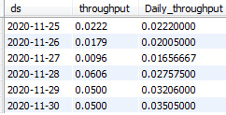
2. Throughput Analysis Task : Calculate the 7-day rolling average of throughput (number of events per second).
Query:
SELECT
ds,throughput,AVG(throughput) OVER(ORDER BY ds ROWS BETWEEN 6 PRECEDING AND CURRENT ROW) as daily_throughput
FROM(
SELECT ds,COUNT(`event`)/SUM(time_spent) AS throughput FROM job_data
WHERE ds BETWEEN ‘2020-11-24’ AND ‘2020-11-30’ GROUP BY DS ORDER BY ds
) as sq1;

Slide 10
Insights
Calculating a 7-day rolling average can be considered as a better option in comparison with the daily metric as 7-day rolling average helps identify trends by smoothing out short term fluctuations in data as shown in the graph.

Slide 11
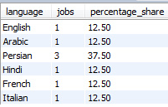
3. Language Share Analysis Task : Calculate the percentage share of each language in the last 30 days.
Query:
SELECT `language`,COUNT(job_id) as jobs,
ROUND(100 * COUNT(job_id) / (SELECT COUNT(job_id) FROM job_data),2)
AS percentage_share
FROM job_data
GROUP BY `language`;

Slide 12
Insights
Persian language is used by millions of people living in Middle East and Central part of Asia.
User base from Middle East and Central Asia are actively engaging with job postings.
Investing in more language support can be a good choice if the organisation plans to expand the market

Slide 13
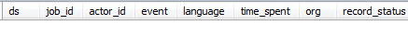
4. Duplicate Row Detection Task : Write an SQL query to display duplicate rows from the job_data table.
Query:
SELECT * FROM (
SELECT * , CASE WHEN COUNT(*) > 1 THEN ‘Duplicate’ Else ‘UNIQUE’ END AS record_status
FROM job_data
ORDER BY ds,job_id,actor_id,`event`,`language`,time_spent,org
) as sq1
WHERE record_status = ‘Duplicate’;

Slide 14
Insights
No Duplicate records were found in the data.
Not a single user interacted with the same job posting more than once

Slide 15
Summary
Metrics Analysis:
total_hrs_pday: Represents the total hours spent reviewing jobs daily; lower values indicate less time spent.
job_reviewed_phr_pday: Measures the number of jobs reviewed per hour.
A 7-day rolling average is recommended for trend analysis, as it smooths short-term fluctuations better than daily metrics.
User Engagement:
Persian is widely spoken in the Middle East and Central Asia, regions with active engagement in job postings.
Expanding language support could enhance user experience and market reach.
Data Integrity:
No duplicate records were found.
Users did not interact with the same job posting more than once.

Slide 16
INVESTIGATING METRIC SPIKE
Case Study - 2

Slide 17
Agenda INVESTIGATING METRIC SPIKE
Weekly User Engagement
User Growth Analysis
Weekly Retention Analysis
Weekly Engagement on each device
Email Engagement Analysis

Slide 18
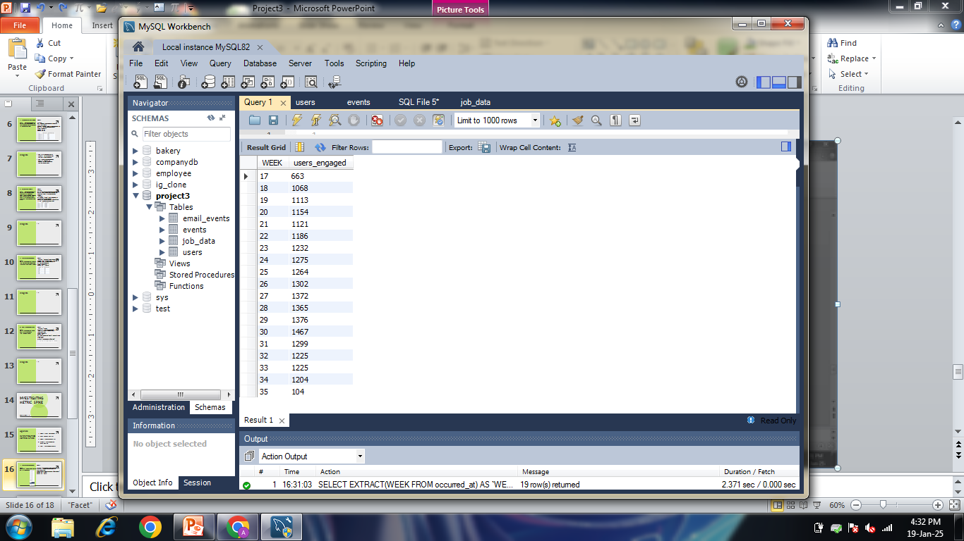
1. Weekly User Engagement Task : Measure the activeness of users on a weekly basis.
Query:
SELECT EXTRACT(WEEK FROM occurred_at) AS `WEEK`, COUNT(DISTINCT user_id) AS users_engaged
FROM events WHERE event_type = 'engagement‘
GROUP BY `WEEK`
ORDER BY `WEEK`;

Slide 19
Insights
Sudden increase in user engagement in week 18
User engagement started to decline after week 30
User engagement was lowest in week 35
Organising Virtual Contests during this period can help with engagement

Slide 20
2. User Growth Analysis Task : Analyze the growth of users over time for a product
Query:
SELECT `year`,`week`,active_users,SUM(active_users) OVER(ORDER BY `year`,`week` ROWS BETWEEN UNBOUNDED PRECEDING AND CURRENT ROW) AS total_active_users
FROM ( SELECT EXTRACT(YEAR FROM activated_at) as `year`,EXTRACT(WEEK FROM activated_at) as `week`,COUNT(DISTINCT user_id) as active_users FROM users
GROUP BY `year`,`week`
ORDER BY `year`,`week`) as sq1;

Slide 22
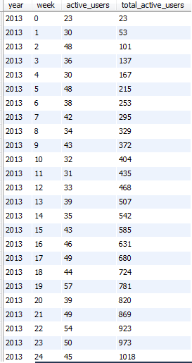
Insights
More no. of users were active per week in 2014 as compared to 2013.
No decline in total users on the platform
Seasonal patterns or campaign effectiveness can be understood by observing spikes or drops in new users.

Slide 23
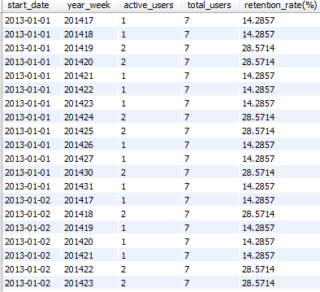
3. Weekly Retention Analysis Task : Analyze the retention of users on a weekly basis after signing up for a product
Query:
SELECT sq1.start_date,sq2.year_week,sq2.active_users,
sq1.total_users,sq2.active_users/sq1.total_users*100 AS `retention_rate(%)`
FROM ( SELECT DATE(activated_at) AS start_date,COUNT(*) AS total_users FROM users GROUP BY 1 ) as sq1,
( SELECT DATE(u.activated_at) AS start_date,YEARWEEK(e.occurred_at) AS year_week,COUNT(DISTINCT e.user_id) AS active_users FROM events e JOIN users u ON e.user_id = u.user_id WHERE e.event_type = 'engagement' GROUP BY start_date,year_week) AS sq2WHERE sq1.start_date = sq2.start_date;

Slide 25
Insights
Retention refers to the percentage of users who performed some action (e.g., logging in, using a feature, making a purchase) in subsequent weeks after signing up.
If a feature was introduced during a specific week, measure its impact by comparing retention rates before and after its release.
Steeper declines suggests that the product struggles to maintain engagement.
Weeks with high retention rate an indicate successful campaigns

Slide 26
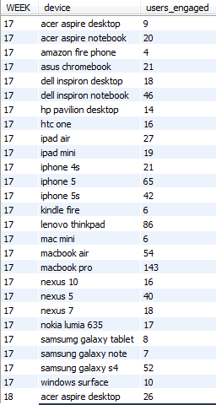
4. Weekly Engagement Per Device Task : Measure the activeness of users on a weekly basis per device
Query:
SELECT EXTRACT(WEEK FROM occurred_at) AS `WEEK`,device, COUNT(DISTINCT user_id) as users_engagedFROM events WHERE event_type = 'engagement‘
GROUP BY `WEEK`,device
ORDER BY `WEEK`,device;

Slide 28
Insights
Device-based activeness data can reveal where users may face difficulties.
Lower activeness on mobile phones as compared to desktops might highlight the need for app-specific features or improved mobile interfaces.
Most no. of users in desktop category use Macbook Pro.
Most no. of users in mobile category use Iphone 5.

Slide 29
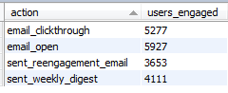
5. Email Engagement Analysis Task : Analyze how users are engaging with the email service
Query:
SELECT
action,COUNT(DISTINCT user_id) as users_engaged
FROM email_events
GROUP BY action;

Slide 30
Insights
Email_open action was performed more than sent_reengagement_mail action,this suggests that a significant number of users are active.
Around 4000 people have mailed weekly digests so far thus having a part in increasing the no. of email_open action.

Slide 31
Summary
User Engagement Trends:
Sharp increase in user engagement observed in week 18, followed by a decline after week 30.
Engagement hit its lowest point in week 35.
Virtual contests during low-engagement periods could help improve activity.
Weekly active users were higher in 2014 compared to 2013.
Despite fluctuations, the total user base on the platform has remained stable.
Seasonal Patterns and Campaign Analysis:
Spikes or drops in new users can indicate seasonal trends or campaign effectiveness.
Retention measures the percentage of users who stay active after signing up.
Retention analysis before and after feature releases can reveal their impact.
High retention rates correlate with successful campaigns, while steep declines indicate challenges in sustaining engagement.

Slide 32
Device Usage and Performance:
Mobile activeness is lower than desktop, suggesting the need for mobile-specific improvements.
Most desktop users prefer MacBook Pro; most mobile users use iPhone 5.\
Email Engagement:
The email_open action is significantly higher than sent_reengagement_mail, indicating active user interest.
Weekly digests have been mailed by around 4,000 users, contributing to increased email engagement.

Slide 33
Reflections
SQL Skills: Gained experience in writing efficient queries and analyzing complex data.
Analytical Growth: Improved ability to interpret data and provide actionable insights.
Challenges Overcome: Navigated complex table relationships.
Optimized query performance through iteration.
Key Takeaways: Strengthened problem-solving and reinforced the importance of data-driven decisions.

Slide 34
Thank you
By: Aditya. C. Mohite
Date: 20/01/2025

