Slide 1
Investigating Neural Collapse Geometry & Its Implications for Early Exiting in CNNs
on Fine-Grained Visual Classification (Oxford Flowers 102)
Aditya Arasamangalam
Research Experience for Undergraduates (REU)
Guide: Sunil Gurlahosur

Slide 2
MOTIVATION
🔍 The Black Box Problem
CNNs achieve high accuracy but their intermediate representations remain opaque. Understanding layer-wise geometry is crucial for trust and deployment.
⚡ Efficiency via Early Exiting
If intermediate layers develop strong geometric structure, we can halt computation early — saving energy and latency for edge deployment and real-time inference.
📊 Neural Collapse as a Lens
NC describes a beautifully structured terminal state (NC1–NC4). All existing work studies it at the FINAL layer. Nobody has systematically tracked it through intermediate layers.

Slide 3
PROBLEM STATEMENT
RQ1
How does Neural Collapse evolve layer-by-layer through a ResNet-18 trained on Oxford Flowers 102?
RQ2
How does the strength of collapse at intermediate layers affect the reliability and accuracy of Early Exit classifiers?
RQ3
What is the interplay between geometric complexity, class imbalance, and the completeness of Neural Collapse?

Slide 4
LITERATURE REVIEW
Liu & Qin (CVPR 2025)
Wang et al. (CVPR 2024)
OOD Detection via Neural Collapse
Debiased Learning via NC
✓ Strong collapse geometry → reliable distance-based OOD detection
✓ Shortcut learning distorts ideal simplex geometry
⚠ Gap: Only studies final layer
⚠ Gap: No intermediate layer bias analysis
Munn et al. (arXiv 2024)
Hasegawa & Sato (arXiv 2024)
Geometric Complexity in Transfer Learning
Multiplicative Logit Adjustment
✓ Collapse strength depends on dataset geometric complexity
✓ Class imbalance distorts collapse; logit scaling repairs it
⚠ Gap: No connection to early exiting
⚠ Gap: Only at the final classifier

Slide 5
NEURAL COLLAPSE METRICS (NC1–NC4)
NC1
Within-Class Collapse
NC2
Simplex ETF
Formula: Tr(Σ_W) / Tr(Σ_B)
Formula: cos(μ_c, μ_c')
Target: → 0
Target: → −1/(C−1)
Features collapse to class means
Class means form equiangular tight frame
NC3
Classifier Alignment
NC4
NCC Classification
Formula: cos(W_c, μ_c − μ_G)
Formula: argmin ||h − μ_c||
Target: → 1.0
Target: → 100%
Classifier weights align with class means
Simple distance classifier matches trained classifier

Slide 6
DATASET: OXFORD FLOWERS 102
102
Many flower species share similar petal shapes, colors, textures — creating high geometric complexity (per Munn et al.)
Fine-Grained Classes
~8,189
Moderate scale — quality of learned geometry genuinely matters. Imbalance effects observable without over-parameterization masking.
Total Images
Rich
Strong low-level features (edges, colors) in early layers → increasingly abstract semantic features (species identity) in deeper layers.
Visual Hierarchy

Slide 7
MODEL ARCHITECTURE
EarlyExitResNet-18: ResNet-18 backbone with 4 early exit classifiers
Layer 1
Layer 2
Layer 3
Layer 4
Features: 64-d
Features: 128-d
Features: 256-d
Features: 512-d
Spatial: 56×56
Spatial: 28×28
Spatial: 14×14
Spatial: 7×7
Exit 1 AdaptivePool → FC(102)
Exit 2 AdaptivePool → FC(102)
Exit 3 AdaptivePool → FC(102)
Exit 4 AdaptivePool → FC(102)
Why ResNet-18?
✓ Canonical architecture for Neural Collapse literature (directly comparable)
✓ Clean residual blocks → natural layer-wise hierarchy for early exits
✓ Skip connections preserve gradient flow → meaningful features even at early layers
✓ Computationally efficient (11.7M params) → rapid experimentation on Apple Silicon MPS

Slide 8
TRAINING CONFIGURATION
Architecture
ResNet-18 (pretrained ImageNet) + 4 Early Exit heads
Dataset
Oxford Flowers 102 (train split → validation on test split)
Optimizer
Adam (lr = 1e-3)
Scheduler
CosineAnnealingLR (T_max = 50 per phase)
Loss
Cross-Entropy (sum of all 4 exits)
Batch Size
32
Epochs
50 (Phase 1) + 50 (Phase 2 — extended) = 100 total
Device
Apple Silicon M5 (MPS backend)
NC Metrics
Computed every epoch on validation set
Checkpoints
Saved every epoch (model + optimizer + scheduler + history)

Slide 9
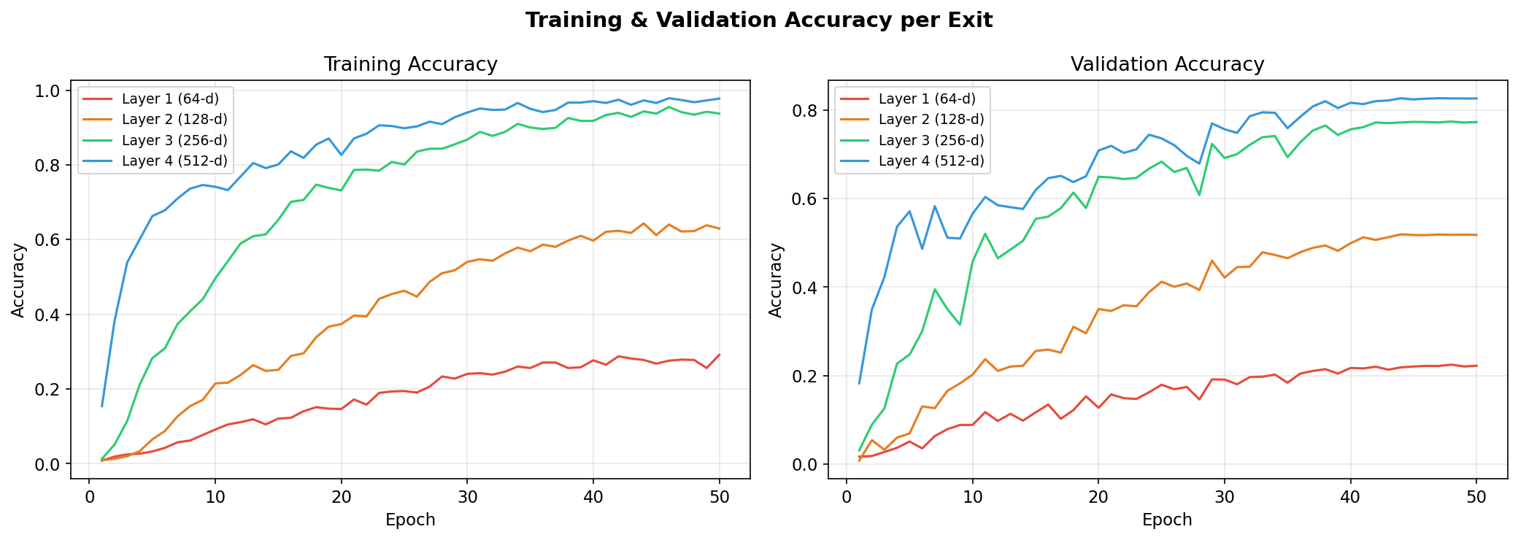
RESULTS: VALIDATION ACCURACY
Exit 1 (Layer 1, 64-d)
Exit 2 (Layer 2, 128-d)
Exit 3 (Layer 3, 256-d)
Exit 4 (Layer 4, 512-d)
22.5%
51.9%
77.4%
82.7%
Best @ epoch 48
Best @ epoch 44
Best @ epoch 48
Best @ epoch 47

Slide 10
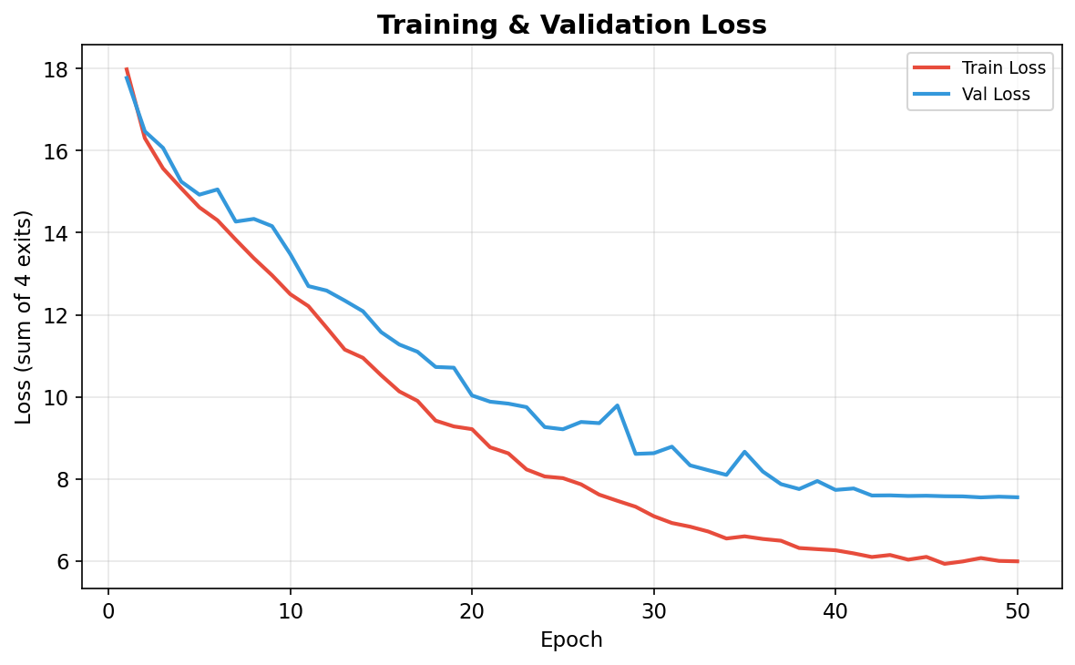
RESULTS: TRAINING & VALIDATION LOSS

Slide 11
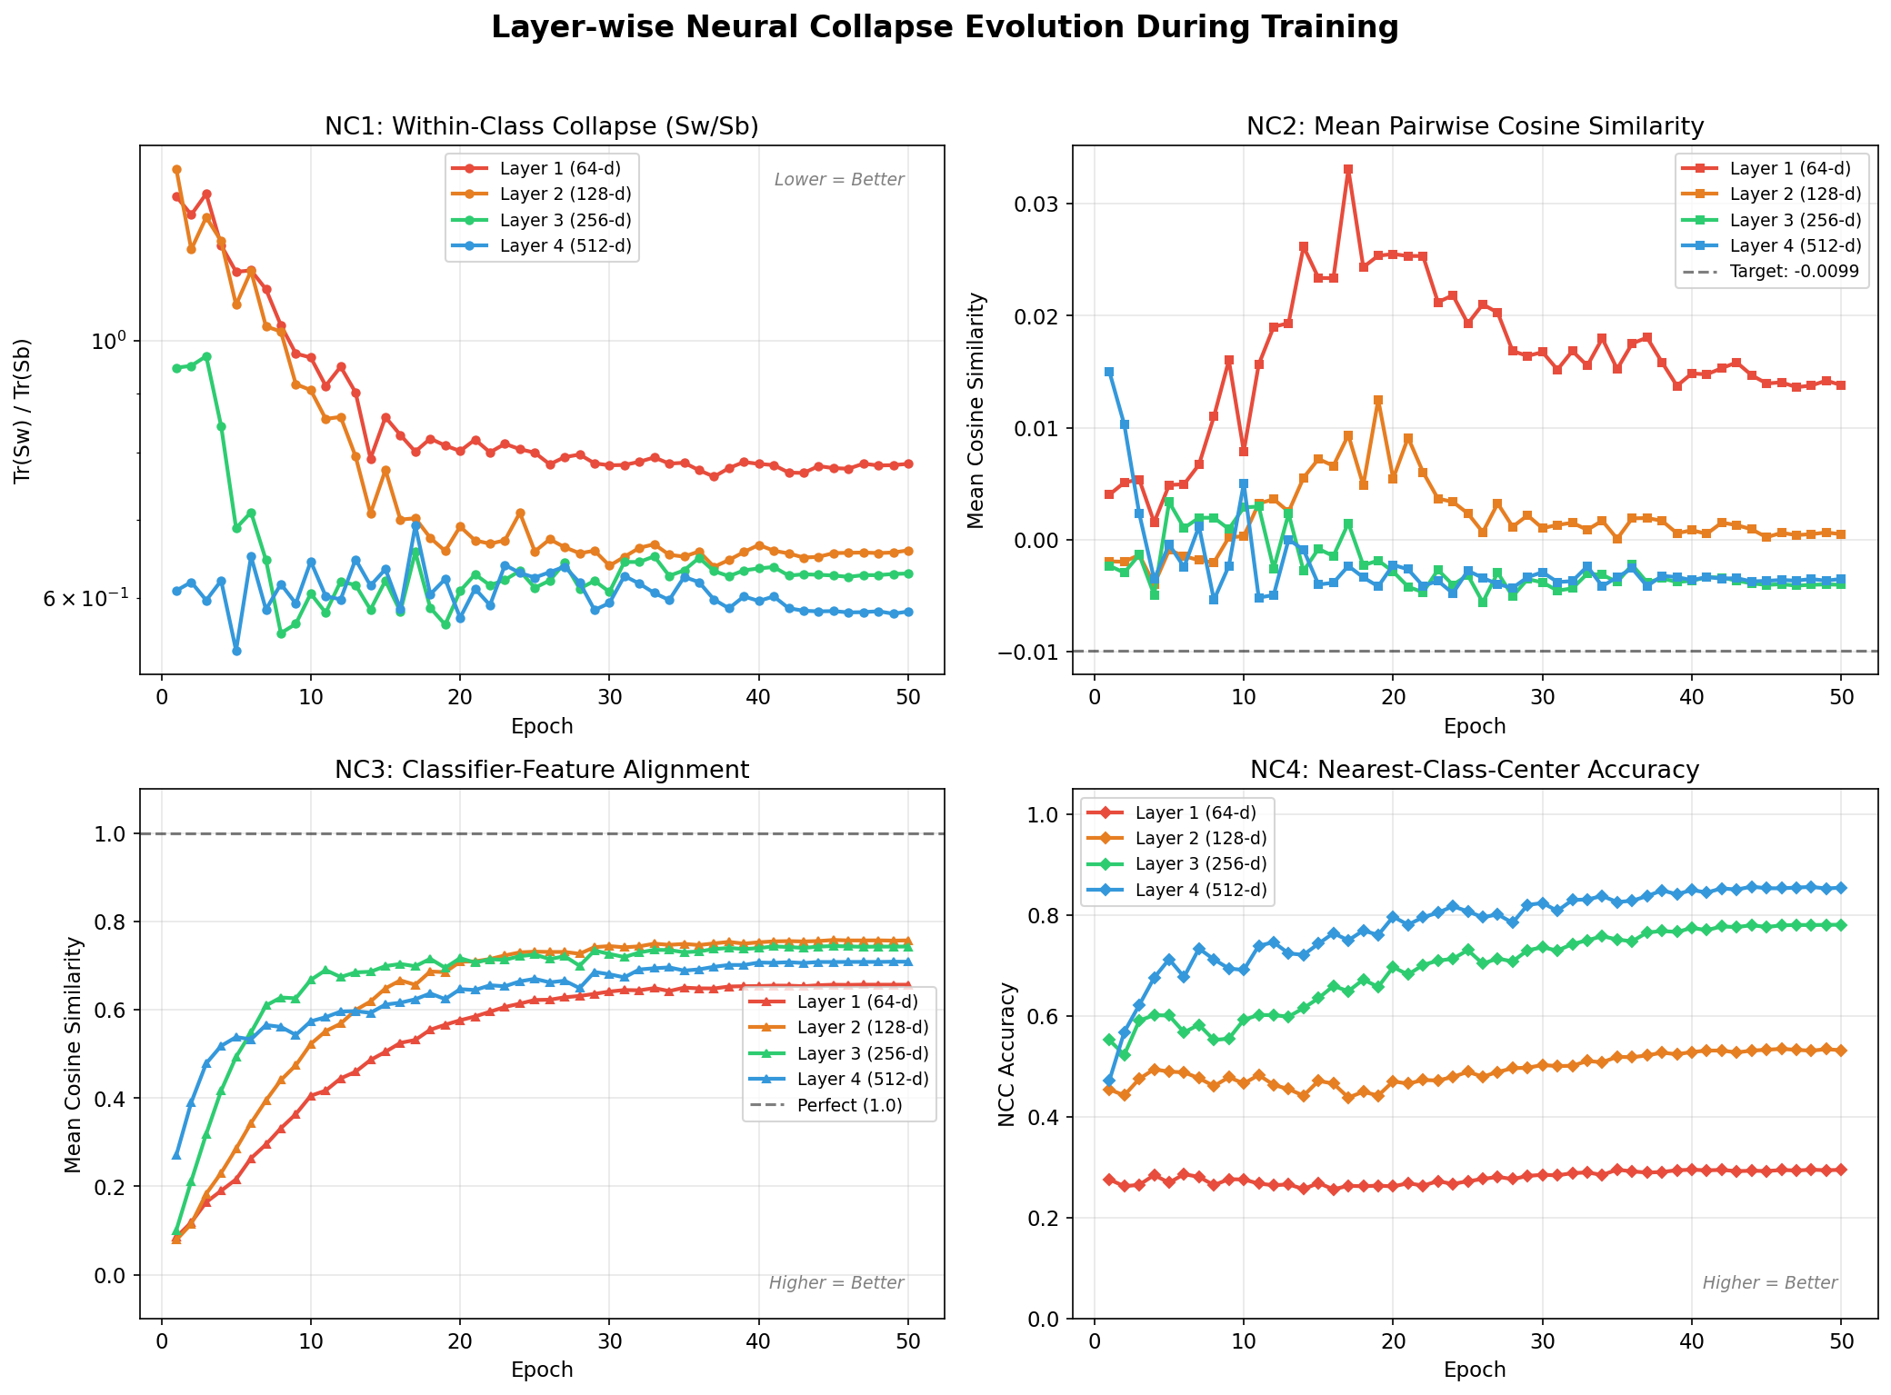
RESULTS: LAYER-WISE NEURAL COLLAPSE EVOLUTION

Slide 12
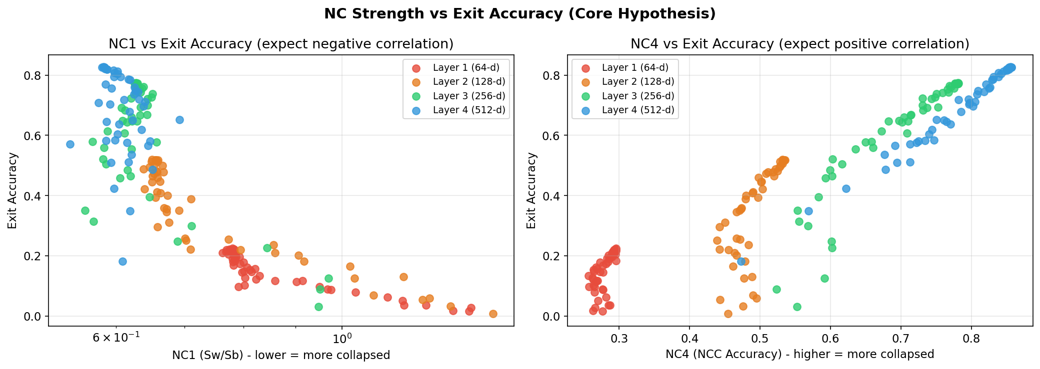
RESULTS: FINAL NC METRICS (EPOCH 50)
Metric
Layer 1 (64-d)
Layer 2 (128-d)
Layer 3 (256-d)
Layer 4 (512-d)
Trend
NC1 (Sw/Sb) ↓ better
0.783
0.659
0.630
0.584
✅ Monotonic ↓
NC2 (cos sim → −0.0099)
0.0138
0.0005
-0.0040
-0.0035
✅ Approaching
NC3 (alignment → 1.0)
0.657
0.758
0.744
0.709
✅ Strong
NC4 (NCC acc ↑ better)
29.5%
53.2%
78.1%
85.5%
✅ Monotonic ↑
🔑 KEY FINDING
Neural Collapse strengthens monotonically from shallow → deep layers. NC1 decreases (0.783 → 0.584) and NC4 increases (29.5% → 85.5%) across all 4 residual blocks, confirming the progressive collapse hypothesis on a fine-grained dataset.

Slide 13
RESULTS: EARLY EXIT SIMULATION
Threshold
Accuracy
Avg Layers
Speedup
L1 Exits
L2 Exits
L3 Exits
L4 Exits
0.50
82.03%
3.20
1.25×
3
506
3,895
1,745
0.70
82.58%
3.41
1.17×
0
196
3,243
2,710
0.90
82.65%
3.66
1.09×
0
19
2,063
4,067
0.99
82.62%
3.92
1.02×
0
0
502
5,647
📊 Key Observations
🔥 Shannon Entropy Analysis
• At τ=0.50: Exit 3 handles 63% of all samples (3,895/6,149)
• Accuracy stays stable (~82.6%) across all thresholds
• Exit 1 almost never triggers — NC too weak at 64-d
• Exit 3 is the "sweet spot" — strong NC, good accuracy
• 1.25× speedup achievable with <1% accuracy loss
Exit 1: H = 4.06 (near-random — 102 classes)
Exit 2: H = 3.24 (still uncertain)
Exit 3: H = 1.14 (confident decisions)
Exit 4: H = 0.43 (highly confident)
Entropy drops 10× from Layer 1 → Layer 4,
directly mirroring NC strength progression.

Slide 14
RESULTS: OOD DETECTION (LIU & QIN 2025)
In-Distribution: Flowers-102 | Out-of-Distribution: CIFAR-10
Exit 1
Exit 2
Exit 3
Exit 4
Gap: −0.081
Gap: −0.047
Gap: +0.056
Gap: +0.139
✗
✗
✓
✓
OOD closer than ID!
OOD still closer
ID closer — detection works!
Strong separation!
🔑 OOD DETECTION VALIDATES PROGRESSIVE COLLAPSE
OOD detection ONLY works at Layers 3–4 (positive gap = ID data closer to class centers). Layers 1–2 CANNOT distinguish in-distribution from out-of-distribution data. This directly confirms that OOD detection reliability requires strong Neural Collapse geometry — exactly as Liu & Qin (2025) theorized, but now validated at intermediate layers for the first time.

Slide 15
KEY FINDINGS
1
Progressive Collapse Confirmed
NC1–NC4 metrics improve monotonically from Layer 1 → Layer 4, confirming that Neural Collapse develops progressively through intermediate residual blocks — not just at the final layer.
2
NC Strength Predicts Exit Reliability
Strong positive correlation between NC4 (NCC accuracy) and exit classifier accuracy. Layers with NC4 > 50% produce usable early exits; below that, predictions are unreliable.
3
OOD Detection Requires Deep Collapse
Distance-based OOD detection fails completely at Layers 1–2 (negative gap) but succeeds at Layers 3–4 (positive gap), providing the first empirical evidence of layer-dependent OOD reliability.
4
Exit 3 is the Practical Sweet Spot
Layer 3 (256-d) achieves 77.3% accuracy with strong NC metrics, handles 63% of samples at τ=0.50, and provides meaningful OOD detection — making it the optimal early exit point.

Slide 16
FUTURE WORK & NEXT STEPS
🔄
Extended Training (100 epochs)
Currently running: Phase 2 training with fresh cosine LR schedule to push accuracy and NC metrics further.
📊
CIFAR-10 Comparative Study
Run identical pipeline on CIFAR-10 (10 classes, low geometric complexity) to validate Munn et al.'s prediction that simpler datasets exhibit stronger collapse.
⚖️
Multiplicative Logit Adjustment at Early Exits
Apply Hasegawa & Sato's MLA to intermediate classifiers — does it help underrepresented classes at shallow layers?
🔬
t-SNE / PCA Feature Visualization
Visualize feature clustering at each layer to qualitatively complement the NC1–NC4 quantitative analysis.
🏗️
Architecture Extension
Extend to DenseNet (feature reuse effects), EfficientNet (scaling effects), and ViTs (attention vs convolution).

Slide 17
Thank You
Aditya Arasamangalam • REU • Guide: Sunil Gurlahosur
Questions?

