Slide 1

Department of Computer Science and Engineering
Layer-wise Analysis of Feature Evolution in
Convolutional Neural Networks
Name:Aditya Arasamangalam
Course: Research Experience for Undergraduates | Guide: Dr Meena S M

Slide 2


Motivation
Accuracy vs Interpretability
Black Box Problem
CNNs achieve high accuracy but lack interpretability, creating a gap between performance and understanding.
Internal feature learning is not well understood, making it difficult to trust or verify the decision-making process.
Output-Centric View
Trust & Explainability
Most work focuses on final outputs, leaving a critical knowledge gap regarding intermediate layer representations.
Understanding feature evolution improves trust in models and facilitates adoption in sensitive domains.

Slide 3
Problem Statement
To investigate how internal representations in CNNs evolve across layers and to identify the role of dataset properties in shaping these representations.

Slide 4

Research Objectives
01
Analyze Hierarchical Feature Maps and Activation Statistics
Investigate feature representations and quantify activation sparsity across convolutional layers.
02
Study Cross-Dataset Behavioral Patterns
Compare internal model responses across multiple datasets to identify consistent learning trends.
03
Link Data Properties to Representation Learning
Establish a mathematical link between input dataset characteristics and resulting feature geometry.

Slide 5
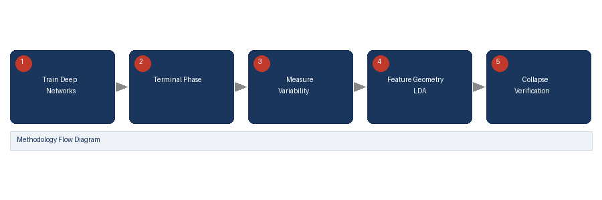
Prevalence of Neural Collapse during the Terminal Phase of Deep Learning Training (2021)
PROBLEM STATEMENT
Deep learning models in the terminal training phase show an unexpected geometric phenomenon where class representations collapse into tight clusters, but the mathematical conditions are not fully characterized.
OBJECTIVES
PROPOSED SOLUTION
RESULTS
Identify and characterize neural collapse in deep networks
Analyze geometric structure of final-layer representations
Understand implications for generalization and feature quality
Mathematically characterize neural collapse by analyzing class-mean convergence, weight-feature duality, and equinorm clustering across classification tasks and architectures.
Features collapse into tight clusters near terminal training
Between-class separation becomes maximal relative to within-class spread
Neural collapse predicts strong generalization performance
METHODOLOGY
CONCLUSION
Analyze trained deep neural networks at terminal phase. Measure within-class variability vs between-class separation. Study feature geometry using linear discriminant analysis.
Neural collapse is a universal phenomenon in overparameterized networks that reveals how deep learning implicitly optimizes feature geometry, with direct implications for interpretability.
REFERENCE:
Papyan et al., Prevalence of Neural Collapse during the Terminal Phase of Deep Learning Training, PNAS, 2020.

Slide 6
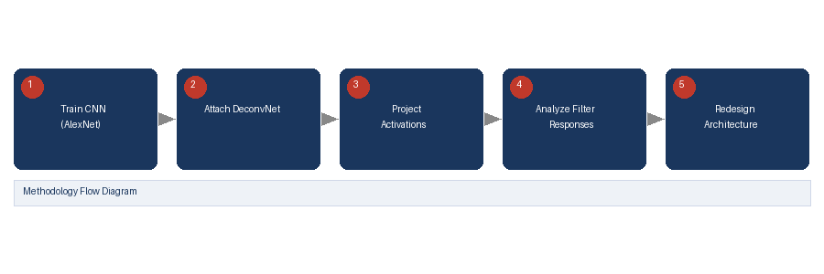
Visualizing and Understanding Convolutional Networks (Zeiler & Fergus, 2014)
PROBLEM STATEMENT
The internal representations learned by CNNs across layers are opaque, making it difficult to understand what features are detected at each depth, limiting model debugging and design.
OBJECTIVES
PROPOSED SOLUTION
RESULTS
Develop techniques to visualize feature detectors at each CNN layer
Understand how input stimuli activate convolutional filters
Use insights to improve CNN architecture design
Introduce deconvnet-based visualization to map activations back to input space, revealing hierarchical feature learning from edges in early layers to semantic concepts in deep layers.
Early layers detect edges and color blobs; deeper layers learn textures and semantic parts
Layer-wise feature specificity increases with depth
METHODOLOGY
CONCLUSION
Visualization guided removal of redundant filters, improving AlexNet accuracy
Use deconvolutional networks to project feature activations back to input pixel space. Analyze which image regions maximally activate each filter. Compare learned features across depths.
Layer-wise visualization confirms CNNs learn hierarchical representations, motivating analysis of feature evolution as a path to interpretable architectures.
REFERENCE:
Zeiler & Fergus, Visualizing and Understanding Convolutional Networks, ECCV, 2014.

Slide 7
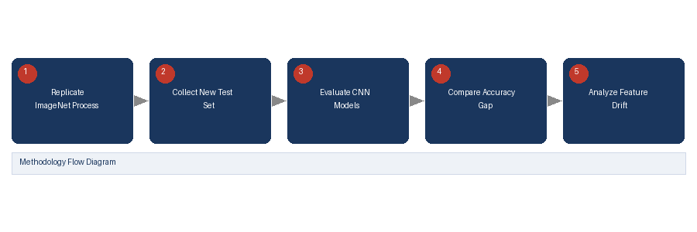
Do ImageNet Classifiers Generalize to ImageNet? (Recht et al., 2019)
PROBLEM STATEMENT
It is unclear how dataset properties (distribution, complexity, noise) affect the representations learned by CNNs across layers, limiting understanding of dataset-model interaction and generalization.
OBJECTIVES
PROPOSED SOLUTION
RESULTS
Study how dataset distribution shifts affect CNN feature learning
Evaluate whether accuracy reflects quality of learned representations
Understand impact of dataset complexity on generalization
Demonstrate that CNN performance drops on resampled datasets even with identical collection process, suggesting learned features overfit to dataset-specific biases beyond semantic content.
Model accuracy drops consistently on new test sets (3–15% gap)
Feature representations are more dataset-specific than previously assumed
Dataset complexity and label noise significantly affect what CNN layers learn
METHODOLOGY
CONCLUSION
Create new test sets replicating ImageNet collection methodology. Evaluate standard CNN models on original vs. new sets. Analyze representation differences across dataset variants.
Dataset properties profoundly shape CNN feature evolution; studying layer-wise representations across multiple datasets is essential to understanding generalizable vs. dataset-specific features.
REFERENCE:
Recht et al., Do ImageNet Classifiers Generalize to ImageNet? ICML, 2019.

Slide 8
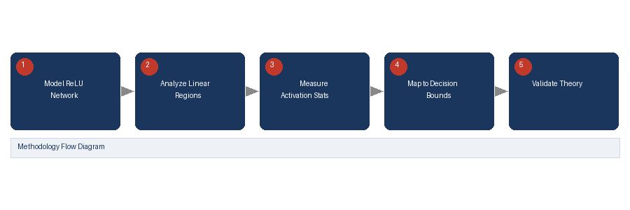
Understanding Deep Neural Networks with Rectified Linear Units (Arora et al., 2018)
PROBLEM STATEMENT
The relationship between activation statistics in intermediate CNN layers and the quality of learned decision boundaries is not well understood, making interpretability and optimization difficult.
OBJECTIVES
PROPOSED SOLUTION
RESULTS
Analyze how ReLU activations shape feature geometry across layers
Study sparsity patterns and their relationship to decision boundaries
Connect activation statistics to model expressivity and generalization
Show that ReLU networks create exponentially many linear regions as depth increases, and that activation sparsity patterns in intermediate layers directly determine decision boundary structure.
Deeper layers produce sparser, more discriminative activations
Mean and variance of activations correlate with decision boundary complexity
METHODOLOGY
CONCLUSION
Sparsity is a key indicator of feature specialization and class discrimination
Theoretically analyze ReLU networks layer-by-layer. Measure sparsity, mean activation, and variance across layers. Map statistics to piecewise-linear decision regions.
Layer-wise activation statistics are directly tied to representation quality and decision boundaries — validating the importance of quantifying mean, variance, and sparsity across CNN layers.
REFERENCE:
Arora et al., Understanding Deep Neural Networks with Rectified Linear Units, ICLR, 2018.

Slide 9

Dataset Selection & Analysis
Food-101
Stanford Cars
FGVC Aircraft
Oxford Flowers
Texture-heavy
Fine-grained
Structure-heavy
Balanced
Noisy backgrounds
High intra-class variance
Complex food plating
Geometry-dominant
Subtle class differences
Varying camera angles
Spatial features
Strong shape priors
Rigid object structure
Optimal for analysis
Clean class boundaries
Uniform lighting conditions

Slide 10
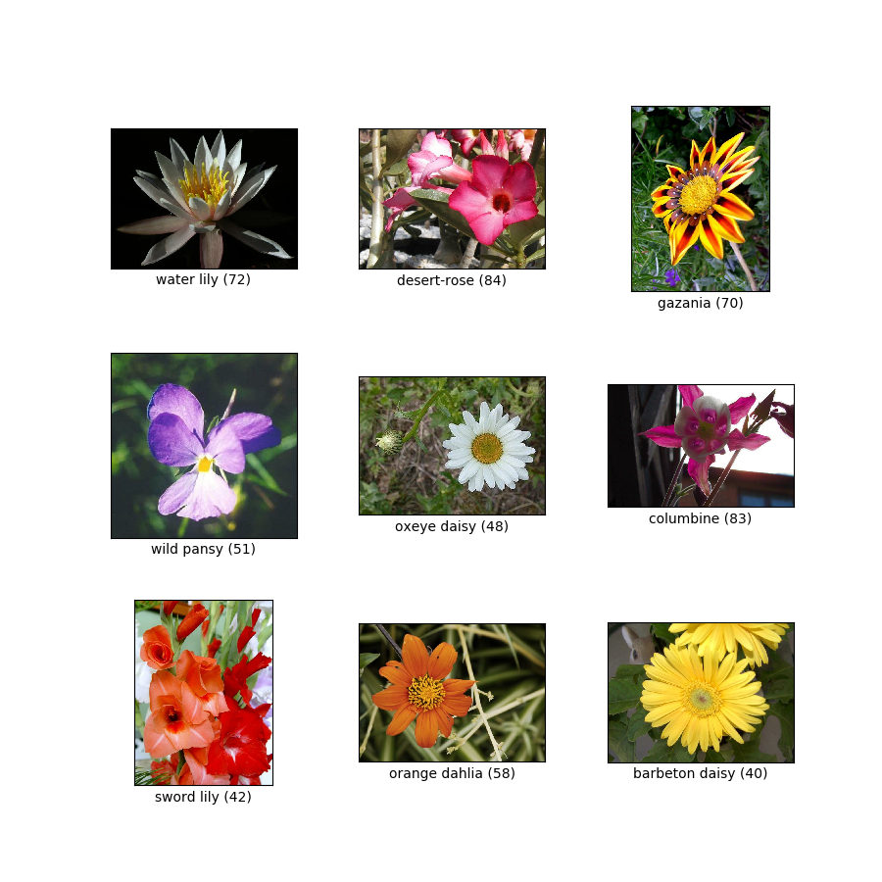
Dataset Selection & Analysis
Oxford Flowers 102 — Visual Conditions
Clean class boundaries • Uniform lighting conditions • Highly balanced distribution

Slide 11
Model Architecture: ResNet-18
Why ResNet-18?
Comparison with Other Architectures
Residual connections: y = F(x) + x
Architecture | Limitation
VGG-16 | No residual connections
AlexNet | Limited depth
DenseNet | Complex connections, high memory
Prevents vanishing gradient problem
Preserves feature information flow
Enables stable feature propagation across layers
ResNet-18 is chosen for its balance of depth, interpretability, and stable feature propagation — making it ideal for systematic layer-wise feature analysis research.

Slide 12

Proposed Solution Framework
Research Methodology & Workflow
1
2
3
4
5
Feature Extraction
Layer-wise Statistical Analysis
Representation Geometry
Cross-Dataset Comparison
Insights & Interpretability
Use ResNet-18 pretrained on ImageNet as the analysis backbone
Compute mean activation per layer, variance and sparsity
Reduce dimensionality of per-image features. Analyse neural collapse trends
Repeat for Oxford Flowers 102, Food-101, Stanford Cars, FGVC Aircraft
Generate heatmaps, visualize feature maps, and motivate design choices

Slide 13
Experiments & Expected Results
Feature Evolution Across Layers
Early Layers
Mid Layers
Deep Layers
Detect edges & simple patterns
Capture textures & colour gradients
Learn semantic representations
Dataset Dependency
Food-101:
Strong early-layer response (texture features)
Stanford Cars:
Deep-layer dependence (fine-grained geometry)
Oxford Flowers:
Balanced activation across all layers

Slide 14
Conclusion & Future Work
Key Contributions
Future Work
Developed layer-wise analysis framework for CNNs
Demonstrated dataset–CNN feature interaction across architectures
Improved CNN interpretability through activation statistics
Neural collapse analysis in greater depth
Early exiting strategies for model efficiency
Feature clustering visualization using t-SNE and PCA
Understanding how CNNs learn across layers enables better model design, improved interpretability, and more trustworthy AI systems.

Slide 15
Problem Statement
To investigate how internal representations in CNNs evolve across layers and to identify the role of dataset properties in shaping these representations.

