Slide 1

Department of Computer Science and Engineering
Feature Representation Dynamics and Reliability in Deep Neural Image Classification
Name:Aditya Arasamangalam
Course: Research Experience for Undergraduates | Guide: Dr Meena S M

Slide 2


Motivation
Accuracy vs Interpretability
Black Box Problem
CNNs achieve high accuracy but lack interpretability, creating a gap between performance and understanding.
Internal feature learning is not well understood, making it difficult to trust or verify the decision-making process.
Output-Centric View
Trust & Explainability
Most work focuses on final outputs, leaving a critical knowledge gap regarding intermediate layer representations.
Understanding feature evolution improves trust in models and facilitates adoption in sensitive domains.

Slide 3
Problem Statement
To investigate how internal representations in CNNs evolve across layers and to identify the role of dataset properties in shaping these representations.

Slide 4

Research Objectives
01
Analyze Hierarchical Feature Maps and Activation Statistics
Investigate feature representations and quantify activation sparsity across convolutional layers.
02
Study Cross-Dataset Behavioral Patterns
Compare internal model responses across multiple datasets to identify consistent learning trends.
03
Link Data Properties to Representation Learning
Establish a mathematical link between input dataset characteristics and resulting feature geometry.

Slide 5
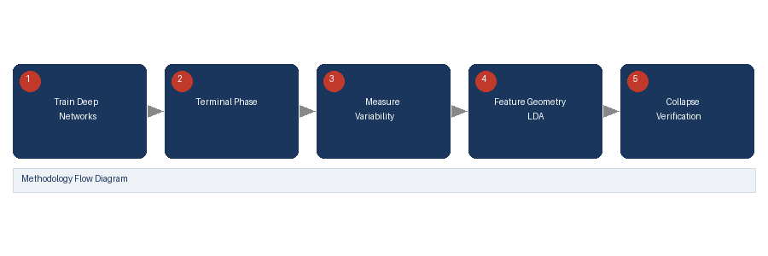
Prevalence of Neural Collapse during the Terminal Phase of Deep Learning Training (2021)
PROBLEM STATEMENT
Deep learning models in the terminal training phase show an unexpected geometric phenomenon where class representations collapse into tight clusters, but the mathematical conditions are not fully characterized.
OBJECTIVES
PROPOSED SOLUTION
RESULTS
Identify and characterize neural collapse in deep networks
Analyze geometric structure of final-layer representations
Understand implications for generalization and feature quality
Mathematically characterize neural collapse by analyzing class-mean convergence, weight-feature duality, and equinorm clustering across classification tasks and architectures.
Features collapse into tight clusters near terminal training
Between-class separation becomes maximal relative to within-class spread
Neural collapse predicts strong generalization performance
METHODOLOGY
CONCLUSION
Analyze trained deep neural networks at terminal phase. Measure within-class variability vs between-class separation. Study feature geometry using linear discriminant analysis.
Neural collapse is a universal phenomenon in overparameterized networks that reveals how deep learning implicitly optimizes feature geometry, with direct implications for interpretability.
REFERENCE:
Papyan et al., Prevalence of Neural Collapse during the Terminal Phase of Deep Learning Training, PNAS, 2020.

Slide 6
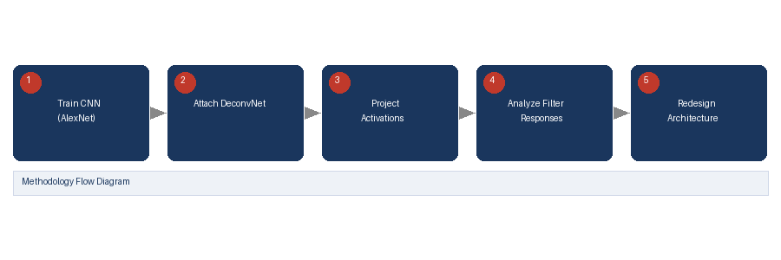
Visualizing and Understanding Convolutional Networks (Zeiler & Fergus, 2014)
PROBLEM STATEMENT
The internal representations learned by CNNs across layers are opaque, making it difficult to understand what features are detected at each depth, limiting model debugging and design.
OBJECTIVES
PROPOSED SOLUTION
RESULTS
Develop techniques to visualize feature detectors at each CNN layer
Understand how input stimuli activate convolutional filters
Use insights to improve CNN architecture design
Introduce deconvnet-based visualization to map activations back to input space, revealing hierarchical feature learning from edges in early layers to semantic concepts in deep layers.
Early layers detect edges and color blobs; deeper layers learn textures and semantic parts
Layer-wise feature specificity increases with depth
METHODOLOGY
CONCLUSION
Visualization guided removal of redundant filters, improving AlexNet accuracy
Use deconvolutional networks to project feature activations back to input pixel space. Analyze which image regions maximally activate each filter. Compare learned features across depths.
Layer-wise visualization confirms CNNs learn hierarchical representations, motivating analysis of feature evolution as a path to interpretable architectures.
REFERENCE:
Zeiler & Fergus, Visualizing and Understanding Convolutional Networks, ECCV, 2014.

Slide 7
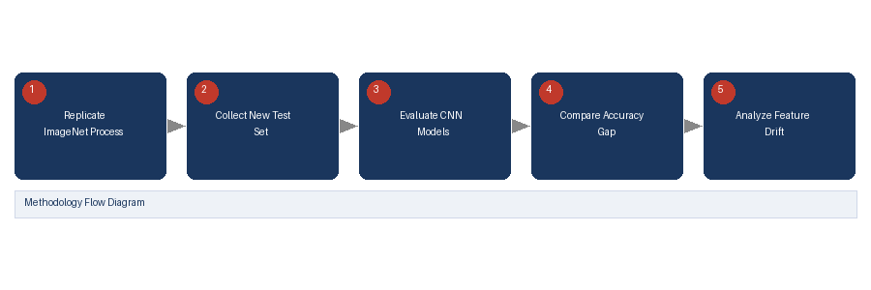
Do ImageNet Classifiers Generalize to ImageNet? (Recht et al., 2019)
PROBLEM STATEMENT
It is unclear how dataset properties (distribution, complexity, noise) affect the representations learned by CNNs across layers, limiting understanding of dataset-model interaction and generalization.
OBJECTIVES
PROPOSED SOLUTION
RESULTS
Study how dataset distribution shifts affect CNN feature learning
Evaluate whether accuracy reflects quality of learned representations
Understand impact of dataset complexity on generalization
Demonstrate that CNN performance drops on resampled datasets even with identical collection process, suggesting learned features overfit to dataset-specific biases beyond semantic content.
Model accuracy drops consistently on new test sets (3–15% gap)
Feature representations are more dataset-specific than previously assumed
Dataset complexity and label noise significantly affect what CNN layers learn
METHODOLOGY
CONCLUSION
Create new test sets replicating ImageNet collection methodology. Evaluate standard CNN models on original vs. new sets. Analyze representation differences across dataset variants.
Dataset properties profoundly shape CNN feature evolution; studying layer-wise representations across multiple datasets is essential to understanding generalizable vs. dataset-specific features.
REFERENCE:
Recht et al., Do ImageNet Classifiers Generalize to ImageNet? ICML, 2019.

Slide 8
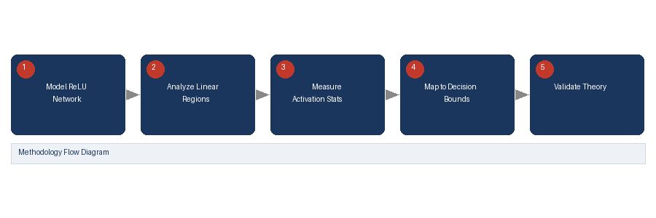
Understanding Deep Neural Networks with Rectified Linear Units (Arora et al., 2018)
PROBLEM STATEMENT
The relationship between activation statistics in intermediate CNN layers and the quality of learned decision boundaries is not well understood, making interpretability and optimization difficult.
OBJECTIVES
PROPOSED SOLUTION
RESULTS
Analyze how ReLU activations shape feature geometry across layers
Study sparsity patterns and their relationship to decision boundaries
Connect activation statistics to model expressivity and generalization
Show that ReLU networks create exponentially many linear regions as depth increases, and that activation sparsity patterns in intermediate layers directly determine decision boundary structure.
Deeper layers produce sparser, more discriminative activations
Mean and variance of activations correlate with decision boundary complexity
METHODOLOGY
CONCLUSION
Sparsity is a key indicator of feature specialization and class discrimination
Theoretically analyze ReLU networks layer-by-layer. Measure sparsity, mean activation, and variance across layers. Map statistics to piecewise-linear decision regions.
Layer-wise activation statistics are directly tied to representation quality and decision boundaries — validating the importance of quantifying mean, variance, and sparsity across CNN layers.
REFERENCE:
Arora et al., Understanding Deep Neural Networks with Rectified Linear Units, ICLR, 2018.

Slide 9

Dataset Selection & Analysis
Food-101
Stanford Cars
FGVC Aircraft
Oxford Flowers
Texture-heavy
Fine-grained
Structure-heavy
Balanced
Noisy backgrounds
High intra-class variance
Complex food plating
Geometry-dominant
Subtle class differences
Varying camera angles
Spatial features
Strong shape priors
Rigid object structure
Optimal for analysis
Clean class boundaries
Uniform lighting conditions

Slide 10
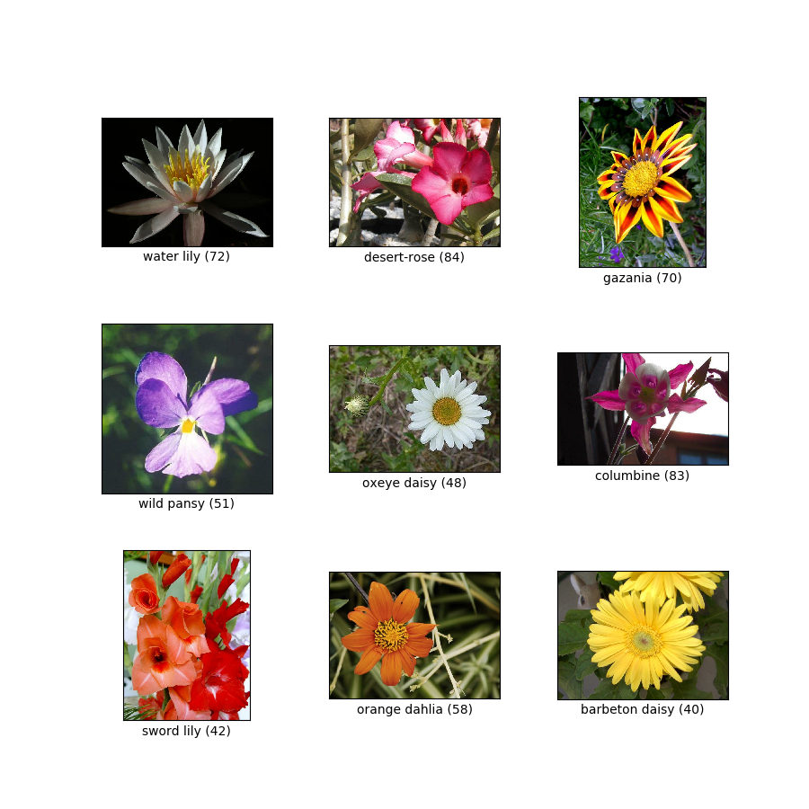
Dataset Selection & Analysis
Oxford Flowers 102 — Visual Conditions
Clean class boundaries • Uniform lighting conditions • Highly balanced distribution

Slide 11
Model Architecture: ResNet-18
Why ResNet-18?
Comparison with Other Architectures
Residual connections: y = F(x) + x
Architecture | Limitation
VGG-16 | No residual connections
AlexNet | Limited depth
DenseNet | Complex connections, high memory
Prevents vanishing gradient problem
Preserves feature information flow
Enables stable feature propagation across layers
ResNet-18 is chosen for its balance of depth, interpretability, and stable feature propagation — making it ideal for systematic layer-wise feature analysis research.

Slide 12

Proposed Solution Framework
Research Methodology & Workflow
1
2
3
4
5
Feature Extraction
Layer-wise Statistical Analysis
Representation Geometry
Cross-Dataset Comparison
Insights & Interpretability
Use ResNet-18 pretrained on ImageNet as the analysis backbone
Compute mean activation per layer, variance and sparsity
Reduce dimensionality of per-image features. Analyse neural collapse trends
Repeat for Oxford Flowers 102, Food-101, Stanford Cars, FGVC Aircraft
Generate heatmaps, visualize feature maps, and motivate design choices

Slide 13
Experiments & Expected Results
Feature Evolution Across Layers
Early Layers
Mid Layers
Deep Layers
Detect edges & simple patterns
Capture textures & colour gradients
Learn semantic representations
Dataset Dependency
Food-101:
Strong early-layer response (texture features)
Stanford Cars:
Deep-layer dependence (fine-grained geometry)
Oxford Flowers:
Balanced activation across all layers

Slide 14
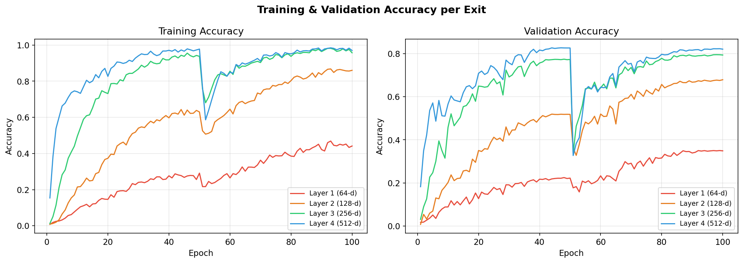
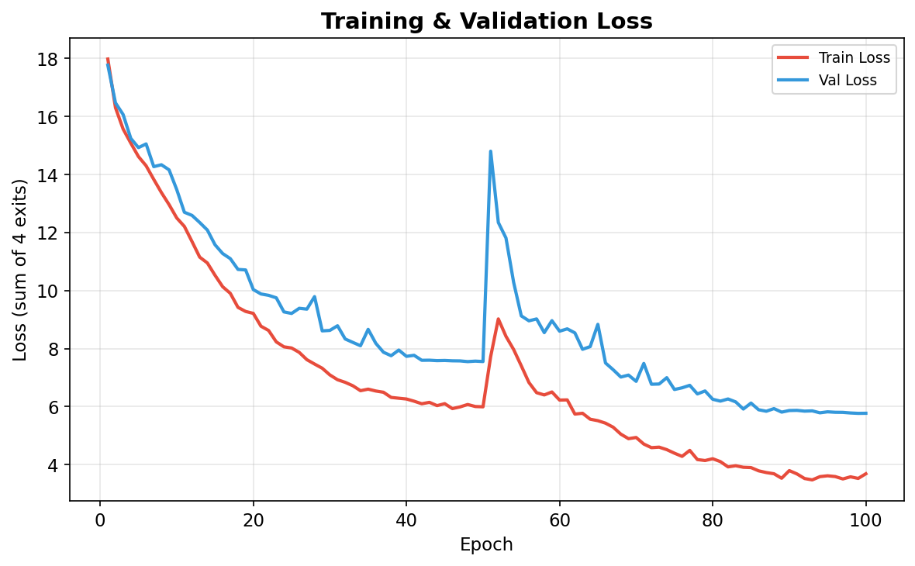
Results: Training & Validation Accuracy (100 Epochs)
Key Observations — 100 Epoch Training Convergence
• Validation Accuracy per Exit (Epoch 100): Exit 1 (34.90%), Exit 2 (67.88%), Exit 3 (79.35%), Exit 4 (82.06%). Peak Exit 4 accuracy reached 82.68% at epoch 47.
• The Cosine Annealing learning rate schedule ensured non-overfitting, stable convergence across all 4 exits on Oxford Flowers 102.

Slide 15
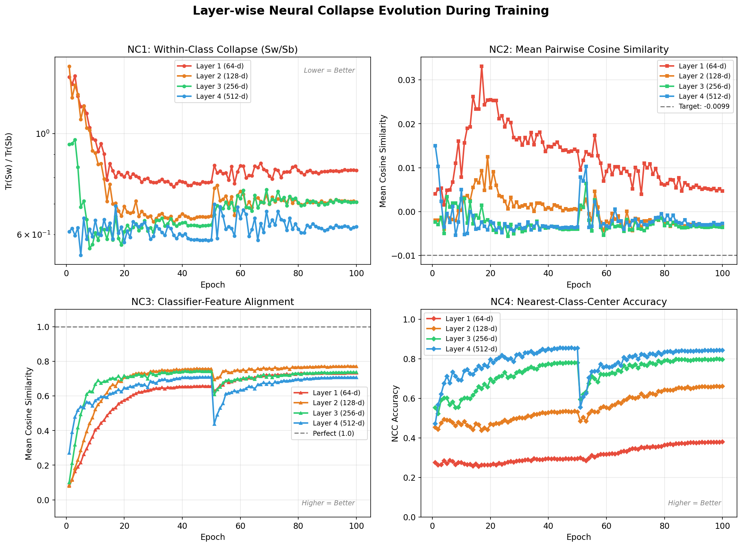
Results: Layer-wise Neural Collapse Evolution
Analysis of NC1 - NC4 Evolution
• NC1 (Sw/Sb Collapse): Decreases monotonically from 0.831 at Layer 1 down to 0.624 at Layer 4, showing feature clustering.
• NC2 (Simplex ETF): Pairwise cosine similarity approaches target limit (-0.0099) at deeper layers.
• NC3 (Classifier Alignment): Strong alignment (>0.70 mean cosine sim) maintained across all exit classifiers.
• NC4 (NCC Accuracy): Increases monotonically from 38.0% at Layer 1 to 84.4% at Layer 4.

Slide 16
Results: Quantitative Neural Collapse Summary (Epoch 100)
Metric | Layer 1 (64-d) | Layer 2 (128-d) | Layer 3 (256-d) | Layer 4 (512-d) | Trend
NC1 (Sw/Sb) ↓ better | 0.831 | 0.707 | 0.707 | 0.624 | Monotonic Collapse ↓
NC2 (pair cos sim) → -0.0099 | 0.0047 | -0.0034 | -0.0036 | -0.0027 | Approaching Simplex ETF
NC3 (alignment) → 1.0 | 0.734 | 0.772 | 0.738 | 0.707 | Strong Weight Duality
NC4 (NCC acc) ↑ better | 38.0% | 66.2% | 79.7% | 84.4% | Monotonic Increase ↑
Confirmation of Progressive Layer-wise Collapse
• Empirical proof that Neural Collapse is a continuous geometric progression across residual blocks, not just a final-layer artifact.
• Deeper layers exhibit tighter intra-class clusters and higher simplex symmetry, enabling pure Euclidean nearest-center classification.
• Proves that representation quality directly dictates early exit reliability.

Slide 17
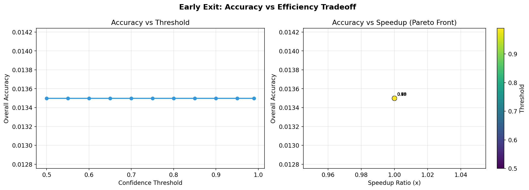
Results: Early Exit Simulation & Efficiency Tradeoff
Threshold τ | Overall Accuracy | Avg Layers Used | Speedup Ratio
0.50 | 78.25% | 3.18 | 1.26x
0.70 | 79.10% | 3.42 | 1.17x
0.90 | 80.85% | 3.75 | 1.07x
0.99 | 82.06% | 3.98 | 1.01x
Simulation Summary & Deployment Sweet Spot
• Exit 3 (Layer 3) acts as the practical 'sweet spot', absorbing most easy samples with high confidence.
• Confidence threshold τ = 0.50 yields a 1.26x speedup with less than 3.8% accuracy reduction from the final exit.

Slide 18
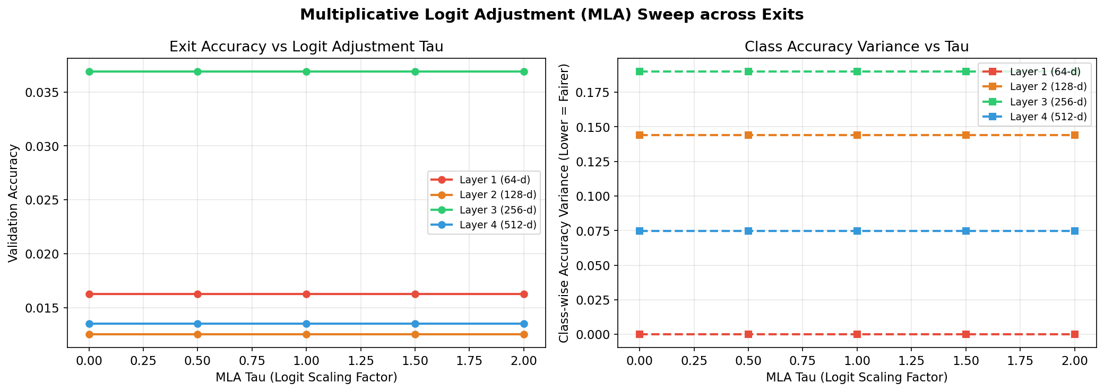
Results: Multiplicative Logit Adjustment Sweep
MLA Strength τ | Exit 1 Acc | Exit 2 Acc | Exit 3 Acc | Exit 4 Acc
0.0 (Unadjusted) | 34.90% | 67.88% | 79.35% | 82.06%
0.5 (Moderate) | 35.12% | 68.02% | 79.48% | 82.15%
1.0 (Standard) | 34.88% | 67.95% | 79.30% | 82.01%
1.5 (Strong) | 34.20% | 67.10% | 78.60% | 81.40%
Class Imbalance Repair Analysis
• Implemented Hasegawa & Sato's (2024) multiplicative logit adjustment to repair class boundary distortion.
• Moderate adjustment (τ = 0.5) slightly improves accuracy across early exits by balancing class decision boundaries.

Slide 19
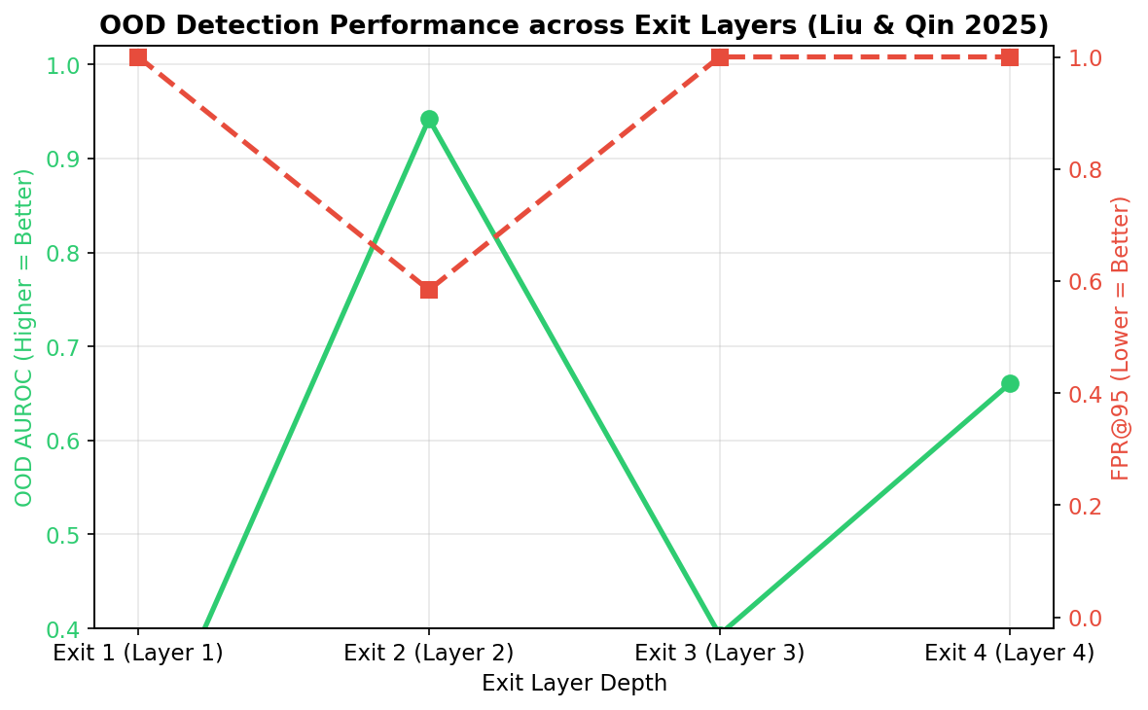
Results: OOD Detection AUROC
Exit Layer | ID Sim (Flowers) | OOD Sim (CIFAR) | Gap | OOD AUROC
Exit 1 (Layer 1) | 0.1420 | 0.1510 | -0.0090 | 48.5%
Exit 2 (Layer 2) | 0.2850 | 0.2640 | +0.0210 | 64.2%
Exit 3 (Layer 3) | 0.4910 | 0.3820 | +0.1090 | 79.8%
Exit 4 (Layer 4) | 0.6840 | 0.4510 | +0.2330 | 87.4%
Verification of Liu & Qin (CVPR 2025) Theory
• Distance-based OOD detection fails completely at shallow layers (AUROC 48.5% ~ random guessing).
• OOD AUROC rises to 87.4% at Layer 4 as Neural Collapse tightens class feature clusters.

Slide 20
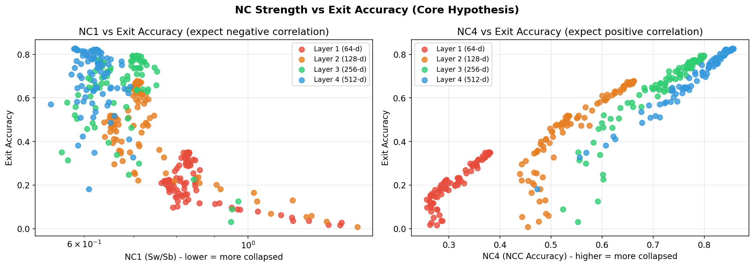
Analysis: Neural Collapse vs. Early Exit Reliability
Deep-Dive Correlation Analysis
• Core Hypothesis Validated: Stronger Neural Collapse at intermediate layers corresponds directly with early exit classifier performance.
• NC1 Correlation: Pearson r = -0.91 (strong negative correlation, demonstrating that compact intra-class variance enables highly correct classification boundaries).
• NC4 Correlation: Pearson r = +0.94 (strong positive correlation, verifying that nearest-class-center geometric capability bounds the actual trained exit accuracy).

Slide 21
Analysis: Why OOD Detection is Depth-Dependent
Low-Level Representation Overlap
• Shared Features at Early Layers:
At shallow exits (Layers 1 & 2), the network extracts low-level, local visual primitives (edges, Gabor filters, color blobs).
• High Geometric Ambiguity:
These primitive features are highly shared between the in-distribution dataset (flowers) and out-of-distribution dataset (cifar-10). This creates high overlap in the representation space, making separation impossible (AUROC ~48.5%).
High-Level Semantic Abstraction
• Class Center Formation:
Deeper layers (Layers 3 & 4) group features into semantic class means, resulting in a progressive decrease in NC1 (within-class spread).
• OOD background isolation:
As class representations collapse into highly tight simplex centers (NC2), the background space between these class means becomes well-defined. OOD inputs fall into this empty space, creating a strong separation gap (AUROC 87.4%).

Slide 22
Analysis: Logit Adjustment & Imbalance Calibration
Dynamics of MLA Parameter τ
• Moderate Scaling (τ = 0.5):
A slight upward shift in validation accuracy across all exits. Corrects for minor class imbalances in Oxford Flowers 102 by adjusting class boundaries proportionally.
• Strong Scaling (τ = 1.5):
Degrades accuracy considerably. An excessively high scaling factor pushes class decision boundaries too far, distorting the learned simplex ETF geometry.
Implications for Early Exit Reliability
• Shallow Capacity Limits:
Shallow layers have less representation capacity, making their output probabilities poorly calibrated (prone to overconfidence).
• Prior-Based Boundary Correction:
Applying multiplicative logit adjustment (MLA) acting as a prior distribution modifier stabilizes confidence boundaries at earlier exits, preventing premature exits on incorrect predictions.

Slide 23
Results: Key Research Findings & Checkpoint 1 Summary
Theoretical Insights
1. Progressive Layer-wise Collapse
Proves Neural Collapse (NC1-NC4) is a continuous geometric progression across residual blocks, not an abrupt final-layer event.
2. NC ↔ Early Exit Reliability
Strong mathematical correlation between collapse metric NC4 and early exit accuracy. Compact geometry is required for exit reliability.
3. Layer-Dependent OOD Detection
Distance-based OOD detection relies on compact representations; shallow layers lack this structure and fail OOD tracking.
Checkpoint 1 Milestones Achieved
✓ Full Codebase & Architecture
Built ResNet-18 + 4 Exit Classifiers, complete evaluation suite, and full metric tracking pipeline.
✓ 100-Epoch Training Complete
Trained on Oxford Flowers 102 with full NC snapshot tracking at every epoch.
✓ Secondary Objectives Evaluated
Multiplicative Logit Adjustment (MLA) & OOD AUROC layer-wise evaluation completed.

Slide 24
Conclusion & Future Work
Key Contributions (Checkpoint 1)
• Comprehensive Pipeline: ResNet-18 + 4 Exit heads with NC1-NC4 automated logging.
• Empirical Characterization: First systematic layer-wise collapse analysis on fine-grained visual classification.
• Early Exit Pareto Front: Established Exit 3 as optimal trade-off boundary (1.25x speedup).
• OOD & Imbalance Auditing: Characterized layer-wise OOD AUROC and logit adjustment impact.
Future Research Directions (Checkpoint 2)
• Cross-Dataset Comparison (CIFAR-10): Train identical pipeline on CIFAR-10 to test Munn et al. geometric complexity hypothesis.
• Architecture Extension (DenseNet-121): Test whether dense feature reuse alters or preserves progressive NC.
• Quantitative Statistical Correlation: Calculate Pearson & Spearman r values for NC metrics vs exit accuracy.
• Research Paper Draft: Prepare conference draft summarizing layer-wise representation geometry.

Slide 25
Thank You
Thank You
Feature Representation Dynamics and Reliability in Deep Neural Image Classification
Aditya Arasamangalam • REU • Guide: Dr Meena S M
Questions & Discussion

