Slide 1

Heading

Slide 2
Table of Contents
Introduction
Motivation
Problem Statement
Summary of Literature Survey
Objectives
Dataset
Pipeline
Overall Methodology
Architecture
Implementation
Results
Outcomes

Slide 3
Introduction

Slide 4
Summary of Literature Survey

Slide 5
Motivation

Slide 6
Problem Statement

Slide 7
Objectives

Slide 8
Dataset

Slide 9
Pipeline

Slide 10
Overall Methodology

Slide 11
Architecture

Slide 12
Implementation

Slide 13
Results

Slide 14
Outcomes

Slide 15
Thank you

Slide 16
Title
Title: Layer-wise Analysis of Feature Evolution in Convolutional Neural Networks
Subtitle: Understanding Feature Representation and Neural Collapse
Author: Aditya Arasamangalam
Course: ReU
Guide: Sunil Gurlahosur

Slide 17
Motivation
The Black Box Problem: CNNs achieve high accuracy but lack internal interpretability.
Output-Centric Bias: Current research predominantly evaluates final output classifications, ignoring intermediate feature structures.
Trust & Explainability: Analyzing how features evolve across hidden layers builds reliable, transparent models for edge deployment.

Slide 18
Problem Statement & Research Question
Research Gap: A lack of quantifiable understanding regarding layer-by-layer feature behavior and how dataset geometric complexity influences learning dynamics.
Core Question: How do internal features geometrically evolve across convolution layers, and how do dataset properties accelerate or hinder this evolution?

Slide 19
Research Objectives
Analyze feature maps across intermediate convolution layers.
Quantify progression using Neural Collapse metrics (NC1-NC4).
Evaluate Early Exit reliability based on intermediate geometric structure.
Compare behavior systematically across datasets with varying structures.

Slide 20
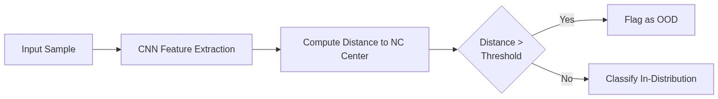
Literature 1 — OOD Detection via Neural Collapse
Paper: Liu & Qin, 2025
Concept: Terminal-phase deep features form tightly packed clusters. This geometry acts as a strict boundary for Out-of-Distribution (OOD) detection.
Limitation Addressed: Focuses only on final layers; our work extends this to early exits.

Slide 21
Literature 2 — Debiased Learning
Paper: Wang et al., 2024
Concept: Shortcut learning distorts the ideal simplex geometry of Neural Collapse. Explicit geometric regularization ensures fair, unbiased representations.
Limitation Addressed: Bias propagation through *intermediate* architectural blocks.

Slide 22
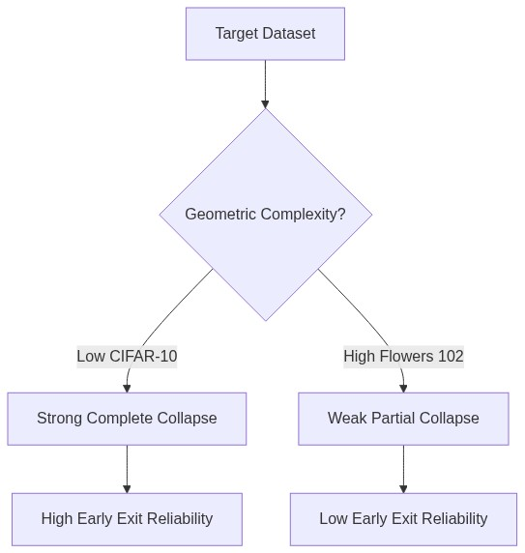
Literature 3 — Geometric Complexity
Paper: Munn et al., 2024
Concept: Neural Collapse is not guaranteed. It is strictly dependent on the "Geometric Complexity" (target dataset's difficulty).
Rationale: Complex, fine-grained datasets yield weak representation overlaps, making them harder to collapse.

Slide 23
Literature 4 — Logit Adjustment
Paper: Hasegawa & Sato, 2024
Concept: Class imbalance mechanically shifts classification boundaries away from optimal Neural Collapse geometry. Multiplicative scaling can mathematically repair this.

Slide 24
Dataset Selection
Primary Focus: Oxford Flowers 102
Balance: 102 classes with moderate data scale.
Complexity: Fine-grained geometry (high inter-class similarity) makes it ideal for testing partial Neural Collapse.
Comparative Baselines:
Food-101 (Texture-dominant)
Stanford Cars (Geometry-dominant)
FGVC Aircraft (Spatial/Structure-dominant)

Slide 25
Model Architecture — ResNet-18
Why ResNet?
Residual Connections: Prevents vanishing gradients, allowing stable measurement of deep features.
Distinct Hierarchical Blocks: Perfect for strategically attaching intermediate Early Exit classifiers.
Comparison: Unlike DenseNet (feature entanglement) or VGG (no residuals), ResNet provides clean architectural benchmarks.

Slide 26
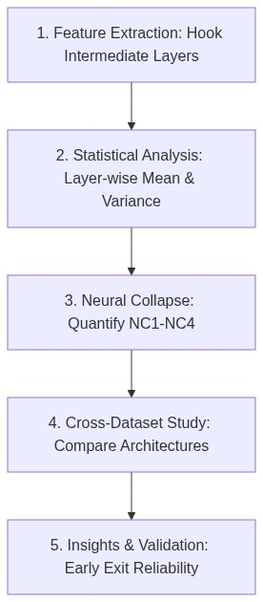
Proposed 5-Stage Framework

Slide 27
Expected Results
Early Layers: Responsive to raw textures and dense edges. Weak collapse limits prediction confidence.
Mid Layers: Capture gradients and shapes. Logit adjustments stabilize boundary distortions.
Deep Layers: Form structured semantic geometries. High collapse guarantees reliable, calibration-sound inferences.

Slide 28
Conclusion & Next Steps
Key Contribution: Developing a principled framework linking internal convolutional geometry directly to inference cost-savings (Early Exiting).
Future Work:
Detailed feature clustering analysis via t-SNE / PCA.
Expansion to Vision Transformers (ViTs) to compare spatial architectures against self-attention collapse.

