Slide 1
Title
Title: Layer-wise Analysis of Feature Evolution in Convolutional Neural Networks
Subtitle: Understanding Feature Representation and Neural Collapse
Author: Aditya Arasamangalam
Course: ReU
Guide: Sunil Gurlahosur

Slide 2
Motivation
The Black Box Problem: CNNs achieve high accuracy but lack internal interpretability.
Output-Centric Bias: Current research predominantly evaluates final output classifications, ignoring intermediate feature structures.
Trust & Explainability: Analyzing how features evolve across hidden layers builds reliable, transparent models for edge deployment.

Slide 3
Problem Statement & Research Question
Research Gap: A lack of quantifiable understanding regarding layer-by-layer feature behavior and how dataset geometric complexity influences learning dynamics.
Core Question: How do internal features geometrically evolve across convolution layers, and how do dataset properties accelerate or hinder this evolution?

Slide 4
Research Objectives
Analyze feature maps across intermediate convolution layers.
Quantify progression using Neural Collapse metrics (NC1-NC4).
Evaluate Early Exit reliability based on intermediate geometric structure.
Compare behavior systematically across datasets with varying structures.

Slide 5
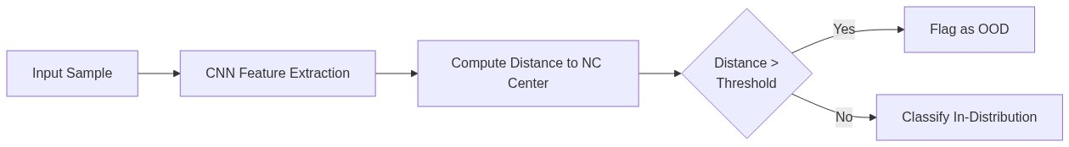
Literature 1 — OOD Detection via Neural Collapse
Paper: Liu & Qin, 2025
Concept: Terminal-phase deep features form tightly packed clusters. This geometry acts as a strict boundary for Out-of-Distribution (OOD) detection.
Limitation Addressed: Focuses only on final layers; our work extends this to early exits.

Slide 6
Literature 2 — Debiased Learning
Paper: Wang et al., 2024
Concept: Shortcut learning distorts the ideal simplex geometry of Neural Collapse. Explicit geometric regularization ensures fair, unbiased representations.
Limitation Addressed: Bias propagation through *intermediate* architectural blocks.

Slide 7
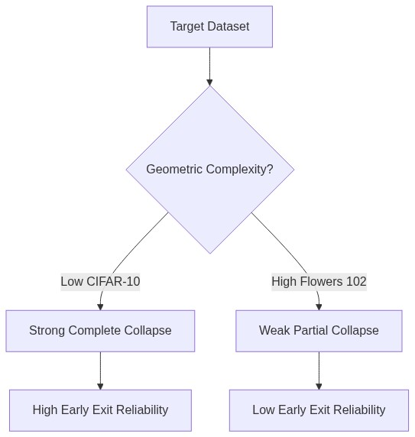
Literature 3 — Geometric Complexity
Paper: Munn et al., 2024
Concept: Neural Collapse is not guaranteed. It is strictly dependent on the "Geometric Complexity" (target dataset's difficulty).
Rationale: Complex, fine-grained datasets yield weak representation overlaps, making them harder to collapse.

Slide 8
Literature 4 — Logit Adjustment
Paper: Hasegawa & Sato, 2024
Concept: Class imbalance mechanically shifts classification boundaries away from optimal Neural Collapse geometry. Multiplicative scaling can mathematically repair this.

Slide 9
Dataset Selection
Primary Focus: Oxford Flowers 102
Balance: 102 classes with moderate data scale.
Complexity: Fine-grained geometry (high inter-class similarity) makes it ideal for testing partial Neural Collapse.
Comparative Baselines:
Food-101 (Texture-dominant)
Stanford Cars (Geometry-dominant)
FGVC Aircraft (Spatial/Structure-dominant)

Slide 10
Model Architecture — ResNet-18
Why ResNet?
Residual Connections: Prevents vanishing gradients, allowing stable measurement of deep features.
Distinct Hierarchical Blocks: Perfect for strategically attaching intermediate Early Exit classifiers.
Comparison: Unlike DenseNet (feature entanglement) or VGG (no residuals), ResNet provides clean architectural benchmarks.

Slide 11
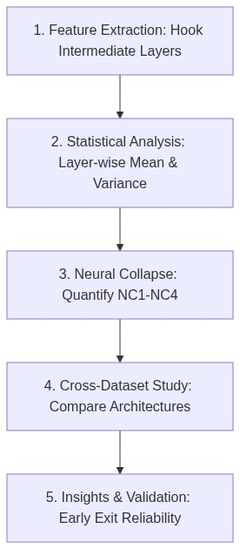
Proposed 5-Stage Framework

Slide 12
Expected Results
Early Layers: Responsive to raw textures and dense edges. Weak collapse limits prediction confidence.
Mid Layers: Capture gradients and shapes. Logit adjustments stabilize boundary distortions.
Deep Layers: Form structured semantic geometries. High collapse guarantees reliable, calibration-sound inferences.

Slide 13
Conclusion & Next Steps
Key Contribution: Developing a principled framework linking internal convolutional geometry directly to inference cost-savings (Early Exiting).
Future Work:
Detailed feature clustering analysis via t-SNE / PCA.
Expansion to Vision Transformers (ViTs) to compare spatial architectures against self-attention collapse.

