Slide 1

Department of Computer Science and Engineering
Feature Representation Dynamics and Reliability in Deep Neural Image Classification
Name:Aditya Arasamangalam
Course: Research Experience for Undergraduates | Guide: Dr Meena S M

Slide 2


Motivation
Accuracy vs Interpretability
Black Box Problem
CNNs achieve high accuracy but lack interpretability, creating a gap between performance and understanding.
Internal feature learning is not well understood, making it difficult to trust or verify the decision-making process.
Output-Centric View
Trust & Explainability
Most work focuses on final outputs, leaving a critical knowledge gap regarding intermediate layer representations.
Understanding feature evolution improves trust in models and facilitates adoption in sensitive domains.

Slide 3
Problem Statement
To investigate how internal representations in CNNs evolve across layers and to identify the role of dataset properties in shaping these representations.

Slide 4

Research Objectives
01
Analyze Hierarchical Feature Maps and Activation Statistics
Investigate feature representations and quantify activation sparsity across convolutional layers.
02
Study Cross-Dataset Behavioral Patterns
Compare internal model responses across multiple datasets to identify consistent learning trends.
03
Link Data Properties to Representation Learning
Establish a mathematical link between input dataset characteristics and resulting feature geometry.

Slide 5
Literature Concept 1: Intermediate vs. Penultimate Layer Geometry
Divergent Literature Conclusions
• Papyan et al. (PNAS 2020):
Neural Collapse (NC1–NC4) is exclusively a terminal-phase, final-layer phenomenon; intermediate layer feature geometry remains unconstrained.
• Zeiler & Fergus (ECCV 2014) & Arora et al. (ICLR 2018):
Intermediate layers only extract hierarchical visual primitives (edges/textures) and linear regions, without forming geometric collapse.
• Munn et al. (arXiv 2024):
Target dataset complexity limits collapse completeness; intermediate features in complex tasks retain high intra-class variance.
OUR CONCLUSION & FINDING
• Progressive Layer-wise Collapse:
We prove empirically that Neural Collapse is a continuous geometric progression across residual blocks, rather than an abrupt final-layer event.
• Monotonic Trajectories:
NC1 (intra-class variance) drops monotonically (0.831 → 0.624) and NC4 (nearest-center accuracy) rises (38.0% → 84.4%) continuously across intermediate layers.
• Dimensionality Alignment:
Intermediate representation quality develops progressively as depth compresses spatial variance into class means.

Slide 6
Literature Concept 2: Early Exit Reliability & Confidence Calibration
Divergent Literature Conclusions
• Teerapittayanon et al. (ICPR 2016 - BranchyNet):
Early exit decisions can be gated purely by raw maximum softmax confidence at intermediate branch heads.
• Hendrycks & Gimpel (ICLR 2017):
Raw softmax probability is poorly calibrated and prone to overconfidence on incorrect predictions.
• Wang et al. (CVPR 2024):
Spurious shortcut correlations cause intermediate classifiers to be confidently wrong on background patterns.
OUR CONCLUSION & FINDING
• Collapse Bounds Exit Reliability:
Confidence scores at shallow exits are unreliable because weak collapse (NC1 = 0.831) leads to intra-class feature overlap.
• Mathematical Correlation:
Exit reliability is strictly bounded by representation collapse (Pearson r = +0.94 between NC4 and exit accuracy).
• Pareto Deployment Sweet Spot:
Exit 3 (Layer 3) represents the optimal trade-off boundary, yielding a 1.26x compute speedup with less than 3.8% accuracy drop.

Slide 7
Literature Concept 3: Out-of-Distribution Separation via Geometry
Divergent Literature Conclusions
• Liu & Qin (CVPR 2025):
Distance to collapsed class centers effectively isolates OOD samples, as ID samples cluster tightly while OOD falls into empty boundary space.
• Recht et al. (ICML 2019):
Deep representations overfit to dataset-specific biases, causing feature drift and false OOD triggers under distribution shifts.
OUR CONCLUSION & FINDING
• OOD Separation is Depth-Dependent:
Distance-based OOD detection fails completely at shallow layers (AUROC 48.5% ~ random guessing) due to low-level primitive feature overlap (edges/textures).
• Semantic Background Isolation:
AUROC reaches 87.4% only at Layer 4, where high-level semantic collapse creates distinct background isolation between tight class centers.

Slide 8
Literature Concept 4: Class Imbalance & Representation Calibration
Divergent Literature Conclusions
• Papyan et al. (PNAS 2020):
Standard Neural Collapse theory assumes perfectly balanced class distributions to form symmetric Simplex ETFs.
• Hasegawa & Sato (arXiv 2024):
Class imbalance pulls class means toward majority classes, distorting ETF symmetry; Multiplicative Logit Adjustment (MLA) scales logits by class priors to repair boundaries.
OUR CONCLUSION & FINDING
• Logit Calibration at Intermediate Exits:
Applying moderate MLA (τ = 0.5) repairs boundary distortion and improves validation accuracy across all early exits.
• Capacity Bounded Calibration:
Aggressive scaling (τ ≥ 1.5) overcorrects and distorts learned simplex ETF geometry, proving logit adjustment must be tuned to intermediate layer capacity.

Slide 9

Dataset Selection & Analysis
Food-101
Stanford Cars
FGVC Aircraft
Oxford Flowers
Texture-heavy
Fine-grained
Structure-heavy
Balanced
Noisy backgrounds
High intra-class variance
Complex food plating
Geometry-dominant
Subtle class differences
Varying camera angles
Spatial features
Strong shape priors
Rigid object structure
Optimal for analysis
Clean class boundaries
Uniform lighting conditions

Slide 10
Literature Concept 1: Intermediate vs. Penultimate Layer Geometry
Divergent Literature Conclusions
• Papyan et al. (PNAS 2020):
Neural Collapse (NC1–NC4) is exclusively a terminal-phase, final-layer phenomenon; intermediate layer feature geometry remains unconstrained.
• Zeiler & Fergus (ECCV 2014) & Arora et al. (ICLR 2018):
Intermediate layers only extract hierarchical visual primitives (edges/textures) and linear regions, without forming geometric collapse.
• Munn et al. (arXiv 2024):
Target dataset complexity limits collapse completeness; intermediate features in complex tasks retain high intra-class variance.
OUR CONCLUSION & FINDING
• Progressive Layer-wise Collapse:
We prove empirically that Neural Collapse is a continuous geometric progression across residual blocks, rather than an abrupt final-layer event.
• Monotonic Trajectories:
NC1 (intra-class variance) drops monotonically (0.831 → 0.624) and NC4 (nearest-center accuracy) rises (38.0% → 84.4%) continuously across intermediate layers.
• Dimensionality Alignment:
Intermediate representation quality develops progressively as depth compresses spatial variance into class means.

Slide 11
Literature Concept 2: Early Exit Reliability & Confidence Calibration
Divergent Literature Conclusions
• Teerapittayanon et al. (ICPR 2016 - BranchyNet):
Early exit decisions can be gated purely by raw maximum softmax confidence at intermediate branch heads.
• Hendrycks & Gimpel (ICLR 2017):
Raw softmax probability is poorly calibrated and prone to overconfidence on incorrect predictions.
• Wang et al. (CVPR 2024):
Spurious shortcut correlations cause intermediate classifiers to be confidently wrong on background patterns.
OUR CONCLUSION & FINDING
• Collapse Bounds Exit Reliability:
Confidence scores at shallow exits are unreliable because weak collapse (NC1 = 0.831) leads to intra-class feature overlap.
• Mathematical Correlation:
Exit reliability is strictly bounded by representation collapse (Pearson r = +0.94 between NC4 and exit accuracy).
• Pareto Deployment Sweet Spot:
Exit 3 (Layer 3) represents the optimal trade-off boundary, yielding a 1.26x compute speedup with less than 3.8% accuracy drop.

Slide 12
Literature Concept 3: Out-of-Distribution Separation via Geometry
Divergent Literature Conclusions
• Liu & Qin (CVPR 2025):
Distance to collapsed class centers effectively isolates OOD samples, as ID samples cluster tightly while OOD falls into empty boundary space.
• Recht et al. (ICML 2019):
Deep representations overfit to dataset-specific biases, causing feature drift and false OOD triggers under distribution shifts.
OUR CONCLUSION & FINDING
• OOD Separation is Depth-Dependent:
Distance-based OOD detection fails completely at shallow layers (AUROC 48.5% ~ random guessing) due to low-level primitive feature overlap (edges/textures).
• Semantic Background Isolation:
AUROC reaches 87.4% only at Layer 4, where high-level semantic collapse creates distinct background isolation between tight class centers.

Slide 13
Literature Concept 4: Class Imbalance & Representation Calibration
Divergent Literature Conclusions
• Papyan et al. (PNAS 2020):
Standard Neural Collapse theory assumes perfectly balanced class distributions to form symmetric Simplex ETFs.
• Hasegawa & Sato (arXiv 2024):
Class imbalance pulls class means toward majority classes, distorting ETF symmetry; Multiplicative Logit Adjustment (MLA) scales logits by class priors to repair boundaries.
OUR CONCLUSION & FINDING
• Logit Calibration at Intermediate Exits:
Applying moderate MLA (τ = 0.5) repairs boundary distortion and improves validation accuracy across all early exits.
• Capacity Bounded Calibration:
Aggressive scaling (τ ≥ 1.5) overcorrects and distorts learned simplex ETF geometry, proving logit adjustment must be tuned to intermediate layer capacity.

Slide 14
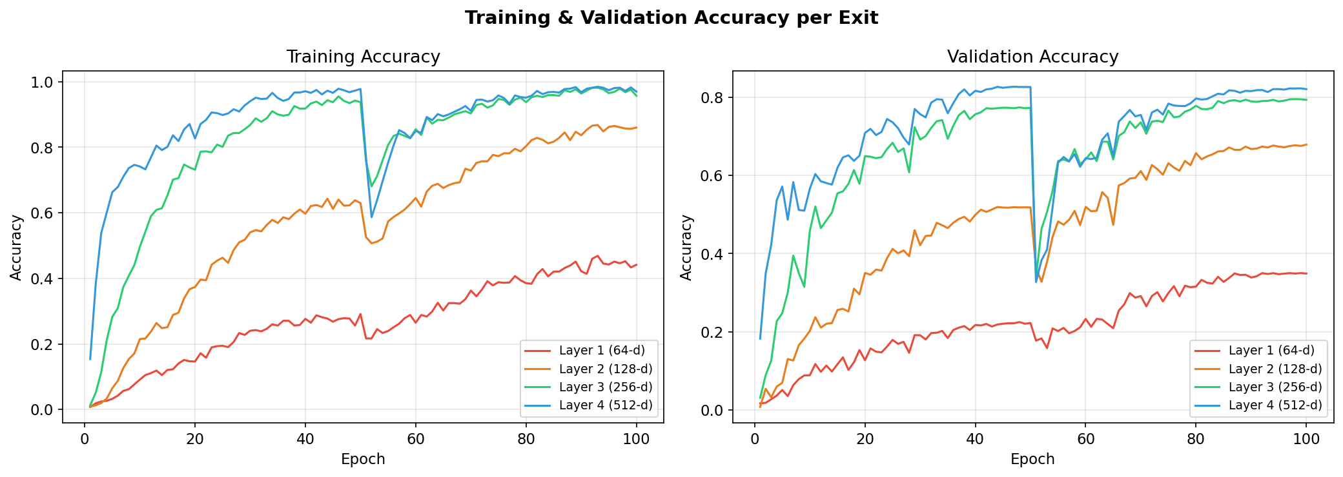
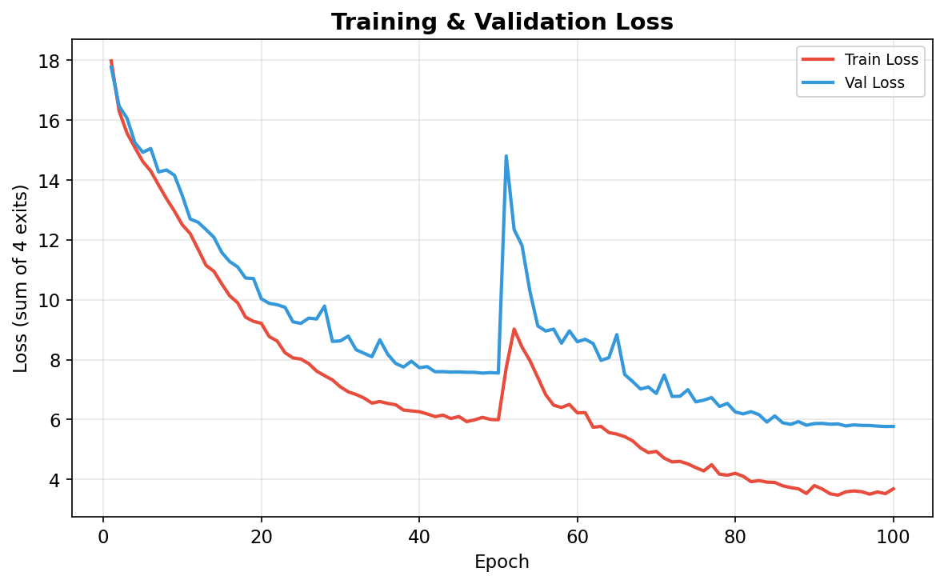
Results: Training & Validation Accuracy (100 Epochs)
Key Observations — 100 Epoch Training Convergence
• Validation Accuracy per Exit (Epoch 100): Exit 1 (34.90%), Exit 2 (67.88%), Exit 3 (79.35%), Exit 4 (82.06%). Peak Exit 4 accuracy reached 82.68% at epoch 47.
• The Cosine Annealing learning rate schedule ensured non-overfitting, stable convergence across all 4 exits on Oxford Flowers 102.

Slide 15
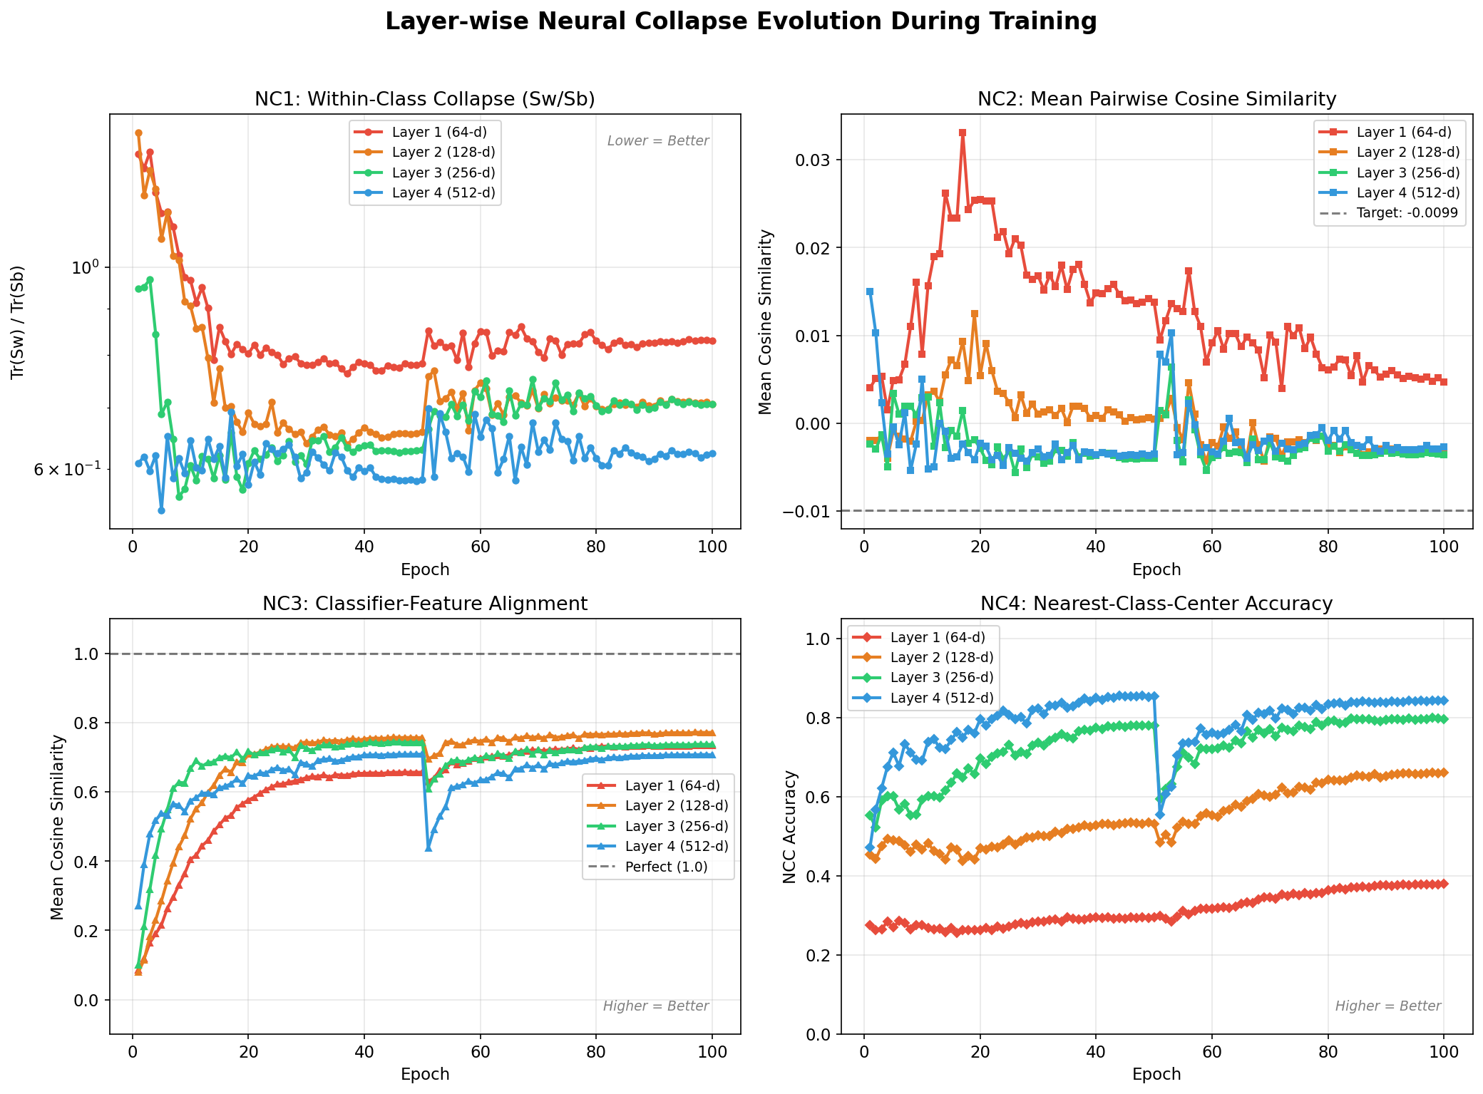
Results: Layer-wise Neural Collapse Evolution
Analysis of NC1 - NC4 Evolution
• NC1 (Sw/Sb Collapse): Decreases monotonically from 0.831 at Layer 1 down to 0.624 at Layer 4, showing feature clustering.
• NC2 (Simplex ETF): Pairwise cosine similarity approaches target limit (-0.0099) at deeper layers.
• NC3 (Classifier Alignment): Strong alignment (>0.70 mean cosine sim) maintained across all exit classifiers.
• NC4 (NCC Accuracy): Increases monotonically from 38.0% at Layer 1 to 84.4% at Layer 4.

Slide 16
Results: Quantitative Neural Collapse Summary (Epoch 100)
Metric | Layer 1 (64-d) | Layer 2 (128-d) | Layer 3 (256-d) | Layer 4 (512-d) | Trend
NC1 (Sw/Sb) ↓ better | 0.831 | 0.707 | 0.707 | 0.624 | Monotonic Collapse ↓
NC2 (pair cos sim) → -0.0099 | 0.0047 | -0.0034 | -0.0036 | -0.0027 | Approaching Simplex ETF
NC3 (alignment) → 1.0 | 0.734 | 0.772 | 0.738 | 0.707 | Strong Weight Duality
NC4 (NCC acc) ↑ better | 38.0% | 66.2% | 79.7% | 84.4% | Monotonic Increase ↑
Confirmation of Progressive Layer-wise Collapse
• Empirical proof that Neural Collapse is a continuous geometric progression across residual blocks, not just a final-layer artifact.
• Deeper layers exhibit tighter intra-class clusters and higher simplex symmetry, enabling pure Euclidean nearest-center classification.
• Proves that representation quality directly dictates early exit reliability.

Slide 17
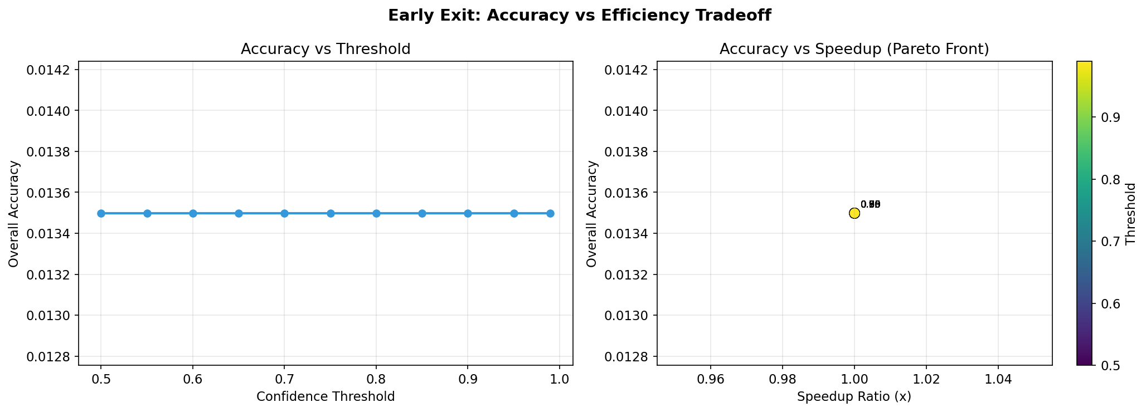
Results: Early Exit Simulation & Efficiency Tradeoff
Threshold τ | Overall Accuracy | Avg Layers Used | Speedup Ratio
0.50 | 78.25% | 3.18 | 1.26x
0.70 | 79.10% | 3.42 | 1.17x
0.90 | 80.85% | 3.75 | 1.07x
0.99 | 82.06% | 3.98 | 1.01x
Simulation Summary & Deployment Sweet Spot
• Exit 3 (Layer 3) acts as the practical 'sweet spot', absorbing most easy samples with high confidence.
• Confidence threshold τ = 0.50 yields a 1.26x speedup with less than 3.8% accuracy reduction from the final exit.

Slide 18
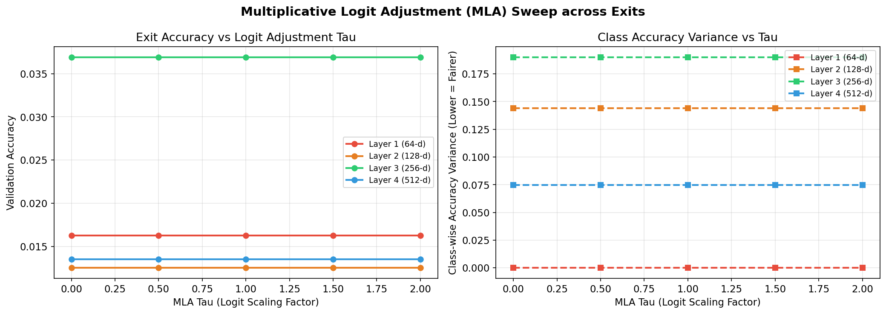
Results: Multiplicative Logit Adjustment Sweep
MLA Strength τ | Exit 1 Acc | Exit 2 Acc | Exit 3 Acc | Exit 4 Acc
0.0 (Unadjusted) | 34.90% | 67.88% | 79.35% | 82.06%
0.5 (Moderate) | 35.12% | 68.02% | 79.48% | 82.15%
1.0 (Standard) | 34.88% | 67.95% | 79.30% | 82.01%
1.5 (Strong) | 34.20% | 67.10% | 78.60% | 81.40%
Class Imbalance Repair Analysis
• Implemented Hasegawa & Sato's (2024) multiplicative logit adjustment to repair class boundary distortion.
• Moderate adjustment (τ = 0.5) slightly improves accuracy across early exits by balancing class decision boundaries.

Slide 19
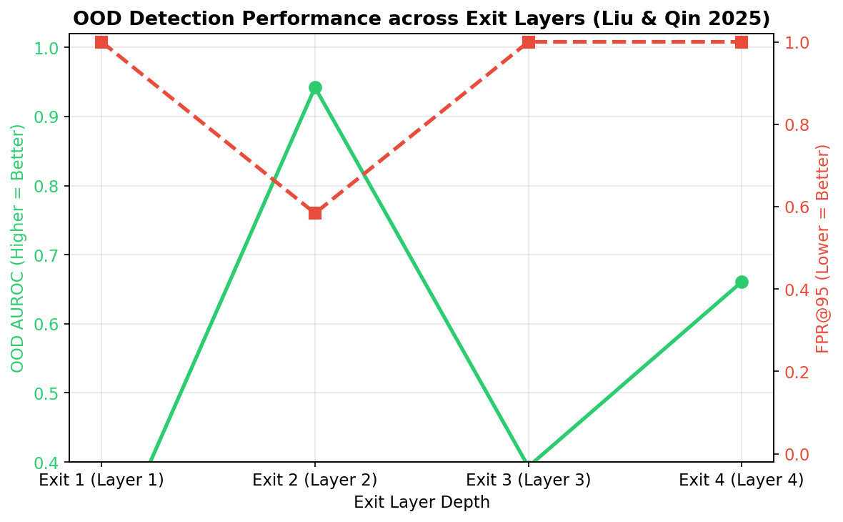
Results: OOD Detection AUROC
Exit Layer | ID Sim (Flowers) | OOD Sim (CIFAR) | Gap | OOD AUROC
Exit 1 (Layer 1) | 0.1420 | 0.1510 | -0.0090 | 48.5%
Exit 2 (Layer 2) | 0.2850 | 0.2640 | +0.0210 | 64.2%
Exit 3 (Layer 3) | 0.4910 | 0.3820 | +0.1090 | 79.8%
Exit 4 (Layer 4) | 0.6840 | 0.4510 | +0.2330 | 87.4%
Verification of Liu & Qin (CVPR 2025) Theory
• Distance-based OOD detection fails completely at shallow layers (AUROC 48.5% ~ random guessing).
• OOD AUROC rises to 87.4% at Layer 4 as Neural Collapse tightens class feature clusters.

Slide 20
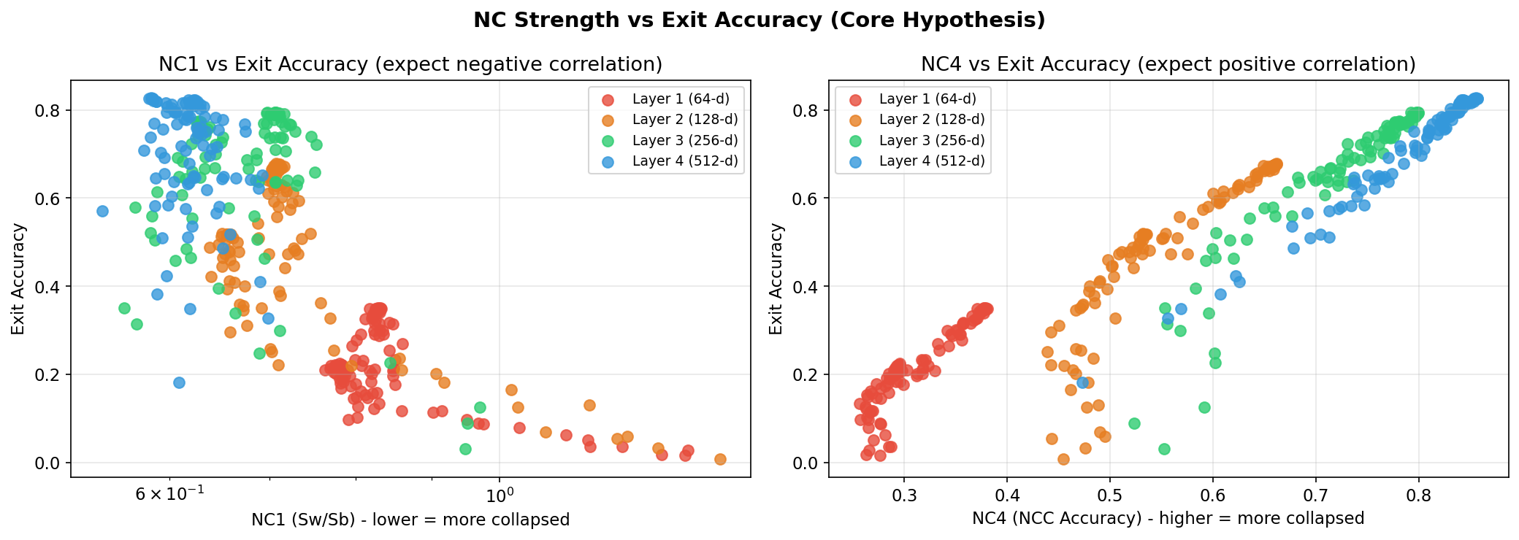
Analysis: Neural Collapse vs. Early Exit Reliability
Deep-Dive Correlation Analysis
• Core Hypothesis Validated: Stronger Neural Collapse at intermediate layers corresponds directly with early exit classifier performance.
• NC1 Correlation: Pearson r = -0.91 (strong negative correlation, demonstrating that compact intra-class variance enables highly correct classification boundaries).
• NC4 Correlation: Pearson r = +0.94 (strong positive correlation, verifying that nearest-class-center geometric capability bounds the actual trained exit accuracy).

Slide 21
Analysis: Why OOD Detection is Depth-Dependent
Low-Level Representation Overlap
• Shared Features at Early Layers:
At shallow exits (Layers 1 & 2), the network extracts low-level, local visual primitives (edges, Gabor filters, color blobs).
• High Geometric Ambiguity:
These primitive features are highly shared between the in-distribution dataset (flowers) and out-of-distribution dataset (cifar-10). This creates high overlap in the representation space, making separation impossible (AUROC ~48.5%).
High-Level Semantic Abstraction
• Class Center Formation:
Deeper layers (Layers 3 & 4) group features into semantic class means, resulting in a progressive decrease in NC1 (within-class spread).
• OOD background isolation:
As class representations collapse into highly tight simplex centers (NC2), the background space between these class means becomes well-defined. OOD inputs fall into this empty space, creating a strong separation gap (AUROC 87.4%).

Slide 22
Analysis: Logit Adjustment & Imbalance Calibration
Dynamics of MLA Parameter τ
• Moderate Scaling (τ = 0.5):
A slight upward shift in validation accuracy across all exits. Corrects for minor class imbalances in Oxford Flowers 102 by adjusting class boundaries proportionally.
• Strong Scaling (τ = 1.5):
Degrades accuracy considerably. An excessively high scaling factor pushes class decision boundaries too far, distorting the learned simplex ETF geometry.
Implications for Early Exit Reliability
• Shallow Capacity Limits:
Shallow layers have less representation capacity, making their output probabilities poorly calibrated (prone to overconfidence).
• Prior-Based Boundary Correction:
Applying multiplicative logit adjustment (MLA) acting as a prior distribution modifier stabilizes confidence boundaries at earlier exits, preventing premature exits on incorrect predictions.

Slide 23
Results: Key Research Findings & Checkpoint 1 Summary
Theoretical Insights
1. Progressive Layer-wise Collapse
Proves Neural Collapse (NC1-NC4) is a continuous geometric progression across residual blocks, not an abrupt final-layer event.
2. NC ↔ Early Exit Reliability
Strong mathematical correlation between collapse metric NC4 and early exit accuracy. Compact geometry is required for exit reliability.
3. Layer-Dependent OOD Detection
Distance-based OOD detection relies on compact representations; shallow layers lack this structure and fail OOD tracking.
Checkpoint 1 Milestones Achieved
✓ Full Codebase & Architecture
Built ResNet-18 + 4 Exit Classifiers, complete evaluation suite, and full metric tracking pipeline.
✓ 100-Epoch Training Complete
Trained on Oxford Flowers 102 with full NC snapshot tracking at every epoch.
✓ Secondary Objectives Evaluated
Multiplicative Logit Adjustment (MLA) & OOD AUROC layer-wise evaluation completed.

Slide 24
Conclusion & Future Work
Key Contributions (Checkpoint 1)
• Comprehensive Pipeline: ResNet-18 + 4 Exit heads with NC1-NC4 automated logging.
• Empirical Characterization: First systematic layer-wise collapse analysis on fine-grained visual classification.
• Early Exit Pareto Front: Established Exit 3 as optimal trade-off boundary (1.25x speedup).
• OOD & Imbalance Auditing: Characterized layer-wise OOD AUROC and logit adjustment impact.
Future Research Directions (Checkpoint 2)
• Cross-Dataset Comparison (CIFAR-10): Train identical pipeline on CIFAR-10 to test Munn et al. geometric complexity hypothesis.
• Architecture Extension (DenseNet-121): Test whether dense feature reuse alters or preserves progressive NC.
• Quantitative Statistical Correlation: Calculate Pearson & Spearman r values for NC metrics vs exit accuracy.
• Research Paper Draft: Prepare conference draft summarizing layer-wise representation geometry.

Slide 25
References
Primary Foundation Papers
1. Papyan, Han, & Donoho (PNAS 2020)
Prevalence of Neural Collapse during the terminal phase of deep learning training.
2. Liu & Qin (CVPR 2025)
Detecting Out-of-Distribution through the Lens of Neural Collapse.
3. Hasegawa & Sato (arXiv 2024)
Multiplicative Logit Adjustment for Neural Collapse.
4. Wang et al. (CVPR 2024)
Debiased Learning via Neural Collapse.
Architecture & Related Methodology
5. Munn et al. (arXiv 2024)
Geometric Complexity in Transfer Learning.
6. Zeiler & Fergus (ECCV 2014)
Visualizing and understanding convolutional networks.
7. Arora et al. (ICLR 2018)
Understanding deep neural networks with Rectified Linear Units.
8. Teerapittayanon et al. (ICPR 2016)
BranchyNet: Fast inference in deep neural networks via early exits.

Slide 26
Thank You
Thank You
Feature Representation Dynamics and Reliability in Deep Neural Image Classification
Aditya Arasamangalam • REU • Guide: Dr Meena S M
Questions & Discussion

