Slide 2
An android application for “DailyDairy”
Submitted to:
Department of Computer Science and Engineering

Slide 3
Supervised by: Prof.Kamal Sethi(HOD)
Prof.Krupi Saraf
Team Members
1.Aditya Deshmukh
2.Aditya Purohit
3.Aman Pratap Singh
4.Anirudha Singh

Slide 4
Project Presentation Outline
Abstract
Introduction
Problem Statement
Survey of Existing Systems
Project Objectives
Requirement Analysis
Solution Proposed
Models and Diagrams
The Implementation
Testing
The Outcome Discussion
Conclusions and Limitations

Slide 5
Abstract
This project idea includes the complete solution of a problem that is faced by daily distributors/vendors and consumers. With this solution we are solving the problem on a large scale and solving the major differences between users and consumers.
Our solution will solve the issues like purchasing, daily management, accounting and billing of daily essential products and grocery items. It helps in budget control by tracking the expenses.

Slide 6
Introduction
Difficult to keep a tab on your daily expenses? Need your own daily calendar to check out your daily expenses. “Ease On Essentials” is a general purpose app for every user. Users can keep track of their personal daily expenses on a touch.
This application is a kind of digital and more elaborate version of ration card which records expenses, manages minor changes in real time, gives ability to overlook false delivery claims and makes payment online directly.
Many features provided by our platform can make the daily problems faced by local distributors whom we deal with an offline subscription basis can be organised, updated and made convenient.

Slide 7
The Problem Statement
There is clash between consumer and vendor regarding product was delivery on a particular day or not .
Many times Vendor makes mistake while generating monthly bill due to same reason.
For them it is difficult to maintain records on paper .
Vendors from rural areas do not have idea that how they can make their task fast and efficient.
They are not digitally sound.
Consumer is many times gets confused regarding his yearly and monthly expenses.

Slide 8
Survey of Existing Systems
Country delight: The problem they addressed was low quality or adulterated milk and vegetables. Quality control of product, good model for a single company. Not available for local vendors and small scale businesses. It's built by a big dairy company and its app is to provide expensive pure products of their own company. | Bigbasket daily: Problems addressed-delivery service of grocery. All grocery of all types in addition to all subscription services. Not available for local vendors and small scale businesses. It's built for a big and capable ecommerce platform with big fundings and only for products they produce. | Grofers: Problems addressed-delivery service of grocery turned into an ecommerce platform. Sales mostly focus on fresh materials which come from their partners or self owned factories. Not available for local vendors and small scale businesses. It's ecommerce platform with big fundings and only focus is on fastest delivery platform.

Slide 9
Outcome of Survey
There are numerous current systems on the market, but none are like ours, and the shortcomings of their platform, which we can counter, are clearly known.some of them are-
There are apps which try to counter problem by making their own personal brands and control whole chain from manufacturing ,supply and sales.
Every app is some sort of ecommerce platform unlike ours.
Not available for small vendors and small scale businesses.
Not centered for the convenience to maintain record for customers in a way to verify customised orders daily.

Slide 10
Objectives
The very first module will be frontend designing which is further divided into two sub-modules
First is UI designing for customer
Second is UI design for vendor
both UI’s will have their separate login, signup, homepage, etc.
The second module will be backend to maintain and manage the data.
The third module will be integration of third party API’s like Payment API or Calendar API.

Slide 11
Requirement Analysis
Hardware Requirements -
- Android Device
System for maintenance
Software Requirements -
React Native :- React Native is a Javascript based framework for writing real, native rendering mobile applications for iOS and Android. It is based on React, Facebook’s Javascript library for building user interfaces, but instead of targeting the browser, it targets mobile platforms.
Firebase :- Firebase is a toolset to build, improve, and grow your app and it helps you to cover a large portion of the services that developers would normally have to build themselves, but don’t really want to build because they’d rather be focusing on the app experience itself.
Visual Studio Code :- It is an IDE with less features than the actual Visual Studio and it could be used on Linux and Mac platforms.

Slide 12
Solution Proposed
In this project we will be working on an android application that is solving the problem of consumer and vendor facing issues regarding quantity of different products & their payment. This application will mainly be focusing on development of a real time application using firebase as database and react-native as javascript based android development framework.
The application itself has many different features that will enable a consumer to make his life easy such as pdf generation, contacting, online payments, and statistical analysis of data using data analytics and machine learning algorithms and providing real time FAQs to have better user experience. By developing this application we are rapidly moving forward towards a very great initiative taken by the government to make our rural India more advanced with the Digital India program.

Slide 13
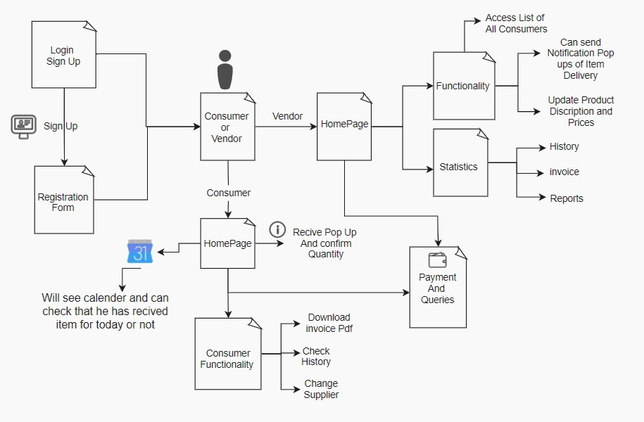
Models/Diagrams

Slide 14
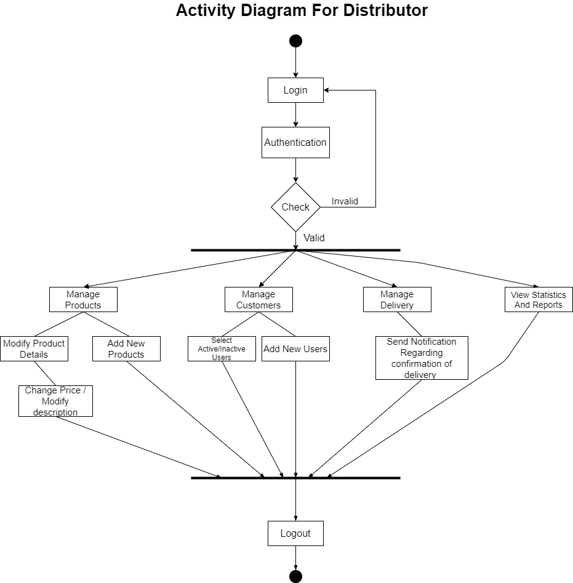
Models/Diagrams

Slide 15
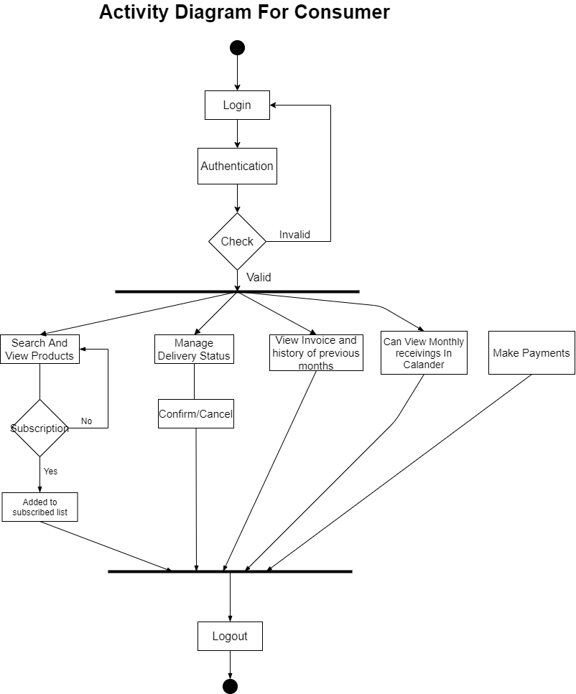
Models/Diagrams

Slide 16
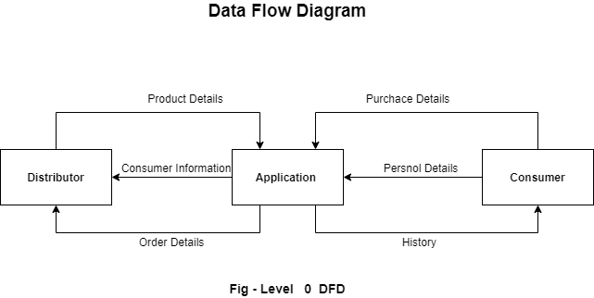
Models/Diagrams

Slide 17
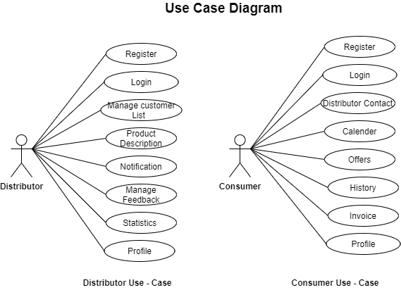
Models/Diagrams

Slide 18
The Outcome Discussion
Paperwork reduction will be the most prominent outcome for nature.
Instant & quick access will allow users to experience good quality of service.
Product distributors can view their stats about their customers and Consumers can view reports anywhere anytime.
Less human efforts on marking product delivery dates on calendars, calculating bills, etc.
Since billing is automated so error probability will be much less and efficiency of business will grow rapidly.

Slide 19
Conclusion and Limitation
In 2021, where all the sectors of the industry are turning towards the digital ecosystem and big tech companies are taking over by controlling the whole chain of business from manufacturing, sales, small vendors like milkman, newspaper, vegetable sellers and many more small scale businesses suffer due to inadequate knowledge of creating digital platforms. To improvise their services this app can be a game changer by giving a one stop solution to both the vendors and their customers. This application would help them to catch up and have a competing and even surviving the current quickly advancing scenario of vending and delivery services. In making this project we will be learning how to coordinate with our team members and try to solve a real life problem and brainstorm to bring an effective solution to it and create an app that mobilizes this industry to the digital world.

Slide 20
Acknowledgment
Here are some links which were referred in the document to for reliable information and comparisons to our application and how it differs and improvers in the shortcomings of other applications.
[1]-https://www.bigbasket.com/bbdaily/
[2]-https://grofers.com/
[3]-https://countrydelight.in/
[4]-https://reactnative.dev/docs/getting-started
[5]-https://firebase.google.com/docs

Slide 21
Q&A

Slide 22
THANKS

