Slide 1

MapReduce
Simplified Data Processing on Large Clusters
By Aditya Ghodgaonkar and Aprajita Thakur

Slide 2
Map Reduce
Algorithm
It is a step wise procedure to solve a problem.

Slide 3
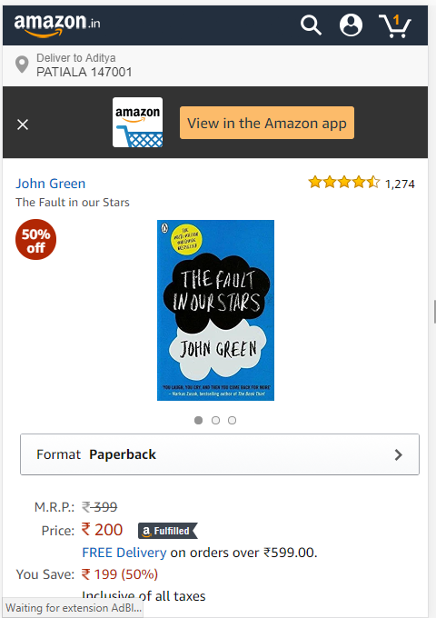
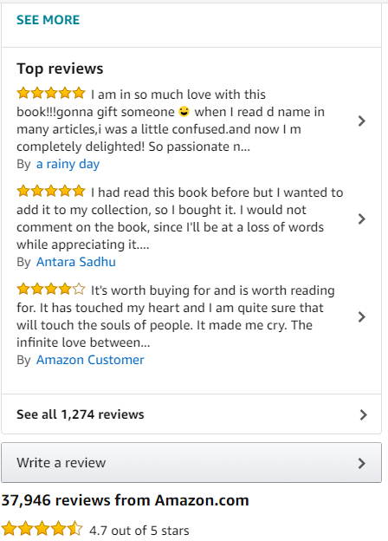
Problem / Motivation
37,946
REVIEWS !!
Buying on Amazon ? Confused ??
Let’s Look at the reviews

Slide 4
The Big Data Analysis Problem !
How can I read so many reviews at a single time and get the crux out of them ?
How can I process this huge amount of data or Big Data ?
Answer : Map Reduce Algorithm

Slide 5
BIG DATA - RECAP

Slide 6
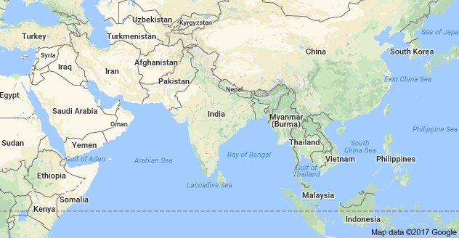
What is MapReduce?
MapReduce is a processing technique and a program model for distributed computing based on java. The MapReduce algorithm contains two important tasks, namely Map and Reduce.
MapReduce is a framework using which we can write applications to process huge amounts of data, in parallel, on large clusters of commodity hardware in a reliable manner.

Slide 7
Major Components
User Components:
Mapper
Reducer
Combiner (Optional)
Partitioner (Optional) (Shuffle)
Writable(s) (Optional)
System Components:
Master
Input Splitter*
Output Committer*
* You can use your own if you really want!

Slide 8
Data Flow using Word Count Example
<store, 1> <opens, 1> <in, 1> <the, 1> <morning, 1> <the 1> <store, 1> <opens, 1> <at, 1> <9am, 1>
<The, 6>
<teacher, 1>
<went, 1>
<to, 1>
<store, 3>
<was, 1>
<closed, 1>
<opens, 1>
<morning, 1>
<at, 1>
<9am, 1>
Split 0
Mapper 0
Input
Reducer 0
Out 0
The store was closed;
the store opens in the morning.
The store opens at 9am.
Split 1
Mapper 1
Reducer 1
Out 1
Split 2
Mapper 2
<The, 1> <teacher, 1> <went, 1> <to, 1> <the, 1> <store, 1> <the, 1> <store, 1> <was, 1> <closed, 1> <the, 1>
Notes:
Mappers = selection; reducer = group by aggregate

Slide 9


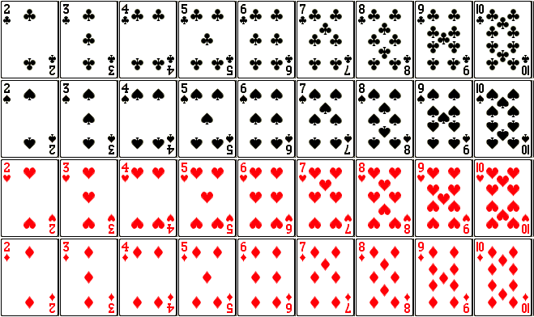
=
+
BIG DATA
Useless
Data
Useful
Data

Slide 10


DATANODE 1
Split 1
Mapper 1
Reducer 1
Reducer 2
NAMENODE
Split 2
Mapper 2
DATANODE 2

Slide 11
Problem / Motivation
37,946
REVIEWS !!
Buying on Amazon ? Confused ??
Let’s Look at the reviews

Slide 12
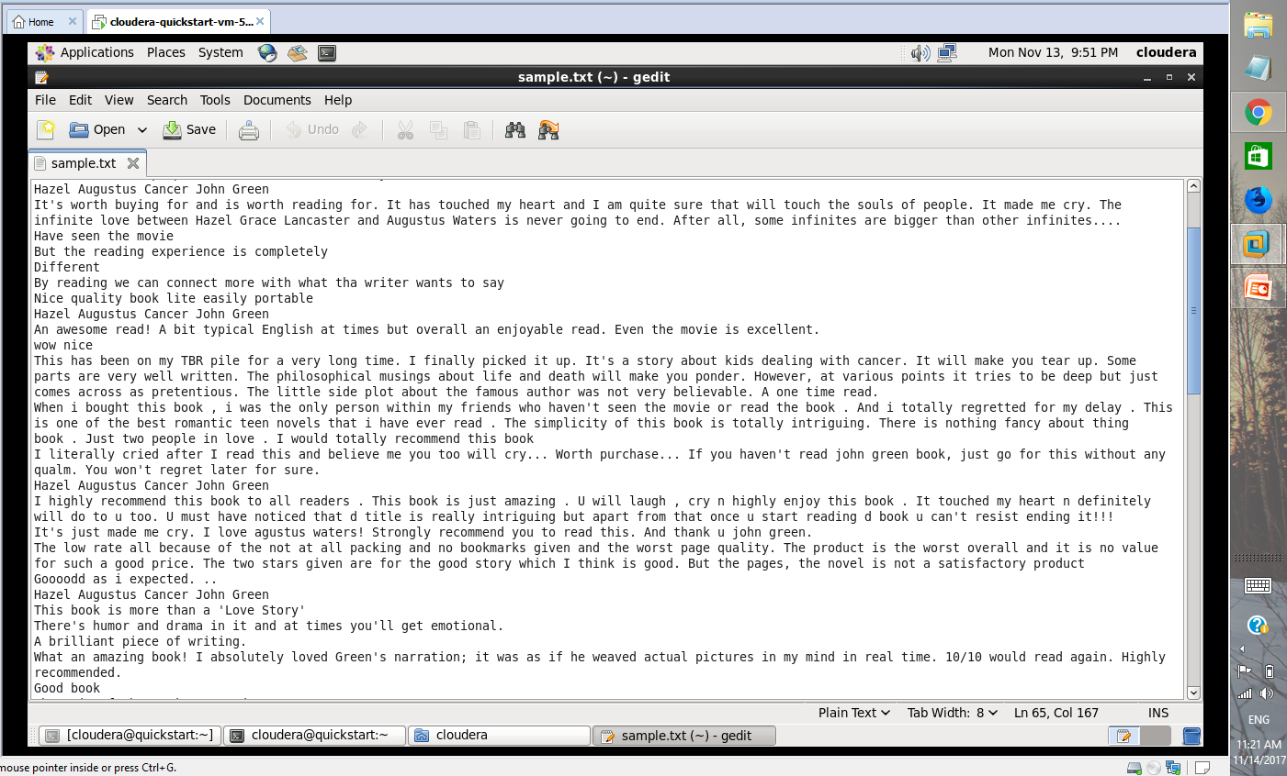
Sample.txt

Slide 13


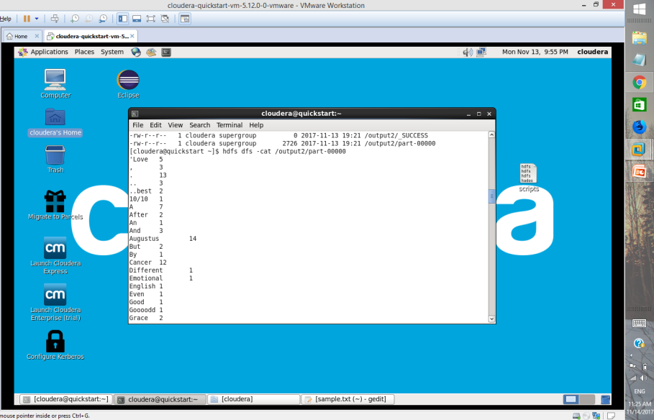
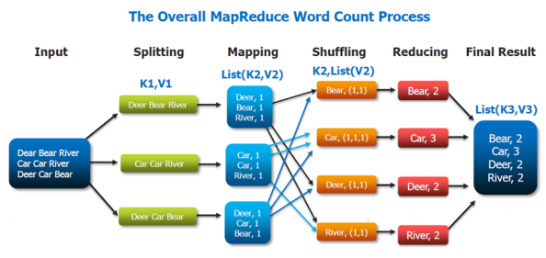

Slide 14

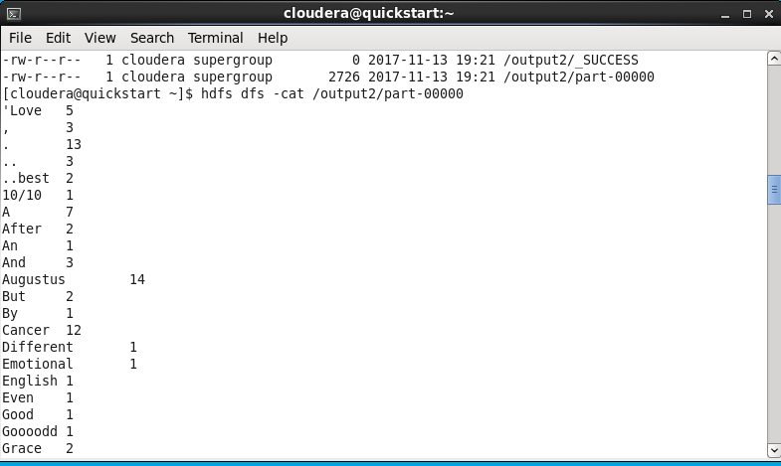

Slide 15
Problem / Motivation
PROBLEM SOLVED
MAP REDUCE
ALGORITHM
Buying on Amazon ? Confused ??
Let’s Look at the reviews
A John Green Novel which starres Augustus and Hazel with umpteen emotions and hence can make you cry

Slide 16
Conclusion
MapReduce provides a simple way to scale your application
Scales out to more machines, rather than scaling up
Effortlessly scale from a single machine to thousands
Fault tolerant & High performance
If you can fit your use case to its paradigm, scaling is handled by the framework

