Slide 1
SOCIAL NETWORK ANALYSIS
Dengue Disease Spread
Network Analysis
Bangladesh National-Level Temporal Epidemiological Network Study
Dataset: Dengue Incidents & Weather Data of Bangladesh (Kaggle)
Disease Spread · Epidemiological Network Analysis · Bangladesh · 2008 – 2019

Slide 2
PROJECT OVERVIEW
Objective
Key SNA Metrics Computed
Model the temporal spread of Dengue fever using national-level monthly climate and case data as a weighted, directed network graph.
Nodes Monthly time periods (134 months, Jan 2008 – Feb 2019)
Edges Temporal transmission links weighted by climate similarity × case burden
Dataset contains 134 national-level monthly records capturing monsoon-driven seasonality and year-over-year epidemic escalation.
Degree Centrality
Identifies highly connected time periods
Betweenness Centrality
Bridges between epidemic phases
Closeness Centrality
Speed of reaching other time periods
PageRank
Recursive outbreak influence score
Clustering Coefficient
Local transmission density
Community Detection
Greedy modularity seasonal clusters
Network Diameter & APL
Global spread distance metrics

Slide 3
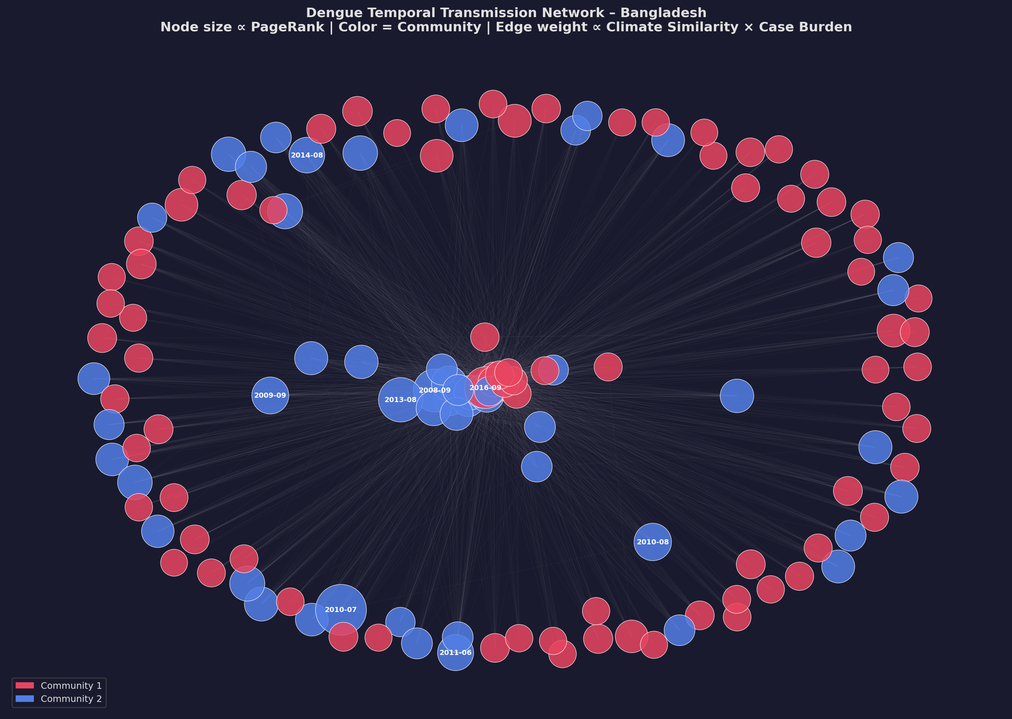
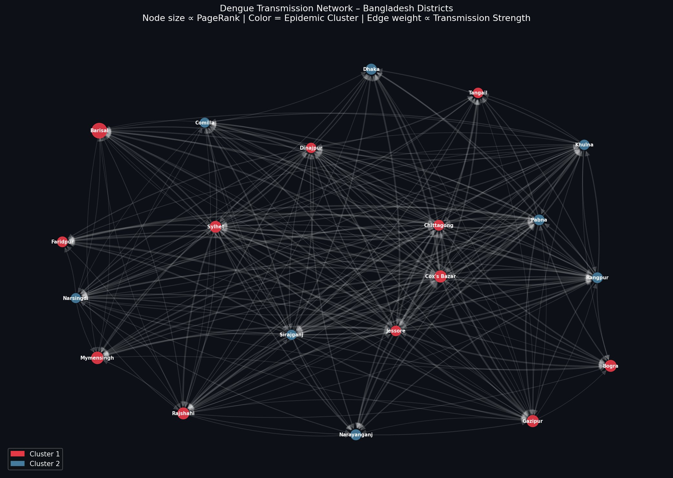
TRANSMISSION NETWORK GRAPH
2 Communities
Greedy modularity detected 2 seasonal communities (dry season vs monsoon).
Directed Graph
Edges weighted by climate similarity × case burden (source month).
Node Size
Proportional to PageRank — larger nodes are higher-influence outbreak periods.
Density
Moderate density (0.10) reflects climate-driven temporal connectivity.

Slide 4
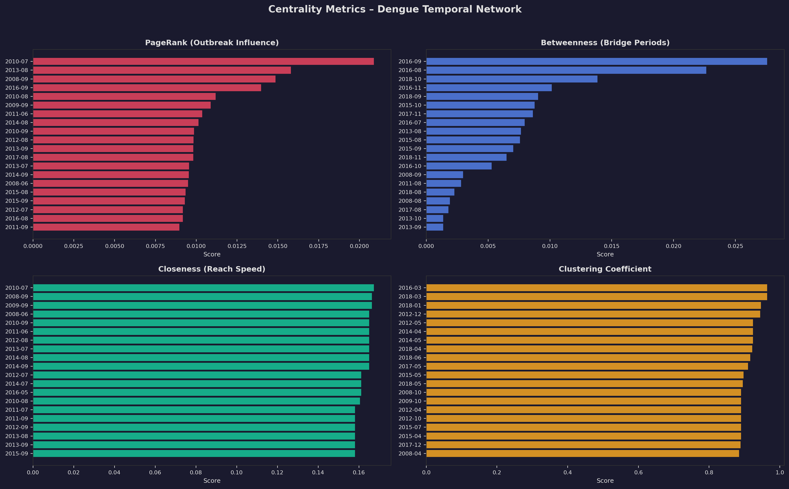
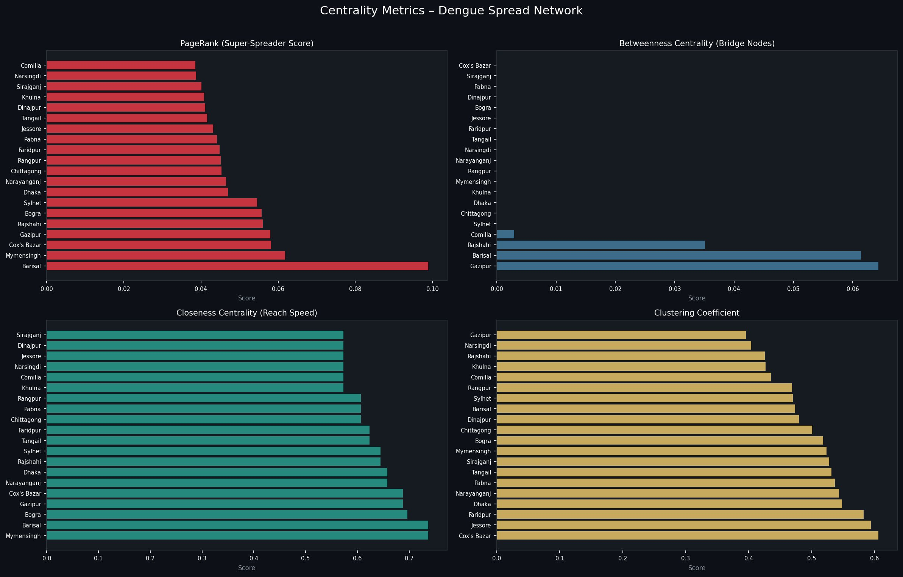
CENTRALITY METRICS ANALYSIS
Note: Charts show top 20 time periods ranked by each metric. All top PageRank periods fall within the monsoon season (Jun–Oct).

Slide 5
TOP OUTBREAK PERIODS – SNA METRICS SUMMARY
Period | Cases | PageRank | Betweenness | Closeness | Clustering
2010-07 | 61 | 0.0209 | 0.0000 | 0.1410 | 0.8833
2013-08 | 339 | 0.0158 | 0.0000 | 0.1582 | 0.4571
2008-09 | 334 | 0.0149 | 0.0030 | 0.1664 | 0.4670
2016-09 | 1544 | 0.0140 | 0.0276 | 0.1955 | 0.3333
2010-08 | 183 | 0.0112 | 0.0019 | 0.1568 | 0.4524
2009-09 | 188 | 0.0109 | 0.0000 | 0.1542 | 0.4286
2011-06 | 61 | 0.0104 | 0.0000 | 0.1542 | 0.4857
2014-08 | 80 | 0.0101 | 0.0000 | 0.1517 | 0.5263
2010-09 | 120 | 0.0099 | 0.0000 | 0.1542 | 0.4667
2012-08 | 122 | 0.0098 | 0.0000 | 0.1542 | 0.4524

Slide 6
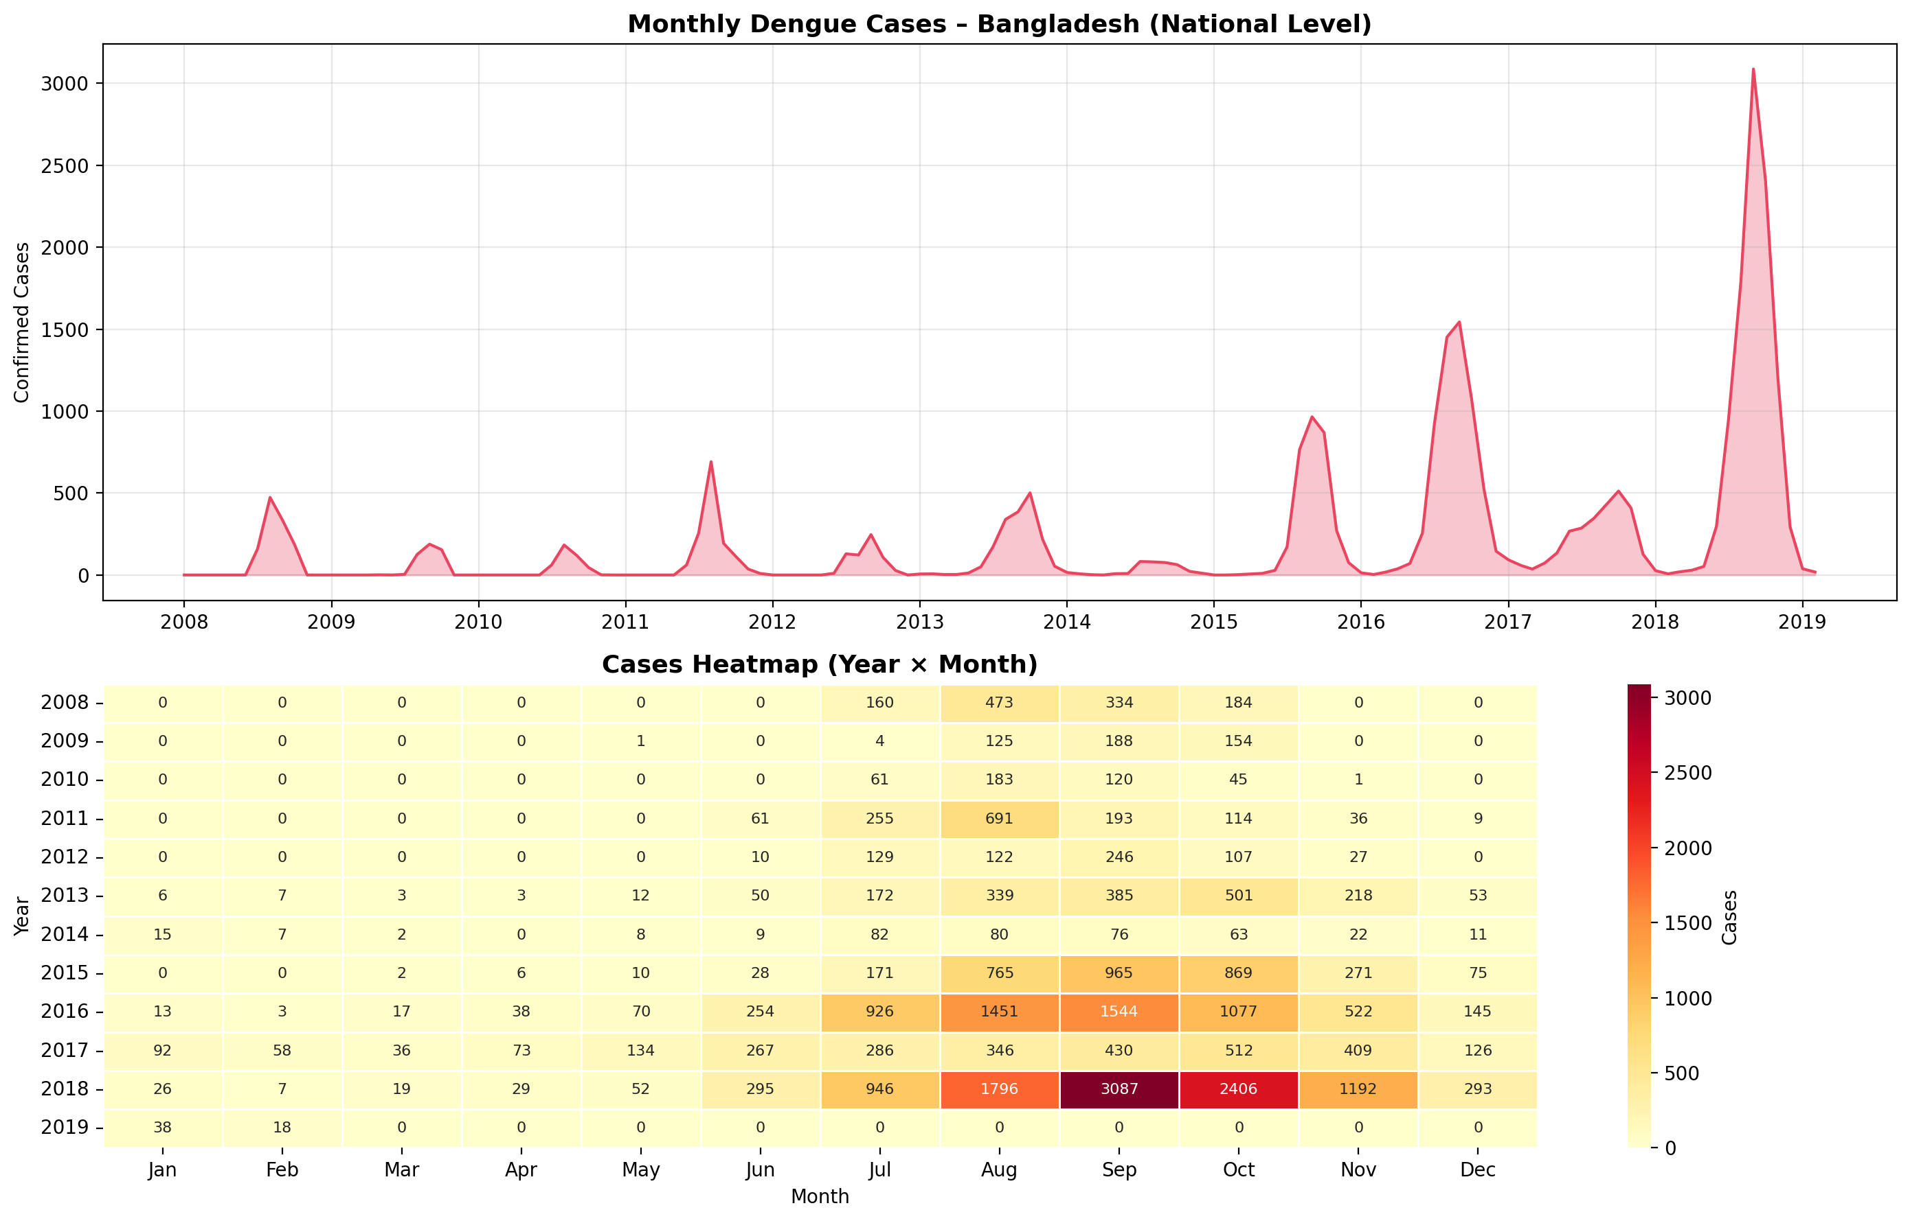
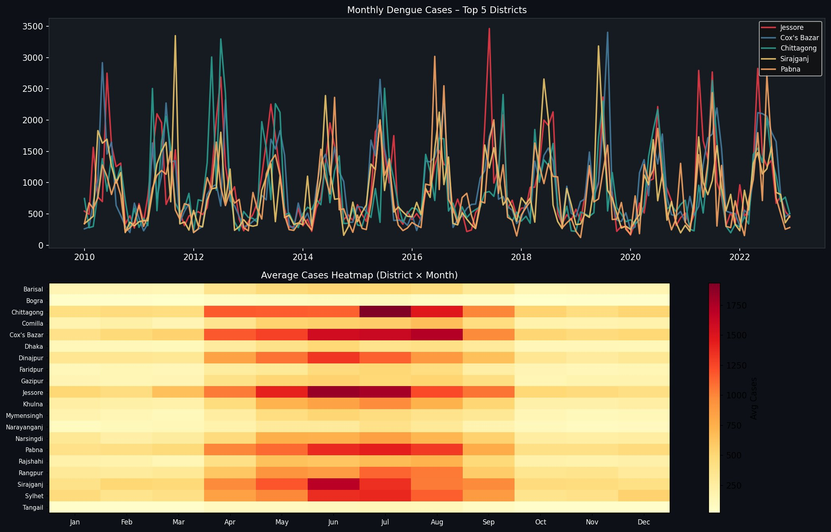
SEASONAL TRENDS & NATIONAL HEATMAP
Peak Season
July–October accounts for the majority of annual case burden nationally.
Off-Season
November–February shows consistently zero or near-zero cases, aligned with drier weather.
Peak Years
2016–2018 show dramatic escalation: Sep 2018 had the peak of 3,087 cases nationally.

Slide 7
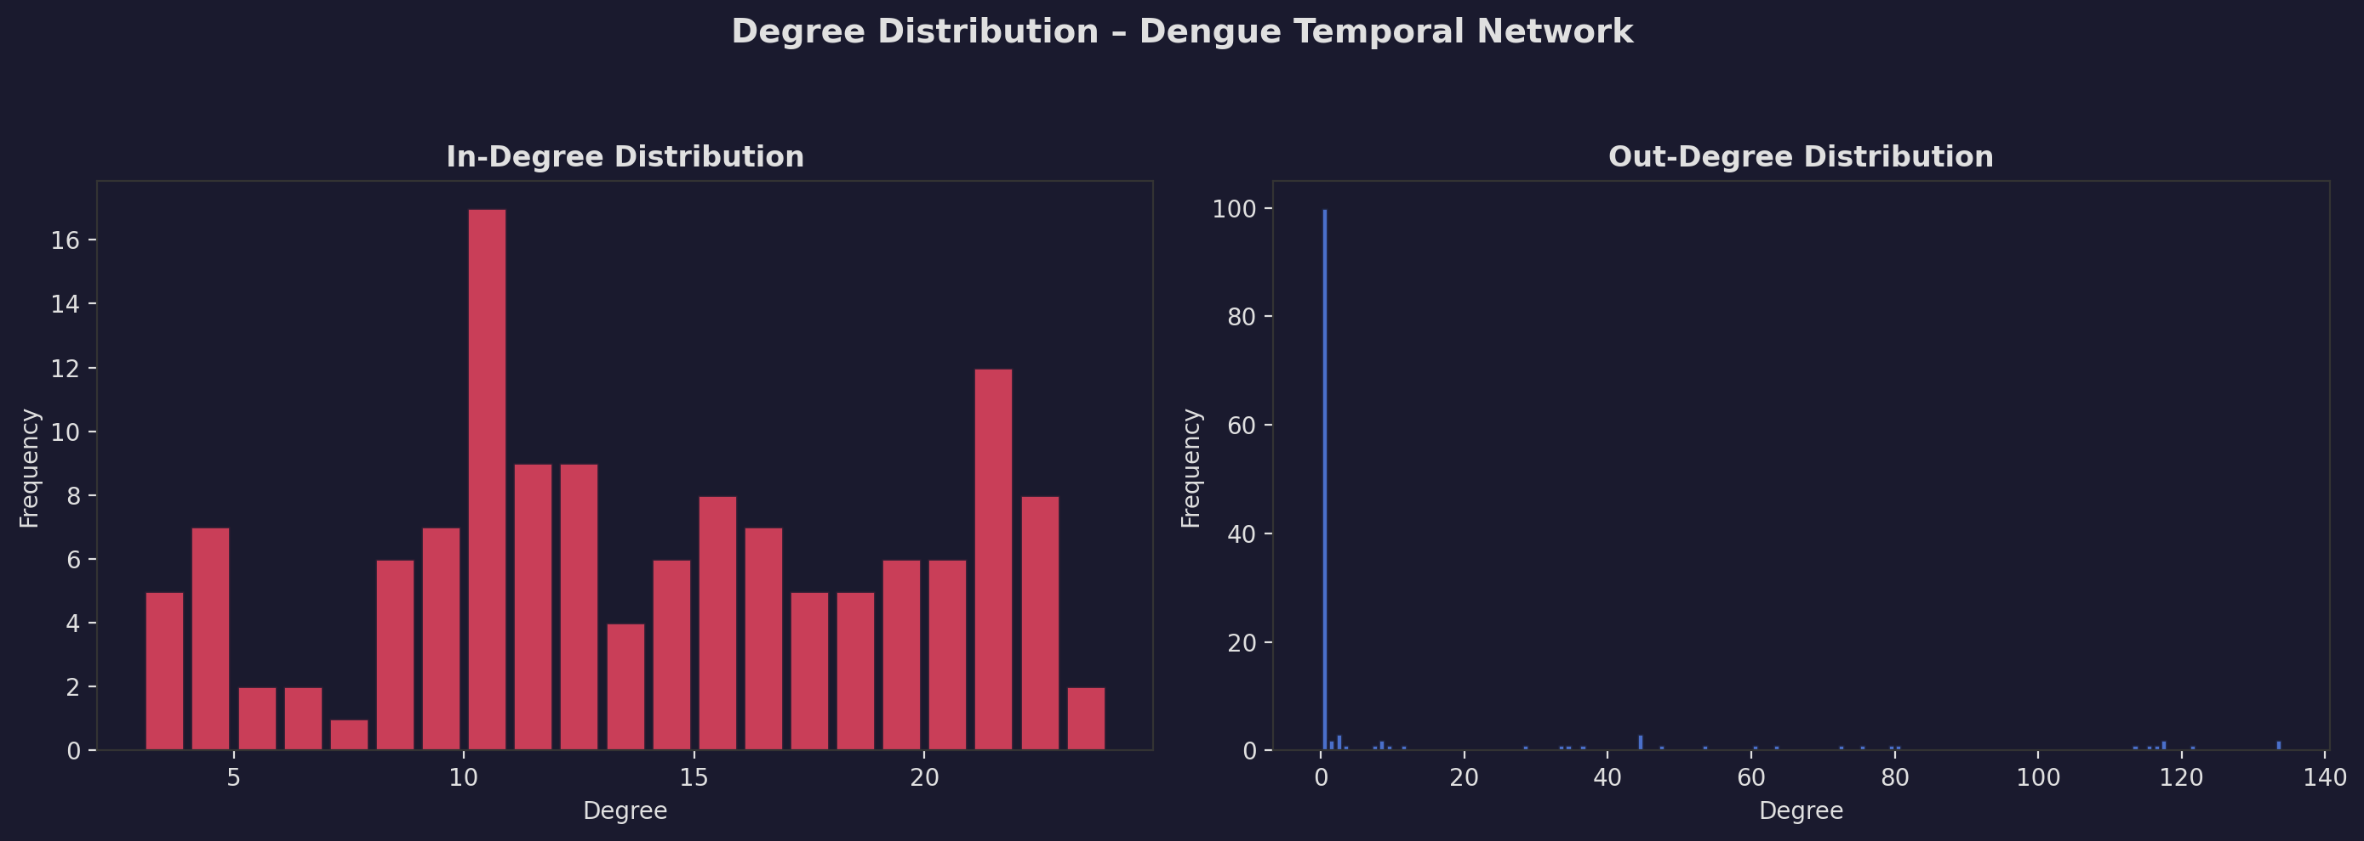
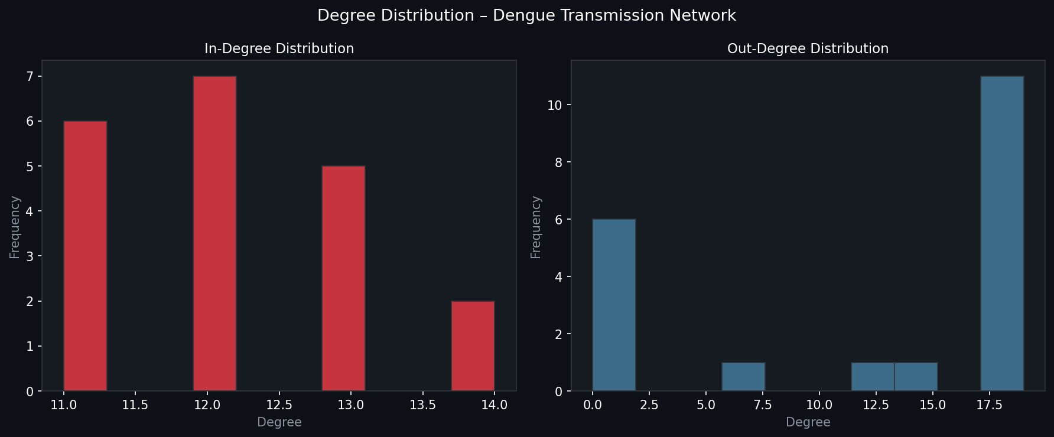
DEGREE DISTRIBUTION ANALYSIS
Interpretation
In-degree varies widely across periods: monsoon months receive transmission links from many outbreak periods, while dry-season months have lower in-degree.
Out-degree is highly skewed: months with zero cases have zero out-degree (sinks), while high-case months like Sep 2018 have high out-degree, confirming super-spreader behaviour.
The asymmetry between in and out-degree distributions is characteristic of temporal epidemic networks where case burden drives directionality.
High-out-degree periods (outbreak months) are the primary drivers of network connectivity.

Slide 8
COMMUNITY DETECTION & GLOBAL NETWORK STATISTICS
134
2
4
1.52
0.10
Monthly
Periods
Seasonal
Communities
Network
Diameter
Avg. Shortest
Path Length
Network
Density
Community Composition
Modularity & Connectivity
Community 1 (82 periods – Dry Season)
Modularity Score
Nov–Apr months across all years: low humidity, low rainfall,
minimal or zero dengue cases. Cooler climate profile.
0.0973 — moderate modularity indicates two distinct seasonal clusters with some cross-cluster edges during transitional months.
Strongly Connected Components
Community 2 (52 periods – Monsoon Season)
105 SCCs detected — most zero-case months are isolated sinks (no outgoing edges).
May–Oct months across all years: high temperature, rainfall,
and humidity. Contains all major outbreak periods.
Weakly Connected Components
Single WCC confirms all periods participate in one connected transmission network.

Slide 9
KEY FINDINGS
01
High-Risk Outbreak Periods Identified
02
Bridge Periods Are Structurally Critical
Jul 2010 (PageRank 0.021) and Aug 2013 (0.016) score highest as recursive influencers. All top-10 periods are monsoon months (Jun–Oct).
Sep 2016 (0.028) and Aug 2016 (0.023) record the highest betweenness — they act as conduits connecting different epidemic phases and are key transitional periods.
03
Pronounced Monsoon Seasonality
04
Escalating Severity Over Time
Peak transmission consistently occurs Jul–Oct, correlating with high rainfall and humidity. Off-season (Nov–Feb) has near-zero cases.
Cases escalated dramatically from 2015–2018, with Sep 2018 recording the dataset peak of 3,087 cases. The network captures this through increasing edge density in later years.

Slide 10
RECOMMENDATIONS
CONCLUSION
Monsoon Preparedness
This study demonstrates that Social Network Analysis applied to temporal climate-case data provides a powerful lens for understanding dengue transmission dynamics in Bangladesh. The directed weighted network revealed that outbreak risk is not uniform — a small subset of monsoon months drive disproportionate transmission. Community detection naturally separated the network into dry and monsoon seasons, confirming climate-driven epidemic structure. Future work should incorporate spatial and mobility data for a comprehensive spatio-temporal model.
Deploy enhanced monitoring and vector control before the June monsoon onset each year.
Bridge Period Intervention
Aug–Sep are the critical bridge periods; intensive intervention here disrupts epidemic momentum.
Year-over-Year Monitoring
The 2015–2018 escalation trend demands ongoing surveillance for early detection of worsening seasons.
Climate-Based Early Warning
High climate similarity between outbreak months enables predictive modelling based on temperature, rainfall, and humidity.
Expand Analysis
Integrate district-level spatial data and mobility data to build a spatio-temporal transmission network.
Dengue Disease Spread – Social Network Analysis · Bangladesh · 2008–2019

