Slide 1
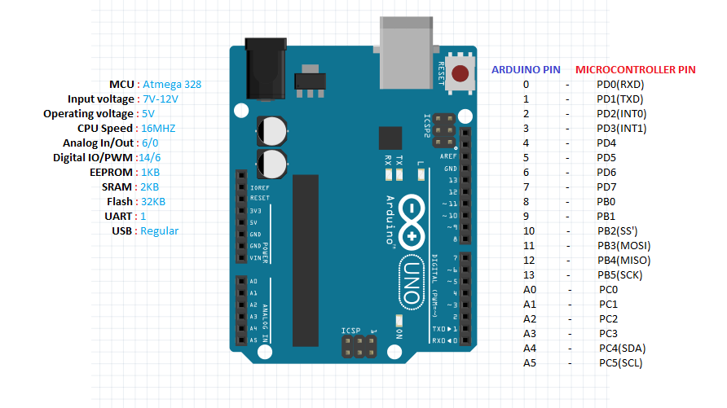
Interfacing of sensors with Aurdino
By Aditya Gupta

Slide 2
Format of Program
#header file declaration
Constant declaration
void setup()
{
// put your setup code here, to run once:
}
void loop()
{
// put your main code here, to run repeatedly:
}
Any other functions if there

Slide 3
Instructions
const int variable_name = integer_value; this will assign value of integer to variable_name
for ex: const int buzzer = 7; // ‘7’will be assign to variable name buzzer
pinMode(digital_pin_no, INPUT/OUTPUT); // set a pin for buzzer output
for example: pinMode(buzzer, INPUT); // set a pin for buzzer output
Serial.begin(Baud_rate); // initialize serial communication:
for example: Serial.begin(9600);
digitalWrite(digital_pin_no, LOW/HIGH);
for example: digitalWrite(buzzer, HIGH)
Serial.print(variable_name/”string”); // this will print the value or string in serial port (serial monitor)
For example: Serial.print(inches); Serial.print("in, ");
delay (int_value);
For example : delay (1000); // this will generate delay of 1000 miliseconds
Serial.println();
For example : Serial.println(sensorValue); //write the value of variable in serial monitor

Slide 4
variable = analogRead(Analog_Pin_no); // stotes reading from analog pin
For example :sensorValue = analogRead(sensorPin);
value = digitalRead(pin_no); // this will red the value of digital pin “1 or 0”pin
For Example sensor_value = digitalRead(7);
val = map(val,0,1024,1024,0);
it will sacle the value from (0-1024 to 1024-0)
pulseIn(echoPin, HIGH);
Reads a pulse (either HIGH or LOW) on a pin. For example, if value is HIGH, pulseIn() waits for the pin to go HIGH, starts timing, then waits for the pin to go LOW and stops timing. Returns the length of the pulse in microseconds or 0 if no complete pulse was received within the timeout.
Serial.println(analogValue, DEC); // print as an ASCII-encoded decimal
Prints data to the serial port as human-readable ASCII text followed by a carriage return character (ASCII 13, or '\r') and a newline character (ASCII 10, or '\n'). This command takes the same forms as Serial.print().
During XBee
Serial.read(); It will read the value/string from serial port
Serial.write();It will write the value/string from serial port
Writes binary data to the serial port. This data is sent as a byte or series of bytes; to send the characters representing the digits of a number use the print() function instead.

Slide 5
LED Blinking
//File->Examples->Basics->Blink
//no need to connect any pin just power on the device and burn the program
void setup()
{
// initialize digital pin 13 as an output.
pinMode(13, OUTPUT);
}
// the loop function runs over and over again forever
void loop() {
digitalWrite(13, HIGH); // turn the LED on (HIGH is the voltage level)
delay(1000); // wait for a second
digitalWrite(13, LOW); // turn the LED off by making the voltage LOW
delay(1000); // wait for a second
}

Slide 6
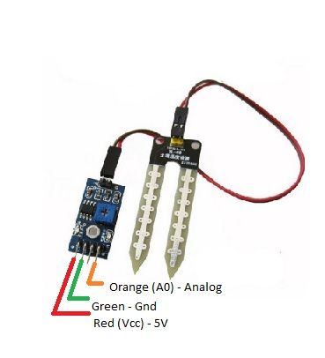
Moisture Sensor
Introduction: This sensor uses the two probes to pass current through the soil, and then it reads that resistance to get the moisture level. More water makes the soil conduct electricity more easily(less resistance), while dry soil conducts electricity poorly(more resistance).

Slide 7
Code
// connect vcc pin of sensor to vcc 5 volt of Aurdino (1st from left), gnd pin to //gnd of board (2nd from left) and right most pin of sensor (data) to A0(Analog //pin) as shown in figure
int sensorPin = 0; // select the input pin for the potentiometer
int sensorValue = 0; // variable to store the value coming from the sensor
void setup() {
// declare the ledPin as an OUTPUT:
Serial.begin(9600);
}
void loop() {
// read the value from the sensor:
sensorValue = analogRead(sensorPin);
//Sensor in water: value > 700
//Sensor in humid soil: 300 < value < 700
//Sensor in dry soil: 0 < value < 300
delay(1000);
Serial.print("sensor = " );
Serial.println(sensorValue);
}

Slide 8
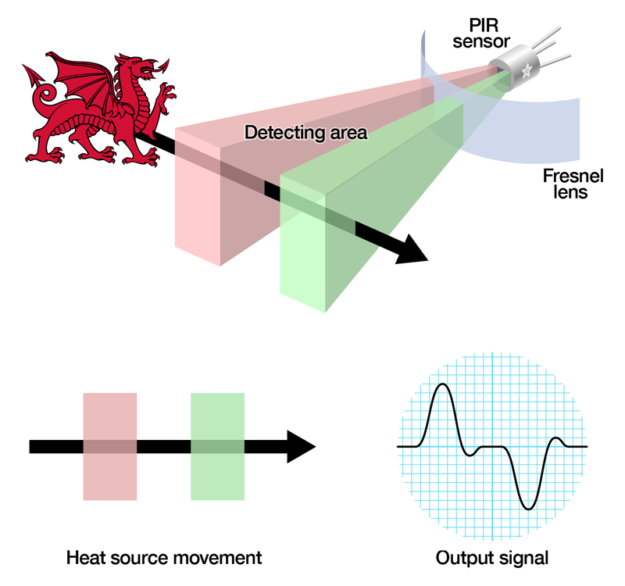
PIR sensor
Introduction: PIR sensors are more complicated than many of the other sensors because there are multiple variables that affect the sensors input and output. To begin explaining how a basic sensor works, we'll use this diagram.
The PIR sensor itself has two slots in it; each slot is made of a special material that is sensitive to IR. we see that the two slots can 'see' out past some distance (basically the sensitivity of the sensor). When the sensor is idle, both slots detect the same amount of IR, the ambient amount radiated from the room or walls or outdoors. When a warm body like a human or animal passes by, it first intercepts one half of the PIR sensor, which causes a positive differential change between the two halves. When the warm body leaves the sensing area, the reverse happens, whereby the sensor generates a negative differential change. These change pulses are what is detected.

Slide 9
Code
// connect vcc pin of sensor to vcc 5 volt of Aurdino, gnd pin to gnd of board and middle pin of sensor (data) to //D4(digital pin)
const int sensor_pin = 4;
int sensor_value = 0;
const int led = 13;
void setup()
{
pinMode(led, OUTPUT);
pinMode(sensor_pin, INPUT);
Serial.begin(9600);
delay(1000);
}
void loop() {
// Get sensor value if any motion observed then output changes
sensor_value = digitalRead(sensor_pin);
//digitalRead(sensor_pin);
// Print on serial
if (sensor_value==1)
{
digitalWrite(led, HIGH);
Serial.println("motion detected");
}
//Serial.println(sensor_pin);
delay(1000);
}

Slide 10
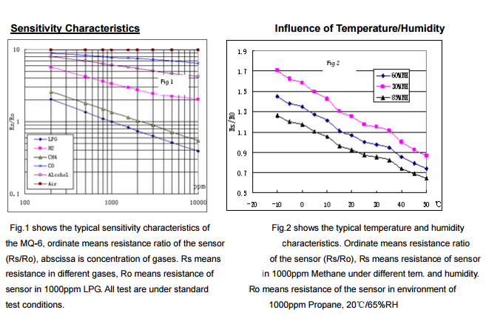
GAS Sensor (MQ-6)
Introduction: Sensitive material of MQ-6 gas sensor is SnO2, which with lower conductivity in clean air. When the target combustible gas exist, The sensor’s conductivity is more higher along with the gas concentration rising. Convert change of conductivity to correspond output signal of gas concentration.
Structure and configuration of MQ-6 gas sensor sensor composed by micro AL2O3 ceramic tube, Tin Dioxide (SnO2) sensitive layer, measuring electrode and heater are fixed into a crust made by plastic and stainless steel net. The heater provides necessary work conditions for work of sensitive components. The enveloped MQ-4 have 6 pin, 4 of them are used to fetch signals, and other 2 are used for providing heating current.

Slide 11
Code
int redLed = 8;
int greenLed = 9;
int buzzer = 10;
int smokeA0 = A5;
// Your threshold value
int sensorThres = 400;
void setup()
{
pinMode(redLed, OUTPUT);
pinMode(greenLed, OUTPUT);
pinMode(buzzer, OUTPUT);
pinMode(smokeA0, INPUT);
Serial.begin(9600);
}

Slide 12
void loop()
{
int analogSensor = analogRead(smokeA0);
Serial.print("Pin A0: ");
Serial.println(analogSensor);
// Checks if it has reached the threshold value
if (analogSensor > sensorThres)
{
digitalWrite(redLed, HIGH);
digitalWrite(greenLed, LOW);
tone(buzzer, 1000, 200);
}
else
{
digitalWrite(redLed, LOW);
digitalWrite(greenLed, HIGH);
noTone(buzzer);
}
delay(100);
}

Slide 13
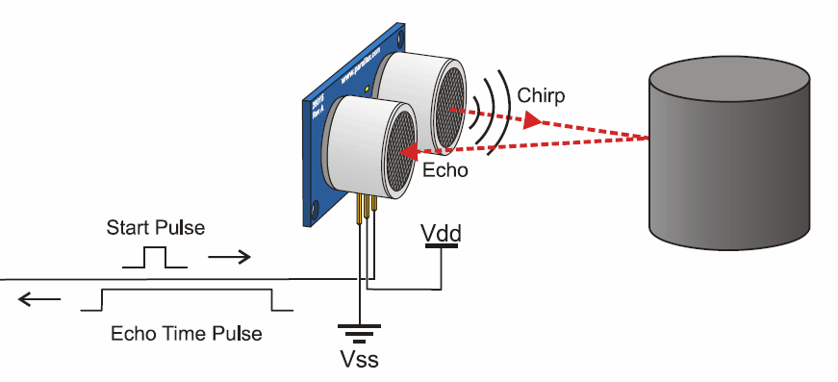
Ultrasonic sensor
Introduction: sensor and how humans, bats and dolphins estimate distance. They learn the echolocation process—sound waves transmitted, bounced back and received. The time difference used to calculate the distance of objects.

Slide 14
Code
// connect vcc pin of sensor to vcc 5 volt of Aurdino, gnd pin to gnd of board, Echo pin of sensor (data) to D6(digital //pin) and Trigger pin of sensor (data) to D5(digital pin)
const int buzzer = 7; // Sensor Input for buzzer
const int trigPin = 5;// Sensor Input for ultra sonic
const int echoPin = 6;// Sensor Input for ultra sonic
void setup()
{
pinMode(buzzer, INPUT); // set a pin for buzzer output
Serial.begin(9600); // initialize serial communication:
}
void loop()
{
long duration, inches, cm;
// The sensor is triggered by a HIGH pulse of 10 or more microseconds.
// Give a short LOW pulse beforehand to ensure a clean HIGH pulse:
pinMode(trigPin, OUTPUT);
digitalWrite(trigPin, LOW);
delayMicroseconds(2);
digitalWrite(trigPin, HIGH);
delayMicroseconds(10);
digitalWrite(trigPin, LOW);

Slide 15
Continue
// Read the signal from the sensor: a HIGH pulse whose duration is the time (in microseconds) from //the sending of the //ping to the reception of its echo off of an object.
pinMode(echoPin, INPUT);
duration = pulseIn(echoPin, HIGH);
inches = microsecondsToInches(duration); // convert the time into a distance
cm = microsecondsToCentimeters(duration);
delay(100);
if (cm<20)
{
long delayValue = 100000000;
digitalWrite(buzzer,HIGH); // write the buzzer pin high to push out the diaphram
delayMicroseconds(delayValue); // wait for the calculated delay value
}
Serial.print(inches);
Serial.print("in, ");
Serial.print(cm);
Serial.print("cm");
Serial.println();
digitalWrite(buzzer,LOW);
}
long microsecondsToInches(long microseconds)
{ return microseconds / 74 / 2;
}
long microsecondsToCentimeters(long microseconds)
{ return microseconds / 29 / 2;
}

Slide 16
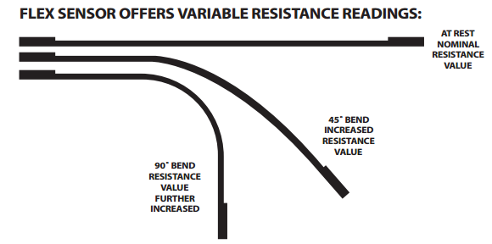
Flex Sensor
Introduction
The Flex Sensor patented technology is based on resistive carbon elements. As a variable printed resistor, the Flex Sensor achieves great form-factor on a thin flexible substrate. When the substrate is bent, the sensor produces a resistance output correlated to the bend radius—the smaller the radius, the higher the resistance value.

Slide 17
Code
// Note that the flex sensor pins are interchangeable. Sensor pin – GND (pin having single line)
// Sensor pin - Analog In 0(pin having resistance connected in single line), with 10K resistor to +5V
// (set the Serial Monitor to 9600 baud)
void setup()
{
Serial.begin(9600);
}
void loop()
{
int sensor, degrees;
// read the voltage from the voltage divider (sensor plus resistor)
sensor = analogRead(0);
// convert the voltage reading to inches
// the first two numbers are the sensor values for straight (768) and bent (853) the second two numbers are the //degree readings we'll map that to (0 to 90 degrees)
degrees = map(sensor, 768, 853, 0, 90);
// note that the above numbers are ideal, your sensor's values will vary to improve the accuracy, run the program, / //note your sensor's analog values when it's straight and bent, and insert those values into the above function.
// print out the result
Serial.print("analog input: ");
Serial.print(sensor,DEC);
Serial.print(" degrees: ");
Serial.println(degrees,DEC);
delay(100);
}

Slide 18
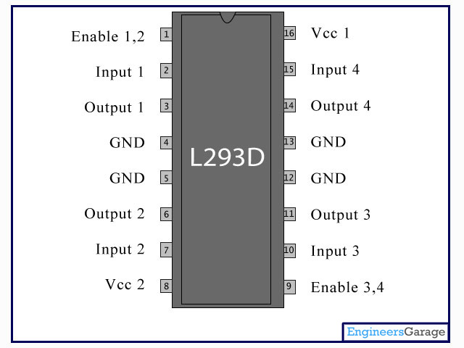
L239D
Time may come where you will be required to control a DC Motor microcontroller. The maximum current that can be sourced from a microcontroller is 15 mA (max) at 5v. It is not sufficient as a DC Motor need currents very much more than that with the voltages of 6v, 12v, 24v etc, depending upon the type of motor used. Among the various solution L239D is simple to implement.
The L293D is a monolithic integrated, high voltage, high current, 4-channel driver.” Basically this means using this chip you can use DC motors and power supplies of up to 36 Volts, that's some pretty big motors and the chip can supply a maximum current of 600mA per channel, the L293D chip is also what’s known as a type of H-Bridge. The H-Bridge is typically an electrical circuit that enables a voltage to be applied across a load in either direction to an output.
It works by having 4 elements in the circuit commonly known as corners: high side left, high side right, low side right, and low side left. By using combinations of these you are able to start, stop and reverse the current. The bit we really care about in all of this is the 2 input pins per motor.

Slide 19
Code
const int motv = 5;
const int motg = 6;
void setup() {
pinMode(motv, OUTPUT);
pinMode(motg, OUTPUT);
Serial.begin(9600);
}
void loop() {
//Rotate right
digitalWrite(motv, HIGH);
digitalWrite(motg, LOW);
delay(10000);
//Rotate left
digitalWrite(motv, LOW);
digitalWrite(motg, HIGH);
// tone(buzzer, 1000, 200);
delay(10000);
}

Slide 20
Accelerometer
Code
// connect vcc pin of sensor to vcc 5 volt of Aurdino, gnd pin to gnd of board and X,Y and Z pin of sensor (data) to //A0, //A1 and A2 (Analog pin)
int scale = 3;
boolean micro_is_5V = true;
void setup()
{Serial.begin(9600);}
void loop()
{
// Get raw accelerometer data for each axis
int rawX = analogRead(A0);
int rawY = analogRead(A1);
int rawZ = analogRead(A2);
float scaledX, scaledY, scaledZ; // Scaled values for each axis
if (micro_is_5V) // microcontroller runs off 5V
{
scaledX = map(rawX, 0, 675, -scale, scale); // 3.3/5 * 1023 =~ 675
scaledY = map(rawY, 0, 675, -scale, scale); // 3.3/5 * 1023 =~ 675
scaledZ = map(rawZ, 0, 675, -scale, scale); // 3.3/5 * 1023 =~ 675
}
else // microcontroller runs off 3.3V
{ scaledX = map(rawX, 0, 1023, -scale, scale);
scaledZ = map(rawY, 0, 1023, -scale, scale);
scaledZ = map(rawZ, 0, 1023, -scale, scale);
}
Serial.print("X: "); Serial.println(rawX); Serial.print("X: "); Serial.print(scaledX); Serial.println(" g");
delay(200);
Serial.print("Y: "); Serial.println(rawY); Serial.print("Y: "); Serial.print(scaledY); Serial.println(" g");
delay(200);
Serial.print("Z: "); Serial.println(rawZ); Serial.print("Z: "); Serial.print(scaledZ); Serial.println(" g");
delay(200);
}

Slide 21
XBee interfacing with Aurdino
// The XBee Shield makes all of the connections you'll need between Arduino and XBee. If you have the shield make
// sure the SWITCH IS IN THE "DLINE" POSITION. That will connect the XBee's DOUT and DIN pins to Arduino pins 2 and 3.
// We'll use SoftwareSerial to communicate with the XBee:
#include <SoftwareSerial.h>
// XBee's DOUT (TX) is connected to pin 2 (Arduino's Software RX)
// XBee's DIN (RX) is connected to pin 3 (Arduino's Software TX)
SoftwareSerial XBee(2, 3); // RX, TX
void setup()
{
// Set up both ports at 9600 baud. This value is most important
// for the XBee. Make sure the baud rate matches the config
// setting of your XBee.
XBee.begin(9600);
Serial.begin(9600);
}
void loop()
{
if (Serial.available())
{ // If data comes in from serial monitor, send it out to XBee
XBee.write(Serial.read());
}
if (XBee.available())
{ // If data comes in from XBee, send it out to serial monitor
Serial.write(XBee.read());
}
}

Slide 22
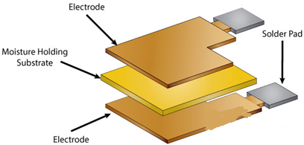
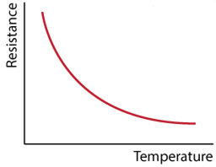
Temperature and Humidity sensor(Dht11)
Introduction
The DHT-11 is a digital-output relative humidity and temperature sensor. It uses a capacitive humidity sensor and a thermistor to measure the surrounding air. Compared to the DHT22, this sensor is less precise, less accurate and works in a smaller range of temperature and humidity, but its smaller and less expensive.
For measuring humidity they use the humidity sensing component which has two electrodes with moisture holding substrate between them. So as the humidity changes, the conductivity of the substrate changes or the resistance between these electrodes changes. This change in resistance is measured and processed by the IC which makes it ready to be read by a microcontroller.
On the other hand, for measuring temperature these sensors use a thermistor. A thermistor is actually a variable resistor that changes its resistance with change of the temperature. These sensors are made by sintering of semiconductive materials such as ceramics or polymers in order to provide larger changes in the resistance with just small changes in temperature. The term “NTC” means “Negative Temperature Coefficient”, which means that the resistance decreases with increase of the temperature.

Slide 23
CODE
// connect vcc pin of sensor to vcc 5 volt of Aurdino, gnd pin to gnd of board //and middle pin of sensor (data) to //D7(digital pin)
#include <dht.h>
dht DHT;
#define DHT11_PIN 7
void setup()
{
Serial.begin(9600);
}
void loop()
{
int chk = DHT.read11(DHT11_PIN);
Serial.print("Temperature = ");
Serial.println(DHT.temperature);
Serial.print("Humidity = ");
Serial.println(DHT.humidity);
delay(1000);
}

Slide 24
Thank
You

