Slide 1
Exploring Large Language Models for Grading Programming Assignments
A rubric-based, multi-approach comparison against human grades
MSc Computer Science (Intelligent Systems) — Dissertation
[Your name] · Supervisor: [name] · [date]
Notes:
Good [morning]. My dissertation asks a practical question: can large language models be trusted to grade student programming assignments — and if so, how should we set them up to do it? I'll take you through the motivation, the design, the implementation, the experiments on real and synthetic data, and the tool I built so a lecturer stays in control.

Slide 2
Motivation

Slide 3
Grading code by hand doesn’t scale
MOTIVATION
• Slow — hand-grading eats staff time as cohorts grow
• Subjective — two markers rarely agree on the same submission
• Doesn’t scale with class size
• Feedback shapes how students learn — quality matters, not just speed
• Pressure to automate — but it must be fair, not just fast
2
Notes:
Grading code by hand is slow, subjective, and doesn’t scale as class sizes grow. And the feedback students get shapes how they learn. So there’s pressure to automate — the question is whether automation can do it fairly, not just fast.

Slide 4
What today’s tools can — and can’t — do
MOTIVATION
• Unit-test autograders (dominant approach)
– Messer et al. 2024 review of 121 tools: ~⅔ grade correctness only
– No partial credit, no open-ended reasoning; feedback is just pass/fail
• LLM-as-a-judge (emerging)
– Zheng 2023, Gu 2025: >80% agreement with humans on open-ended tasks
– Reads code, reasons, writes feedback → a plausible grader, not just a test runner
3
Notes:
A 2024 review of 121 tools found two-thirds only check correctness, almost always with unit tests — which can’t grade partial credit, reasoning, or open-ended work. In parallel, LLM-as-a-judge shows >80% agreement with humans on open-ended tasks, making an LLM a plausible grader, not just a test runner.

Slide 5
Can we trust it? The gap → six research questions
MOTIVATION
• EU AI Act: automated grading is “high-risk” — human oversight mandated
• Students distrust opaque autograders
• Gap: prior work tests ONE variable at a time (one style / type / model / run)
• Aim: systematically explore reliable LLM grading → 6 RQs:
– RQ1 classifier vs free · RQ2 whole vs point · RQ3 robustness
– RQ4 bias · RQ5 feedback quality · RQ6 failure modes
4
Notes:
Trust is the catch. The EU AI Act calls automated grading high-risk and mandates human oversight, and students distrust opaque autograders. The research gap: prior work tests one variable at a time. My aim is to explore reliable LLM grading systematically, broken into six research questions.

Slide 6
Design

Slide 7
Two datasets: real + synthetic
DESIGN
• Real — University of Hamburg “Algorithmen und Datenstrukturen” (AD2022)
– Anonymised student code, 3 winter terms, Java + Python (~1,526 solutions)
– Ecological validity — real, messy student code
• Synthetic — authored by me
– 21 asymptotic-analysis questions (real corpus is implementation-only)
– Crafted correct / semi-correct / wrong solution variants
• Real proves it works in the wild; synthetic gives controlled coverage
6
Notes:
Two complementary datasets. Real: the University of Hamburg Algorithms and Data Structures corpus — anonymised submissions over three winter terms, Java and Python. Synthetic, authored by me: 21 asymptotic-analysis questions (the real corpus is implementation-only), plus crafted correct/semi/wrong solution variants for controlled coverage. Real proves it works in the wild; synthetic controls exactly what I measure.

Slide 8
Example question types
DESIGN
Implementation · 19_20-1-1-java
Asymptotic analysis · asym-1-java
"Implement a function that calculates the LCM of two given values." (may not use import)
"Calculate the asymptotic worst-case running time of f, as a function of N. Refer to line numbers."
int gcd(int a, int b) {
if (a < b) {
int tmp = a; a = b; b = tmp;
}
int r = a % b;
if (r == 0) return b;
return gcd(r, b);
}
int lcm(int a, int b) {
return (a * b) / gcd(a, b);
}
static int f(int[] a) {
int n = a.length;
int s = 0;
for (int i = 0; i < n; i++) {
for (int j = 0; j <= i; j++) {
s += a[j] * a[i];
}
}
int t = g(a);
return s + t;
}
7
Notes:
Two example questions: on the left, an implementation task from the real Hamburg corpus — compute the LCM using a GCD helper. On the right, one of my authored asymptotic-analysis questions — the student must derive the tight time-complexity bound and justify it by line number. Same rubric machinery grades both, even though one is 'does the code work' and the other is 'is the reasoning about the code correct'.

Slide 9
Rubric design
DESIGN
• Question-specific rubrics (beat generic ones — Pathak et al. 2025)
• ~6 points per rubric; point marks sum to 100
• Exactly 3 buckets per point: Correct / Semi / Wrong, each with criteria
• Same rubric drives BOTH free-marking and classification — a fair comparison
8
Notes:
Grading is only as good as the rubric. I use question-specific rubrics — Pathak et al. show these beat generic ones. Each has ~6 points; every point has exactly three buckets — Correct, Semi, Wrong — with criteria, and marks sum to 100. Same rubric drives both free-marking and classification, so the comparison is fair.

Slide 10
Rubric example — one point, three buckets
DESIGN
Point 1 · “gcd function present and structurally correct” — 15 marks (19_20-1-1)
Wrong — 0 marks | Semi — 8 marks | Correct — 15 marks
No gcd function defined and no gcd-like logic present anywhere in the submission. | A gcd function is defined but has a broken signature or structure (e.g. missing return, wrong parameter count, no identifiable loop/recursion body). | A gcd function with the correct signature (two parameters, returns a value) and a recognisable recursive or iterative structure is present.
Every rubric point uses this same 3-bucket structure — the same criteria drive both free-marking and classification.
9
Notes:
One concrete rubric point, in full: whether the student's gcd function is present and structurally correct, worth 15 marks. Wrong means no gcd logic at all; Semi means a gcd function exists but its signature or structure is broken; Correct means a properly-shaped gcd function is present — its actual correctness is checked by later points. Every point in every rubric follows this same three-bucket pattern.

Slide 11
The four grading approaches (2×2)
DESIGN
• Two axes: rubric granularity × scoring mode. Approaches 3 & 4 (classification) are the novel contribution.
 | Whole rubric | Point-by-point
Free marks | Approach 1 | Approach 2
Classify → bucket | Approach 3 | Approach 4
Every approach runs 3× per (question, student, model); median = final score.
10
Notes:
This 2×2 is the heart of the design. Two decisions: granularity (whole rubric vs one point at a time) and scoring mode (free marks vs classify into a fixed bucket). Approaches 3 and 4 — grading as classification — is the novel part no prior work tests.

Slide 12
Ground truth, repeated runs & metrics
DESIGN
• Human ground truth (per-point buckets) = the yardstick for everything
• Every case run 3× → median (self-consistency, Wang et al. 2023)
• Metrics: MAE, Spearman ρ, Cohen’s κ, run std-dev, format-OK %, time
• Leniency = signed bias — catches hidden strictness/generosity correlation misses
11
Notes:
I graded a reference set by hand, bucket by bucket — the yardstick for everything. Because LLMs are stochastic, every case runs three times and I take the median. Metrics: MAE and Spearman for accuracy and ranking, Cohen’s kappa for buckets, run std-dev for stability, format-OK, time — and leniency, the signed bias correlation is blind to.

Slide 13
Implementation

Slide 14
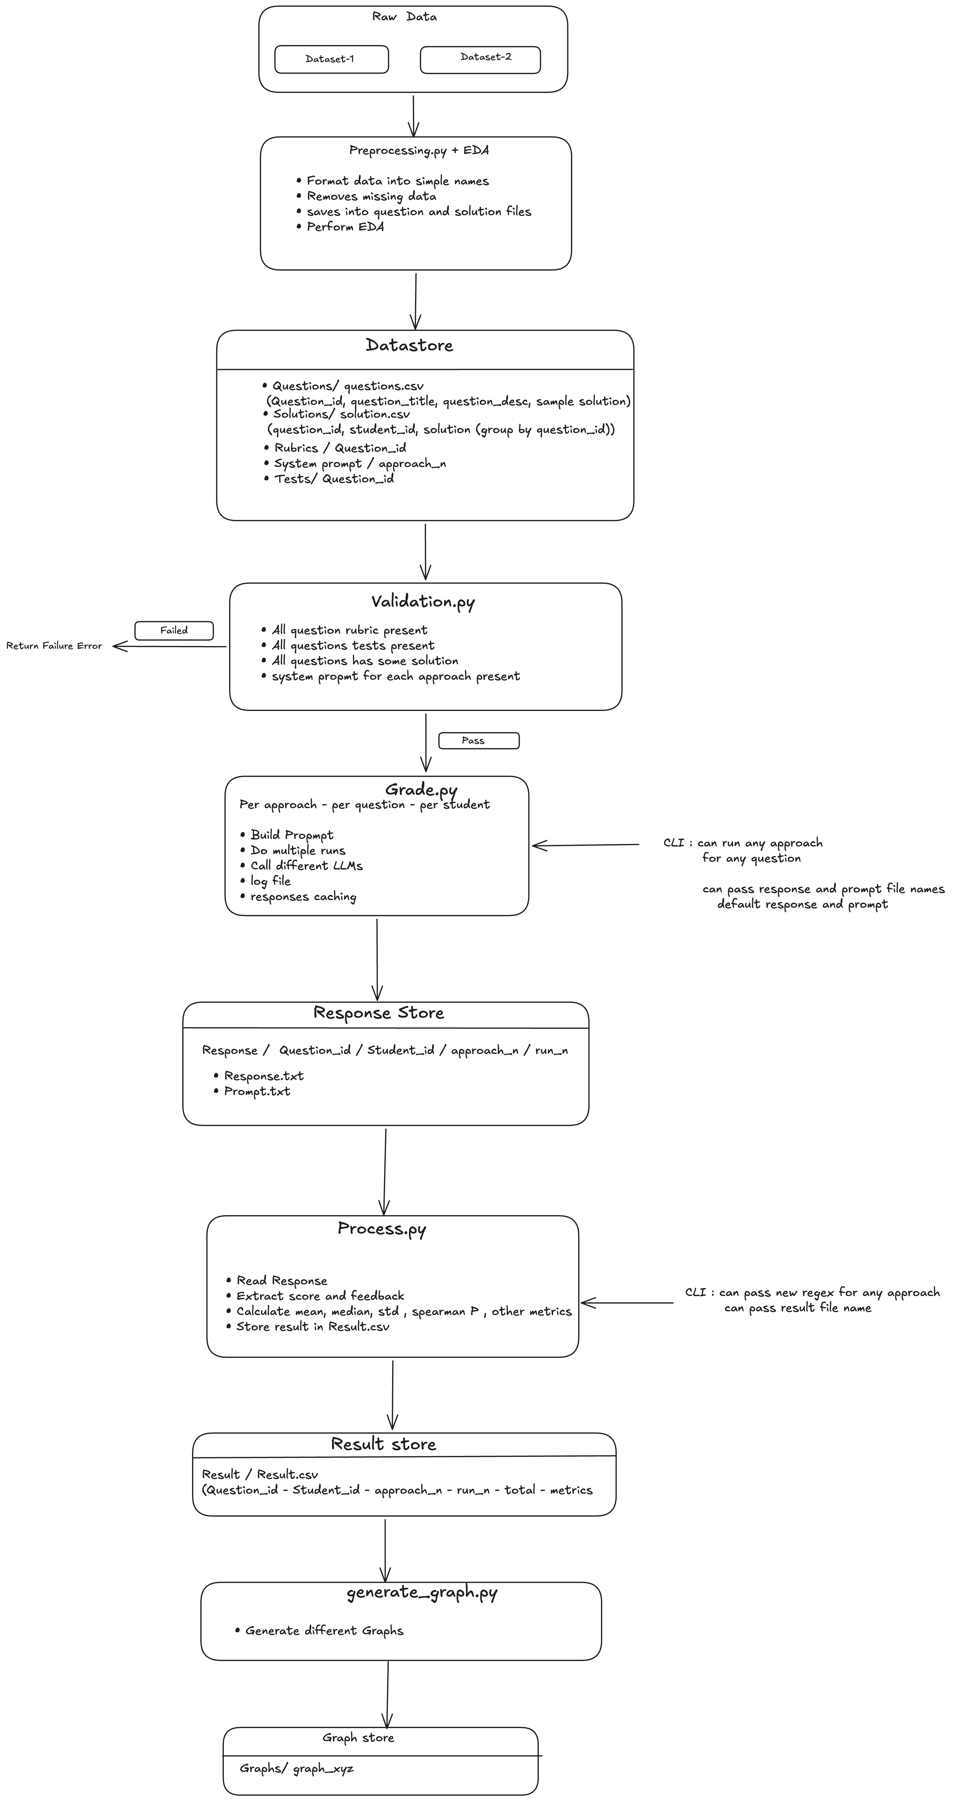
Pipeline architecture
IMPLEMENTATION
13
Notes:
A six-stage pipeline: preprocessing cleans the raw dataset into a datastore; validation checks it; the grade stage builds prompts and calls the models; processing parses responses into scores; metrics computes everything; and the last stage generates the plots. One orchestrator runs it end-to-end, and every stage is skippable so long runs resume.

Slide 15
Prompting & multi-backend grading
IMPLEMENTATION
• Prompt = question + sample solution + student code + rubric (whole or one point)
• System prompt pins output to a strict, parseable format (POINT_ID / MARKS|BUCKET / FEEDBACK / TOTAL)
• Three backends, one code path:
– Ollama (local) · NVIDIA NIM (cloud) · generic OpenAI-compatible (Gemini, …)
• Swap any model without touching the grading logic
14
Notes:
Each prompt gives the question, a reference solution, the student’s code, and the rubric — whole or single point — plus a system prompt that pins output to a strict parseable format. The same code talks to Ollama, NVIDIA NIM, and any OpenAI-compatible provider, so I can swap models without touching the grading logic.

Slide 16
Prompt design — the four approaches
IMPLEMENTATION
Same header every time (question + sample + student code). Rows = scoring mode · Columns = rubric granularity — only the instruction + output format change.
Approach 1 · Whole rubric + Free marks
Approach 2 · Point-by-point + Free marks
Given: whole RUBRIC (all points + ranges)
Assign a numeric mark per point.
POINT_ID: <id>
MARKS: <number>
FEEDBACK: <1-2 sentences>
... one block per point ...
TOTAL: <sum of all MARKS>
Given: ONE point [one call per point]
Assign a numeric mark for THIS point.
MARKS: <number>
FEEDBACK: <1-2 sentences>
Approach 3 · Whole rubric + Classify
Approach 4 · Point-by-point + Classify
Given: whole RUBRIC (all points + buckets)
Choose ONE bucket label per point.
POINT_ID: <id>
BUCKET: <exact bucket label>
FEEDBACK: <1-2 sentences>
... one block per point ...
Given: ONE point [one call per point]
Choose ONE bucket label for THIS point.
BUCKET: <exact bucket label>
FEEDBACK: <1-2 sentences>
15
Notes:
All four prompts share the same header — question, sample solution, student code — and differ only in two axes. Left column (1 & 3) sends the whole rubric in one call; right column (2 & 4) sends one point per call. Top row (1 & 2) asks for a free numeric mark; bottom row (3 & 4) asks the model to classify into a bucket label. Only Approach 1 prints a TOTAL — and even then the pipeline ignores it and re-sums the per-point marks itself. This is the 2×2 design made visible in the prompts.

Slide 17
Engineering realities
IMPLEMENTATION
• Robust response parser + a format-OK flag on every response
• Retries on timeout/empty; completed runs skipped → long runs restartable
• Fixed a real bug: a reasoning model exhausted its token budget “thinking”
– returned empty → disabled thinking-mode for that model
• These details are why the results are trustworthy, not noisy
16
Notes:
Getting local models to reliably produce parseable output was real work: the parser flags format compliance, calls retry, completed cases are skipped so runs restart. One model kept burning its token budget ‘thinking’ and returned nothing — I disabled thinking-mode for it.

Slide 18
Experiments

Slide 19
Two-phase experimental design
EXPERIMENTS
• Phase 1 — Model selection (controlled, synthetic set)
– 10 questions × correct/semi/wrong × 5 models × 4 approaches × 3 runs = 1,800 gradings
• Phase 2 — RQ study with the chosen models vs human grades
• First earn trust in a model, then use it to study how to grade
18
Notes:
Two phases. First a controlled model-selection study on the synthetic set — 1,800 gradings — to earn the right to trust a model. Then the RQ study with the chosen models. First pick a trustworthy grader, then study how to grade.

Slide 20
Phase 1 — Model selection
EXPERIMENTS
• Choose the best local + cloud model from 5 candidates
• Judged on MAE, stability, format compliance, leniency, and speed
• Chosen: Qwen3:14b (local) + gpt-oss-120b (cloud)
• Next: full comparison table, then MAE / stability / format-failure graphs
19
Notes:
Before the research questions I chose which models to trust, comparing five candidates on error, stability, format compliance, leniency and speed. The small models broke format; I picked Qwen3-14b locally and gpt-oss-120b in the cloud, prioritising accuracy and calibration. [→ read the deciding numbers from these graphs live.]

Slide 21
Model comparison — 5 candidates
EXPERIMENTS · MODEL SELECTION
Model | MAE ↓ | ρ ↑ | κ ↑ | Leniency →0 | Max dev ↓ | Format ↑ | Time(s) ↓
devstral-small-2 | 6.65 | 0.942 | 0.684 | −2.78 | 2.28 | 100.0% | 23.9
Qwen3:14b | 6.19 | 0.936 | 0.735 | +0.78 | 5.71 | 98.6% | 62.9
gemma4:26b | 8.89 | 0.857* | 0.698* | −1.14 | 8.65 | 90.6% | 106.3
nemotron-3-super-120b-a12b | 10.45 | 0.830 | 0.761 | −7.00 | 7.58 | 88.9% | 119.1
gpt-oss-120b | 7.27 | 0.942 | 0.728 | +0.78 | 7.79 | 94.2% | 17.8
• Highlighted rows = chosen models · greyed row = gemma4:26b, dropped
* gemma4’s ρ/κ computed on a pooled basis for this comparison, not identical methodology to the other four rows.
20
Notes:
Full picture across all five candidates. Devstral is the most stable and has zero format failures, but is stricter and less accurate. Nemotron has the best bucket agreement but is the strictest, slowest, and least format-compliant. Gemma4:26b — the largest model tried at 26B parameters — actually underperforms the 14B Qwen: worse accuracy, the worst run-to-run stability, and roughly 9% format failures on long prompts, which is why it was dropped despite its size. Qwen3-14b and gpt-oss-120b win on the combination of accuracy and calibration, which is why they're the two models carried into the RQ study.

Slide 22
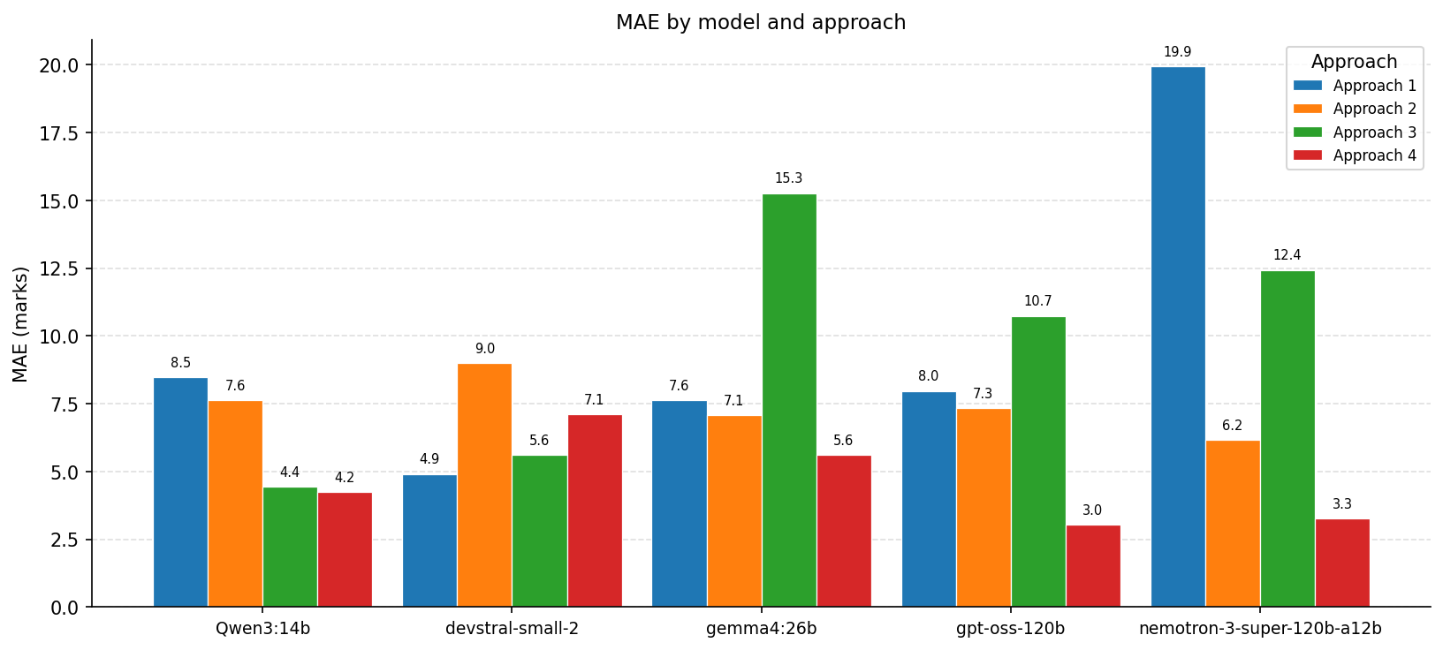
MAE by approach — 5 candidate models
EXPERIMENTS · MODEL SELECTION
21
Notes:
Mean absolute error from human grades, per approach, for all five candidate models. [→ point out which models are most accurate.]

Slide 23
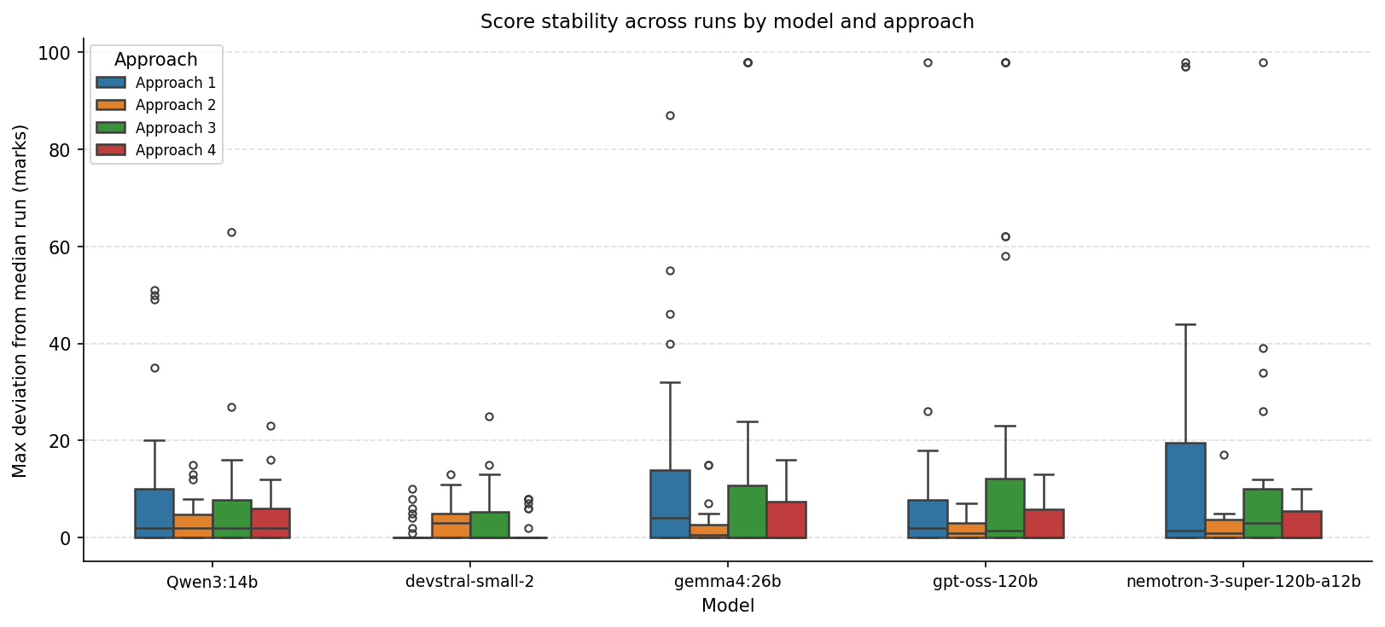
Stability by model
EXPERIMENTS · MODEL SELECTION
22
Notes:
How much each model’s score moves across the three runs. [→ note the most and least stable models.]

Slide 24
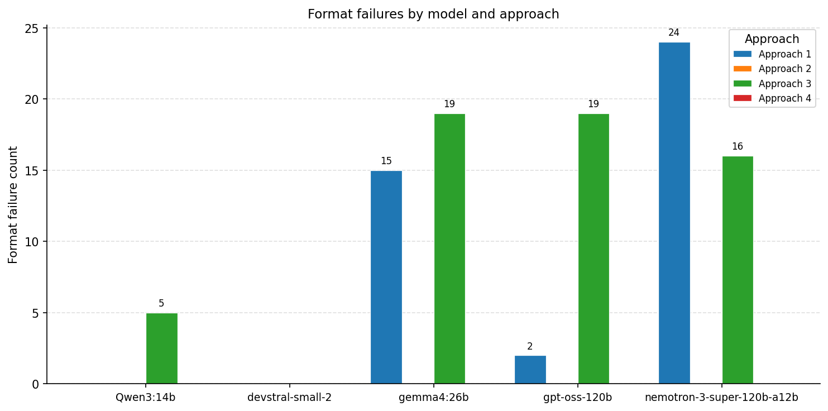
Format-failure count
EXPERIMENTS · MODEL SELECTION
23
Notes:
How often each model broke the required output format. [→ note which small/large models failed and why they were dropped.]

Slide 25
RQ1 — Classifier vs free-marker
EXPERIMENTS · RQ1
• Question: classify each rubric point into a bucket, or let the LLM freely assign marks?
• Check: run-to-run consistency; agreement with human; does free-marking score lower?
• Novel — no prior work tests LLM-as-classifier for grading
24
Notes:
RQ1: should the model classify into buckets or freely assign marks? I look at run-to-run consistency and agreement with human grades. The classifier only picks among three buckets, so we’d expect less drift. This is the novel comparison. [→ state the finding from the graphs.]

Slide 26
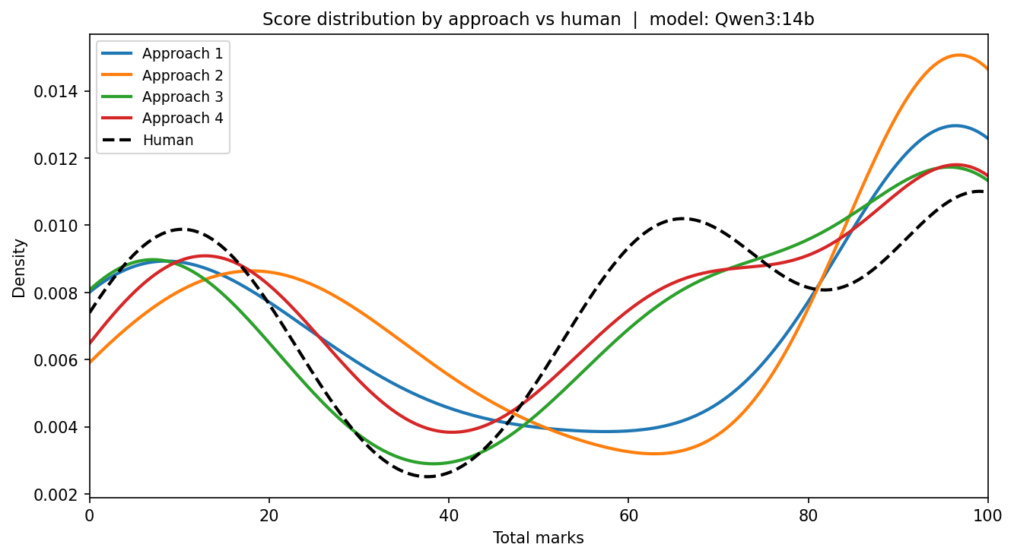
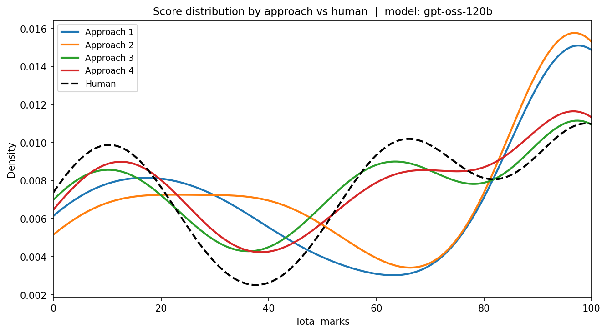
RQ1 · Score distribution vs human
EXPERIMENTS · RQ1
Qwen3:14b · local
gpt-oss-120b · cloud
25
Notes:
Distribution of LLM totals against human totals, per model. [→ which sits closer to human, and any shift.]

Slide 27
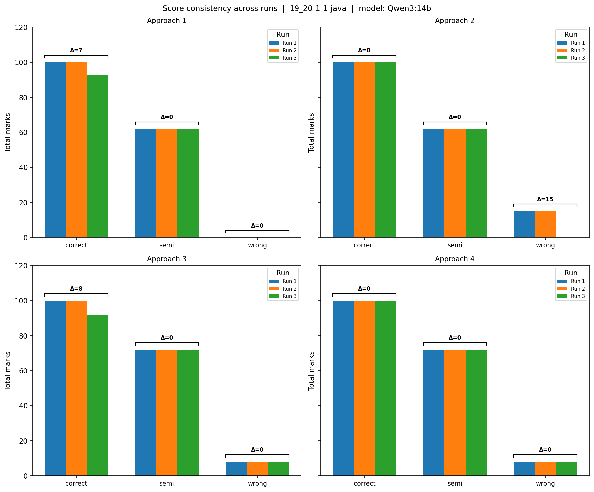
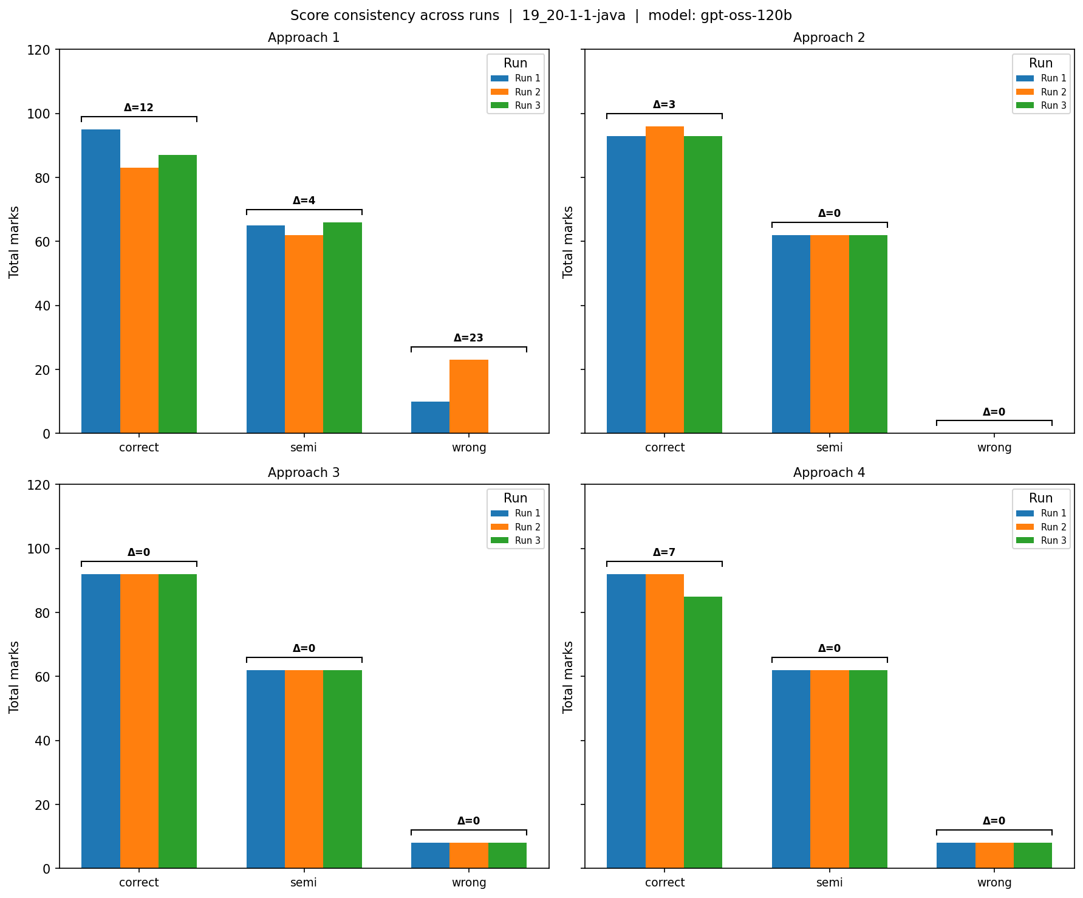
RQ1 · Run consistency (implementation)
EXPERIMENTS · RQ1
Qwen3:14b · local
gpt-oss-120b · cloud
26
Notes:
Score spread across the three runs on an implementation question, per model. [→ classifier vs free-marker stability.]

Slide 28
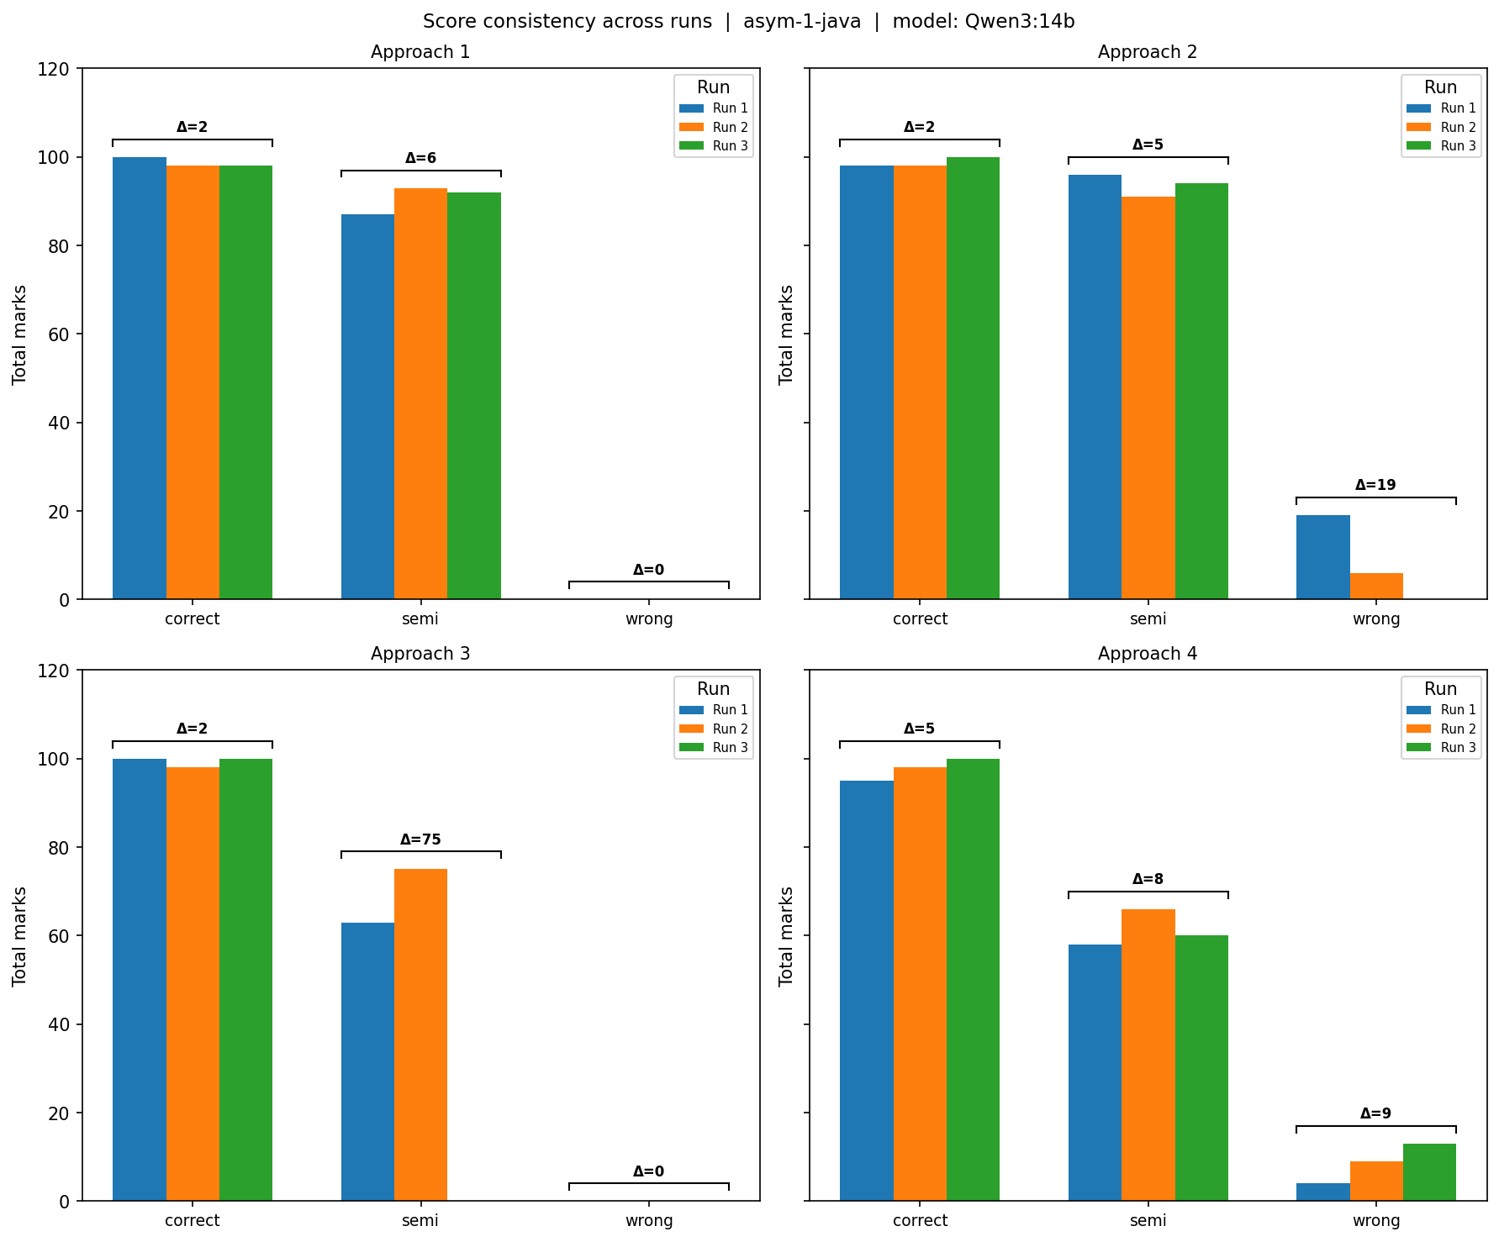
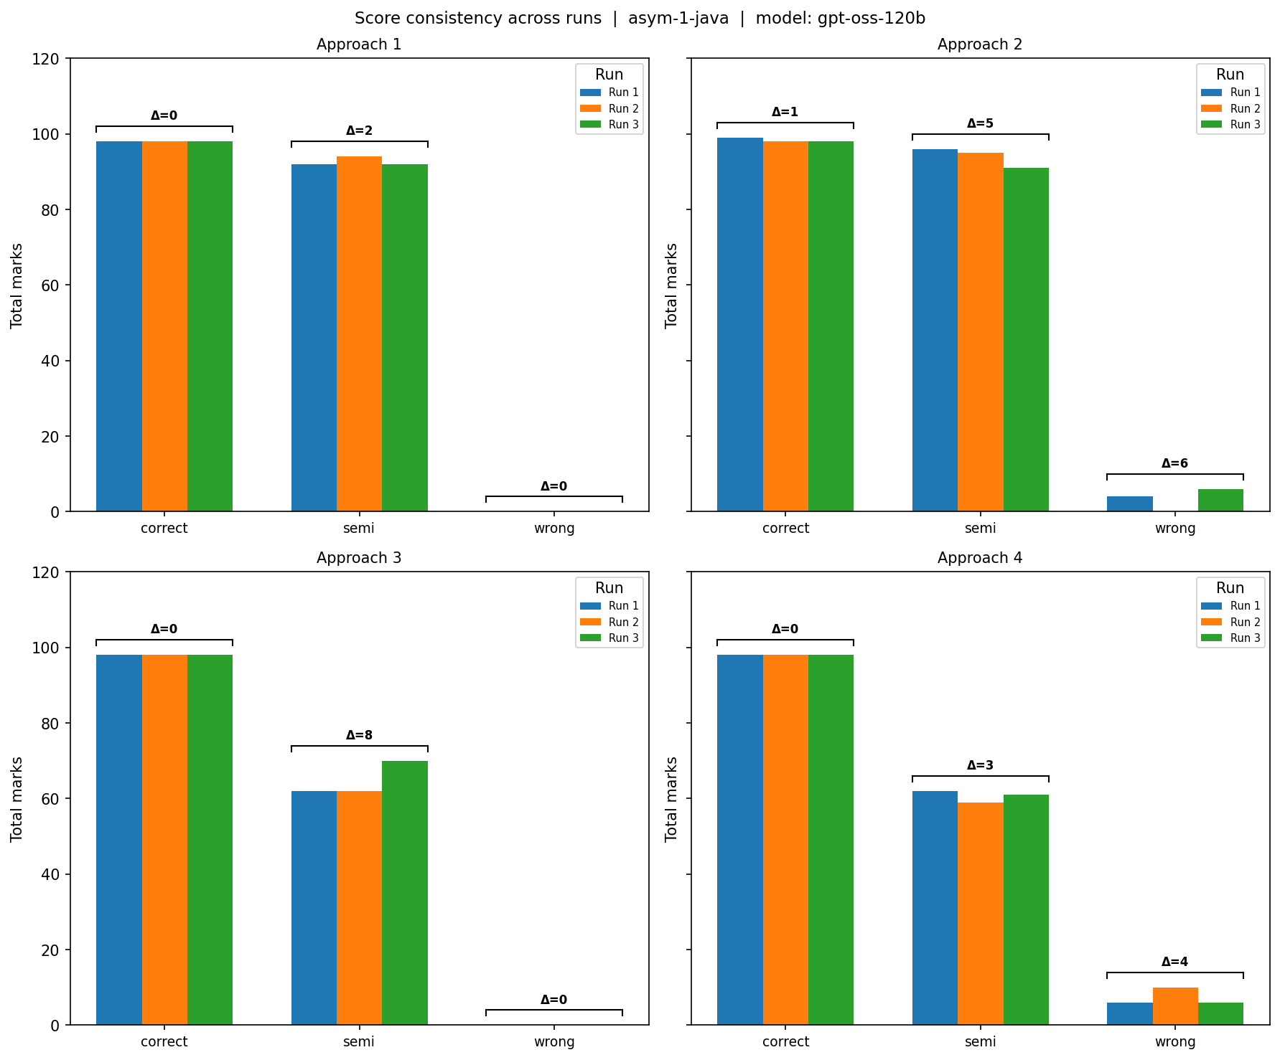
RQ1 · Run consistency (asymptotic)
EXPERIMENTS · RQ1
Qwen3:14b · local
gpt-oss-120b · cloud
27
Notes:
Score spread across runs on an asymptotic-analysis question, per model.

Slide 29
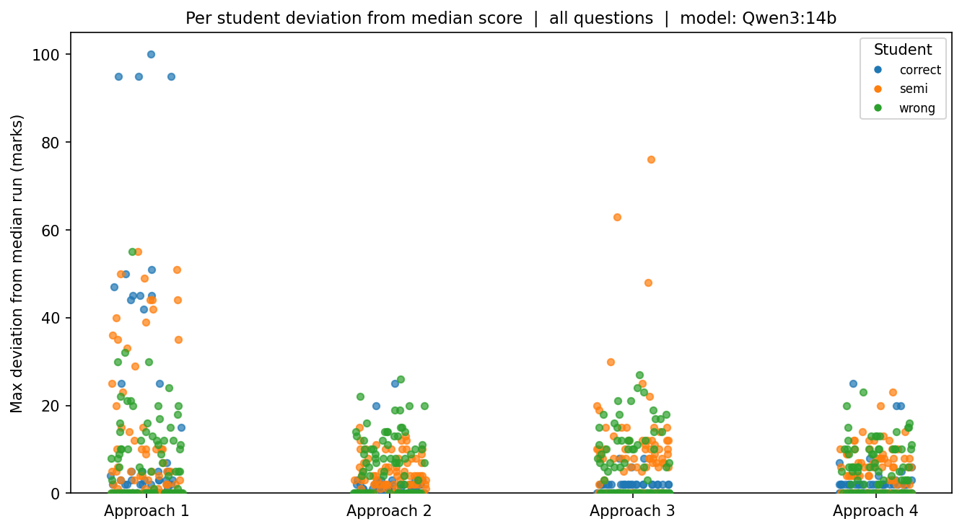
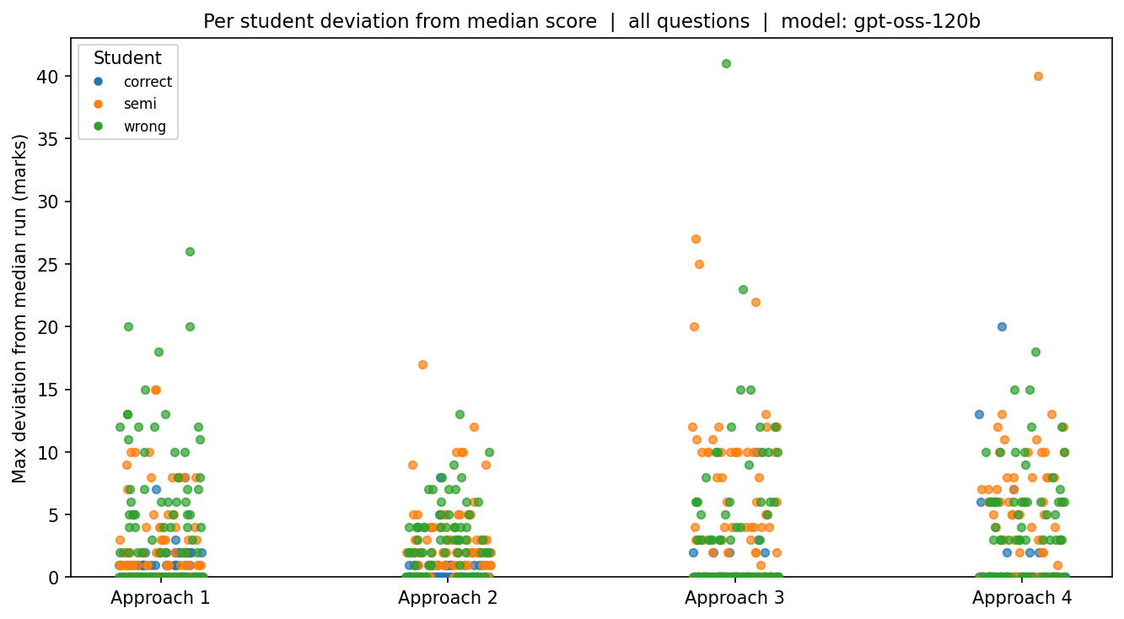
RQ1 · Median deviation across runs
EXPERIMENTS · RQ1
Qwen3:14b · local
gpt-oss-120b · cloud
28
Notes:
How far run scores deviate from the median across all questions, per model.

Slide 30
RQ2 — Whole rubric vs point-by-point
EXPERIMENTS · RQ2
• Question: pass the whole rubric at once, or one point per call?
• Check: which aligns better with human; time & cost (one call per rubric point)
• Pathak et al. 2025: point-wise tends to score lower
29
Notes:
RQ2: whole rubric in one call, or one point at a time? I compare accuracy by approach and time. Point-by-point makes one call per rubric point, so it’s inherently costlier. [→ state whether it buys better agreement and whether it grades lower.]

Slide 31
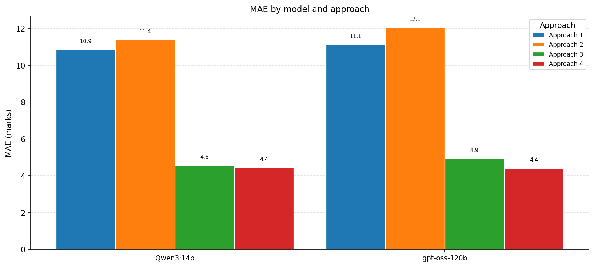
RQ2 · MAE by approach (both models)
EXPERIMENTS · RQ2
30
Notes:
Error from human grades per approach, for Qwen and gpt-oss. [→ which approach aligns best.]

Slide 32
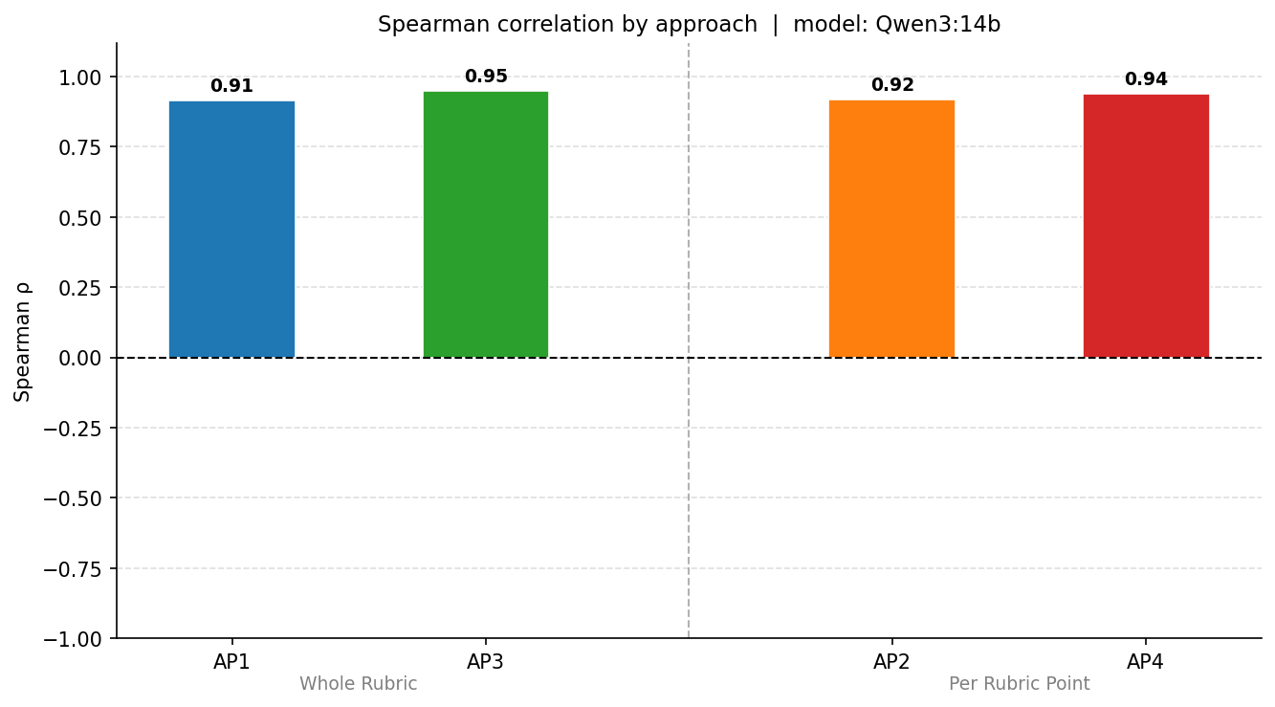
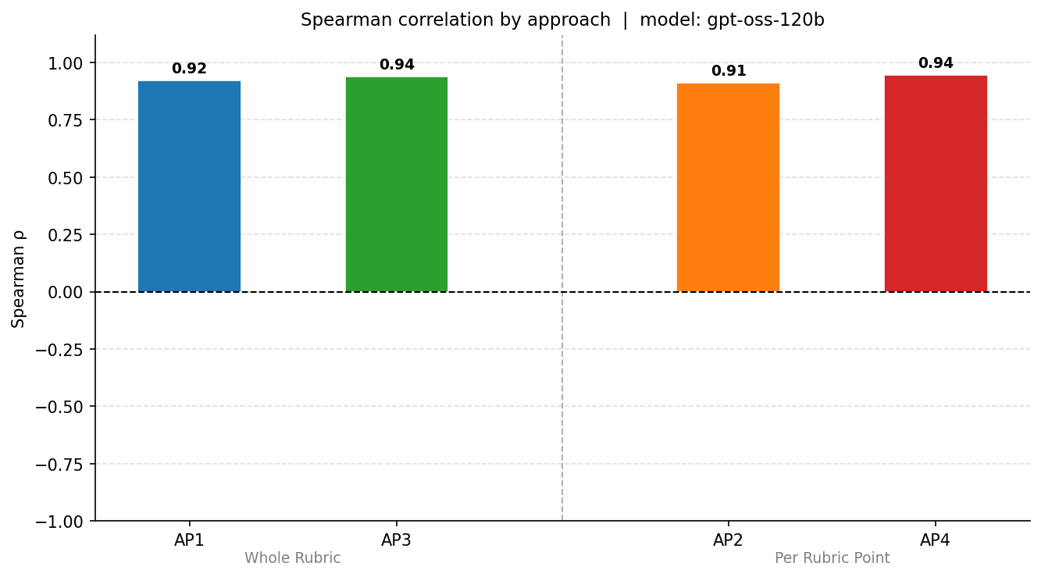
RQ2 · Spearman ρ by approach
EXPERIMENTS · RQ2
Qwen3:14b · local
gpt-oss-120b · cloud
31
Notes:
Rank correlation with human grades per approach, per model.

Slide 33
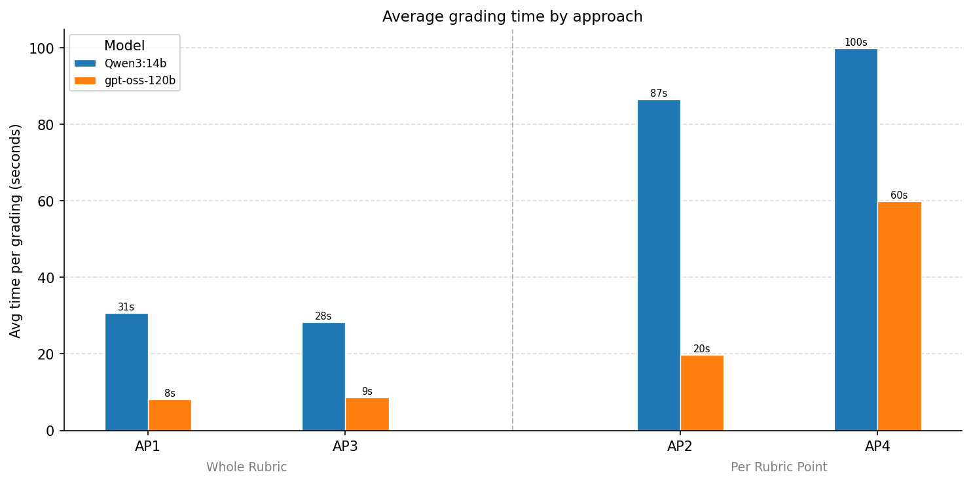
RQ2 · Time by approach (both models)
EXPERIMENTS · RQ2
32
Notes:
Wall-clock time per approach. Point-by-point costs one call per rubric point. [→ quantify the accuracy-vs-compute trade-off.]

Slide 34
RQ3 — Robustness / stability
EXPERIMENTS · RQ3
• Question: how stable are marks across repeated runs? Does it depend on model & approach?
• Check: score variation across 3 runs; classification vs free; format-failure rate
• Schroeder 2025: a grader can be accurate yet unreliable
33
Notes:
RQ3: how stable are marks across runs, and does it depend on model and approach? A grader can be accurate yet unreliable — giving different marks on identical input. [→ note which model and approach are most stable, and format-failure rates.]

Slide 35
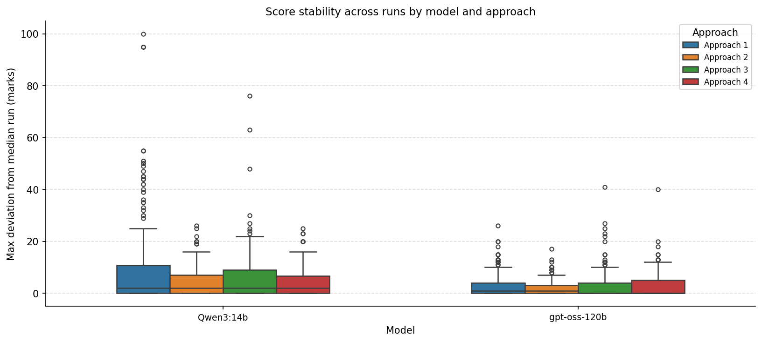
RQ3 · Stability by model (both models)
EXPERIMENTS · RQ3
34
Notes:
Score movement across the three runs, per model. [→ most/least stable.]

Slide 36
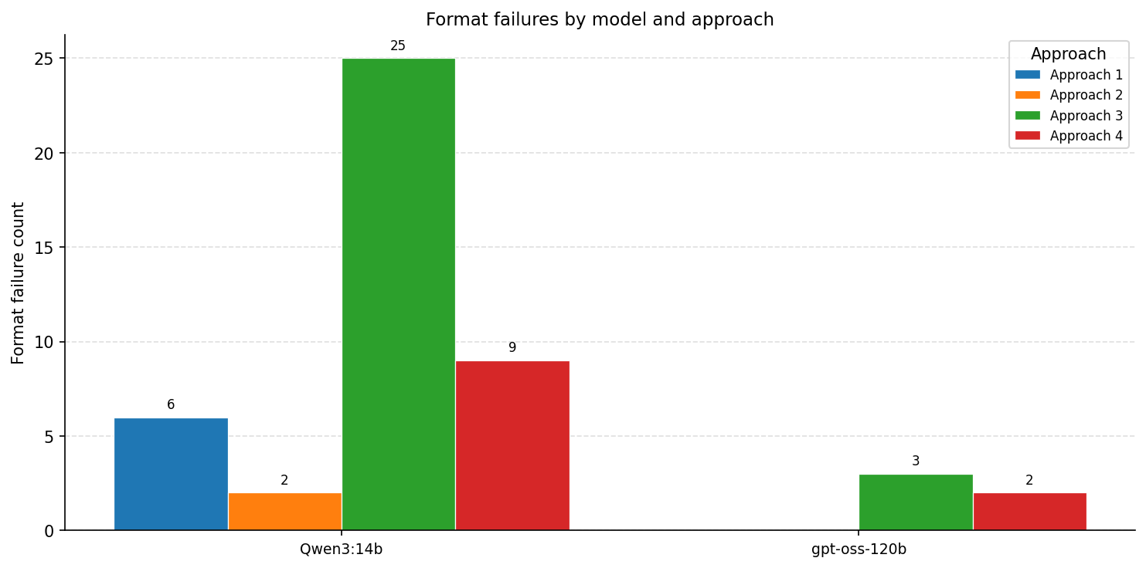
RQ3 · Format failures (both models)
EXPERIMENTS · RQ3
35
Notes:
How often each model broke the output format. [→ compare the two production models.]

Slide 37
RQ4 — Bias
EXPERIMENTS · RQ4
• Question: too strict or too generous? middle-bucket avoidance? length bias?
• Check: leniency; bucket distribution vs human; length ↔ marks correlation
• Ye 2024 “verbosity bias” · Jukiewicz 2025 liberal vs restrictive graders
36
Notes:
RQ4: is the model biased — too strict or generous, avoiding the middle bucket, or rewarding longer code regardless of quality? Ye et al. call that verbosity bias. These plots let me measure where each model sits. [→ state the direction of any bias found.]

Slide 38
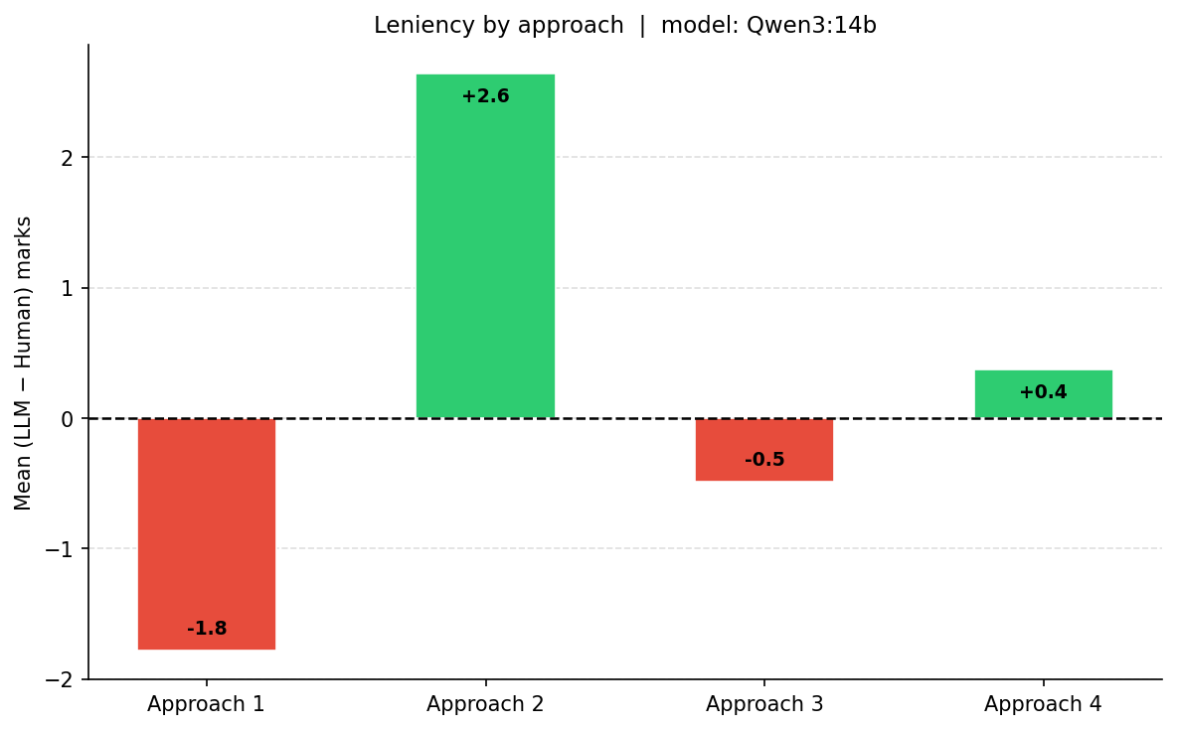
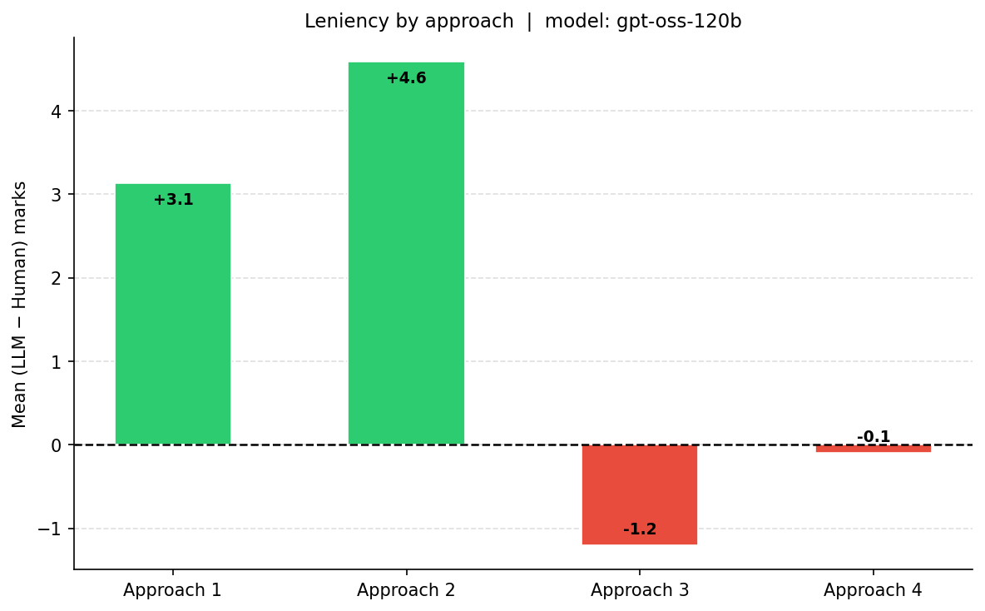
RQ4 · Leniency by approach
EXPERIMENTS · RQ4
Qwen3:14b · local
gpt-oss-120b · cloud
37
Notes:
Signed bias (LLM − human) per approach, per model. Positive = generous, negative = strict.

Slide 39
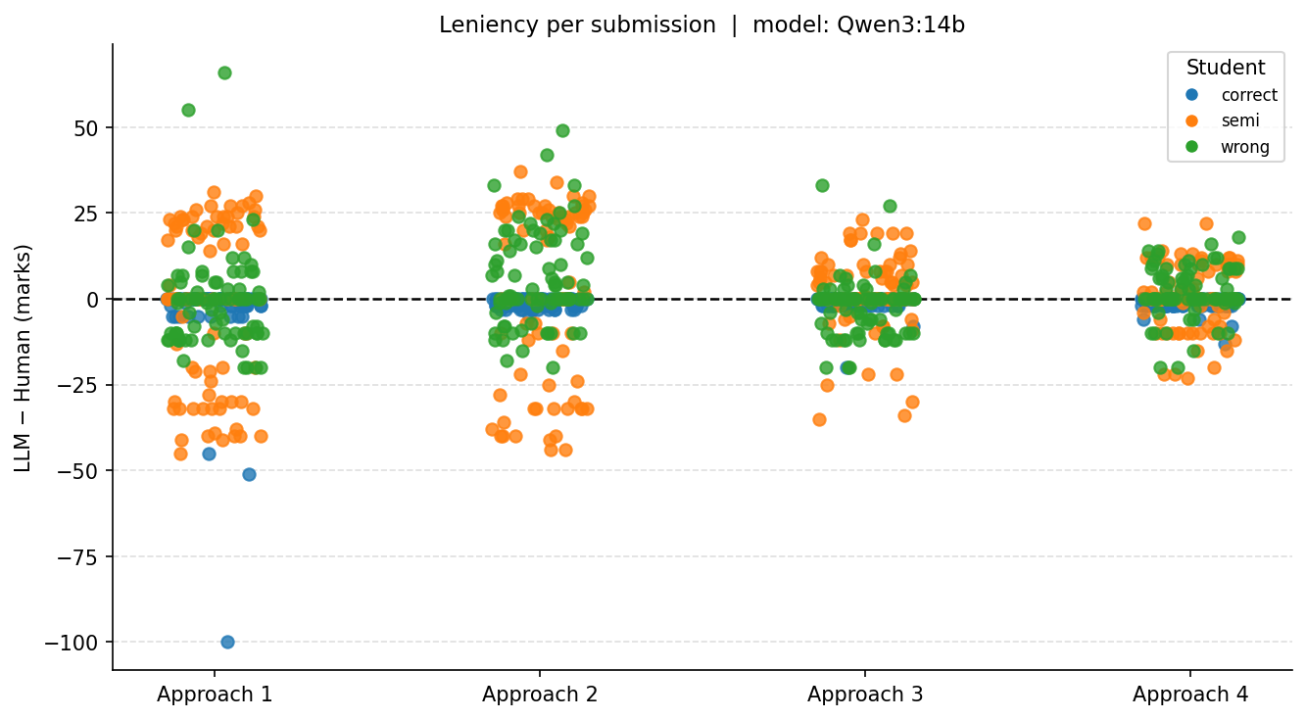
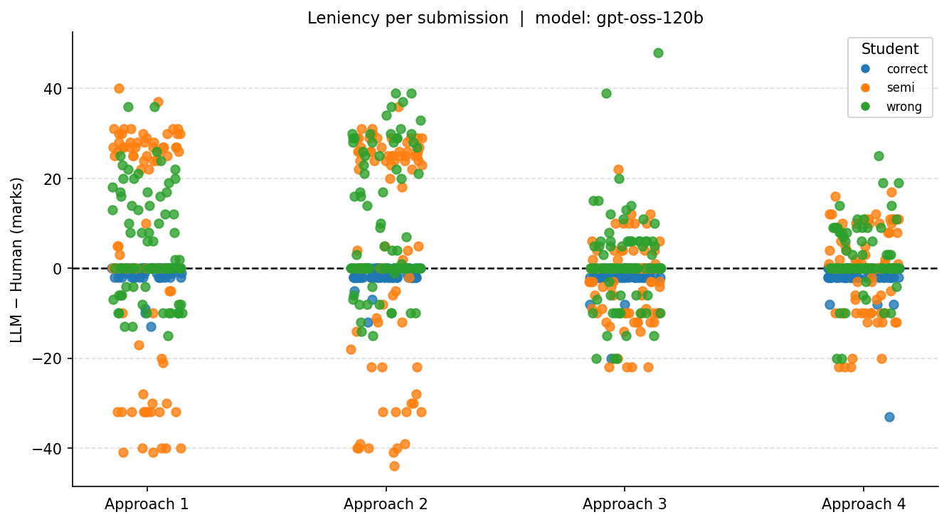
RQ4 · Leniency scatter
EXPERIMENTS · RQ4
Qwen3:14b · local
gpt-oss-120b · cloud
38
Notes:
Per-submission LLM vs human totals, per model. [→ systematic shift off the diagonal.]

Slide 40
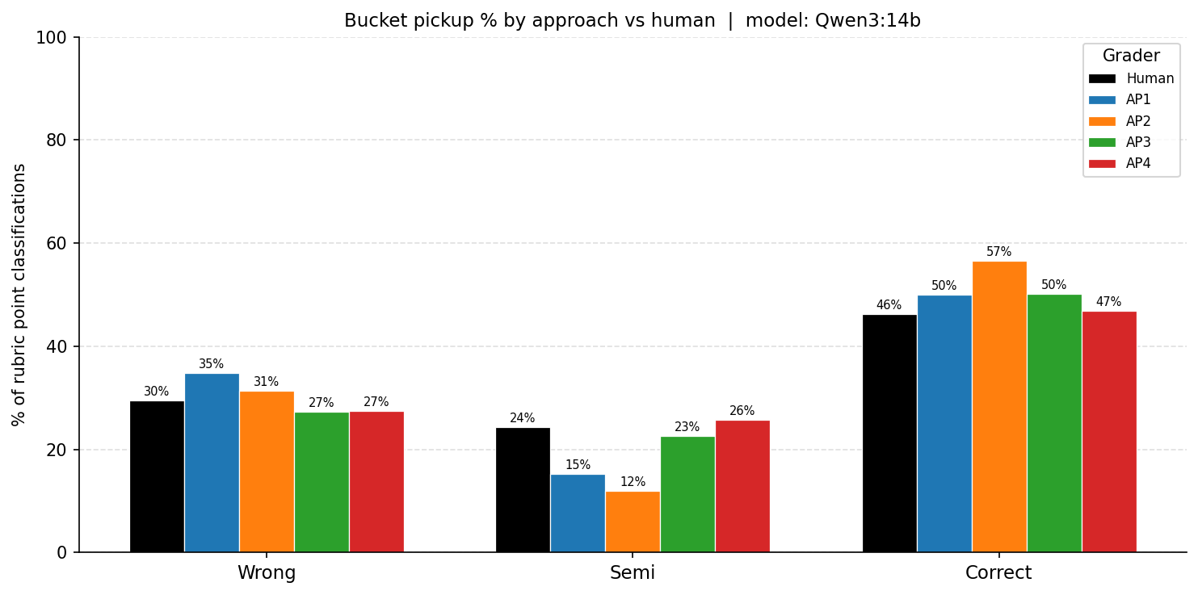
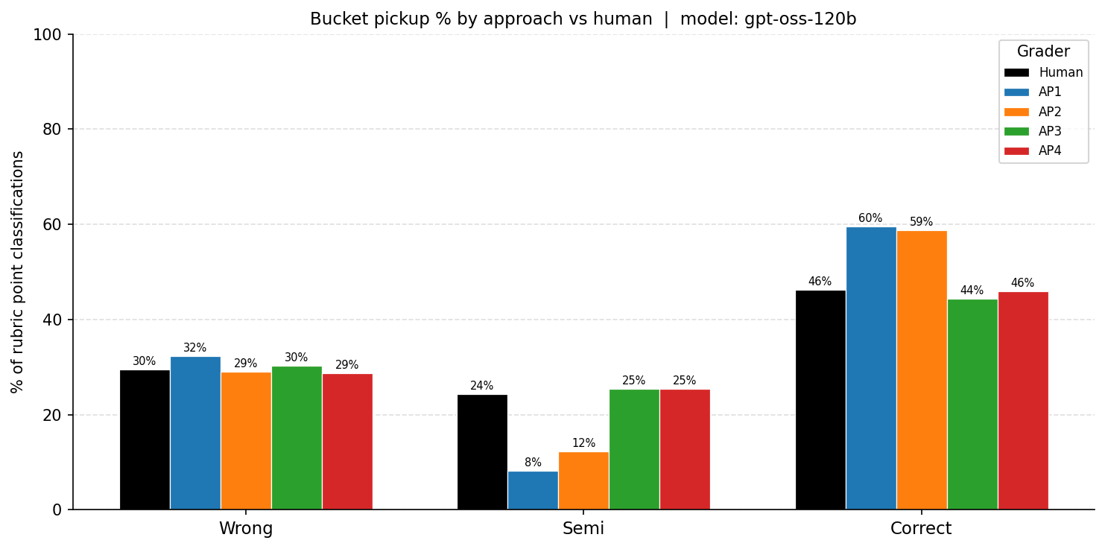
RQ4 · Bucket distribution vs human
EXPERIMENTS · RQ4
Qwen3:14b · local
gpt-oss-120b · cloud
39
Notes:
How often each bucket is chosen vs human — does the model avoid the middle bucket?

Slide 41
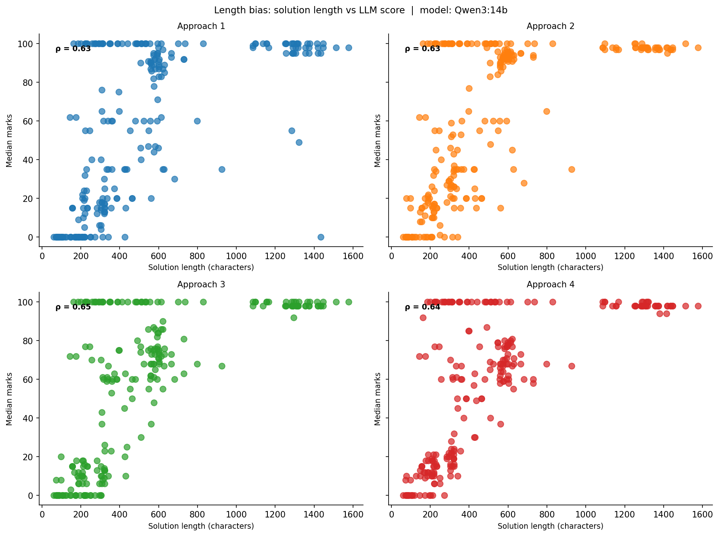
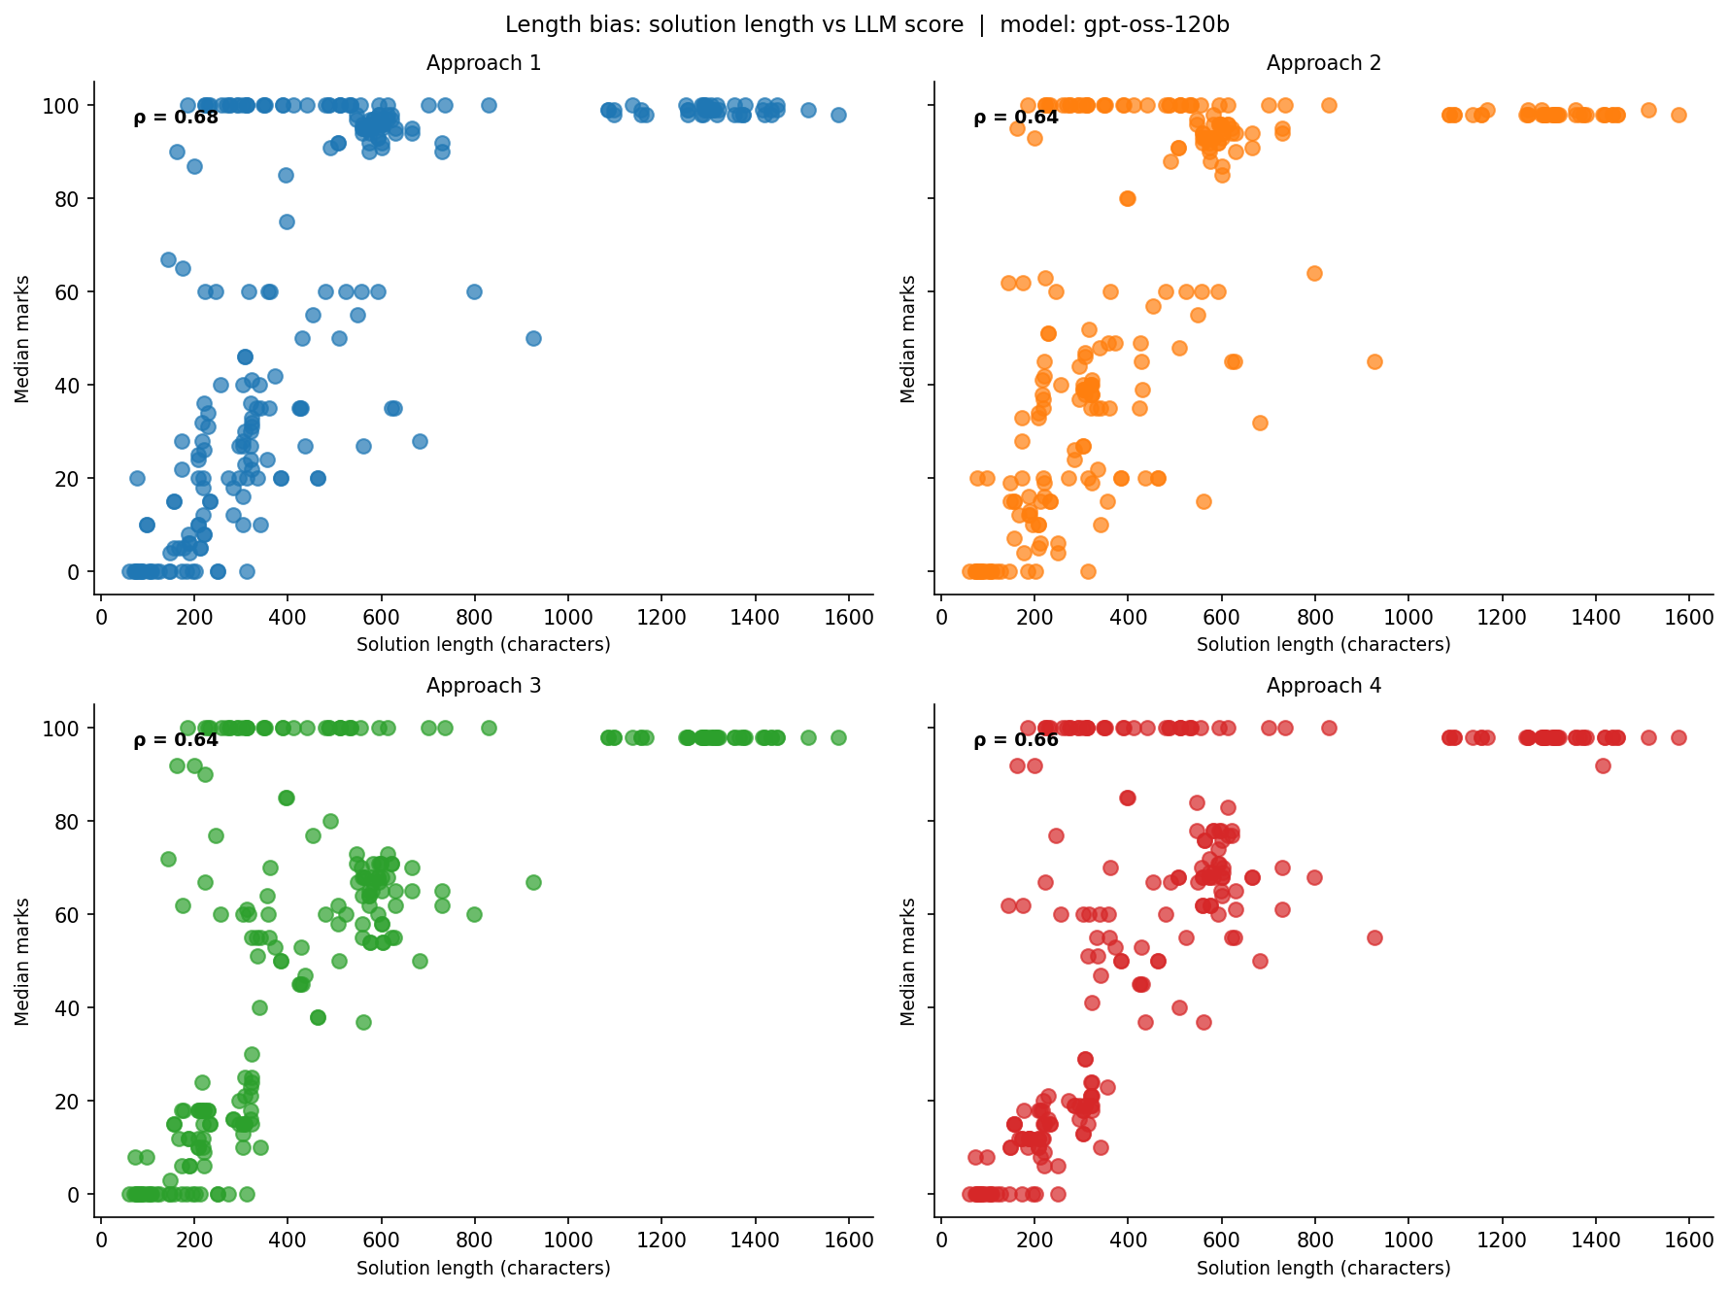
RQ4 · Length bias
EXPERIMENTS · RQ4
Qwen3:14b · local
gpt-oss-120b · cloud
40
Notes:
Submission length vs marks awarded, per model. [→ does longer code score higher regardless of quality?]

Slide 42
RQ5 — Feedback quality
EXPERIMENTS · RQ5
• Question: is feedback grounded & consistent with the mark, or generic/hallucinated?
• Check: manual 0–4 score; automatic feedback-contradiction rate
• Jia 2024: 23–27% of LLM feedback hallucinated · Qian 2025: 16-dim framework
• Result is a table / manual analysis (no graph)
41
Notes:
RQ5: is the feedback trustworthy — grounded in the student’s code and consistent with the mark — or generic and hallucinated? Jia et al. found ~a quarter of LLM feedback is hallucinated. I score grounding, factual correctness and score-feedback agreement, plus an automatic contradiction rate. [→ present the feedback table.]

Slide 43
RQ6 — Failure modes
EXPERIMENTS · RQ6
• Question: what mistakes recur — are they systematic or random?
• Check: largest human–LLM gaps, each tagged with an error type
– hallucination · wrong rubric point · length-for-marks · code wrong but high marks
• Result is a tagged failure-case table (no graph)
42
Notes:
RQ6: what kind of mistakes does the model make, and are they systematic? I take the largest human–LLM gaps and tag each with an error type. [→ present the tagged failure cases.] RQ5 and RQ6 are my most qualitative, still-maturing analyses.

Slide 44
GUI

Slide 45
Why a GUI: human-in-the-loop
GUI
• LLM grades → Streamlit review tool → human finalises
• EU AI Act + SURE (Korthals 2026): human oversight; review only uncertain cases
– → cuts human grading effort by 40–90%
• Deliverable is decision-support, NOT a replacement for the lecturer
44
Notes:
Every serious paper — and the EU AI Act — says the model must not decide alone. Korthals et al. show reviewing only the uncertain cases cuts grading effort 40–90%. So the deliverable is decision-support that keeps the lecturer in control.

Slide 46
The review tool (live demo)
GUI
• Overview & Outliers: clickable mark histogram, class stats, bulk “finalise all”
• Review & Adjust: student code + sample + rubric side by side
– all four approaches shown together; per-point bucket / marks / feedback editor
– pre-fill from any approach OR from human ground truth, then save final grade
• LLM does the first pass; the human keeps the final say
Live demo preferred; run: streamlit run src/explorer/overview.py
45
Notes:
The Overview page gives a clickable mark distribution with class stats and a bulk finalise. Review & Adjust opens one submission: question, student code, sample and rubric side by side; all four approaches together; a per-point editor; and pre-fill from any approach or from ground truth. The LLM does the first pass; the human keeps the final say.

Slide 47
Multi-provider & cohort view
GUI
• Provider-agnostic — Ollama (local) / NVIDIA NIM / Gemini
• Rubric-point difficulty: which criteria students found hardest
• RQ plots on demand inside the tool
• Compare whole cohorts across assignments over time
46
Notes:
The tool is provider-agnostic, surfaces which rubric points students found hardest, shows RQ plots on demand, and compares whole cohorts over time. A department could point it at any model and any course.

Slide 48
Conclusion

Slide 49
Contributions, limitations & future work
CONCLUSION
• Contributions
– First joint comparison: classifier-vs-free × whole-vs-point, local + cloud, multi-run
– Implementation + asymptotic questions, real + synthetic data; a pipeline + human-in-the-loop tool
• What the results answer (headline from the final graphs): RQ1–RQ6
• Limitations: single-grader ground truth · authored asymptotic questions · feedback partly manual
• Future: scale real-student run · multi-grader truth · de-biasing
Thank you — questions?
48
Notes:
To close: the first study to compare classifier-vs-free-marking and whole-vs-point-by-point together, across local and cloud models, over repeated runs, on implementation and asymptotic questions, and on real and synthetic data — with a full pipeline and a human-in-the-loop tool. [→ deliver one headline per research question.] Limitations: single-grader ground truth, self-authored asymptotic questions, partly-manual feedback analysis. Thank you.

