Slide 1
Racing to the Sink: Why Gated Attention Still Forms Attention Sinks
Attention sinks are necessary for softmax, and preferred by training
Group Number: G28
Names: Aditya Kariwal, Manish Kundu, Samyak Sheersh
Roll Numbers: [roll numbers]
Base paper: Ran-Milo (2026), Attention Sinks Are Provably Necessary in Softmax Transformers, arXiv:2603.11487

Slide 2
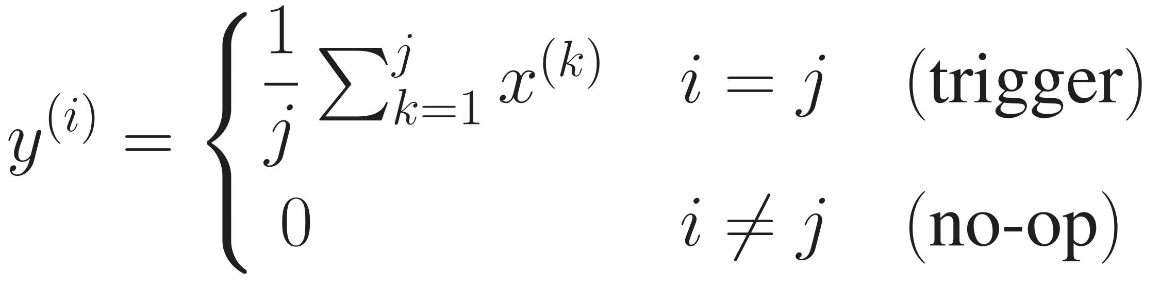

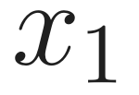
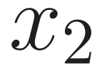


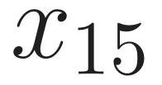

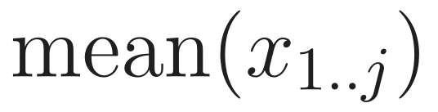
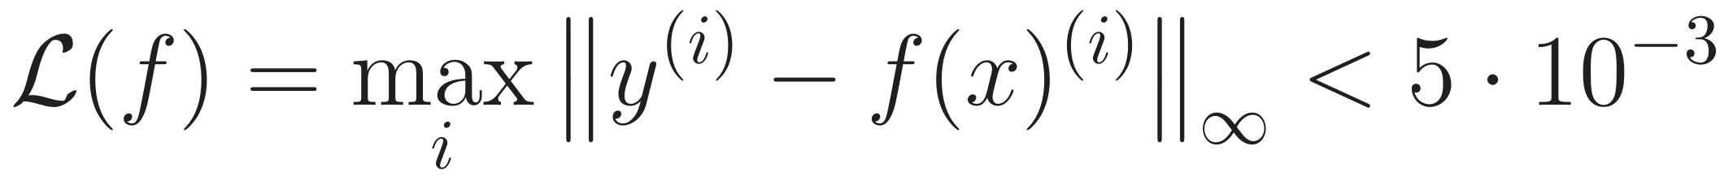
Problem Statement
input
target
the trigger sits at a random position j; every token carries 13 random content features
Theorem (Ran-Milo, 2026)
A softmax model needs an attention sink to do nothing; ReLU attention does not.
The paper's remedy: gating or un-normalised attention.
Our question
A gated head can output zero without any sink (we construct one). Does training actually use the gate? If not, what decides which way a head switches off, and can we control it?
Data pipeline. Synthetic task: 128 fresh sequences per step, generated on the fly. Language model: TinyStories at character level, [BOS] + 255 characters per sample.

Slide 3
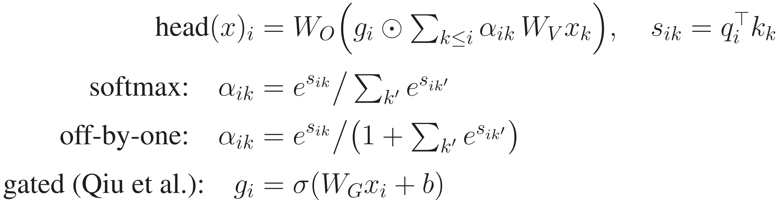
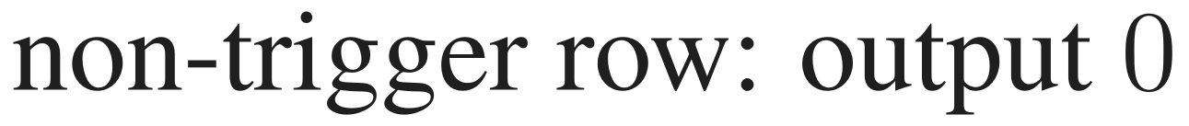


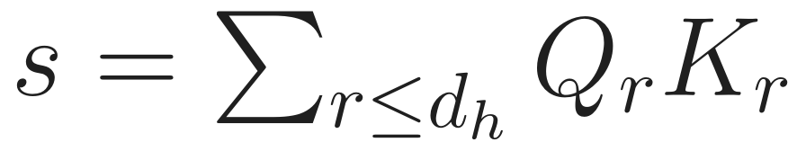
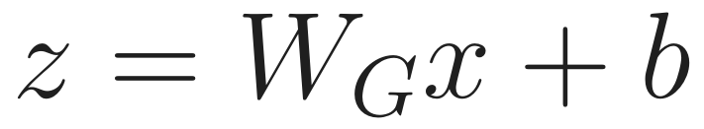
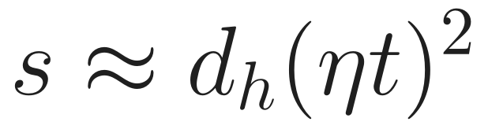
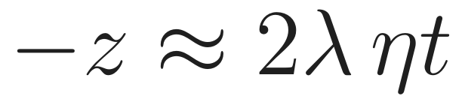
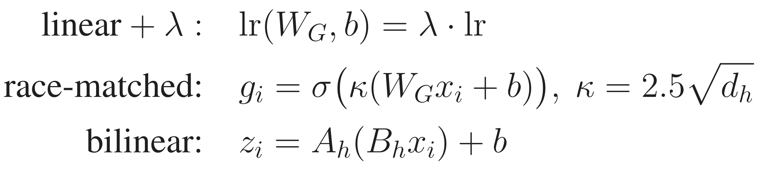
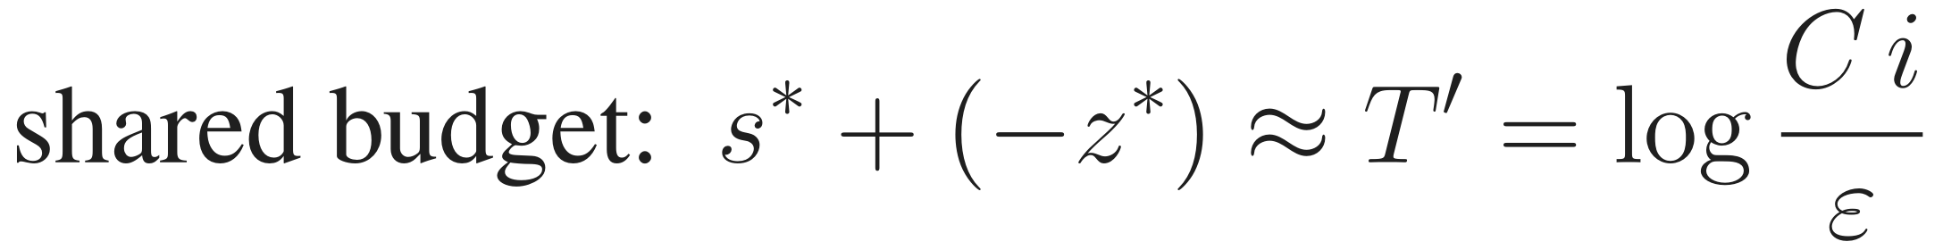
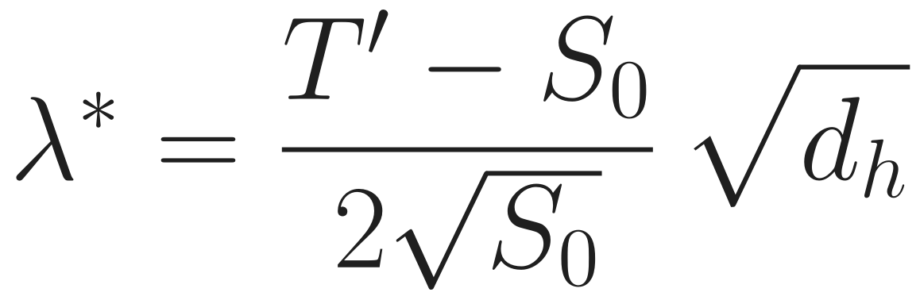
Architecture
Attention-only transformer (as in the base paper)
Two ways for a head to switch off
Gate parameterisations we study
The faster route takes the larger share of the budget, which gives
Language model: character-level GPT, 6 layers, d = 384, 6 heads of width 64, pre-LN + MLP, context 256, AdamW; same attention variants.

Slide 4
Contribution Code
Written from scratch in PyTorch. Excerpts of our contributions; full code in src/.
src/sinks.py · gate parameterisations
src/sinks.py · racing the two routes
if gate_kind == "bilinear": # z = A_h (B_h x) + b
self.W_GB = nn.Linear(d, H * dh, bias=False)
self.W_GA = nn.Parameter(torch.empty(H, dh, dh))
else:
self.W_G = nn.Linear(d, H * dh, bias=True)
if gate_kind == "scaled": # race-matched gate
self.kappa = gate_scale * math.sqrt(dh)
self.W_G.weight.data.div_(self.kappa) # muP: init / kappa
def gate_logits(self, x): # == gate lr x kappa
return self.kappa * self.W_G(x)
gate_p = [p for n, p in named if "W_G" in n]
qk_p = [p for n, p in named if n[:3] in ("W_Q", "W_K")]
groups = [
dict(params=other_p, lr=lr),
dict(params=qk_p, lr=lr * qk_lr_mult), # sink
dict(params=gate_p, lr=lr * gate_lr_mult), # gate
]
opt = torch.optim.Adam(groups, betas=(0.9, 0.95))
# stop when the l_inf error on a batch < 5e-3
src/race_theory.py · closed-form critical multiplier
src/probe.py · zero-valued gradient probes
def lam_star(dh, i=8, eps=5e-3, vbar=1.0, a0=0.6):
T = math.log(vbar * i / eps) # shared budget T'
S0 = math.log(i * a0 / (1 - a0)) # sink-head logit
return (T - S0) * math.sqrt(dh) / (2 * math.sqrt(S0))
p_s = torch.zeros(H, requires_grad=True) # BOS logit
p_g = torch.zeros(H, requires_grad=True) # gate logit
layer.probe = (row_mask, p_s, p_g) # non-trigger rows
gs = torch.autograd.grad(loss, ps + pg)
gate_pull = g / layer.dh # per coordinate

Slide 5
Benchmark Methods and Evaluation
Methods compared
Evaluation metrics
Method | Role | Source
softmax | baseline: sink is necessary | Ran-Milo 2026
ReLU | sink-free, un-normalised | Ran-Milo 2026
softmax-off-by-one | null slot: can switch off | Miller 2023
linear output gate | gate: can switch off | Qiu et al. 2025
gate + lr multiplier λ | speeds up the gate route | ours
race-matched gate | κ = 2.5·√d_h, muP-style | ours
bilinear gate | gate as fast as the sink | ours
controls | Q/K-lr ×10, all-lr ×10, SGD | ours
Metric | Definition
BOS mass | mean attention on BOS, non-trigger rows
sink head | BOS mass > 0.6
gate value | importance-weighted, off / trigger rows
steps | until ℓ∞ error < 5·10⁻³
s*, −z* | sink-logit gap / gate closing at stop
λ* | λ where mean BOS mass crosses 0.6
LM | val loss, BOS attention, BOS outlier
3–5
558
11 CPU + 2×T4
1 script
seeds per configuration
models trained in total
local cores and Kaggle GPUs
src/summarize.py recomputes every number

Slide 6
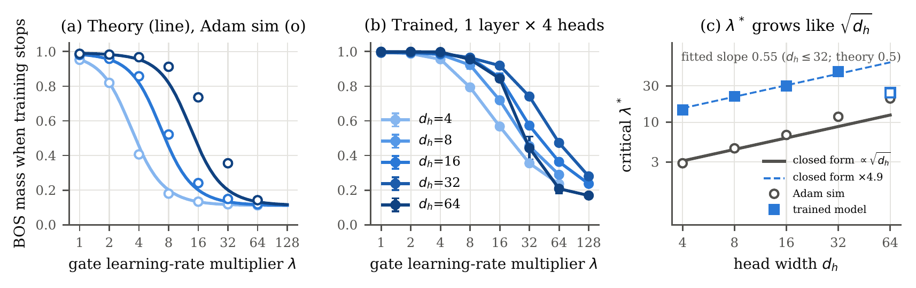
Results and Discussion
0/48 → 48/48
r = -0.83
slope 0.55
0.85 · 0.85 · 0.85
sink heads with gate lr ×10, then also Q/K lr ×10: the race is causal
shared log-budget: s* + (−z*) = 8.8 ± 1.8
λ* ∝ √d_h (theory 0.5); constant ×4.9
BOS mass at λ = 16 for base lr 3e-5 / 1e-4 / 3e-4: identical
What holds. Sinks are preferred, not only necessary: gated models keep them at every depth and gate init, though a sink-free solution exists.
What fails. SGD still forms sinks; at 4 layers λ* hardly depends on width, so the √d_h gate fails at d_h = 4.
Limitations. Synthetic task; first-order theory (constant off by ~5×); our small LMs formed no sinks in 20k steps, so the LM test is open.
Conclusion. An off switch makes sinks unnecessary but not absent: the gate must also learn fast enough. Its learning rate decides the race.
4 layers × 4 heads, 3 seeds | sink heads | steps
baseline, λ = 1 | 23/48 | 18.4k
gate lr ×10 | 0/48 | 3.3k
gate ×10 and Q/K ×10 | 48/48 | 3.4k
all learning rates ×10 | 33/48 | 3.4k

