Slide 1

FILE STORAGE AND SHARING WITH EFS AND EC2
SERVICES USED :
VPC
EFS
EC2
CLOUD WATCH

Slide 2
SETTING UP A SECURE VPC
Create VPC: Define the VPC name and assign an IPv4 CIDR block to establish the network range.
Create Subnet: Define a subnet name and assign an IPv4 CIDR block within the VPC to specify the subnet's IP address range.
Create Internet Gateway: Create an Internet Gateway (IGW) and attach it to your VPC to enable internet connectivity for your resources.
Create Route Table: Define a route table and add routes to direct traffic, such as setting a route for 0.0.0.0/0 to the Internet Gateway (IGW), then associate the route table with the appropriate subnets.

Slide 3
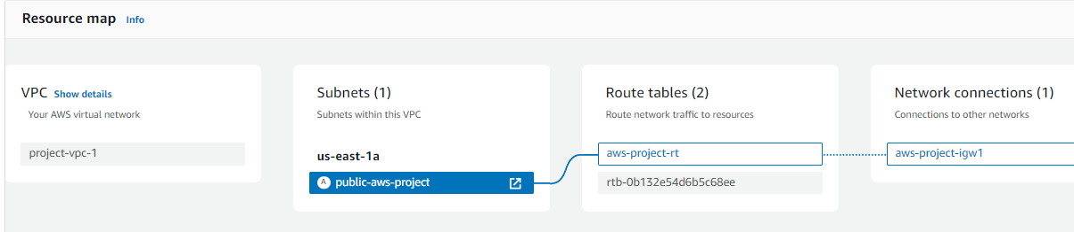
Name of VPC is “project-vpc-1” and use CIDR block 10.0.0.0/24.
Name of Subnet is “public-aws-project” and use CIDR block 10.0.0.0/25 within the VPC.
Name of Internet Gateway is “aws-project-igw1” and attach it to your VPC.
Now Adding a route for 0.0.0.0/0 to the Internet Gateway and associate it with the subnet.
Deploy EC2 instances and EFS (Elastic File System) within the created VPC for network isolation and access control.
SETTING UP A SECURE VPC

Slide 4
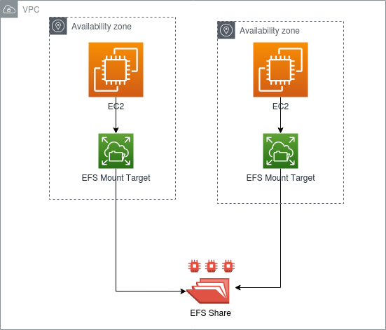
SETTING UP AN EFS
Go to the EFS console: Navigate to Amazon EFS
in the AWS Management Console.
Create file system: Click "Create file system" to
start the setup.
Select your VPC: Choose the VPC you created in Step 1.
Add mount targets: Add mount targets in the
subnets you created.
Configure security groups: Allow NFS traffic
(TCP/2049) in the security groups.

Slide 5
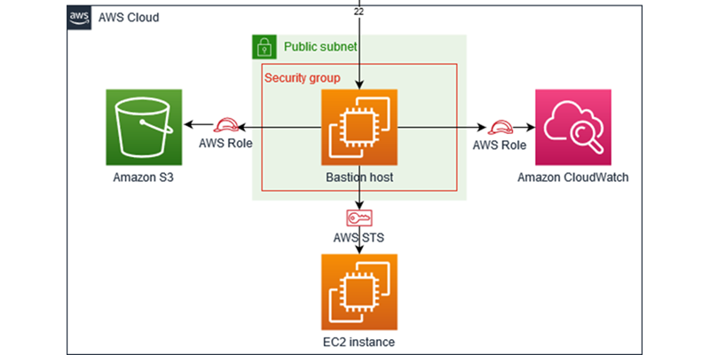
SETTING UP A EC2 UBUNTU SERVER
Launch Instance: Go to the EC2 console and click
"Launch Instance," then choose an Ubuntu AMI.
Configure Instance: Select instance type, configure network
to use your VPC and subnet, and configure security groups
to allow necessary traffic (e.g., SSH).
Add Storage: Configure the storage options as needed,
such as the size and type of EBS volumes.
Launch and Connect: Review and launch the instance, then
connect via SSH using the key pair you specified during setup.

Slide 6
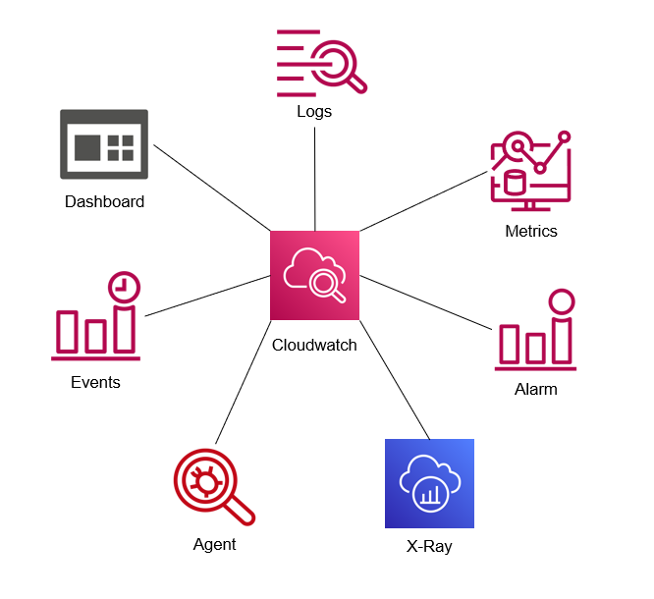
SETTING UP A Cloud Watch
Launch Instance: Go to the EC2 console and click
"Launch Instance," then choose an Ubuntu AMI.
Configure Instance: Select instance type, configure
network settings to use your VPC and subnet, and configure
security groups to allow necessary traffic (e.g., SSH).
Add Storage: Configure the storage options as needed, such
as the size and type of EBS volumes.
Launch and Connect: Review and launch the instance,
then connect via SSH using the key pair you specified
during setup.

Slide 7
CONCLUSION:
The successful implementation of this project has provided a robust and flexible cloud environment capable of supporting various applications and workloads.
By leveraging AWS services like VPC, EC2, EFS, and CloudWatch, we have established a solid foundation for scalable, secure, and manageable cloud operations.
The architecture provides high availability through the use of multiple subnets, internet gateways, and route tables, ensuring continuous service operation.
CloudWatch offers centralized monitoring and management of resources, providing real-time insights and automated responses to performance issues.
Amazon EFS for shared file access and CloudWatch for monitoring, ensuring reliable and managed access to data across EC2 instances.

Slide 8
THANK YOU

