Slide 1
Ride-Hailing Startup — Q4 Profit Dip Analysis
Analysis of 20% profit drop in 2025Q2 vs 2025Q1
Based on operational, ride-type, city-level, and retention data

Slide 2
Key KPIs (Real Data)
Profit 2025Q1: ₹3,151,779 → 2025Q2: ₹2,509,500 (-20.4% change)
Total rides: 154,212 → 121,946 (-20.9% change)
Avg profit/ride: 20.44 → 20.58 (0.7%)
Highest loss city: Mumbai (-50.3%)

Slide 3
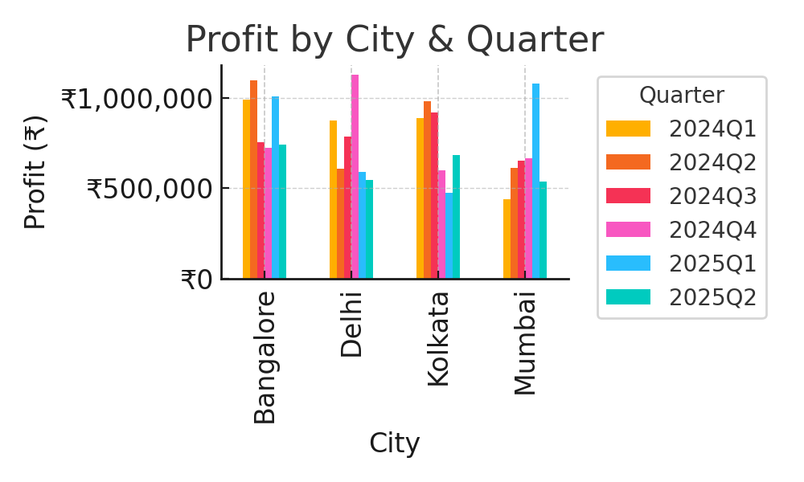
City-Level Analysis

Slide 4
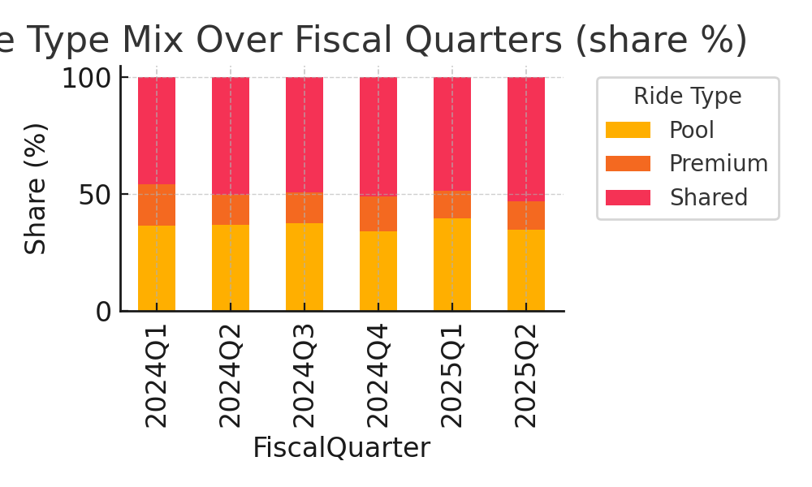
Ride Type & Mix Analysis

Slide 5
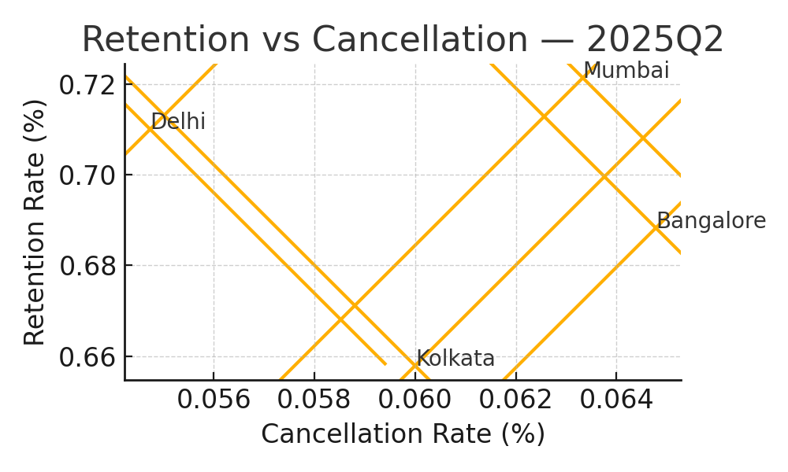
Retention vs Cancellation

Slide 6
Recommendations
Short-term (0-3 months):
- Targeted win-back promotions in Mumbai & Delhi
- Focused driver incentives in peak hours
- Reduce blanket promotions; shift to targeted offers
Long-term (3-12 months):
- Subscription passes and corporate ride packages
- Dynamic pricing & competitor monitoring
- Loyalty program redesign for high-value users

