Slide 1



blinkit Analysis
blinkit
BY- Aditya kumar
india’s Last Minut App

Slide 2
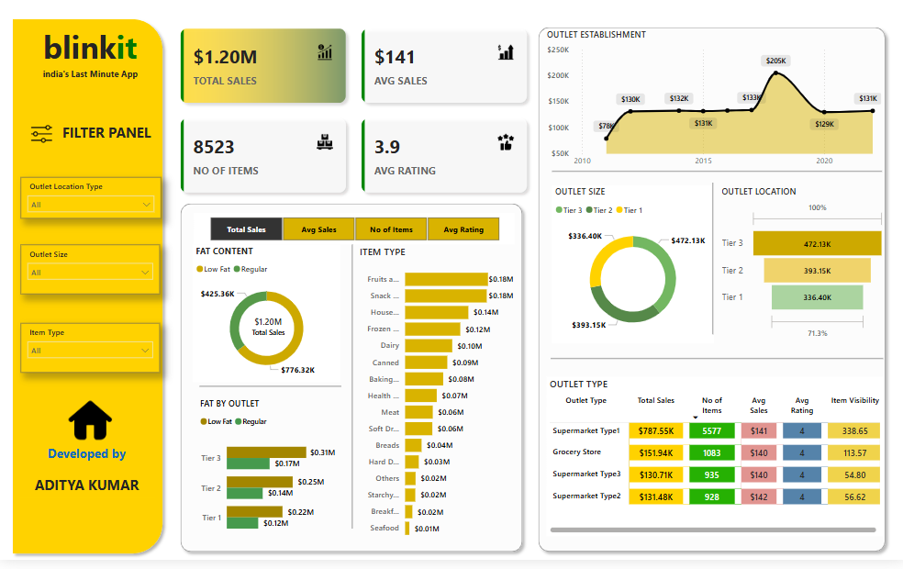
Dashboard

Slide 3

STEPS IN POJECT
Requirement Gathering | Business Requirement
Data Walkthrough
Data Connection
Data cleaning | Quality Check
Data Modeling
Data Processing
Dax Calculations
Dashboard lay outing
Charts Development and Formatting
Dashboard | Report Development
Insights Generation

Slide 4

Business Requirement
To Conduct a comprehensive analysis of Blinkit’s sales performance, customer satisfaction and inventory distribution to identify key insights and opportunities for optimization using various KPI’s and visualization in powerBI.

Slide 5
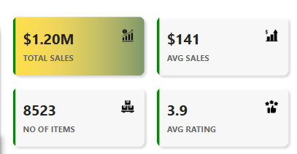
KPI’s Requirements
Total sales: The overall revenue generated from all item sold.
Average sales: The average revenue per sale.
Number of Itmes: The total count of diffirent item sold
Average Rating : The average customer rating for items sold

Slide 6
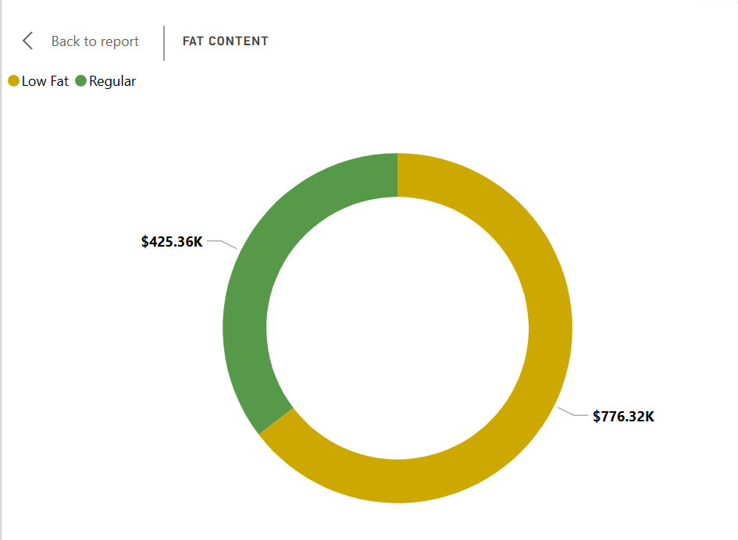
Chart’s Requirements
Total sales by Fat Content:
Objective: Analyze the impact of cat content on totol sales.
Additional KPI Metrics: Assess how other KPIs (Average sales, Number of item, Average Rating) vary with fat content.
Chart Type: Donut chart

Slide 7
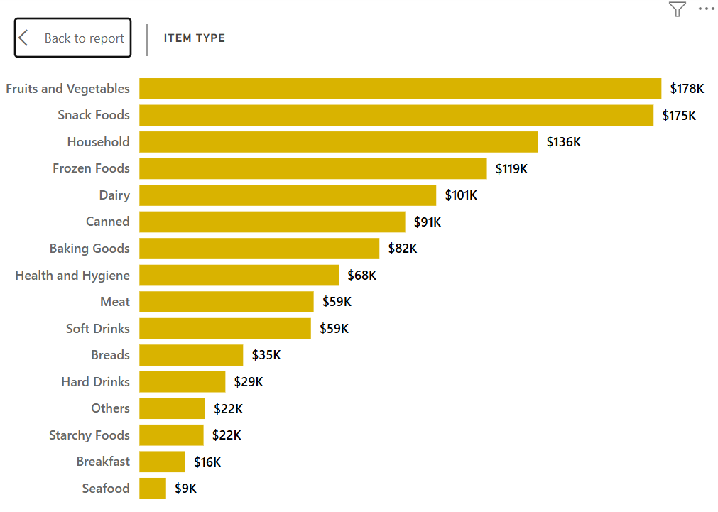
Chart’s Requirements
2.Total sales by Item Type:
Objective: Identify the performance of diffrent item type in terms of total sales.
Additional KPI Metrics: Assess how other KPIs (Average sales, Number of item, Average Rating) vary with fat content.
Chart Type: Bar chart

Slide 8
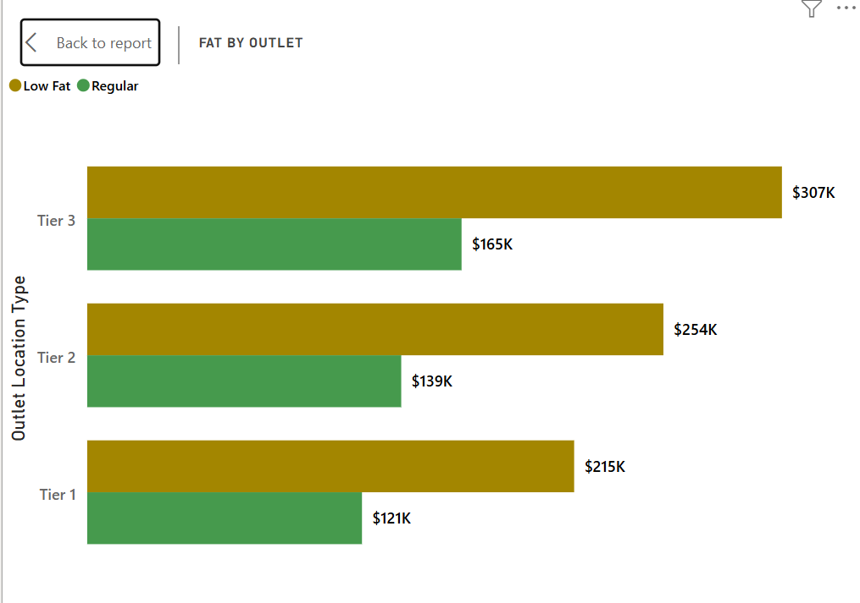
Chart’s Requirements
3.Fat content by outlet for Total sales:
Objective: Compare total sales across different outlets segmented by fat content.
Additional KPI Metrics: Assess how other KPIs (Average sales, Number of item, Average Rating) vary with fat content.
Chart Type: Stacked column chart

Slide 9
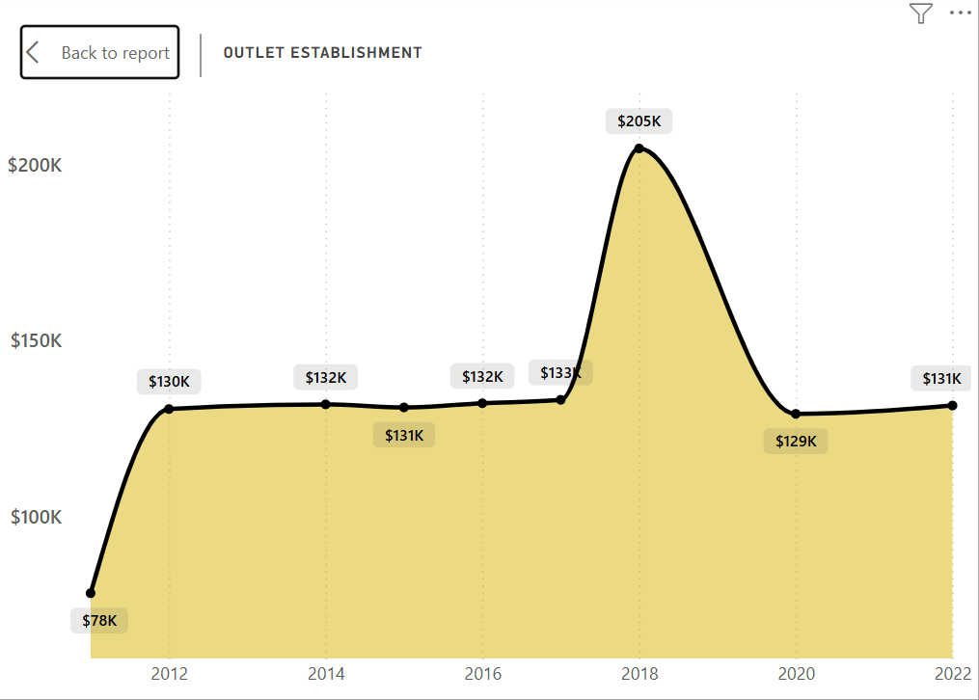
Chart’s Requirements
4.Total Sales by outlet Establishment:
Objective: Evalute how the age or type of outlet establishment influences total sales.
Additional KPI Metrics: Assess how other KPIs (Average sales, Number of item, Average Rating) vary with fat content.
Chart Type: Line Chart

Slide 10
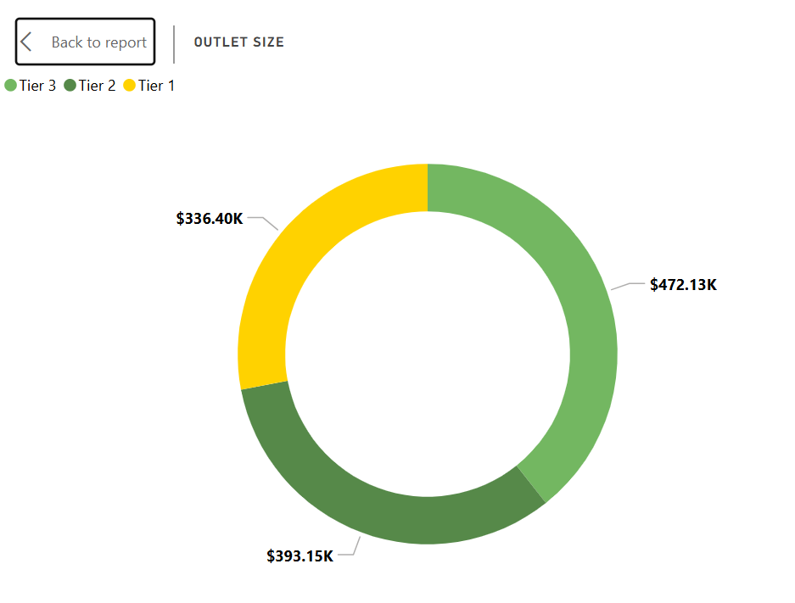
Chart’s Requirements
5. Sales by outlet size:
Objective: Analyze the correlation between outlet size and total sales.
Additional KPI Metrics: Assess how other KPIs (Average sales, Number of item, Average Rating) vary with fat content.
Chart Type: Donut | pie chart

Slide 11
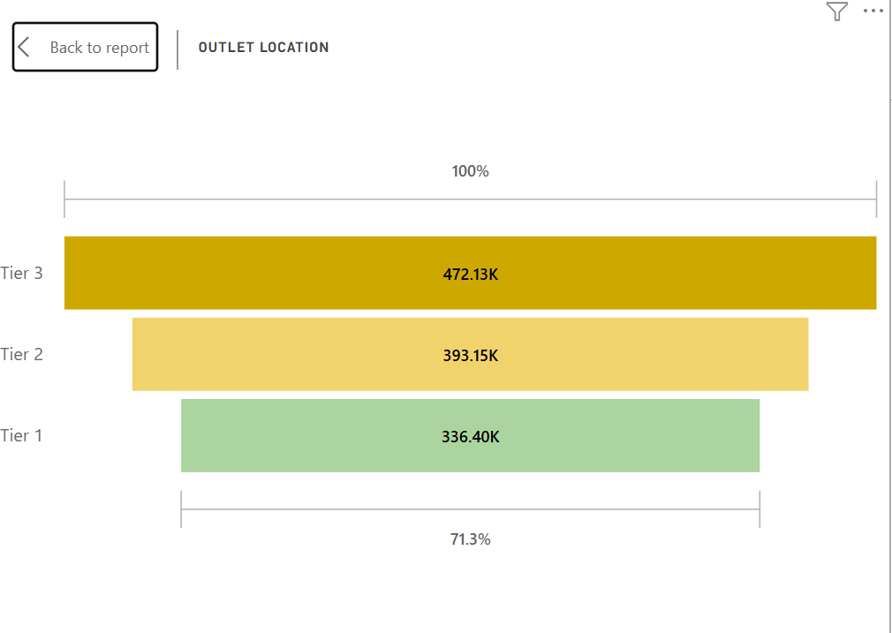
Chart’s Requirements
6. Sales by outlet location:
Objective: Assess the geographic distribution of sales across different locations.
Additional KPI Metrics: Assess how other KPIs (Average sales, Number of item, Average Rating) vary with fat content.
Chart Type: Funnel map

Slide 12
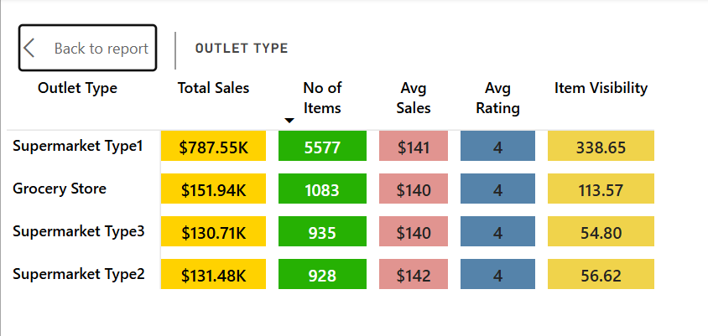
Chart’s Requirements
7. All metrics by outlet type.
Objective: Provide a comprehensive view of all key metrics(total sales, Average sales, number of items, average rating.
Chart Type: Matrix card

Slide 13



Thank You
Presented by
ADITYA KUMAR

