Slide 1




Sales Performance Dashboard in Excel(MIS)
Created by Aditya Kumar

Slide 2
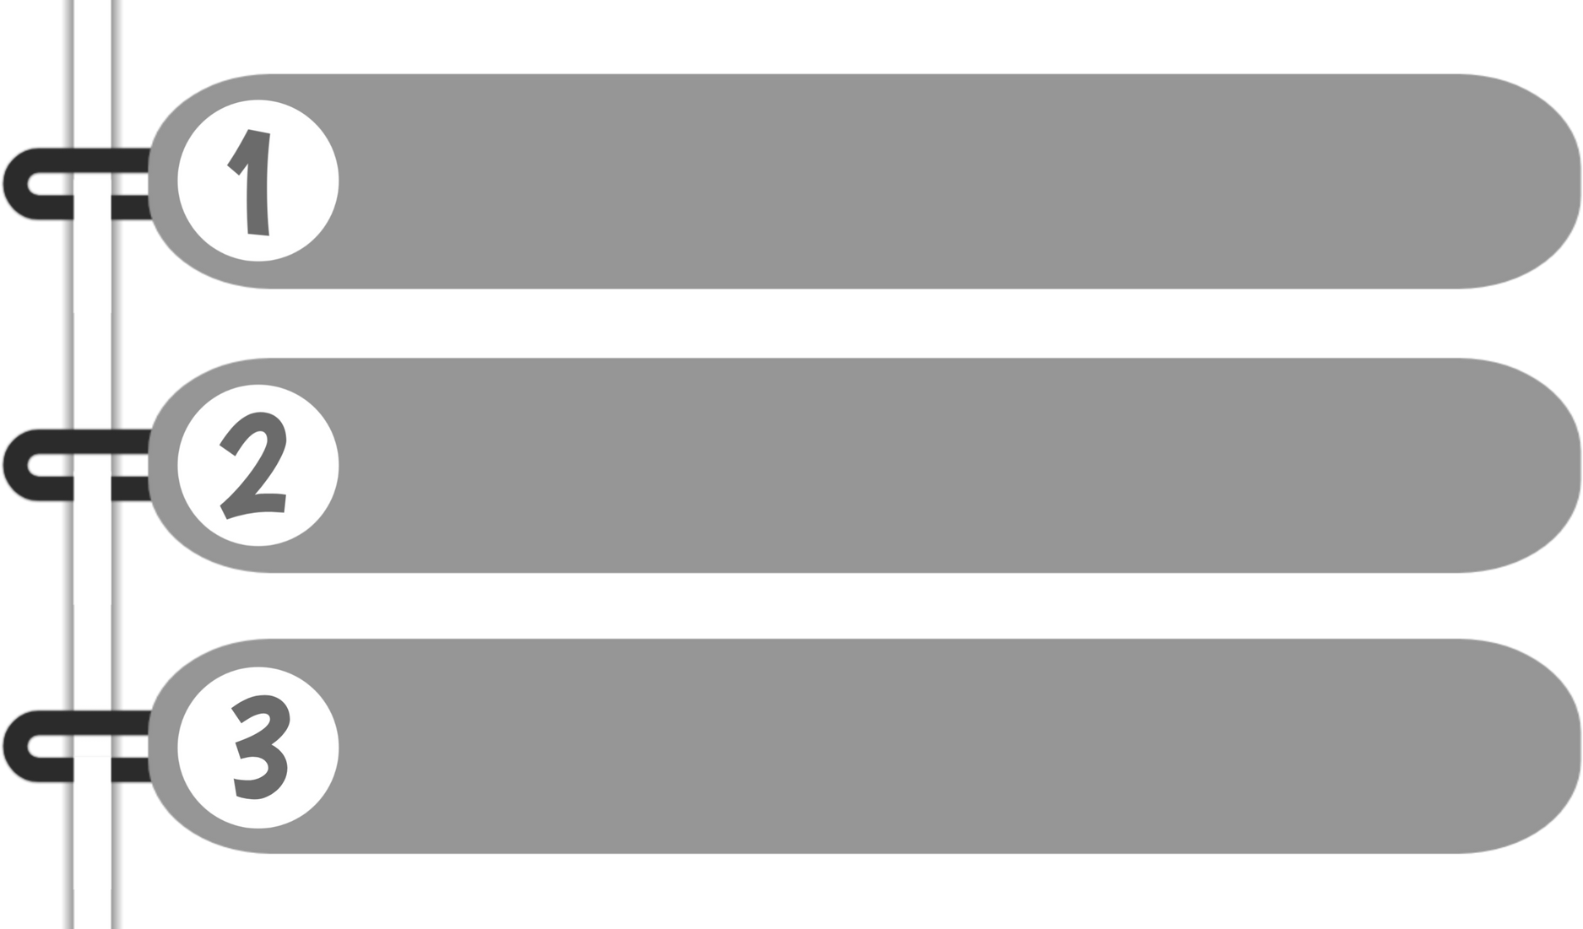
Introduction
Tracks sales performance across multiple cities.
Provides insights on total sales, target achievement, and improvement areas.
Interactive city selection for detailed analysis.

Slide 3
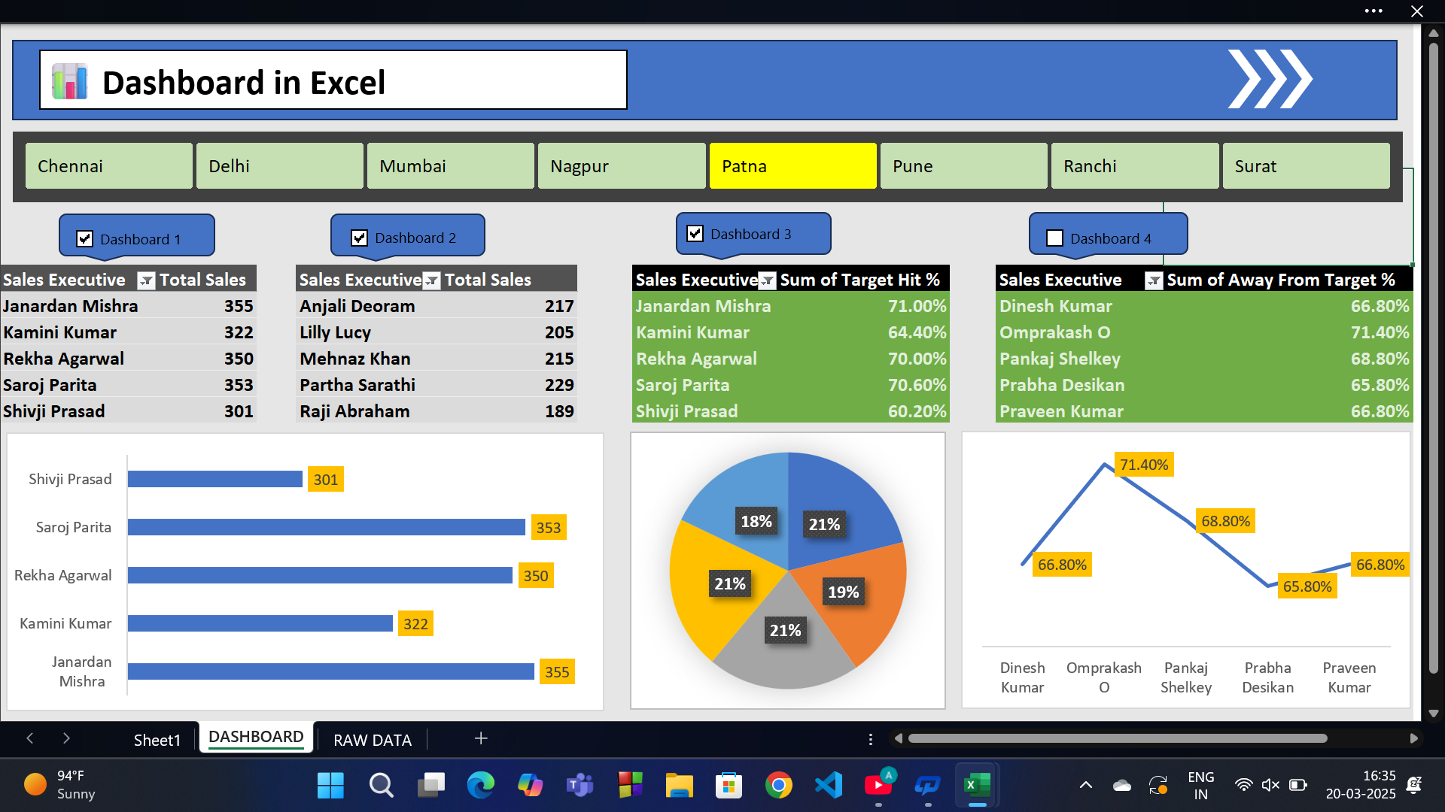
Dashboard Overview

Slide 4
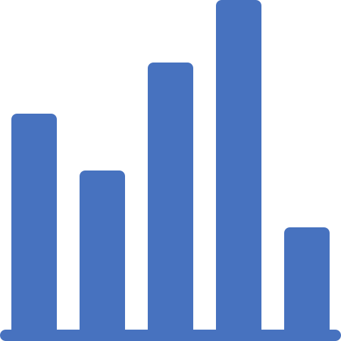
Key Insights
🏆 Janardan Mishra achieved highest sales: 355 units.
🎯 Highest Target Achievement: 71% (Janardan Mishra).
📈 Best Target Hit Rate: 71.4% (Omprakash O).
🌍 Dynamic city selection enables detailed analysis.

Slide 5
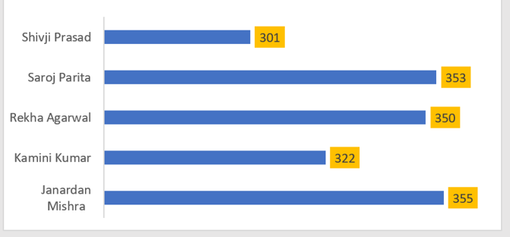
Visual Breakdown
Horizontal Bar Chart: Top Sales Performers.

Slide 6
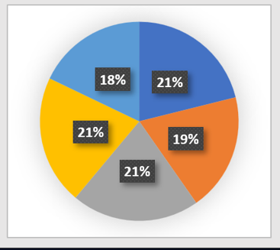
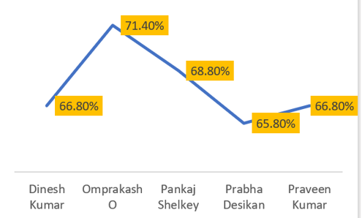
Visual Breakdown
Pie Chart: Contribution of Teams.
Line Chart: Target Deviation Trend.

Slide 7

Conclusion
Excel dashboards simplify performance tracking.
Visualizations enable faster, better decision-making.
"Data is the new oil, and dashboards are the refineries." 🚀

Slide 8



Thank You
Presented by
ADITYA KUMAR

