Slide 1

Tech Yantra
SUBMITTED BY:-
Mukesh Kumar

Slide 2
INTRODUCTION
Purpose: The tutorial website aims to provide educational resources and tutorials
on a specific subject or range of subjects.
We hope that achieving better practices on the requested website is a
great way to help make the job a success.

Slide 3
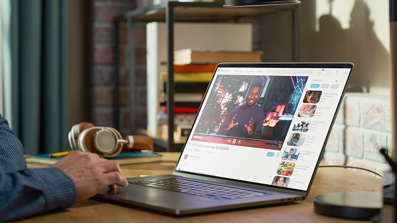
Objectives
Learning and Education: The primary purpose of a tutorial website is to facilitate learning
and education. It aims to provide knowledge, skills, and understanding of a particular topic
or set of topics to the target audience.
Progressive Learning: Tutorial websites often follow a progressive learning approach,
starting with the basics and gradually building upon foundational concepts. This allows
learners to acquire knowledge incrementally and progress to more advanced topics as they
gain proficiency.

Slide 4
Advantages
Tutorial websites provide easy access to educational materials anytime and anywhere with an internet connection. Learners can access tutorials from the comfort of their homes or any other location, eliminating the need for physical attendance in a traditional classroom.

Slide 5
Technology Used
Frontend
Html
CSS
Backend
Java
Mysql

Slide 6
JAVA
Java is a programming language and a platform. Java is a high level, robust, object-oriented and secure programming language.
Java was developed by Sun Microsystems (which is now the subsidiary of Oracle) in the year 1995. James Gosling is known as the father of Java. Before Java, its name was Oak. Since Oak was already a registered company, so James Gosling and his team changed the name from Oak to Java.

Slide 7
MYSQL
MySQL is currently the most popular database management system software used for managing the relational database.
Open source.
Supported by Oracle Company.
It is commonly used in conjunction with JDBC scripts for creating powerful and dynamic server-side or web-based enterprise applications.

Slide 8
ADMIN
Admin can login/logout
Admin add customer / remove
Admin view customer details

Slide 9
CUSTOMER
Customer view all details.
Customer login/logout.
Customer download details.

Slide 10
CUSTOMER
New Customer
Customer details
Deposite details
Customer
Calculate bill
Delete customer
New Admin
Logout

Slide 11
THANK
YOU

