Slide 1


SMART INDIA HACKATHON 2024
Problem Statement ID – SIH1633
Problem Statement Title- Intelligent platform to Interconnect Alumni and Student for Technical Education Department, Govt. of Rajasthan
Theme- Smart Education
PS Category- Software
Team ID- 30994
Team Name- ALUMights

Slide 2
IDEA / AIM
ALUMights
Idea / Solution
Problem Resolution
Colleges can send bulk messages and mails to all specific batch students
Up to date alumni work, Current Job automatically shared on the feed
Implementation of the Alumni Association platform for the University/Institute.
Web application with two portals for Students and Colleges on the same platform
Aadhar card / Digilocker authentication
Feed section provided to share any post, such as photos, thoughts, etc.
Interactive directory for easy communication with other member
Feedback section, donation section and gallery
Unique Point of view
Common systematic alumni tracing platform for all UGC verified colleges
Capability to synchronize multiple colleges at real time
Non Alumni registered member can access Internship Opportunities posted by Alumni
Colleges Customize their section maintaining theme and their culture

Slide 3
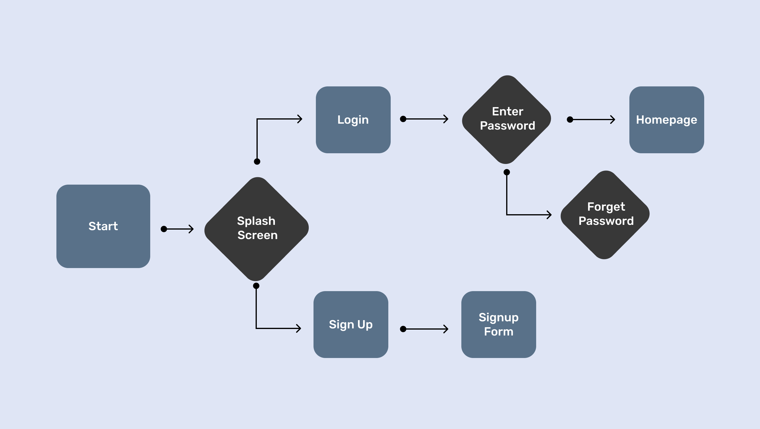




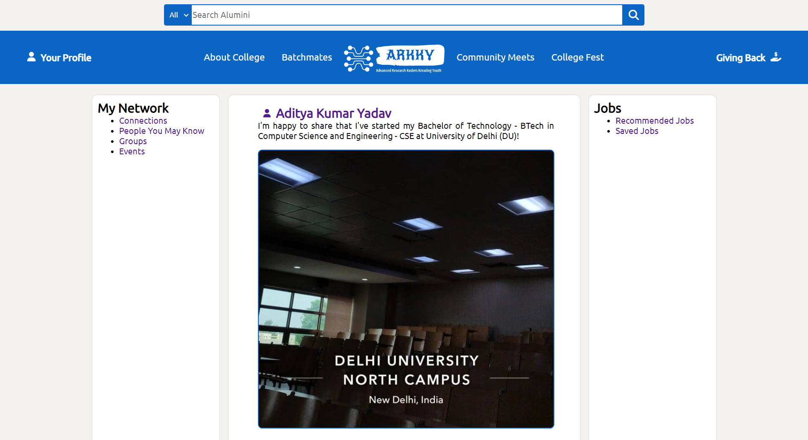












TECHNICAL APPROACH
ALUMights
Web Application Development :
HTML, CSS, JavaScript for Frontend and Python [Django] for Backend
Home Page
Login
Psswrd
Mobile Application Development :
Student/ College
Authenticate
Data
Base
Flutter – Framework used for building the mobile application , ensuring Cross Platform Compatibility
Register
SignUp Form
Cloud Services:
MySQL – Relational Database Management
High responsive rest APIs
Encryption and Security :
Custom encryption algorithm powered by 8 layer octa 256 bit encryption for secure data transmission
Product Status :
40% product built completed
and further is on progress.
Testing & Validation is next
https://github.com/Adityakyadav/ALUMights.git

Slide 4

FEASIBILITY VIABILITY
ALUMights
Resources: Establishing and Maintaining with Time and Diverse Knowledge
Technology: In this Era of Artificial Intelligence, Using AI ChatBot and Latest Technologies
Engagement and Data Management : Latest Info and Queries Involved, and record them via Database
Organizational Support: Strong backing from the University can Significantly Enhance the Feasibility of our Alumni Network
Purpose and Value Proposition: Connects Unevenly Spreaded UGC Colleges
Sustainability : Sponsorship and Reasonable Membership Fees
Feedback and Adaptation: Regularly gathering Feedbacks of members and Adapting to their Needs
Communication Channels: Utilizing Various Social Media Platform Instagram, X, to promote
FEASIBILITY ANALYSIS
VIABILITY ANALYSIS

Slide 5
IMPACT AND BENEFITS
ALUMights
Career Advancement: Boosts career prospects through job placements, professional development, and mentorship
Networking Opportunities: Valuable connections, collaborations, and partnerships through shared backgrounds & experiences
Skill Building: Exposure to New Ideas, provides students with skill-building opportunities
Social Support: Alumni can offer support through donations, scholarships, and internships
Reputation Enhancement: Showcasing successful graduates enhances the institute’s reputation
Fundraising and Facilities: Alumni contributions can improve research facilities, labs, and other resources
Engagement and Contribution: Engaged alumni are more likely to volunteer, mentor, and participate in institutional events
Feedback and Improvement: Insights help refine programs, curriculum, and services
Long-Term Support: A strong network ensures ongoing engagement and loyalty to the institution
Educational Events: Networking events, workshops, and seminars enhance skills and knowledge
Community and Support: Alumni networks foster social connections, helping members stay in touch and providing personal support.
Exclusive Resources: Members may access industry reports, research publications, and other educational materials
Brand Ambassadors: Successful alumni can promote the institution’s value and mission
Social Events: Reunions and gatherings strengthen relationships within the alumni community
Job Referrals: Alumni can benefit from job referrals and recommendations within their network

Slide 6

RESEARCH AND REFERENCES
ALUMights
YouTube Channels for HTML, CSS and JavaScript :
  CodeWithHarry – https://www.youtube.com/@CodeWithHarry
  Apna College – https://www.youtube.com/@ApnaCollegeOfficial
  freeCodeCamp.org – https://www.youtube.com/@freecodecamp
  CS50 – https://www.youtube.com/@cs50
Talk session :
A thoughtful session with some of the alumni for their needs and ideas
Google : www.google.com

