Slide 1

How to excel in your Master Thesis !
Presented By:
Aditya Mehta
Bhupender Kumar Saini

Slide 2
AGENDA
Motivation
Background
Identifying a thesis topic
Approaching professor
Work on thesis
Writing
Questions
Defence
Types of thesis

Slide 3
Motivation
Exposure
Gateway to job or research
Ownership
Practical exposure of research and end-to-end solution development
Plays crucial role in getting job or research position (Unique selling point)
Project and time management
Importance
30 ECTS, 6 months writing time (1 ECTS = 30 hrs)

Slide 4
background
Roles and responsibility
Author
Perform experiment/code
Write thesis
Communicate problems
Share progress reports
First supervisor
Defines scope and feasibility
Feedback, evaluation
Second supervisor
Feedback on progress
Closely works with author

Slide 5
Types of master thesis
Qualitative
Literature review or survey-oriented
Quantitative
Experiment-oriented
Should be well-documented and reproducible
In Industry
Usually experiment-oriented
Can be paid/unpaid
In University
In any case, you need a professor at University
Keep at least 3-5 months' time for coordinating and taking shared decision
Publication is easier
1-2 months' time to understand topic well
Register immediately: sometimes human are deadline-driven.

Slide 6
identifying master thesis topic
Find what interests you
Research what has been done already
Brainstorm
Feasibility test
Find supervisor
Look for open master thesis topic in industry or university.
Ask professor if he has something to offer.
Discuss with colleague (thesis should not be an activity in isolation).
Gain sufficient practical experience before registering master thesis.
Create a pilot or demo project before promising big things.
Check if your seminar or research topic can be extended to a thesis.

Slide 7
Approaching professor
Professor's interest
Your idea
Be adaptive, flexible, and take feedback on your idea.
Write a proposal of your idea beforehand.
Look for state of art in your idea.
What one single problem are you trying to solve?
What contribution do you intend to make based on your hypothesis?
Your master thesis topic

Slide 8
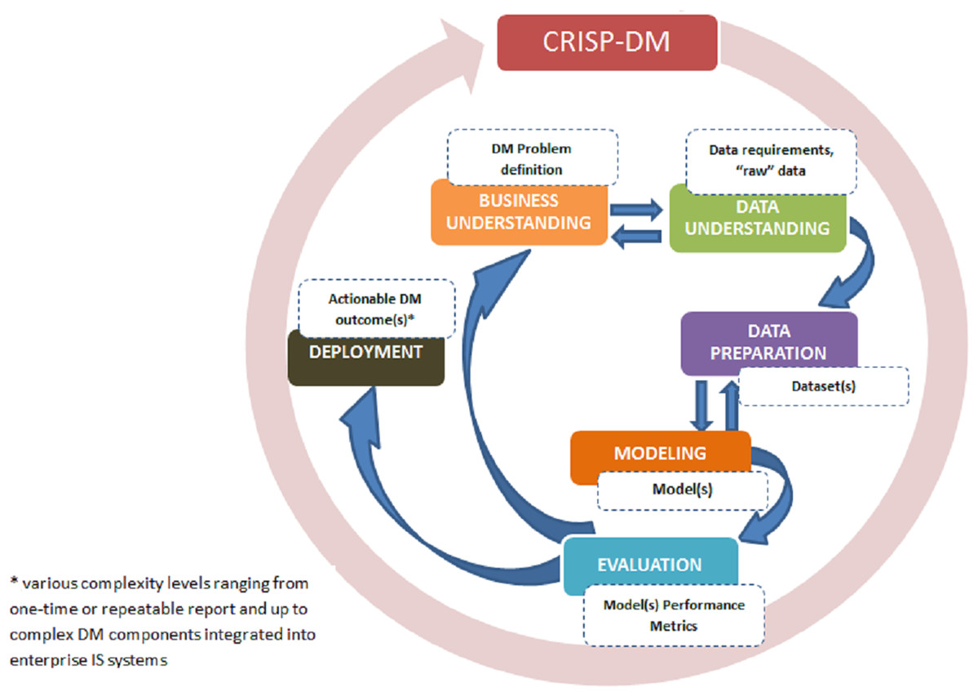
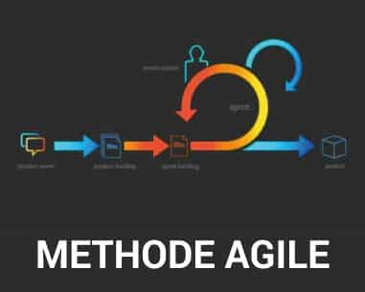
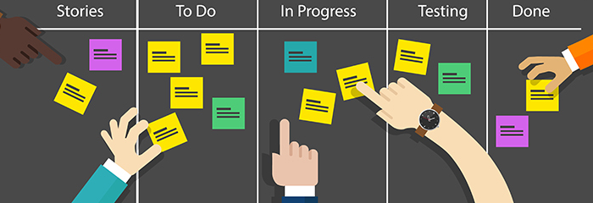
Working on master thesis
Thesis is about consuming and producing quality scientific contributions
Approach a problem systematically.
Evaluation should be roughly 2/3 part.
Use tools such as Zotero, Mendeley
Try to automate what is redundant.
Take logs of experiment.
Share your progress, embrace feedbacks.
Ask for help.
No strict rules for length
Organize/use tags to arrange various things
Freeze things 1-2 weeks before submission

Slide 9
Writing Master thesis
Start writing at the early stage
Utilize what you learnt from logs.
Have at least 2 reviews from friends and then 2 reviews from supervisor. Must take your supervisor review.
Must revise until you are confident.
Automate redundant process.

Slide 10
Defense Presentation
Present your results and defend your work
Presentation should convey complete picture of your master thesis including methodology, contribution, future work, and conclusion.
Timeline is after 6 months of thesis writing time
Check if this date falls in the next semester to identify if you should enroll for next semester
Answer questions and propose future work possibilities

Slide 11

Questions?

