Slide 1


K.L.E Society’s
C. B. Kore Polytechnic, Chikodi.
Adarsh Kokane
339CS22002
339CS22005
339CS22001
339CS23705
Aditya Mane
Prathamesh Devarkar
Soham More

Slide 2
Contents
INTRODUCTION
OBJECTIVES
HARDWARE AND SOFTWARE REQUIREMENTS
TECHNOLOGIES AND LANGUAGES
DATA FLOW DIAGRAM
ERD DIAGRAM
BENEFITS
SCREENSHOTS OF PROJECT
FUTURESCOPE
USE-CASES
CONCLUSION

Slide 3
INTRODUCTION
A Job Portal is an online platform that connects job seekers with recruiters. It serves as a bridge between candidates looking for employment and employers searching for the right talent. The system provides an easy-to-use interface where candidates can sign up, create profiles, search for jobs, apply by uploading resumes, and filter jobs based on location and company. On the other hand, recruiters can register, post job vacancies, manage company profiles, and view applications from candidates.

Slide 4
OBJECTIVES
Provide a User-Friendly Job Search Platform.
Simplify the Job Application Process.
Enable Recruiters to Post and Manage Jobs
Allow Candidates to Save and Bookmark Jobs
Improve the Job Matching System

Slide 5
Hardware and Software Requirements
Software:
Operating System : Windows 10/11, macOS, Linux (Ubuntu preferred)
Frontend Technologies : HTML, CSS, JavaScript, React.js
Backend Technologies : Node.js with Express.js
Database : Supa base
Version Control : Git, GitHub/GitLab/Bitbucket
Package Manager : npm
IDE/Code Editor : VS Code, Sublime Text, or IntelliJ IDEA
Browser : Google Chrome, Firefox, or Edge
Hardware:
Processor: Intel Core i3 or equivalent
RAM : 4GB
Storage : 100GB SDD
Display:1366x768 resolution

Slide 6
Technologies AND LANGUAGES
FORNTEND
REACT
JAVASCRIPT
CSS
IDE
Visual Studio
Sublime
BACKEND
Node js

Slide 7
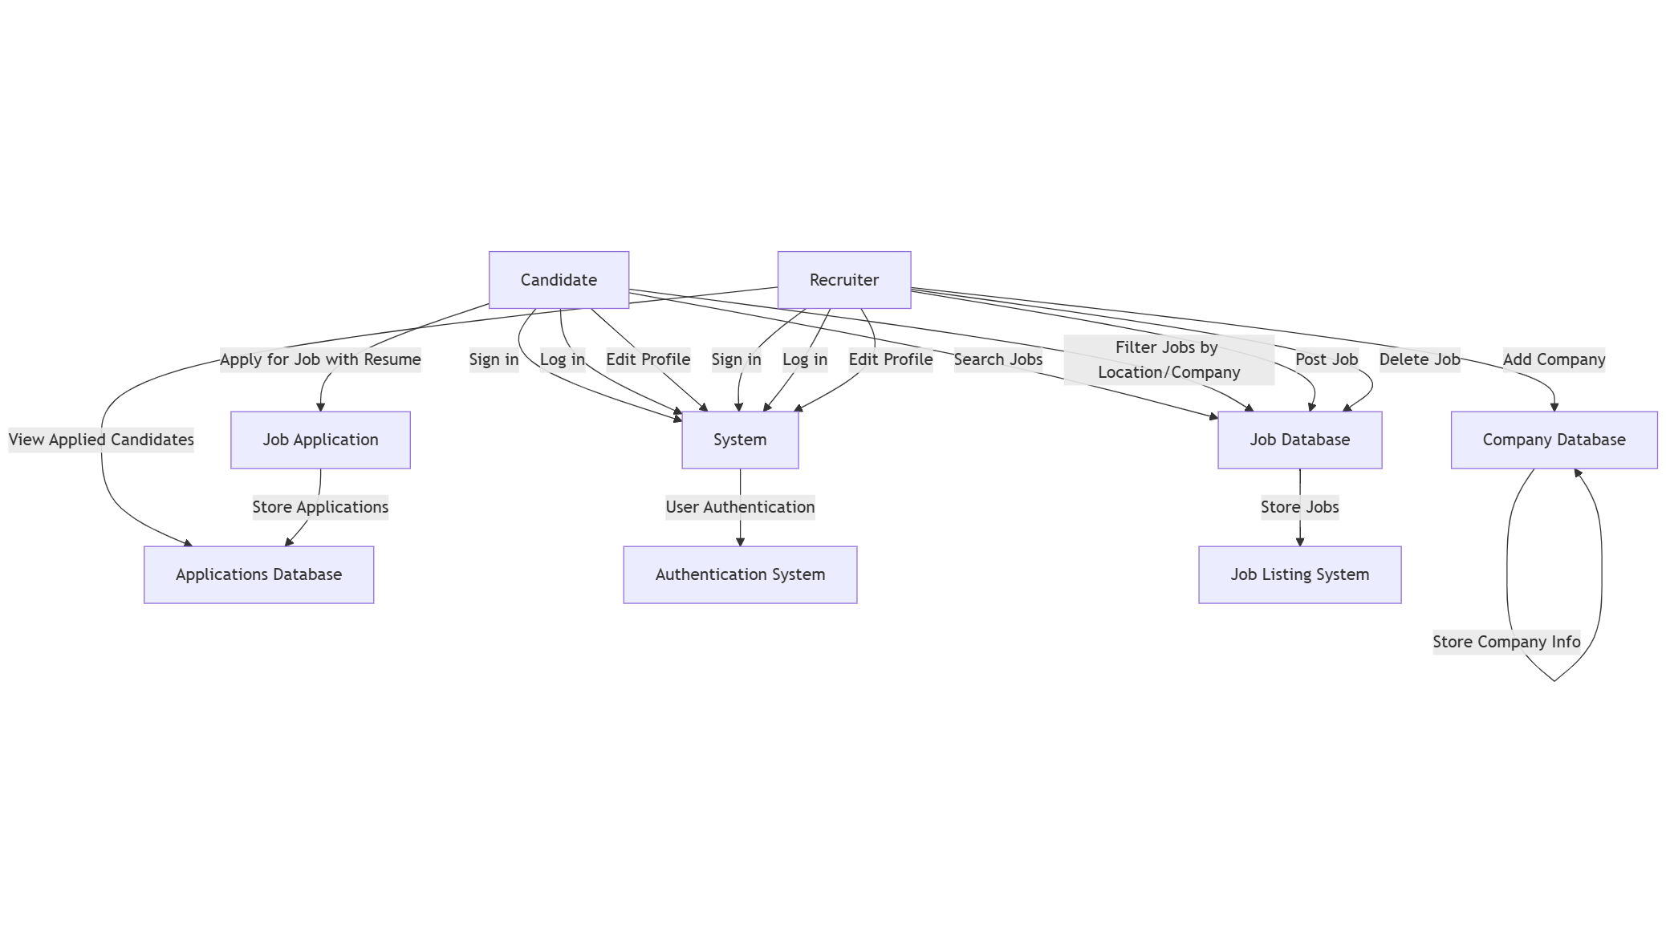
Data flow diagram

Slide 8
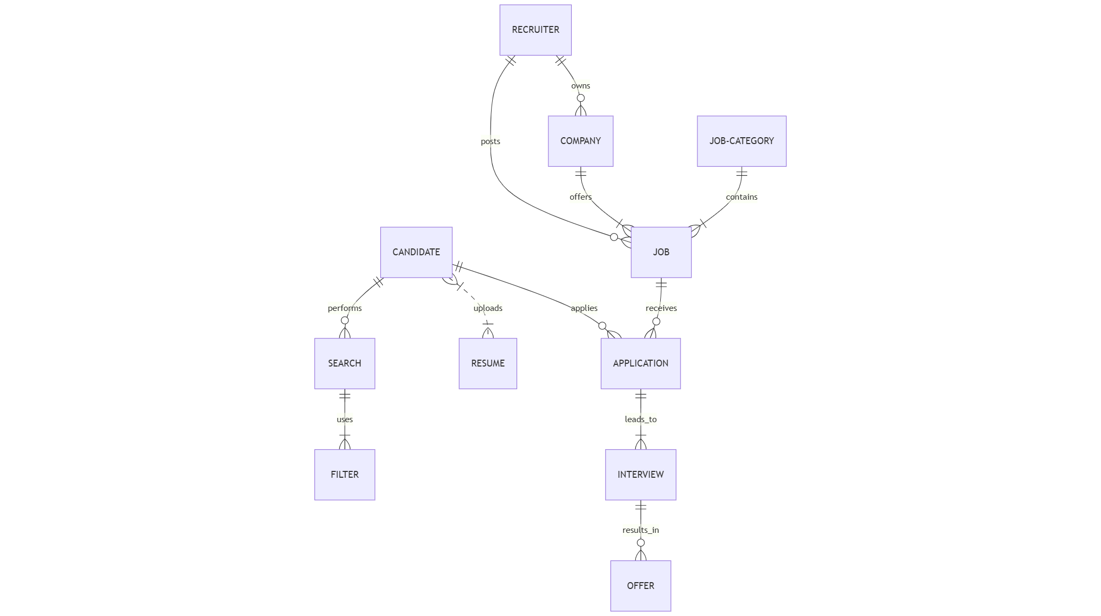
Er diagram

Slide 9
Benefits
Efficient Job Matching: It streamlines the job search and hiring process by connecting candidates with recruiters quickly and easily.
Centralized Platform: Both job seekers and recruiters can manage their profiles, applications, and job postings in one place, saving time and effort.
Increased Opportunities: It provides candidates with more job opportunities and recruiters with access to a larger pool of potential employees.
Improved User Experience: The platform makes it easier for users to navigate, apply, and post jobs with features like profile editing, resume uploads, and job filtering.

Slide 10
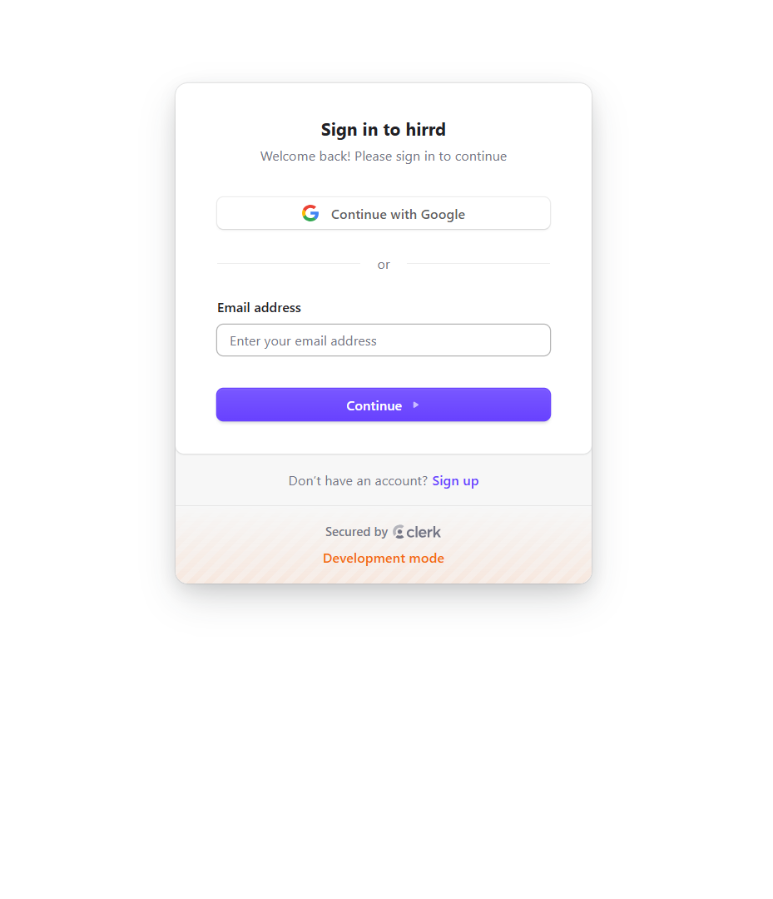
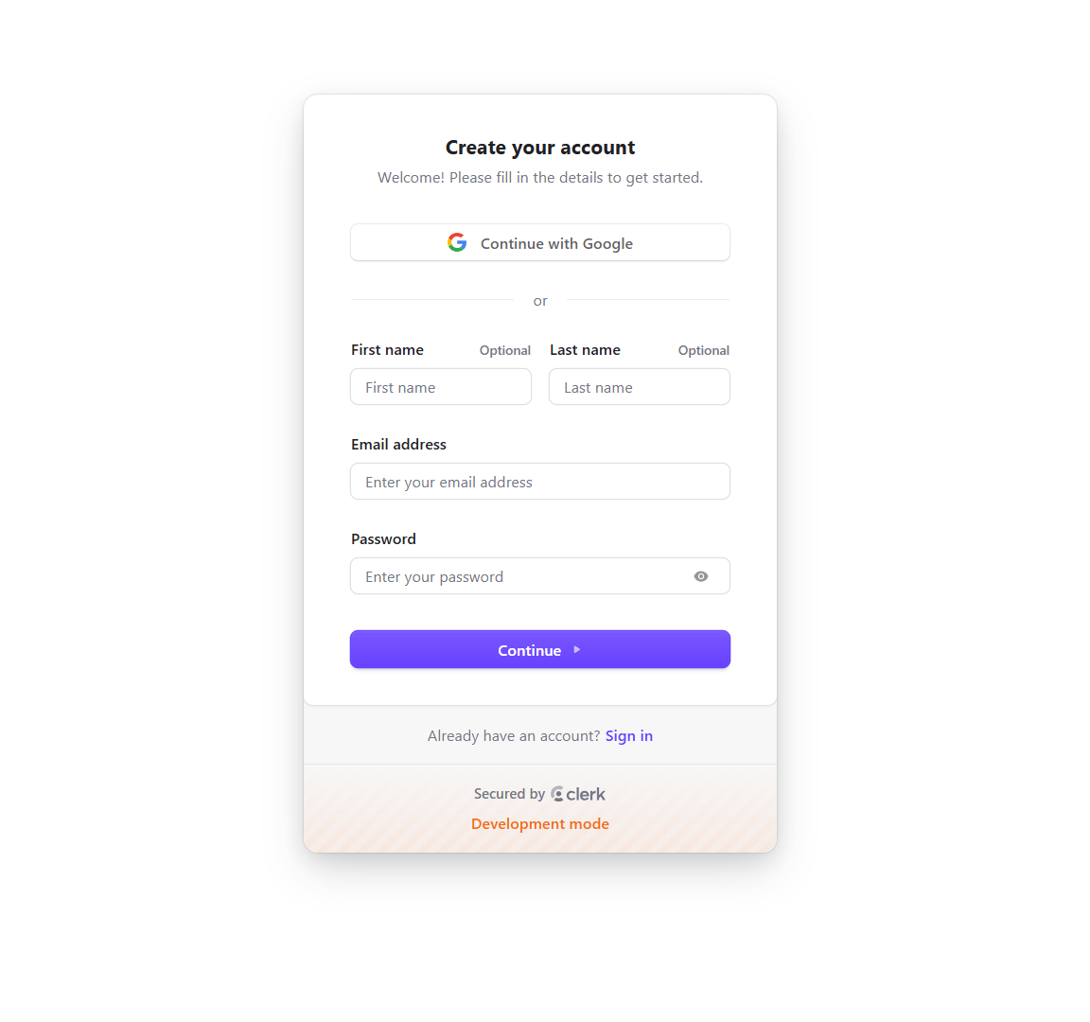
Sign up or register page

Slide 11
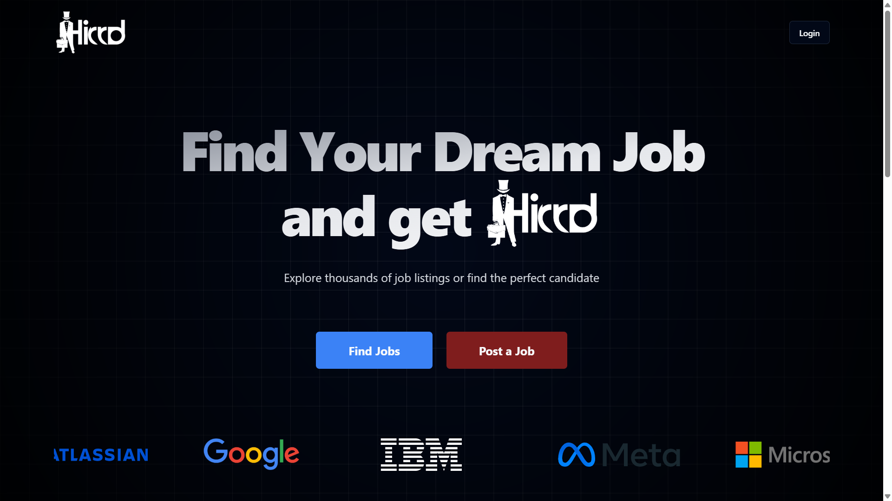
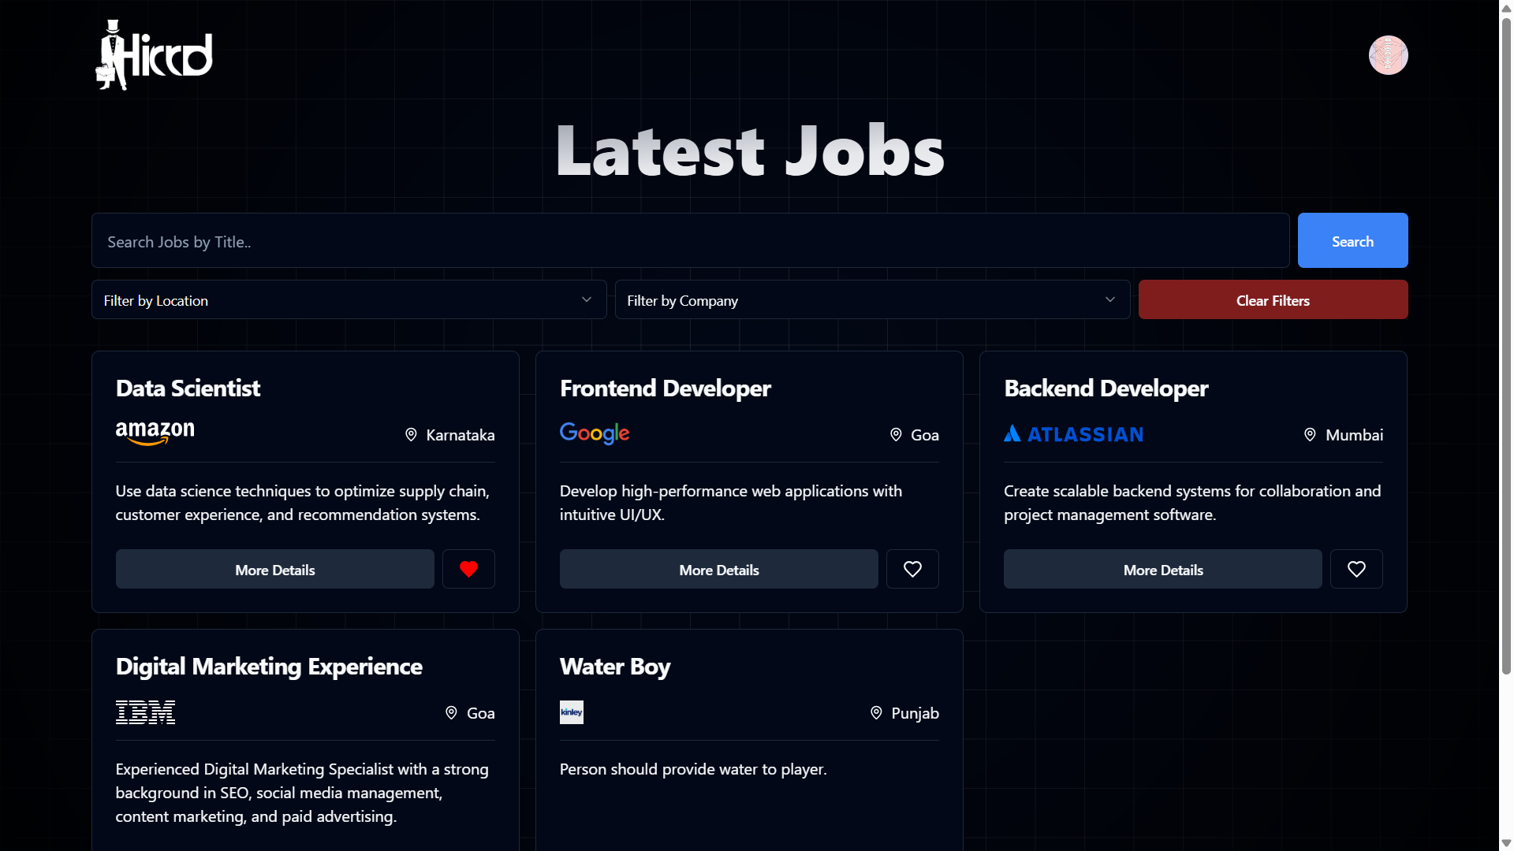
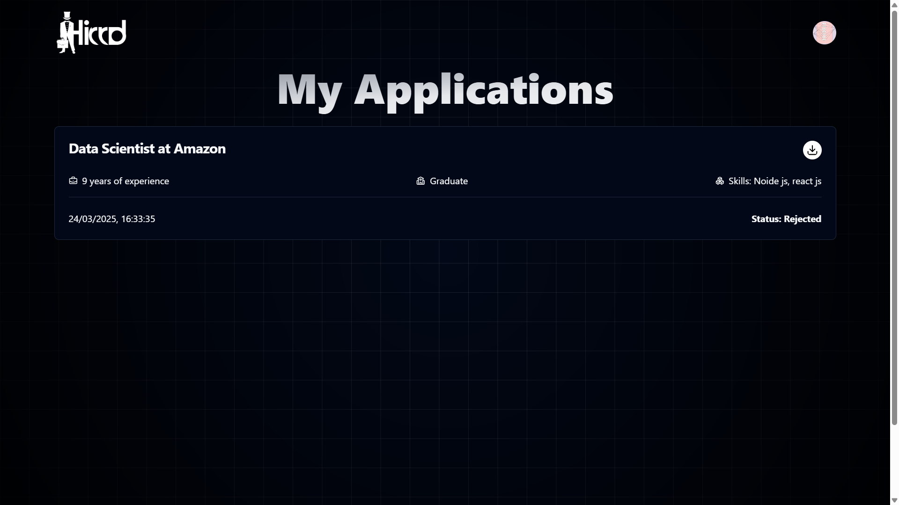
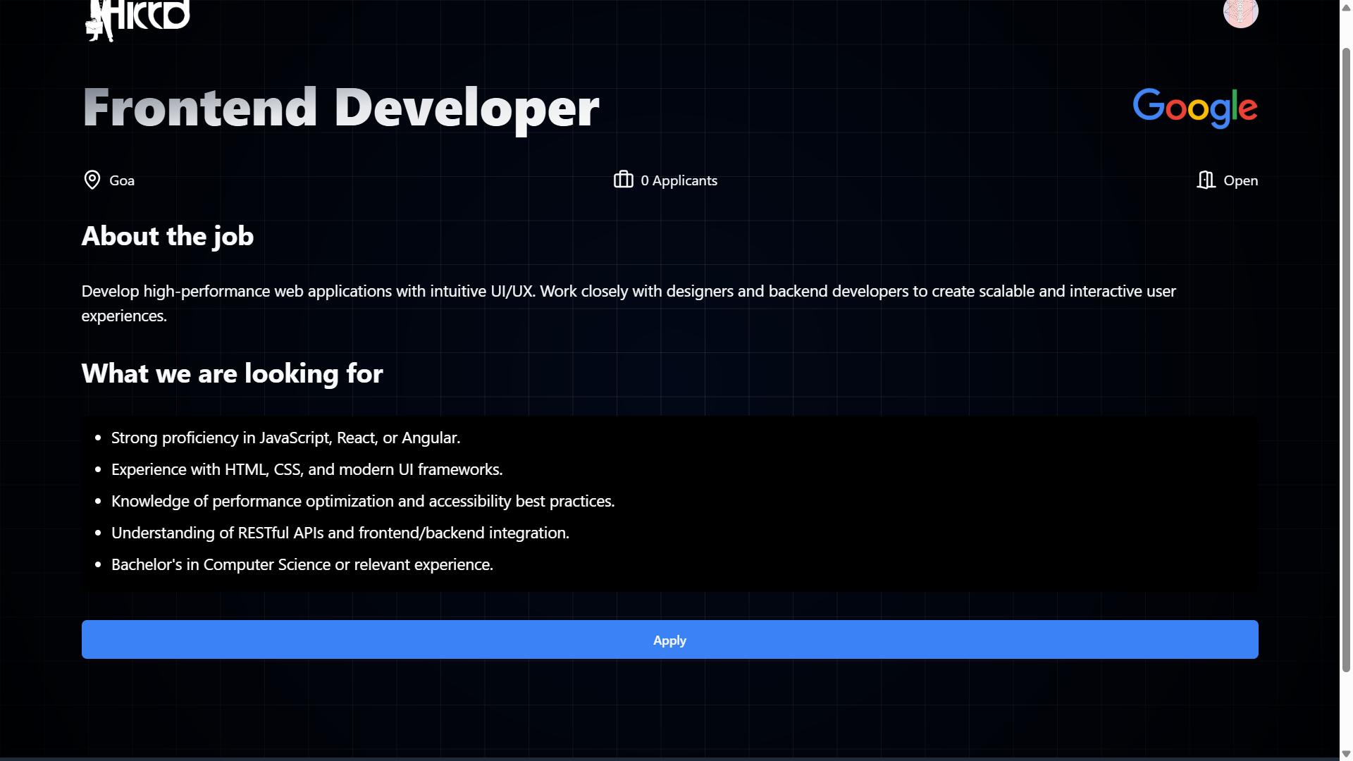
Candidate Interface

Slide 12
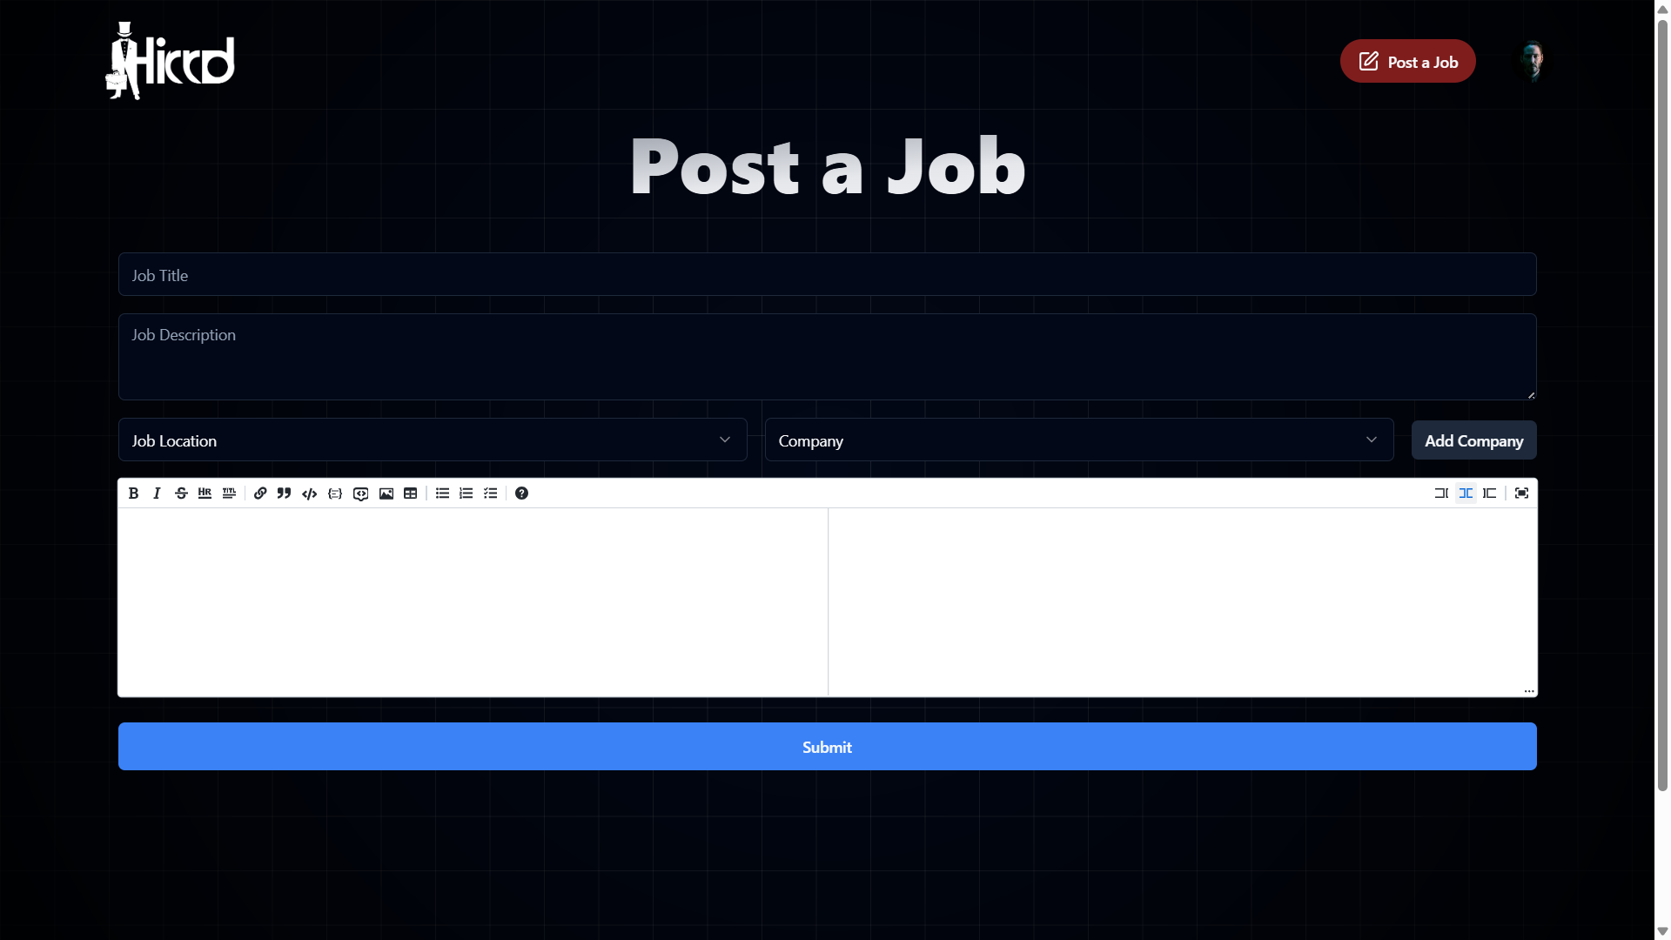
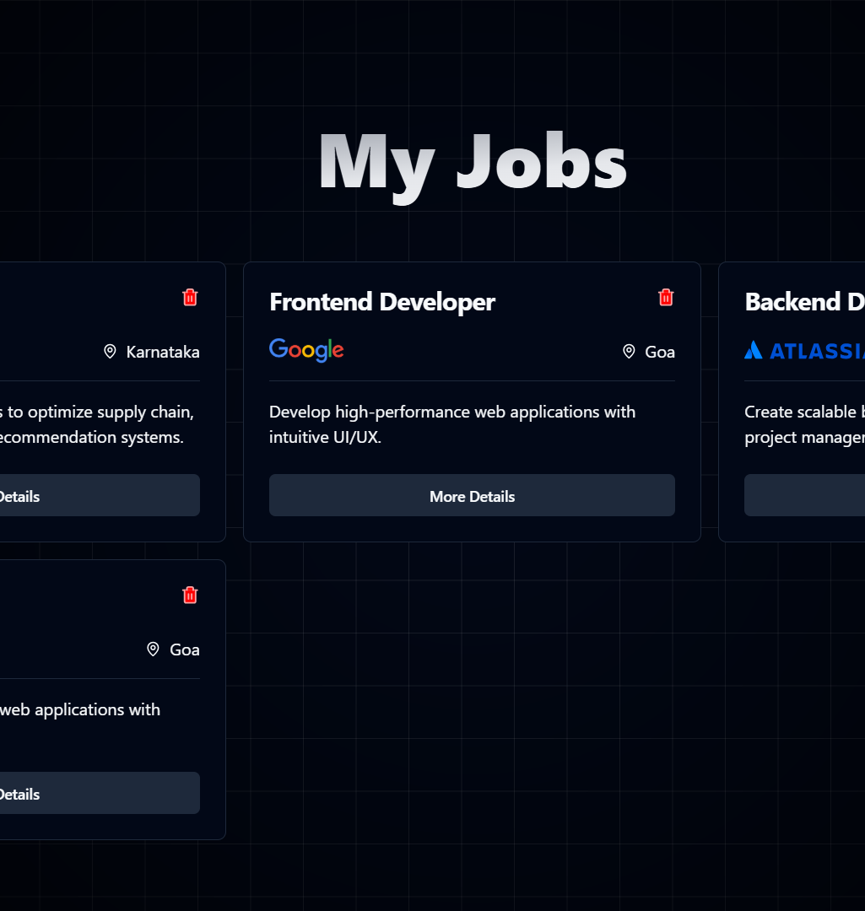
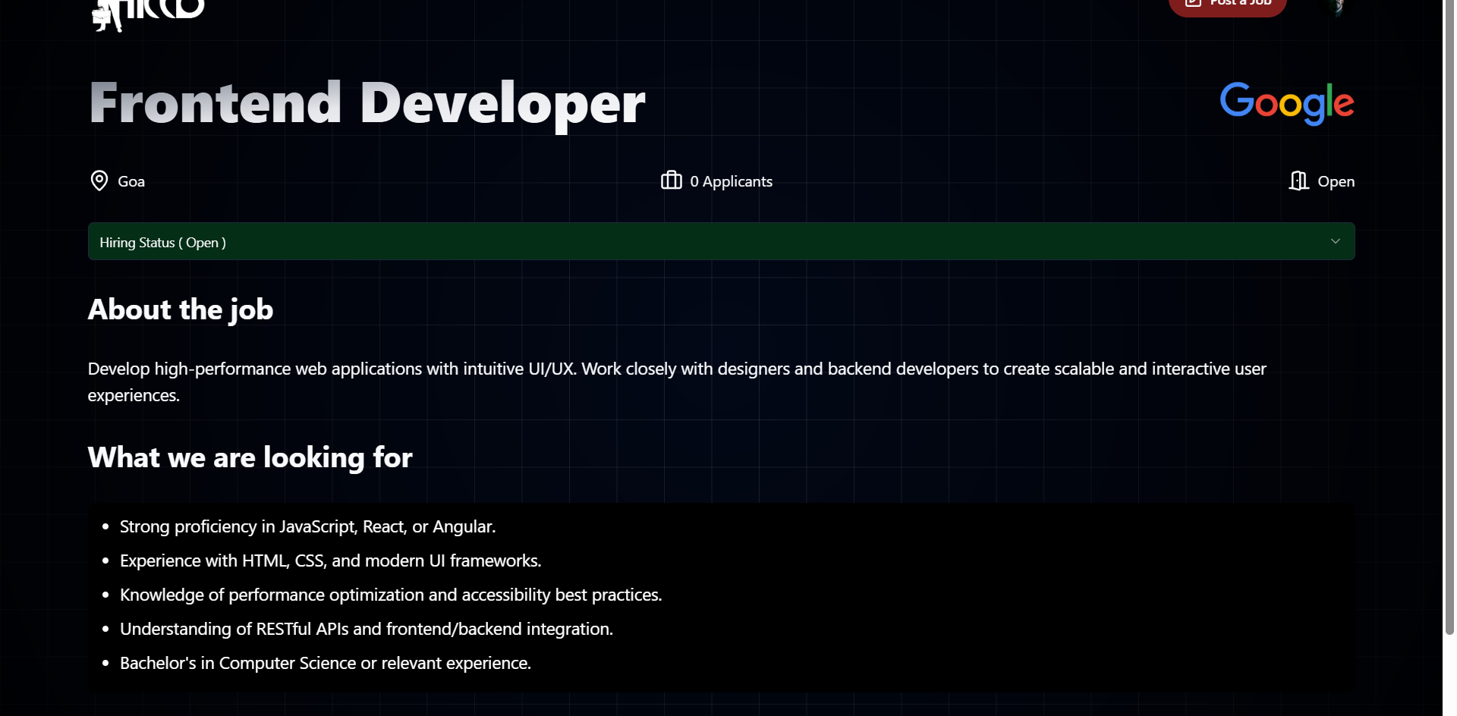
Recruiter Interface

Slide 13
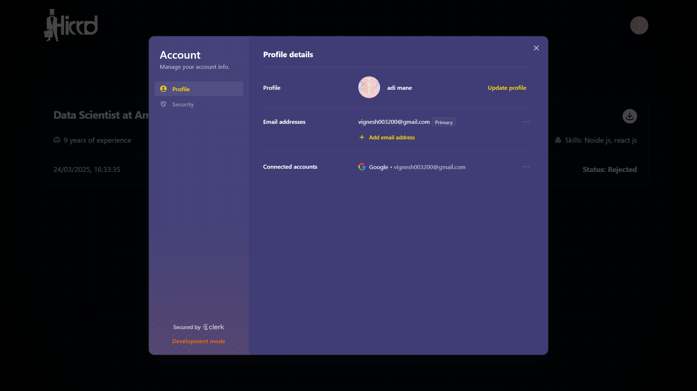
Manage Profile

Slide 14
Future scope
Video Interview Integration
Skill Assessment and Certification Integration
Internship and Training Program Listings
Smart AI-Based Negotiation Assistance for Job Offers
Automated Job Alerts for Candidates

Slide 15
Candidate Sign Up / Login
Edit Candidate Profile
Open the job portal homepage.
Click on “Sign Up”.
Enter required details (name, email, password).
Click “Register” to create an account.
For login, enter email and password and click “Login”.
Go to “My Profile”.
Click on “Edit”.
Update information like name , email etc.
Click “Save”.

Slide 16
Job Search and Filtering
Apply for Job
Browse job listings.
Select a job.
Click “Apply”.
Upload resume if not already uploaded.
Submit application.
Navigate to “Search Jobs”.
Enter keywords in search bar.
Apply filters like location or company.
View relevant job listings.

Slide 17
Recruiter Sign Up / Login
Post a Job
Open the portal.
Click on “Recruiter Sign Up”.
Fill in details (name, email, company, password).
Click “Register”.
Use credentials to log in.
Navigate to “Post Job”.
Enter job title, description, location, requirements.
Click “Post Job”.

Slide 18
Conclusion
The Job Portal System is a powerful platform that simplifies the hiring process for both candidates and recruiters. It enables candidates to search, apply for jobs, and manage their profiles efficiently, while recruiters can post jobs, review applications, and hire the right talent seamlessly.
With features like resume uploads, job filtering, and application tracking, the system enhances the overall job search experience. Additionally, future enhancements like AI-powered recommendations, automated screening, and virtual interviews will further improve efficiency and accessibility.
This project not only streamlines the recruitment process but also bridges the gap between job seekers and employers, making it a valuable solution for the modern job market.

Slide 19
Thank You

