Slide 1

KLE SOCIETY’S
CHIDAND.B.KORE POLYTECHNINC, CHIKODI
KARNATAKA 2024-2025
DEPARTMENT OF COMPUTER SICENCE & ENGINEERING
A SYNOPSIS REPORT ON
“ONLINE BLOOD BANK MANAGEMENT”
Submitted for partial fulfillment of the requirement of the award of the
DIPLOMA IN COMPUTER SCIENCE & ENGINEERING UNDER THE GUIDENCE OF
Miss . Sarita Khot (Lecturer)
A Project Synopsis
By
Adarsh Kokane 339CS22002
Aditya Mane 339CS22005
Prathamesh Devarkar 339CS22001
Soham More 339CS23705

Slide 2
Contents
Introduction
Abstract
Objective
Advantages and Disadvantages
Problem Statement
Future Scope
Use-Cases
Use Case Diagram
Data flow Diagram
Screenshot Of Project
Conclusion

Slide 3
Introduction
A Blood Bank Management System (BBMS) is a specialized software solution that helps blood banks and healthcare institutions efficiently manage blood donation, storage, and distribution. It acts as a bridge between donors, recipients, and blood bank administrators, ensuring a smooth and organized blood supply process.
It streamlines the entire blood donation and distribution process, ensuring that blood units are efficiently collected, stored, and allocated based on demand, availability, and compatibility.
The system allows donors to register, schedule donations, and track their donation history. Hospital staff and administrators can review blood requests, manage inventory, and monitor supply levels in real time.

Slide 4
Abstract of Project
The Blood Bank Management System (BBMS) is a web-based application designed to streamline the process of blood donation, storage, and distribution. The system acts as a centralized platform connecting blood donors, recipients, and blood bank administrators, ensuring the efficient management of blood supply.
The system allows donors to register, schedule donations, and track their donation history. Hospitals and healthcare institutions can request specific blood types, while administrators can monitor inventory levels and ensure timely allocation of blood units. The BBMS enhances transparency, reduces manual errors, and ensures a quick response to emergencies by providing real-time updates on blood availability.
By automating donor registration, blood request processing, and inventory management, the system improves efficiency, minimizes wastage, and ensures that patients receive the required blood on time. This project aims to provide a reliable and user-friendly solution to support the critical needs of blood banks and healthcare facilities.

Slide 5
OBJECTIVE
Automate donor registration, scheduling, and donation tracking.
Maintain real-time blood inventory for efficient management.
Ensure transparency and security in blood donation records.
Integrate with healthcare systems for smooth coordination.
Reduce wastage by optimizing blood storage and distribution.

Slide 6
Advantages
User-Friendly Interface – Makes it easy for donors, recipients, and staff to navigate and use the system.
Easy Search & Matching – Allows searching for donors or blood units based on type, location, or urgency.
Efficient Blood Storage & Tracking – Helps in managing blood inventory, tracking donations, and ensuring proper storage.
Faster Blood Availability – Quick search and retrieval of blood based on type, availability, and location.

Slide 7
Disadvantages
Technical Issues – System crashes, bugs, or slow servers can cause delays.
Data Security Risks – Sensitive donor and patient data must be protected from hacking or misuse.
Dependency on Internet – Cloud-based systems require stable internet for smooth operation.
Limited Adoption in Rural Areas – Some areas may lack the technology or awareness to implement the system.

Slide 8
Problem statement
Manual Donor Search – Finding a suitable blood donor is often done through word of mouth or outdated records, making the process slow and inefficient.
Data Management Issues – Storing and updating donor details manually can lead to inconsistencies, missing records, and outdated information.
Lack of Real-Time Availability – There is no system to check if a donor is currently available or has recently donated blood, leading to delays.
Limited Search Options – Users cannot efficiently filter donors based on specific blood groups and locations, making the search process difficult.
Communication Gap – There is no direct way for recipients to contact potential donors, creating delays in emergency situations.

Slide 9
Future Scope
The Blood Bank System has established a solid foundation for efficient blood donation and management, yet there are several areas where the system can be expanded and improved upon. Below are potential directions for future development:
AI-Powered Donor Matching
Mobile Application
Cloud-Based Data Management
Integration with Social Media Platforms

Slide 10
User Login
USE CASES
User Registration (Sign Up
The user navigates to the homepage.
The user clicks on the "Sign Up" button.
The system displays the sign-up form with fields for
Name, Email, Password, Blood Group, and State.
The user enters valid details in all fields.
The user clicks the "Submit" button.
The user navigates to the homepage.
The user clicks the "Login" button.
The system redirects the user to the login page.
The user enters their email and password.
The user clicks the "Submit" button.

Slide 11
Search for Donors
View Donor List
The user clicks on the "Search Donors" option.
The system displays a search form with filters for Blood Group and State.
The user selects the required Blood Group and State.
The user clicks the "Search" button.
The user navigates to the "View Donors" button.
Available Donors will Display.

Slide 12
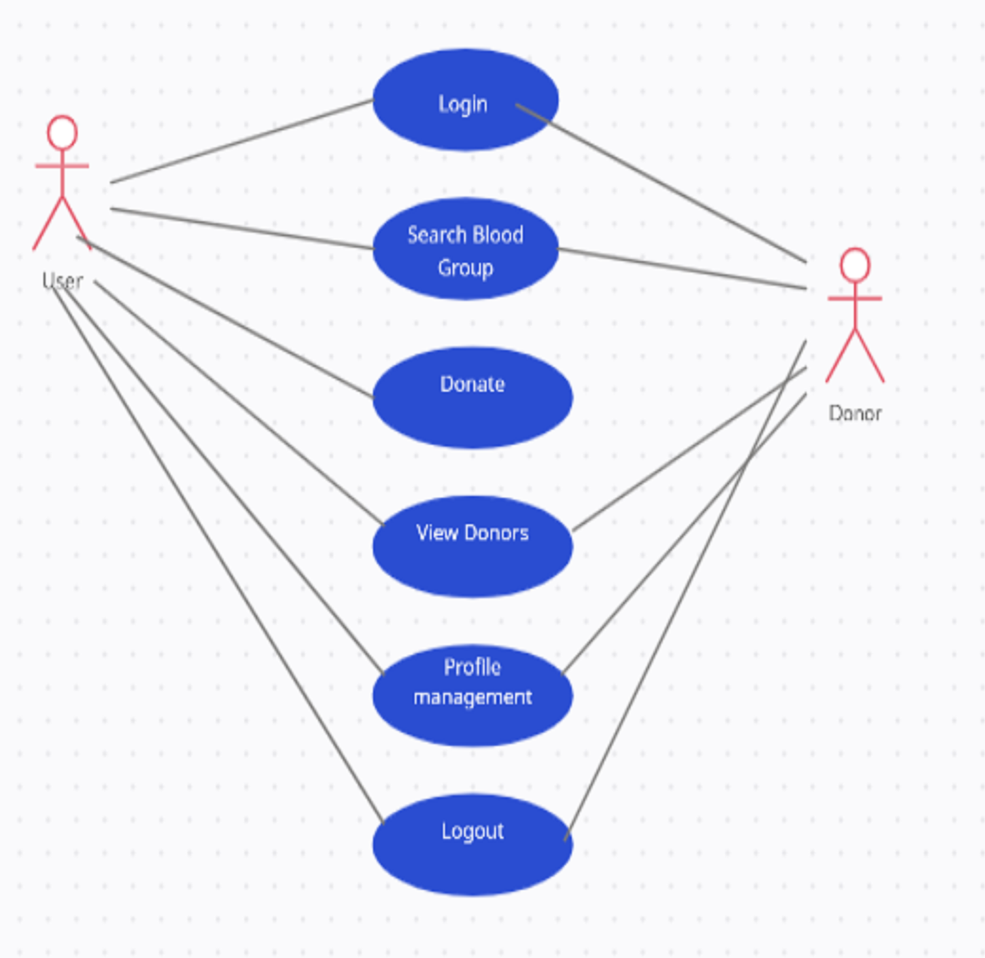
Use Case Diagram

Slide 13
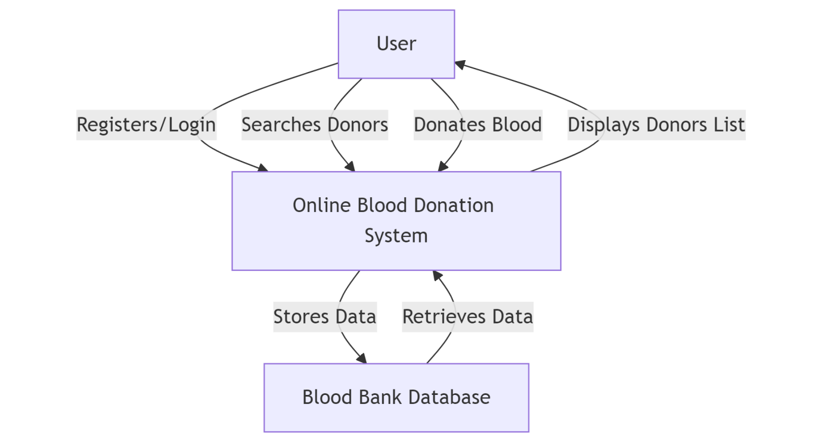
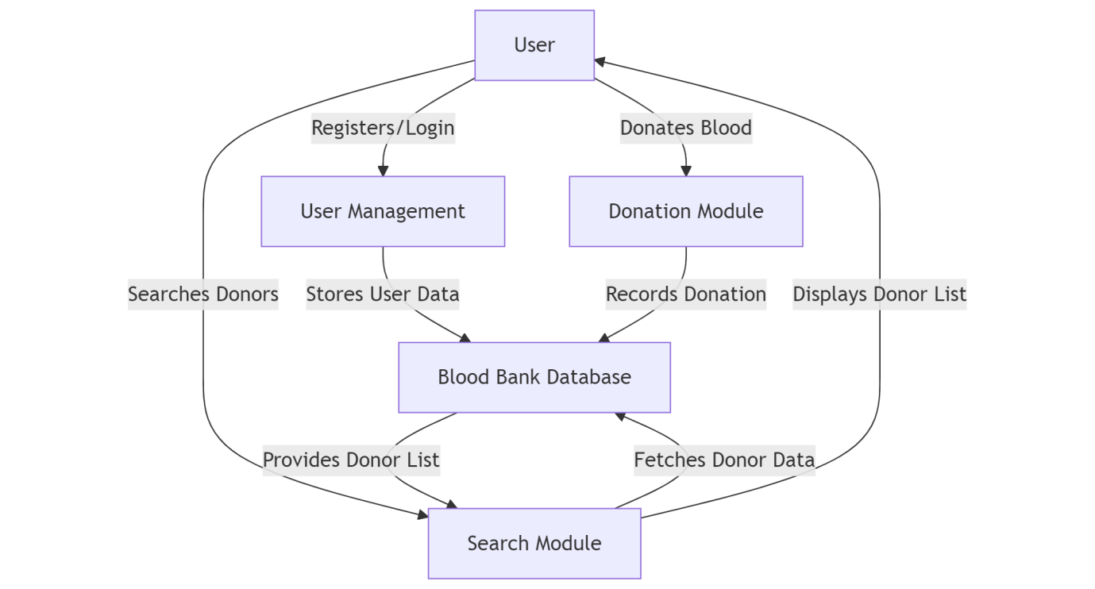
Data Flow Diagram

Slide 14
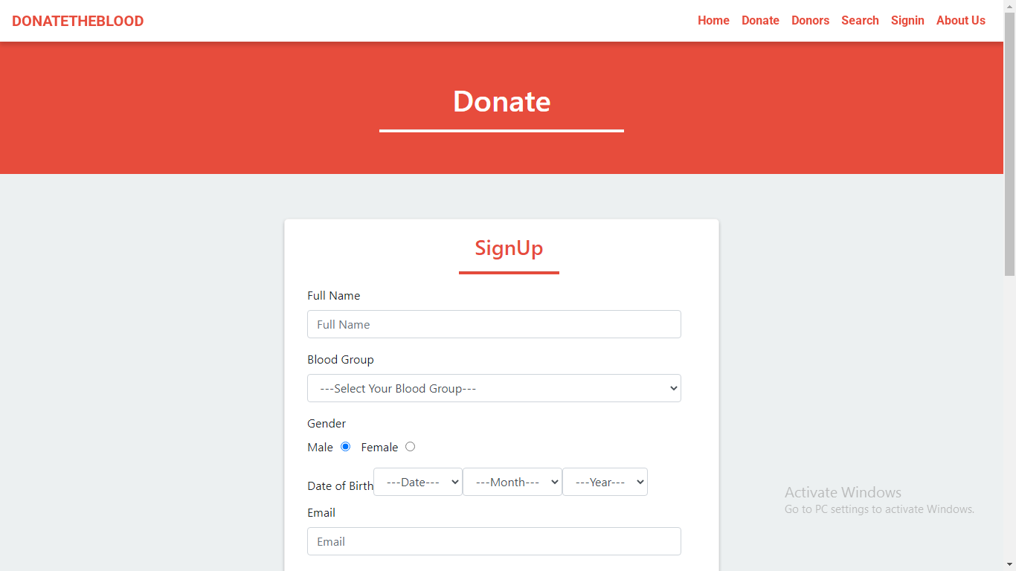
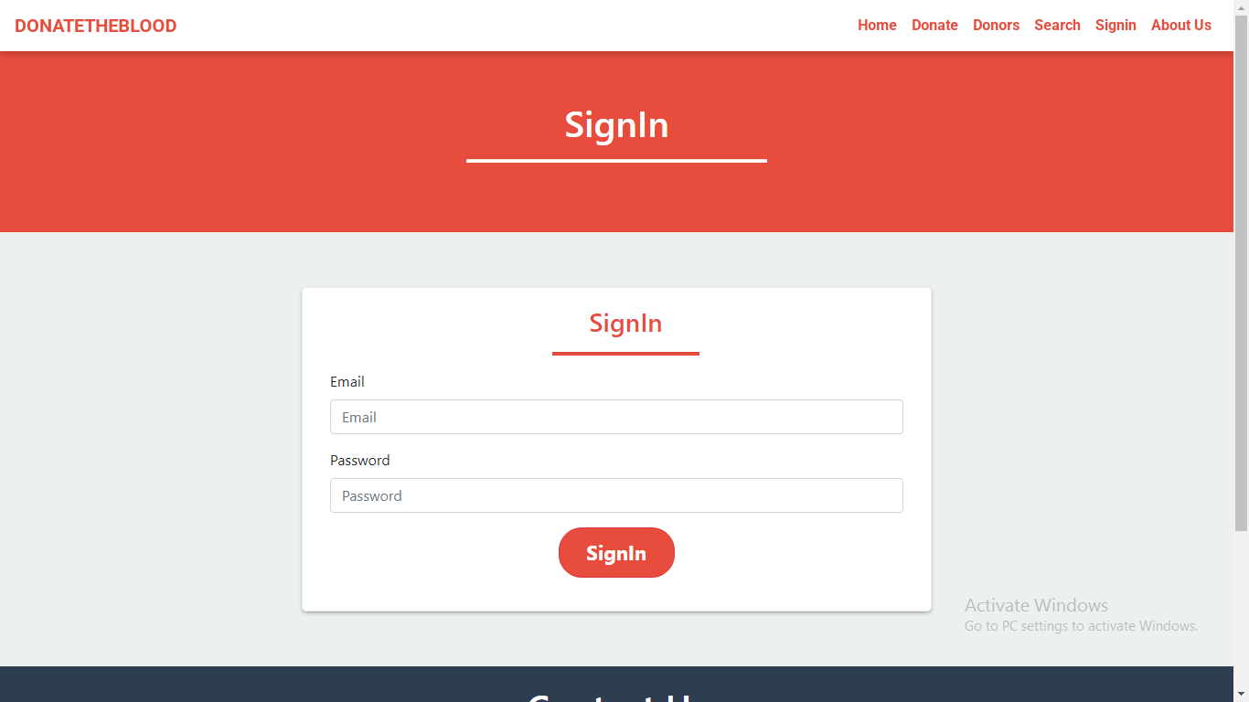
User Authentication

Slide 15
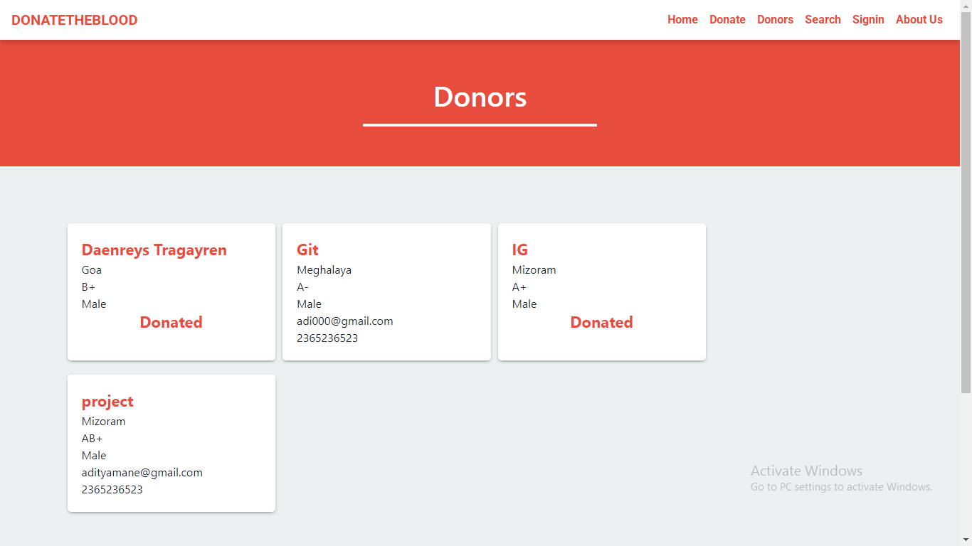
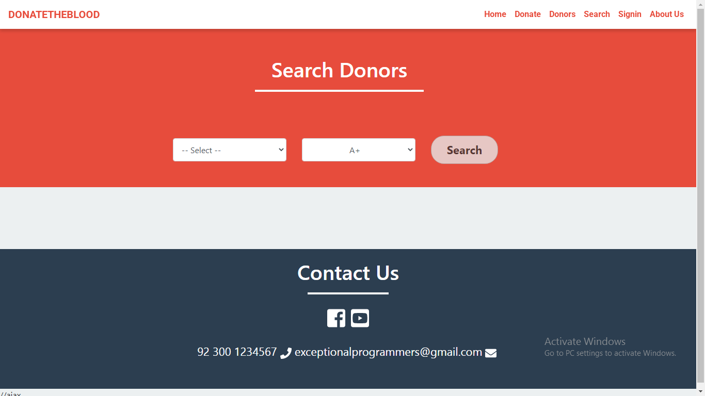
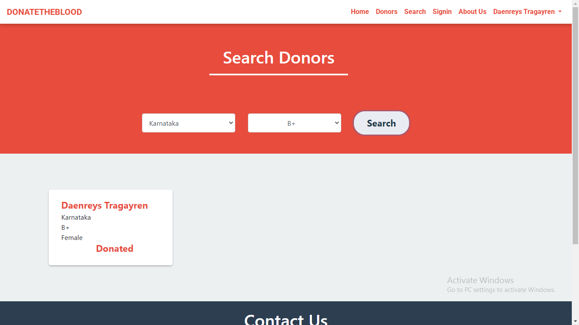
Donors and Search Function

Slide 16
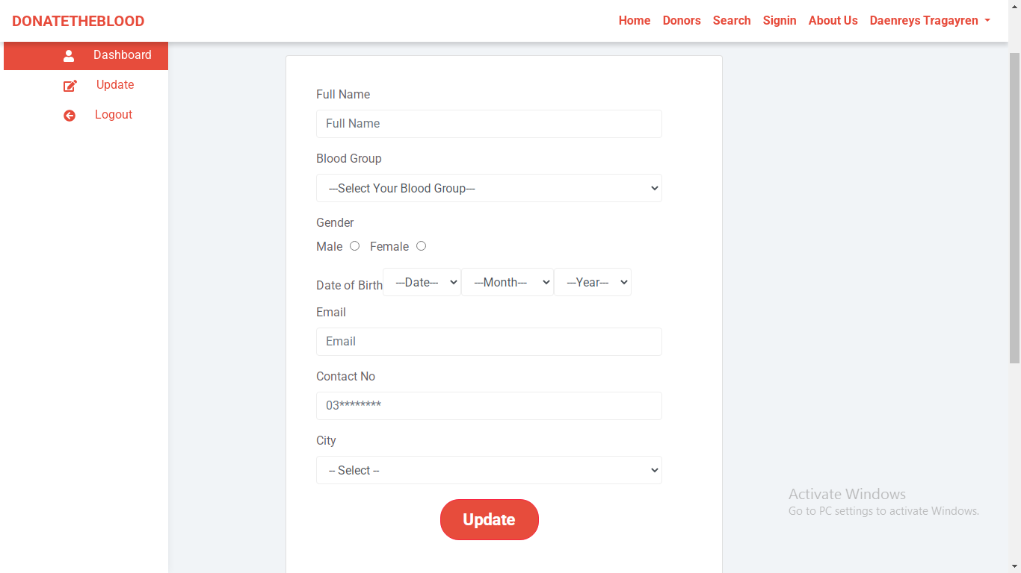
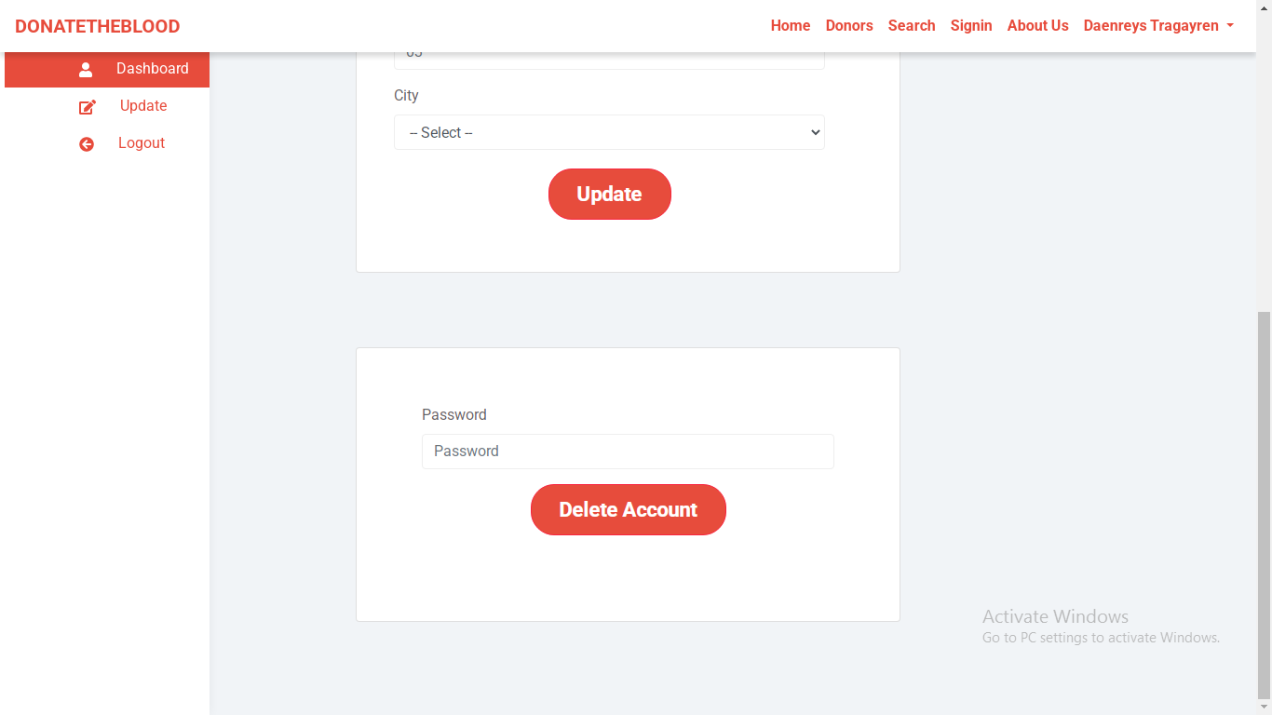
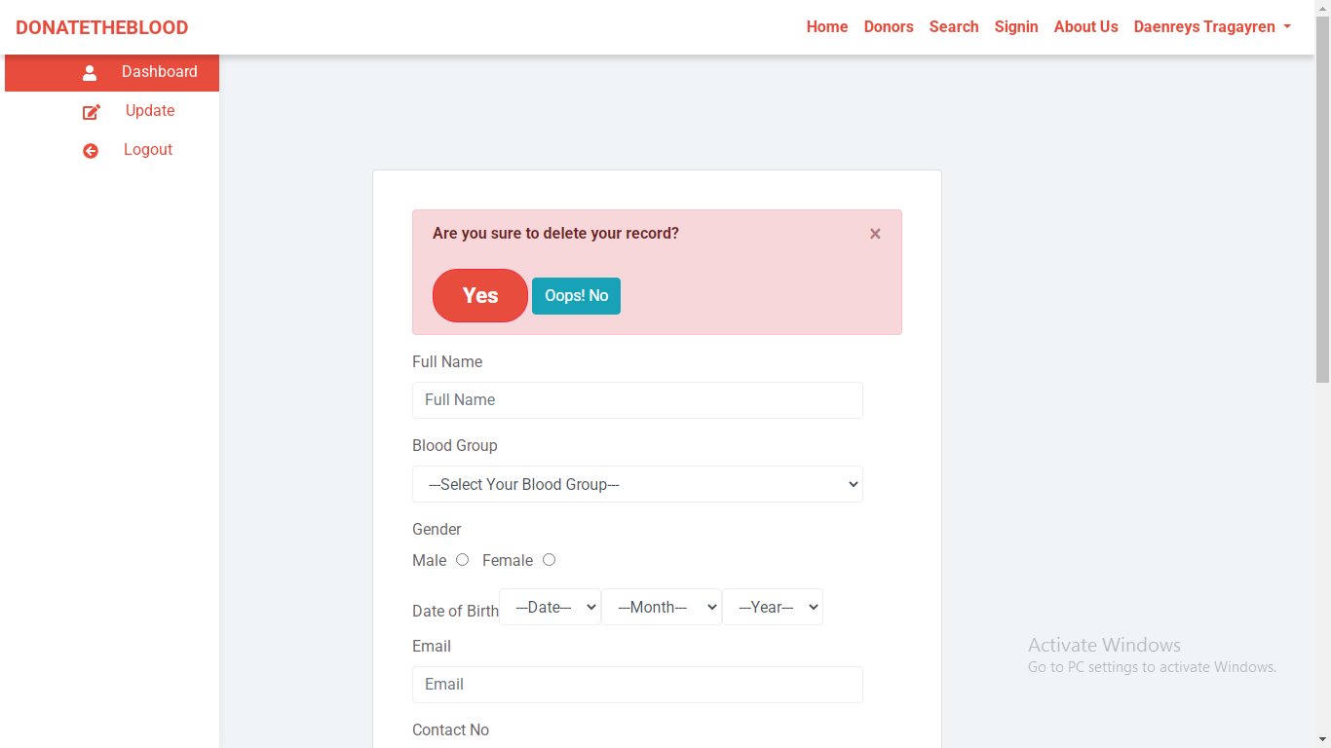
Account Update and Delete

Slide 17
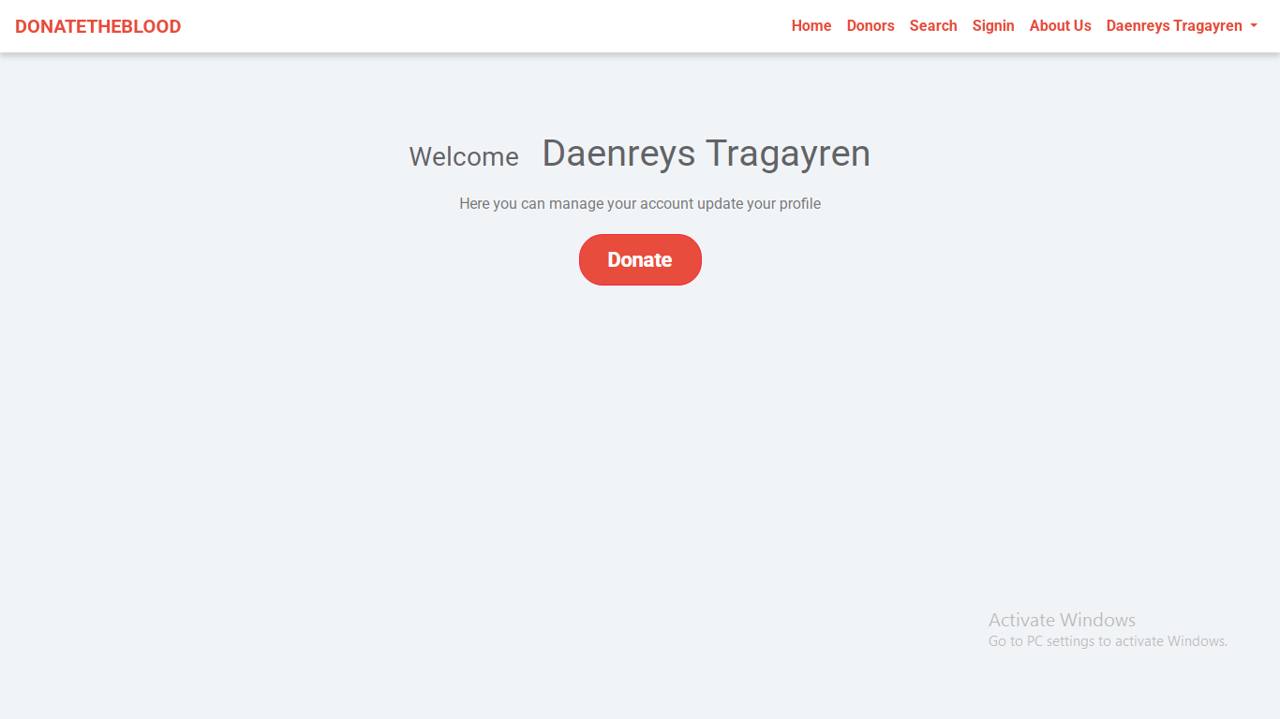
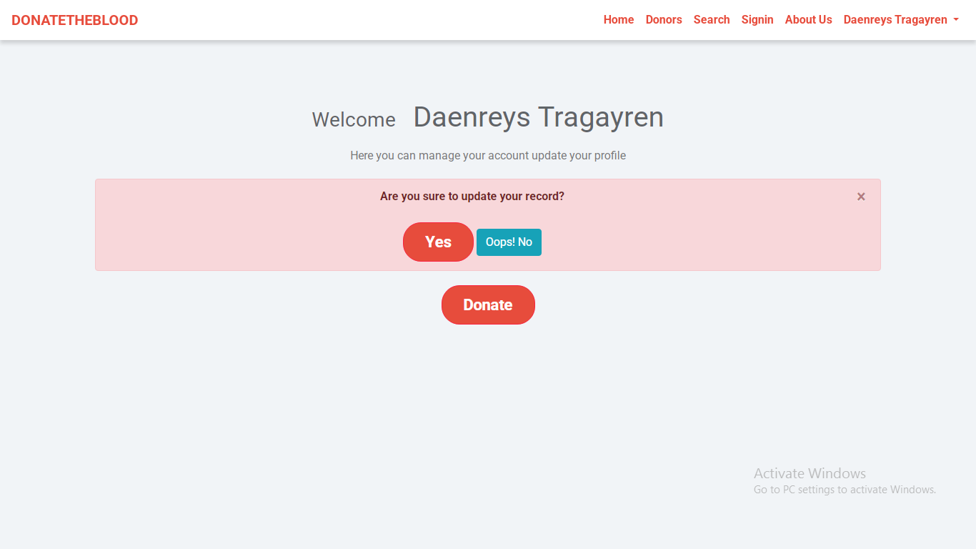
Notification

Slide 18
Conclusion
The Blood Bank System ensures a smooth and efficient blood donation process by connecting donors with those in need. It simplifies donor registration, search, and availability tracking, making blood donation more accessible. With future enhancements like AI matching and real-time notifications, the system can become even more effective in saving lives.

Slide 19
Thank you

