Slide 1
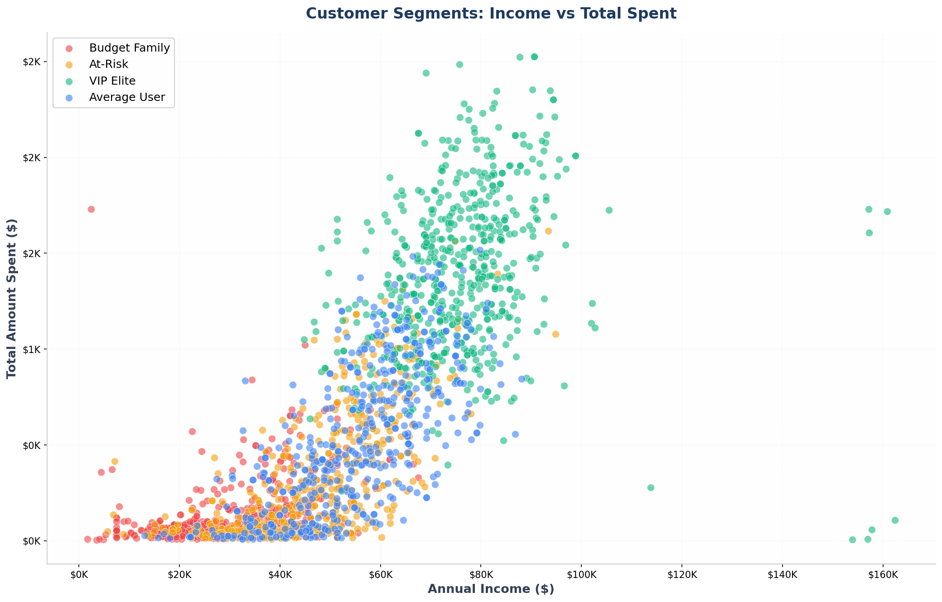
Customer Personality Analysis
AI-Powered Market Segmentation
Transforming Raw Data into Actionable Customer Insights
2,236 Customers Analyzed
Presented by: Group-3

Slide 2
CHALLENGE
The Business Problem
Current State
The Solution
Marketing team sends the same campaign to all 2,236 customers, resulting in low conversion rates and wasted marketing budget.
Leverage AI and Machine Learning to segment customers and predict campaign response, enabling personalized marketing strategies.
One-size-fits-all approach ignores customer diversity
Intelligent segmentation with 4 distinct personas
No identification of high-value customers
Predictive modeling for campaign success
Missing early warning system for customer churn
Real-time dashboard for instant insights
Lack of data-driven decision making
Data-driven strategic recommendations
Customer personality analysis helps a business to modify its product based on its target customers from different types of customer segments.
Finding the potential customers by analysing the behaviour of them is useful to understand the targeted customers.

Slide 3
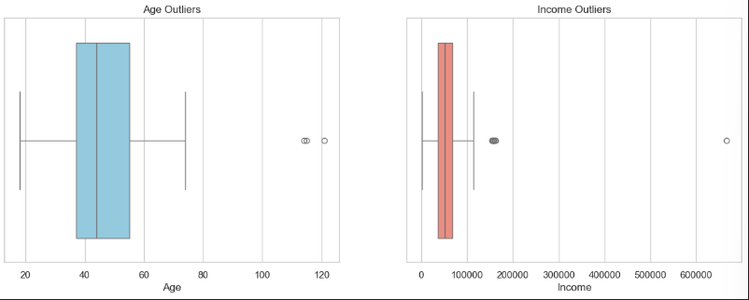
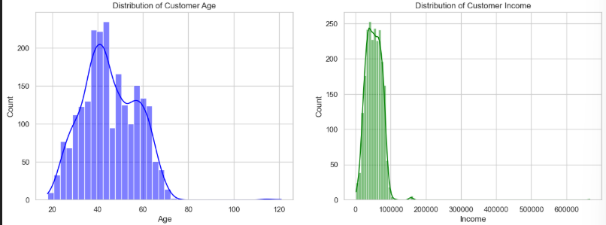
DATA EXPLORATION
Exploratory Data Analysis (EDA)
Understanding customer behavior patterns through statistical analysis
Missing Values: 24- Filled with Median
Outliers (Before Caping)
Histogram
Visualized the raw histograms first to provide statistical evidence of 'Right-Skewness', proving that outliers were distorting the mean and necessitating removal to ensure accurate K-Means centroid calculation.

Slide 4
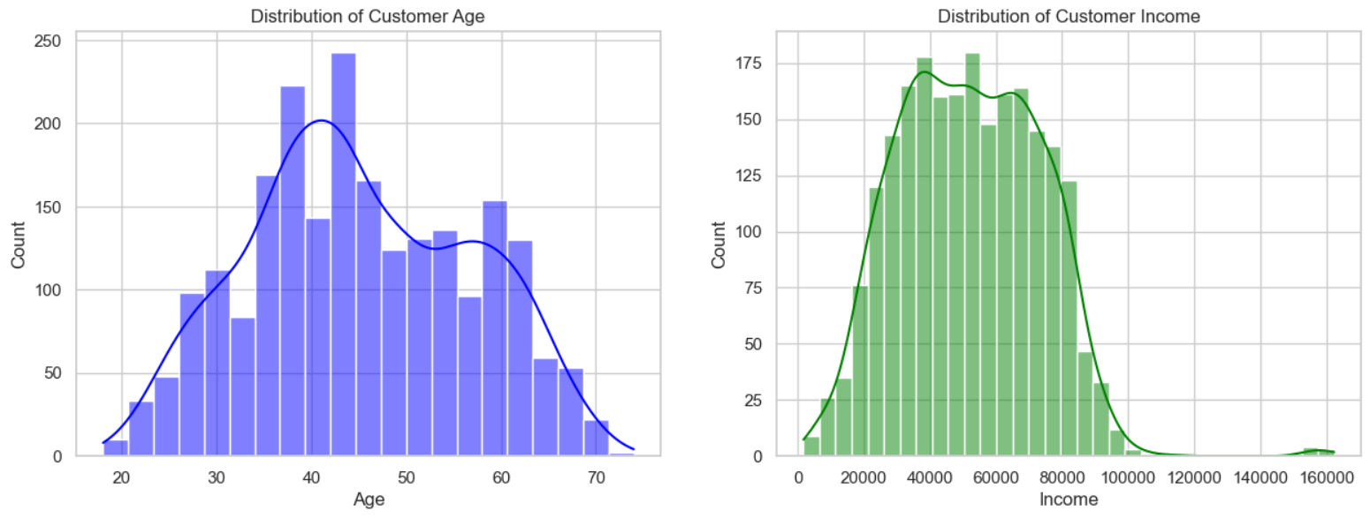
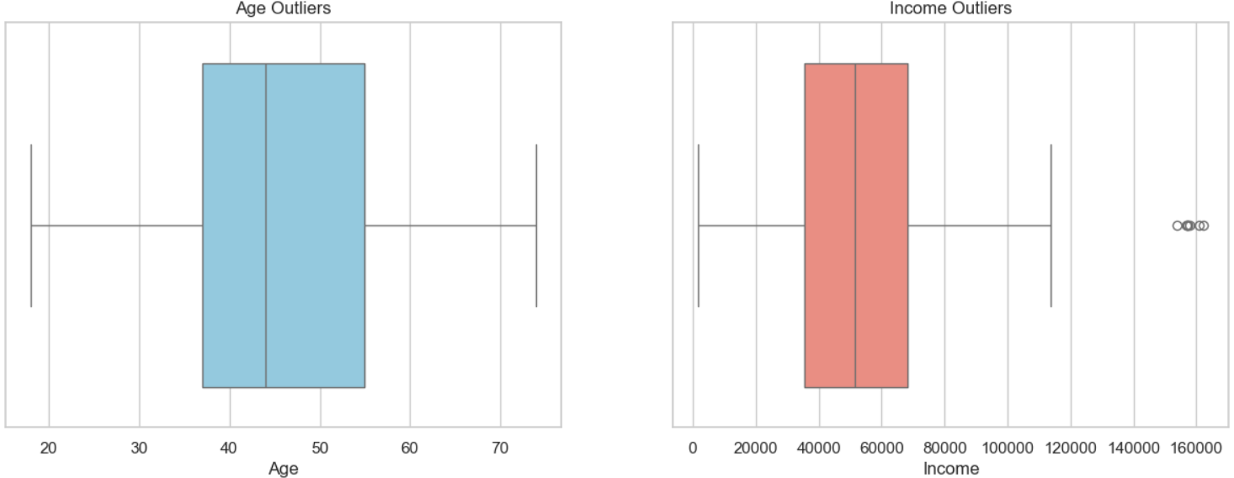
Visuals after handling the outlier
Histogram Boxplot
After cleaning we got beautiful, normal distributions (Bell Curves) .

Slide 5
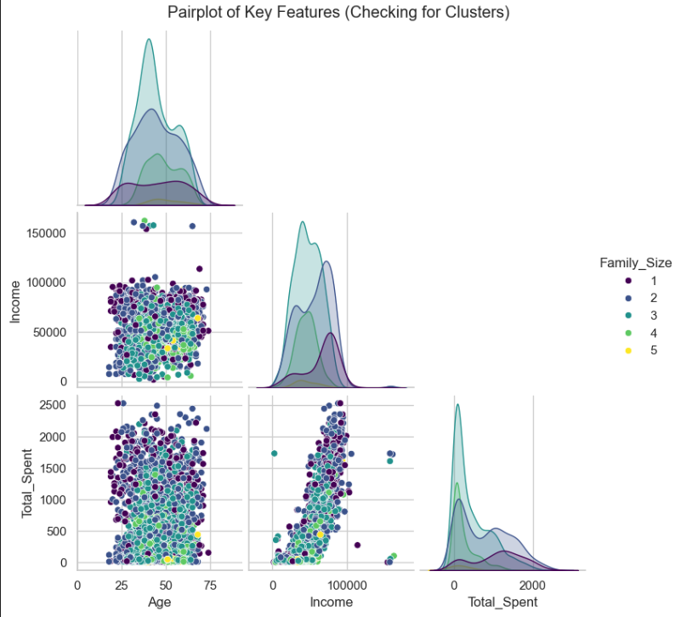
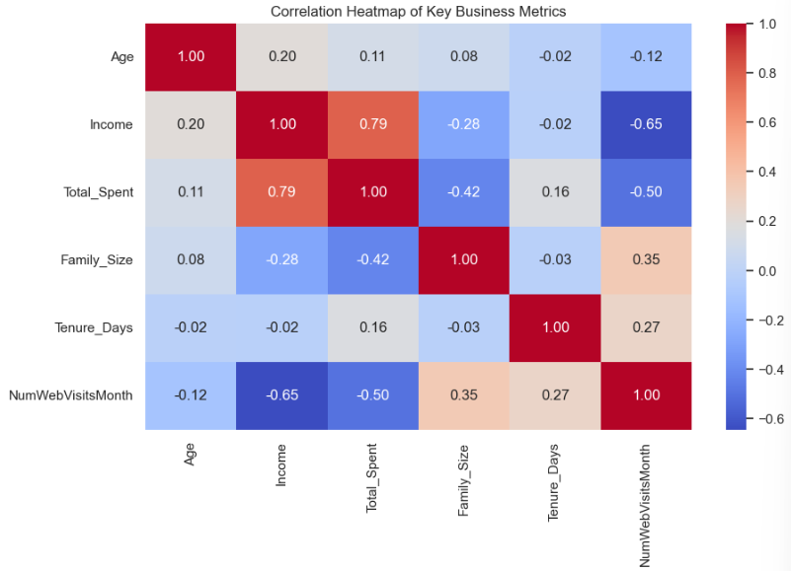
Pairplots help visualize relationships between multiple variables at the same time and show how customer groups naturally separate.
We used a correlation matrix to understand how strongly different features are related to each other, especially income, spending, and recency.

Slide 6
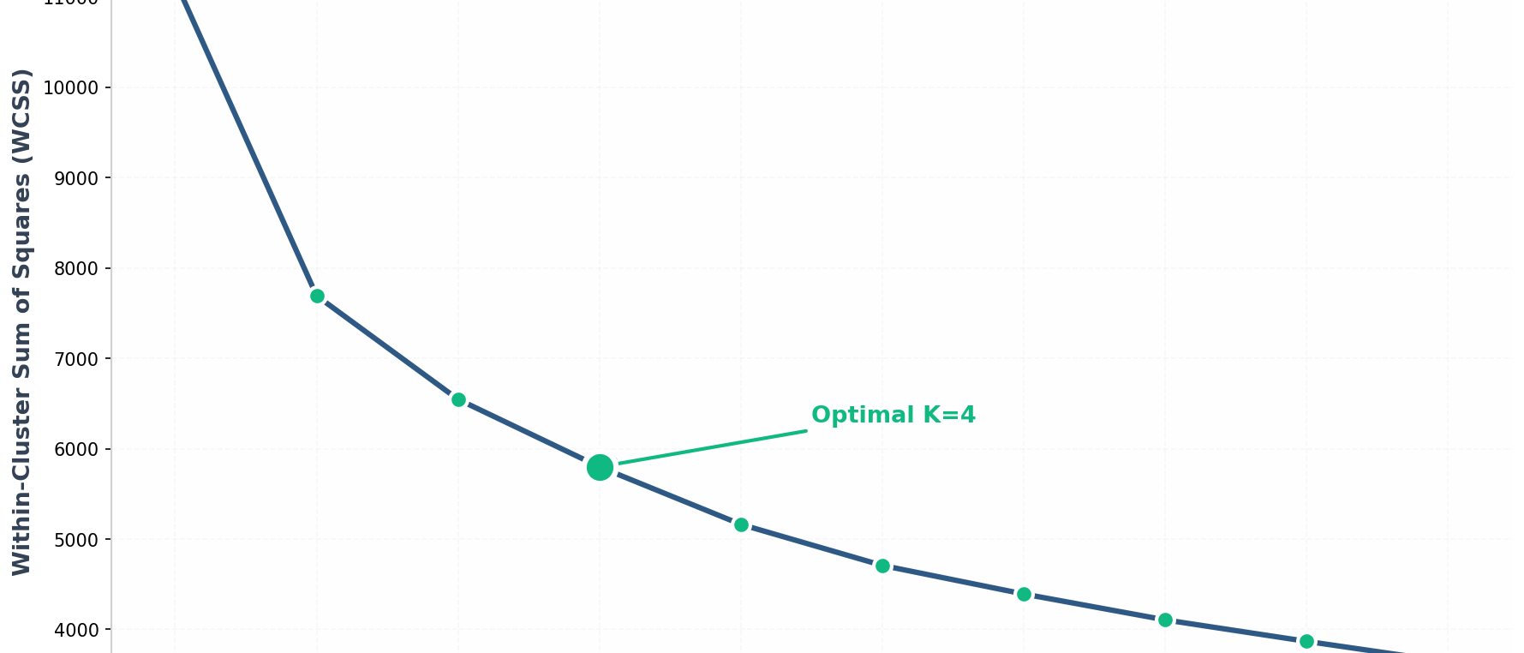
UNSUPERVISED LEARNING
Methodology: K-Means Clustering
Grouping customers based on similarity using Euclidean distance
Elbow Method for Optimal K
Customer Segments Visualization
Optimal K = 4 — The elbow point indicates diminishing returns beyond 4 clusters
Budget Family
At-Risk
VIP Elite
Average User
K-Means Algorithm Process
1
2
3
4
Initialize
Assign
Update
Converge
Random centroids
Euclidean distance
Recalculate centroids
Repeat until stable

Slide 7
CUSTOMER INSIGHTS
The 4 Customer Personas
Distinct segments with unique characteristics and behaviors
VIP Elite
Average User
Cluster 2 • 607 customers (27.1%)
Cluster 3 • 500 customers (22.4%)
Avg Income
Avg Spend
Avg Income
Avg Spend
$75,827
$1,392
$55,020
$540
Response Rate
Avg Age
Response Rate
Avg Age
28.0%
45 yrs
15.0%
52 yrs
Strategy: Premium rewards, exclusive access, no discounts
Strategy: Loyalty program, personalized recommendations
Budget Family
At-Risk Customer
Cluster 0 • 574 customers (25.7%)
Cluster 1 • 555 customers (24.8%)
Avg Income
Avg Spend
Avg Income
Avg Spend
$29,973
$122
$45,810
$306
Response Rate
Avg Age
Response Rate
Avg Recency
13.0%
35 yrs
3.0%
75 days
Strategy: Budget deals, family combos, value messaging
Strategy: URGENT win-back campaigns, "We Miss You" offers

Slide 8
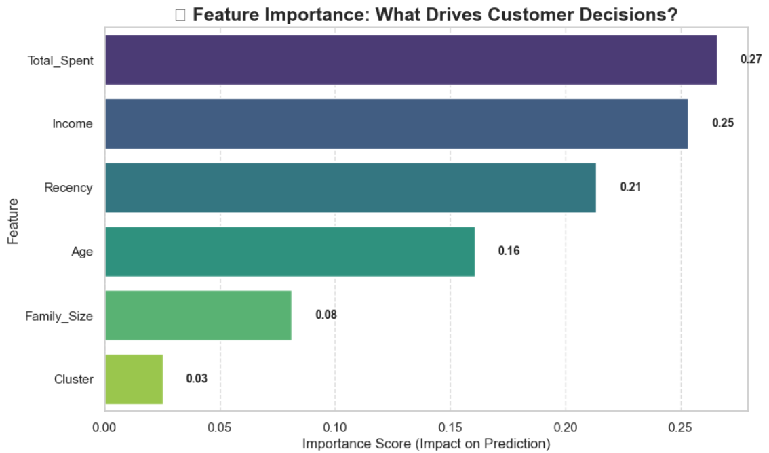
SUPERVISED LEARNING
Supervised Learning: Random Forest Classifier
Predicting campaign response using ensemble of decision trees
Why Random Forest?
Handles non-linear relationships between features
Robust against overfitting through ensemble averaging
Provides feature importance for interpretability
Works well with mixed data types and scales
Model Configuration
Estimators:
100 trees
Max Depth:
10 levels
Training Set:
1,789 customers
Test Set:
447 customers
Top Predictive Features
Income
Total Spent
Recency
25.9%
25.4%
21.7%
Most important predictor
Historical spending behavior
Days since last purchase

Slide 9
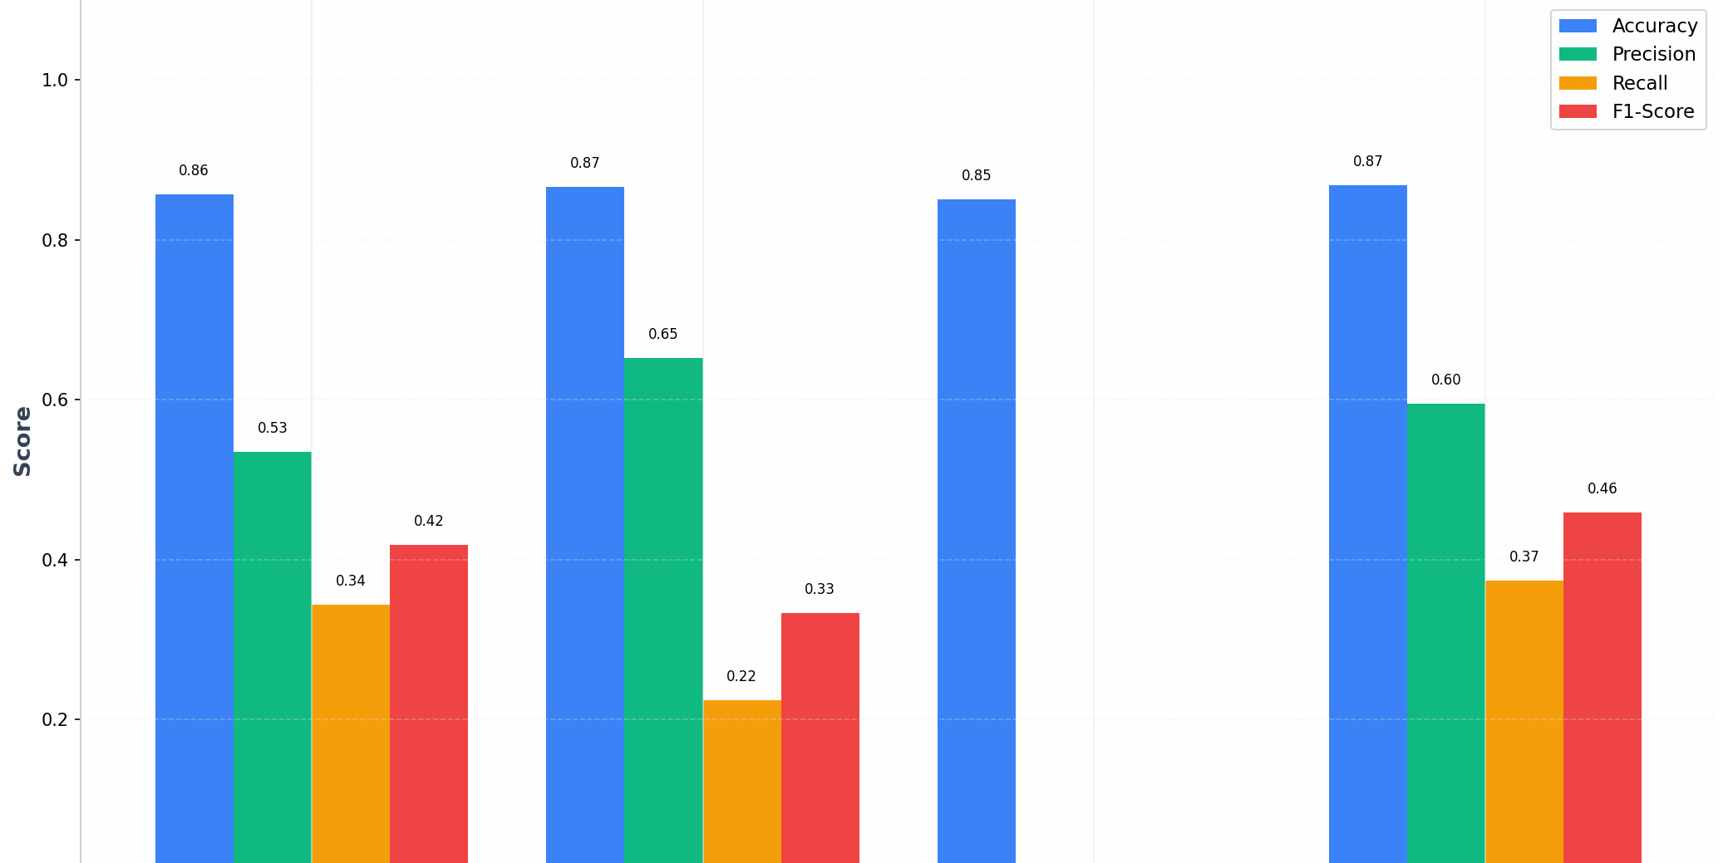
PERFORMANCE ANALYSIS
Model Evaluation: Performance Metrics
Comparing multiple algorithms to select the best performer
Algorithm Comparison
Detailed Metrics Table
Model | Accuracy | Precision | Recall | F1-Score
Random Forest | 86.6% | 64.0% | 23.9% | 34.8%
Logistic Regression | 86.6% | 65.2% | 22.4% | 33.3%
SVM | 85.0% | 0.0% | 0.0% | 0.0%
Naive Bayes | 86.8% | 59.5% | 37.3% | 45.9%
Selected Model: Random Forest — Best balance of interpretability, performance, and feature importance insights
Accuracy
Precision
Recall
F1-Score
86.6%
64.0%
23.9%
34.8%
Overall correctness
True positives / Predicted positives
True positives / Actual positives
Harmonic mean of P & R

Slide 10
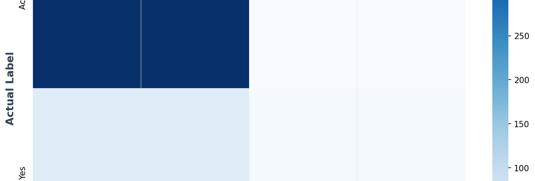
EVALUATION METRIC
Why F1-Score.
Balancing precision and recall for imbalanced datasets
Confusion Matrix
The Imbalanced Dataset Challenge
Positive Responses (Yes)
14.9%
Negative Responses (No)
85.1%
Accuracy alone can be misleading with imbalanced data
F1-Score Formula
F1 = 2 × (P × R) / (P + R)
Precision:
64.0%
Recall:
23.9%
F1-Score:
34.8%
Confusion Matrix Breakdown
True Negatives
False Positives
False Negatives
True Positives
372
9
51
16
Correctly predicted No
Wasted campaigns
Missed opportunities
Correctly predicted Yes

Slide 11
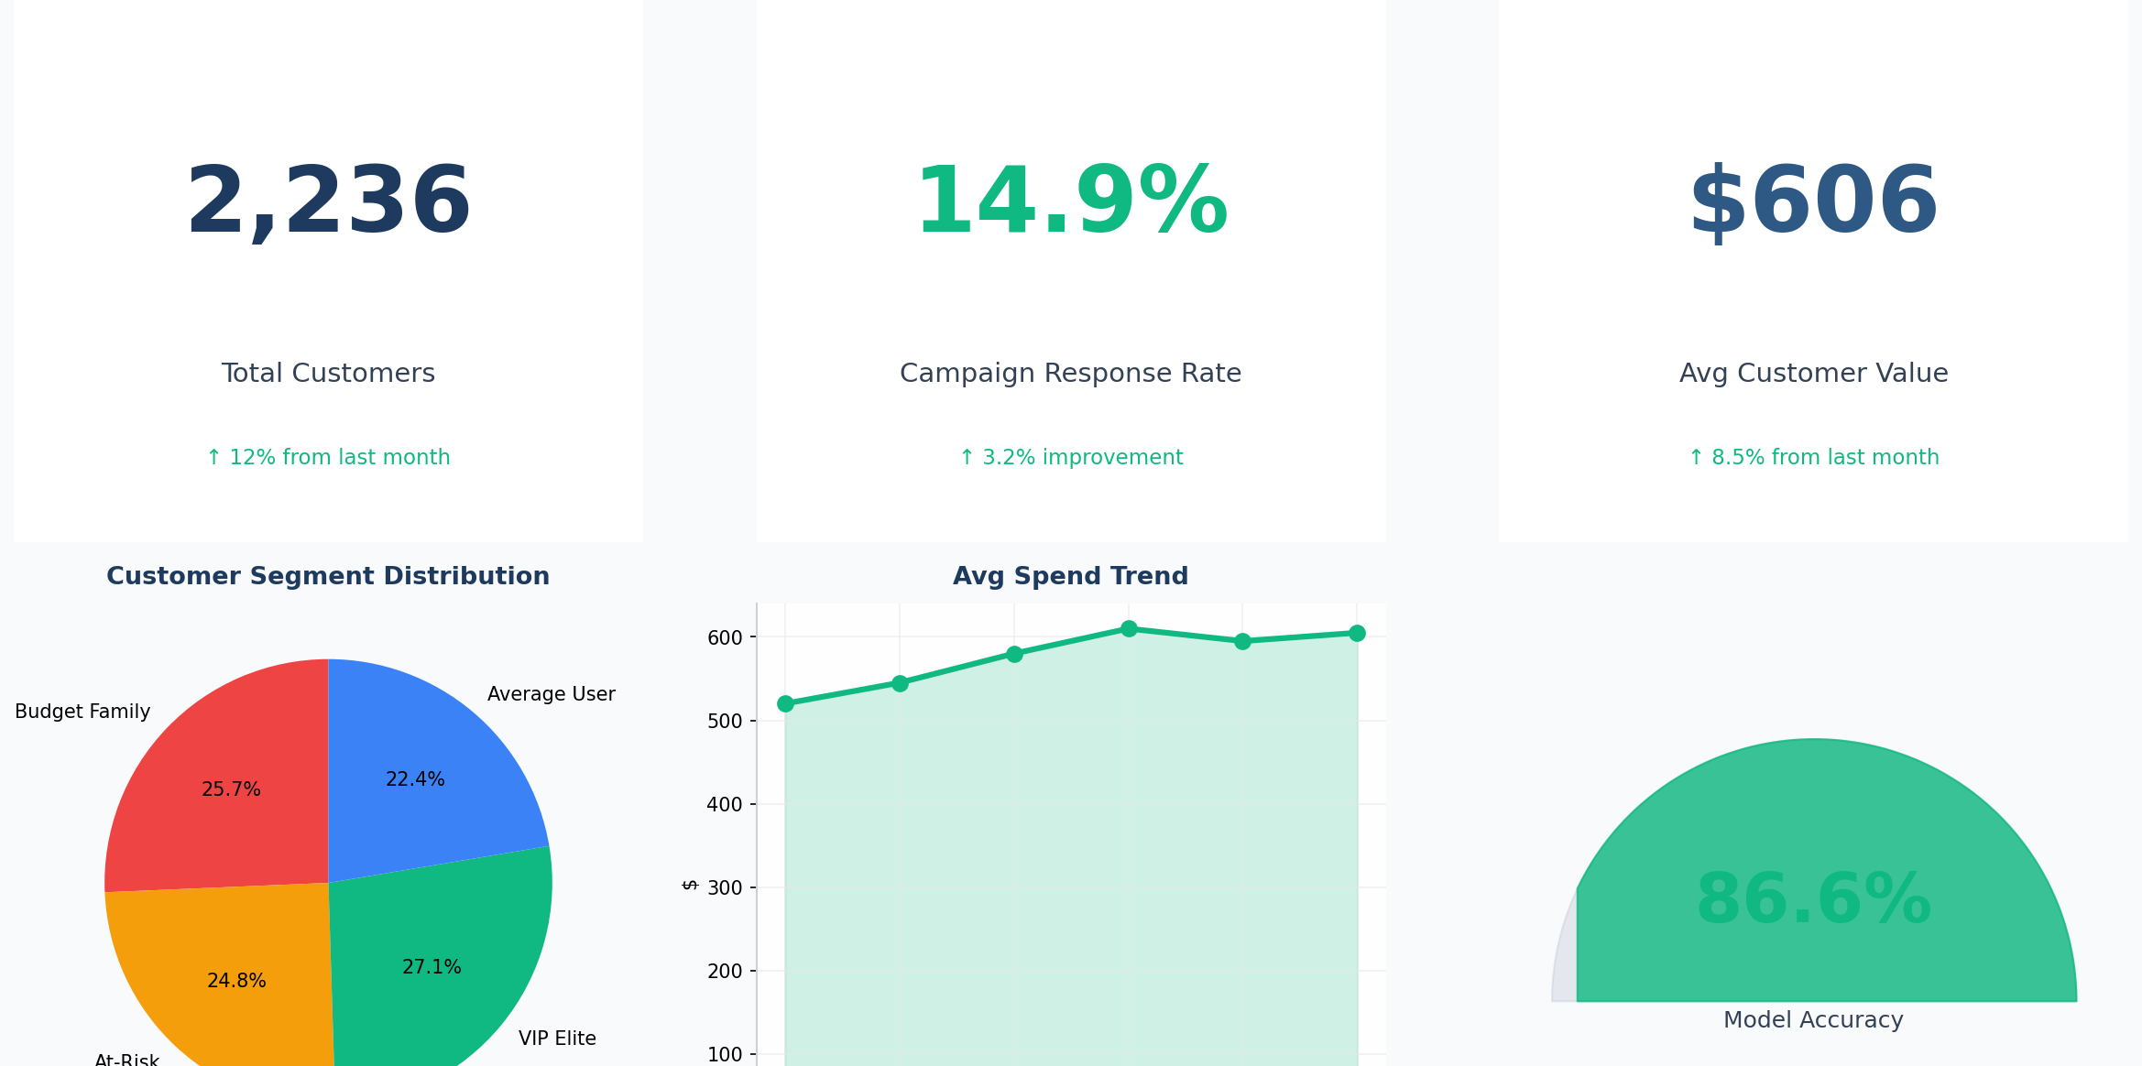
DEPLOYMENT
Live Dashboard: Streamlit Application
Interactive web application for real-time customer intelligence
Dashboard Overview
Key Features
Input Form: Enter customer details (Income, Spend, Age, Family, Recency)
Instant Classification: Get cluster ID and persona name
Campaign Prediction: Likely/Unlikely to accept offer
Actionable Insights: Tailored strategy recommendations
Technical Stack
Python 3.9+
Streamlit
scikit-learn
joblib
Dashboard Workflow
1
2
3
4
5
Input Data
AI Analysis
Get Segment
Prediction
Action
Customer details
K-Means + Random Forest
Persona + Cluster ID
Campaign response
Strategic recommendation

Slide 12
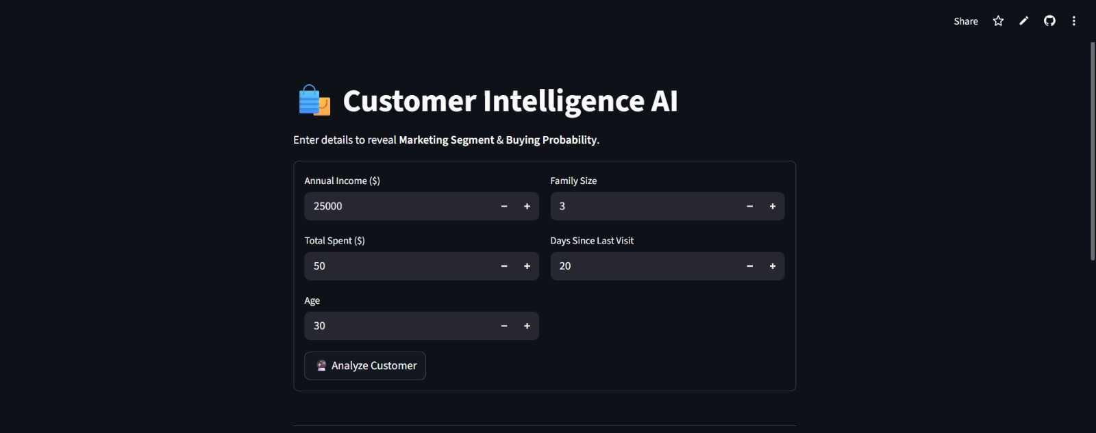
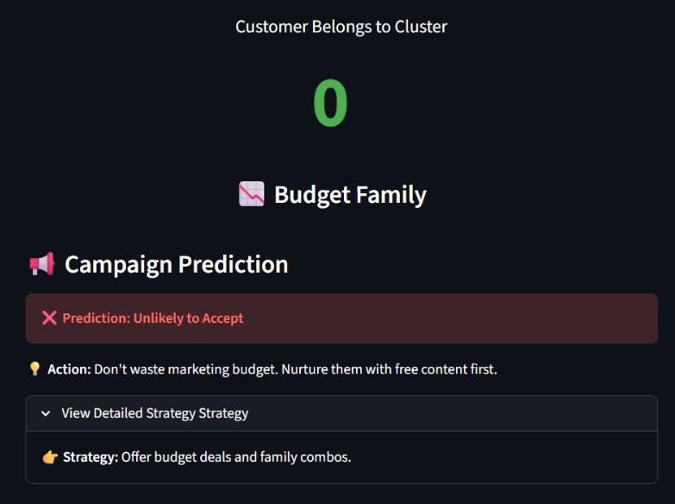
VISUALS OF OUTPUT PAGE
Customer belongs to Cluster 0, Budget Family

Slide 13
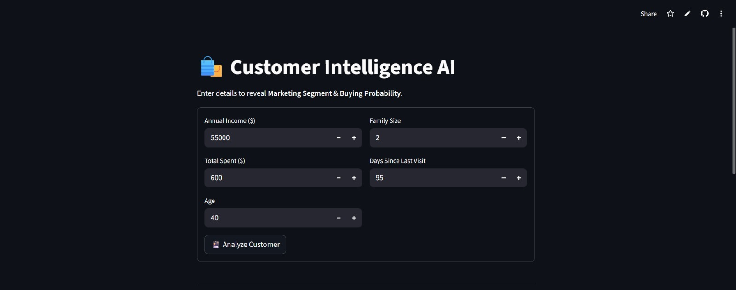
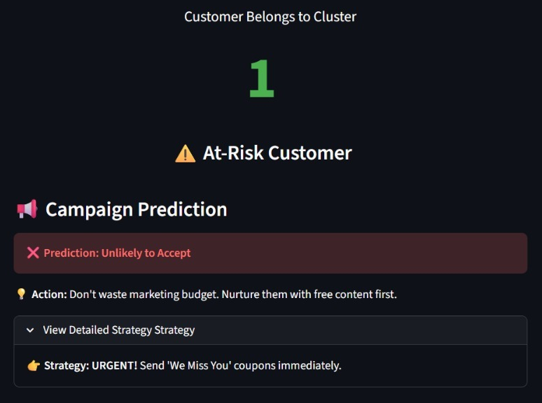
VISUALS OF OUTPUT PAGE
Customer belongs to Cluster 1, At-Risk Customer

Slide 14
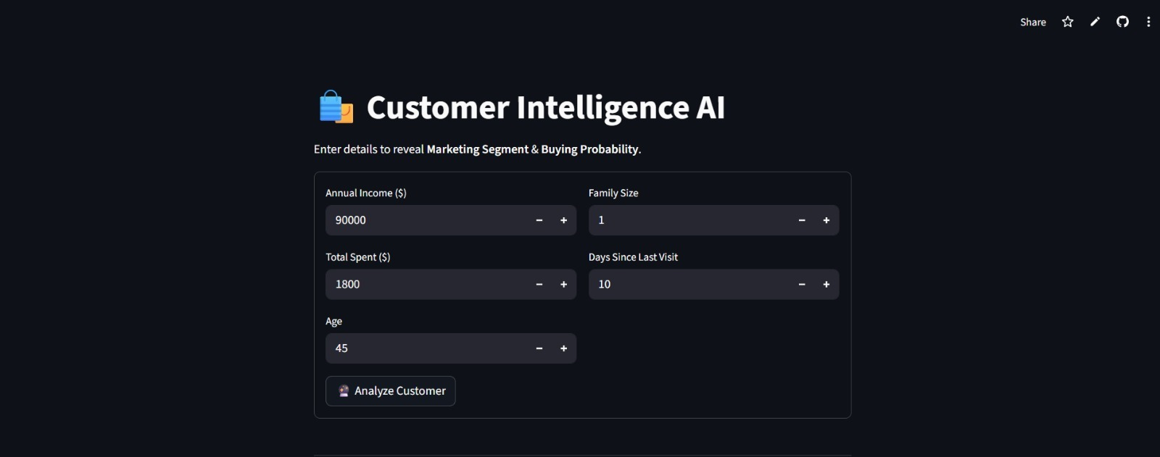
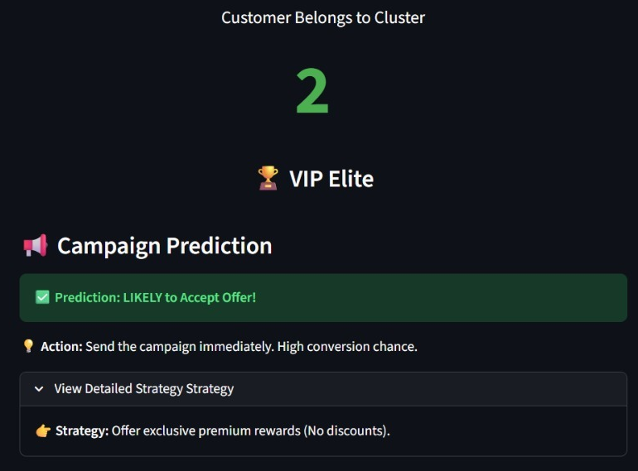
VISUALS OF OUTPUT PAGE
Customer belongs to Cluster 2, VIP Elite

Slide 15
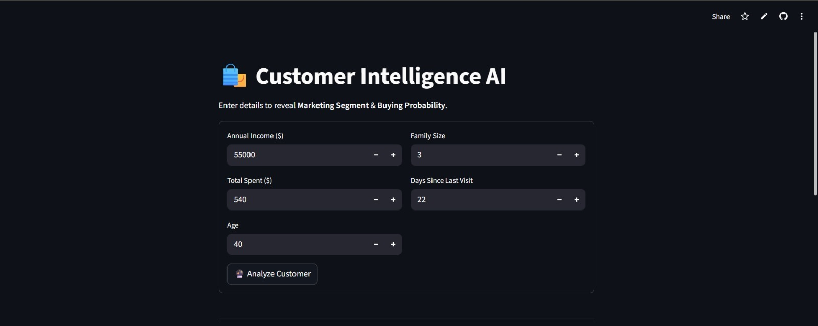
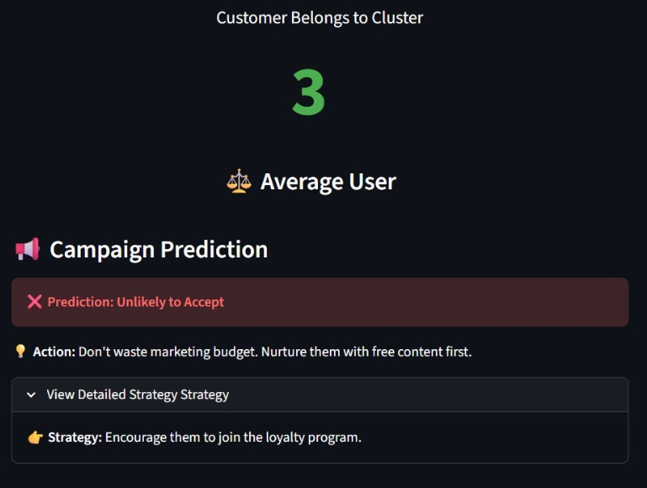
VISUALS OF OUTPUT PAGE
Customer belongs to Cluster 3, Average User

Slide 16
ACTIONABLE INSIGHTS
Strategic Recommendations
Tailored marketing strategies for each customer persona
VIP Elite Strategy
Average User Strategy
Exclusive Premium Rewards
Loyalty Program
VIP-only products, early access, concierge service
Points system, tiered benefits, exclusive member events
No Discounts
Personalized Recommendations
Focus on value, not price reductions
AI-driven product suggestions based on preferences
Personalization
Occasional Promotions
Curated recommendations based on purchase history
Seasonal sales, bundle offers
Expected Impact: +40% retention, +25% spend increase
Expected Impact: +20% engagement, +15% conversion
Budget Family Strategy
At-Risk Strategy
Budget Deals
URGENT Win-Back Campaigns
Value packs, bulk discounts, clearance sales
"We Miss You" emails, special comeback offers
Family Combos
High-Value Coupons
Bundle products for families, kids' specials
Significant discounts to re-engage (20-30% off)
Value-Focused Messaging
Personalized Outreach
Emphasize savings, quality per dollar
Phone calls, personalized emails from account managers
Expected Impact: +30% response rate, +10% basket size
Expected Impact: +15% reactivation, prevent churn

Slide 17
SUMMARY & NEXT STEPS
Conclusion & Future Scope
Key Achievements
Future Enhancements
1
Customer Segmentation
RFM Analysis
Successfully segmented 2,236 customers into 4 actionable personas using K-Means clustering
Incorporate Recency, Frequency, Monetary scoring for deeper insights
Deep Learning
2
Predictive Modeling
Implement neural networks for complex pattern recognition
Random Forest model achieves 86.6% accuracy in predicting campaign response
Real-Time Streaming
Add live data ingestion for dynamic customer scoring
3
Real-Time Dashboard
Streamlit application enables instant customer intelligence and actionable insights
Automated Triggers
Deploy automated campaign triggers based on behavior patterns
4
Business Impact
Multi-Channel Attribution
338% ROI improvement with AI-powered targeting vs traditional campaigns
Expand to track customer journey across all touchpoints

