Slide 1
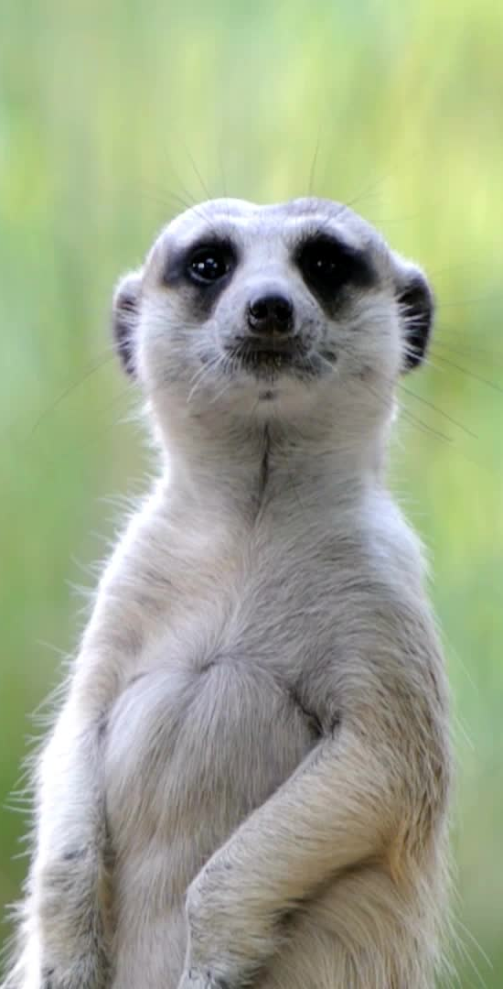
Camunda Animal Picture App
A Tech Challenge for Consulting
Aditya Behera
06/08/2024

Slide 2

Introduction
A simple Camunda client app that fetches random pictures of cats, dogs, or bears.
Technologies and Frameworks:
Camunda 8
Zeebe
Spring Boot
Docker
Kubernetes (Helm)
Java
H2 Database

Slide 3
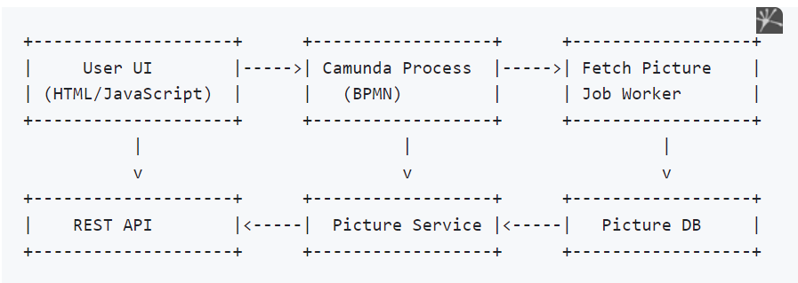
Project Overview
The application fetches random pictures of cats, dogs, or bears based on user selection.
Key Functionalities:
User selects an animal type.
The app fetches and stores the picture from an external API.
The picture is retrieved and displayed to the user.

Slide 4
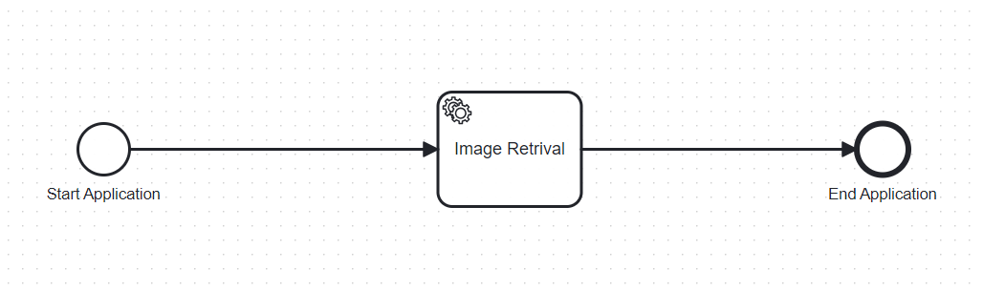
Process Model (BPMN)
Start Event: User selects an animal.
Service Task: Fetch the picture from the API..
End Event: Process completion.

Slide 5

Application Architecture
Components:
Client App: Deploys the process model and starts process instances.
REST API: Handles user requests and Zeebe communicates with Camunda.
Job Worker: Fetches and stores pictures.
Database: Stores picture URLs.
Camunda 8 Engine: Manages process workflows.

Slide 6

Client Application
Deployment: Deploys the BPMN model to Camunda Engine.
REST API:
Start Process: Endpoint to start a process instance.
Retrieve Picture: Endpoint to fetch the picture URL from the database.
Example Endpoints:
POST /start-process
GET /picture/{processInstanceKey}

Slide 7
Job Worker
Fetch Picture: Job worker fetches a picture based on user selection.
Store Picture: Job worker stores the picture URL in the database. (H2 DB)

Slide 8
Containerization
Dockerization:
Dockerfile for creating the application image.
Docker Compose for running the app with dependencies.
Docker Compose Setup:
Services:
Camunda, Application, Database
Command:
docker compose up -d

Slide 9
Kubernetes Deployment
Helm Chart Structure:
Chart.yaml: Chart metadata.
values.yaml: Configuration values.
templates/: Kubernetes resource templates.
Steps to Deploy:
Install Helm.
Create the Helm chart structure and configure.
Deploy the app using Helm.
Environment Variables:
Configure access to Camunda clusters. (SaaS)
Checking Status:
Commands to check pod and service statuses.

Slide 10
Questions & Answers
Open floor for questions from the audience.

