Slide 1
Adventure Works
-Aditya Patel
Tools Used:
Excel
Power BI
Tableau
SQL

Slide 2
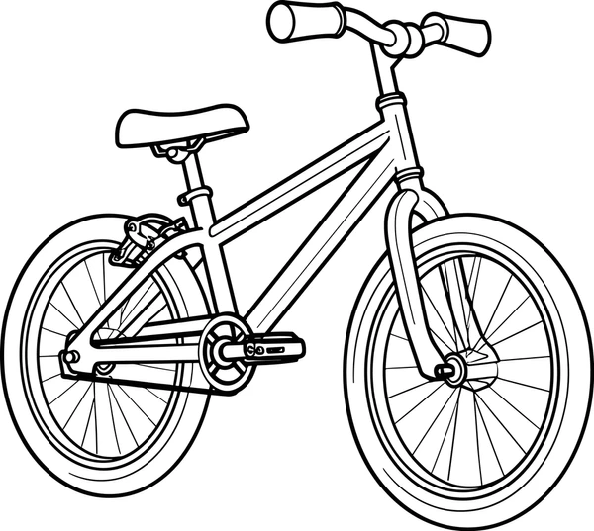
About the Company
Adventure Works Cycles is a multinational company that manufactures and sells bicycles across North America, Europe, and Asia.
The company operates a key manufacturing plant in Mexico that produces essential components for its bicycle product line.
Adventure Works aims to expand market share by targeting valuable customers and improving operational efficiency.

Slide 3
Business Problem & Project Objective
Adventure Works wanted to:
Identify high value customers
Improve sales performance
Optimize inventory
Reduce operational costs
Expand online presence
Key Focus Areas:
Sales Performance
Customer Behavior
Product Analysis
Operational Efficiency

Slide 4
Technical Skills
Tool | Skills Used
Excel | Data Cleaning, Relationship, Data Transformation, Pivot Tables, Lookup Functions (VLOOKUP/XLOOKUP), Charts, Initial Data Analysis
Power BI | Data Modeling, DAX Measures, KPI Dashboards, Interactive Visualizations, Trend Analysis, Customer Segmentation, Sales Analysis, Business Reporting
Tableau | Data Visualization, Dashboard Design, , Trend Analysis, Customer Segmentation, Sales Analysis, Storytelling with Data
SQL | Data Extraction, Joins, Aggregations, Filtering, Subqueries, Data Querying, KPI Calculation

Slide 5

Sales Performance Analysis
Overall performance shows ₹29.36M in total sales with a strong profit margin of 41.15%.
North America and Australia are the top contributing regions driving major sales revenue.
Monthly trends show steady increase in both sales and profit margin.

Slide 6
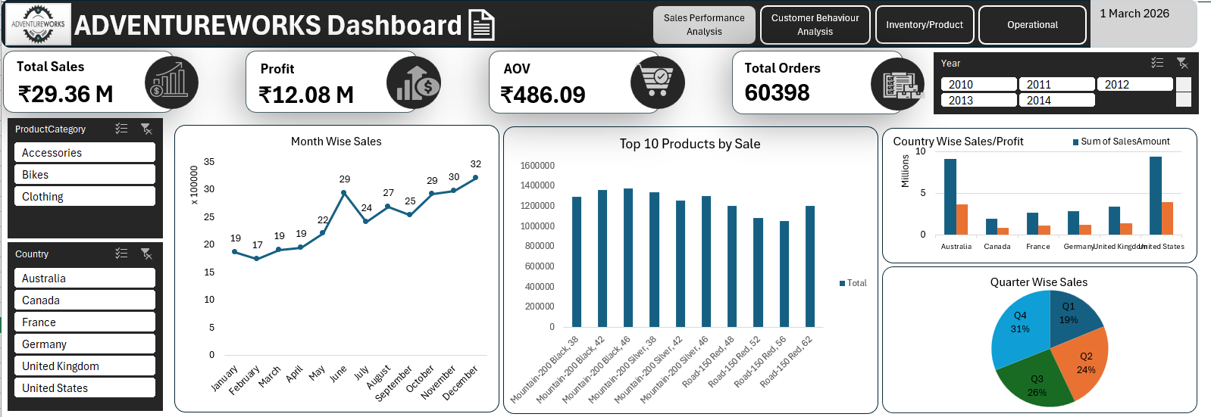
Excel Dashboard

Slide 7
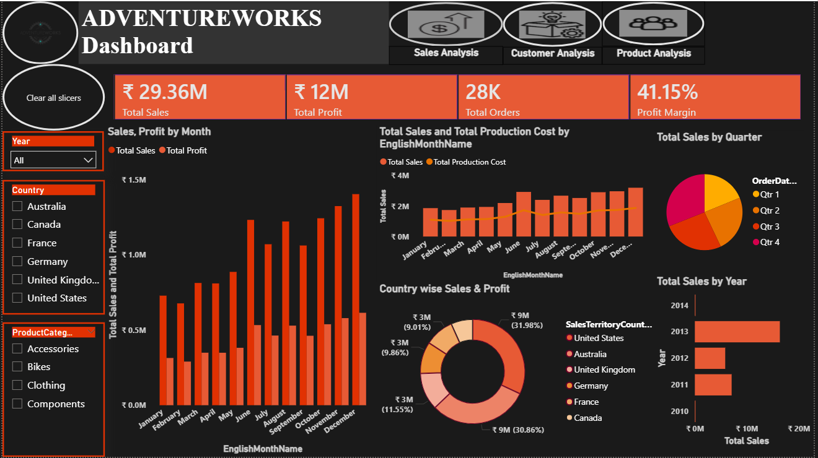
Power BI Dashboard

Slide 8
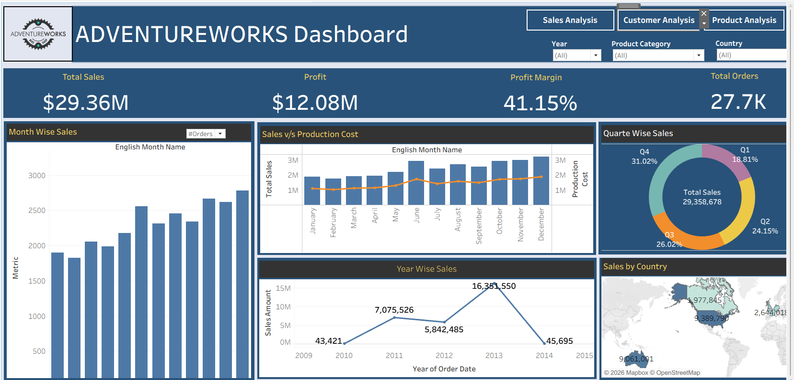
Tableau Dashboard

Slide 9

Customer Behaviour Insights
Customer base consists of 18K total customers with balanced gender distribution.
Adult customers generate the highest sales across all income levels.
High repeat purchase rate (86.5%) indicates strong customer loyalty.

Slide 10
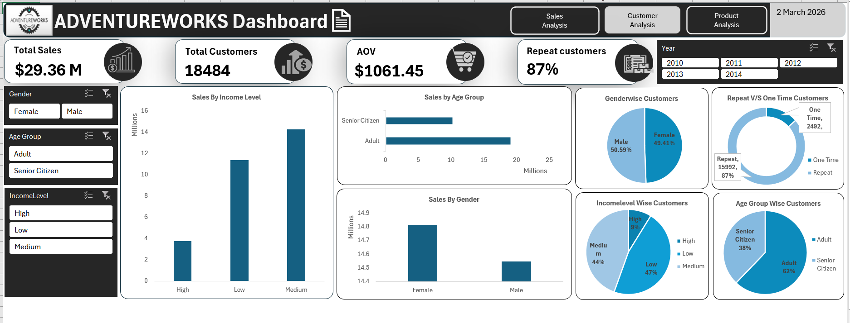
Excel Dashboard

Slide 11
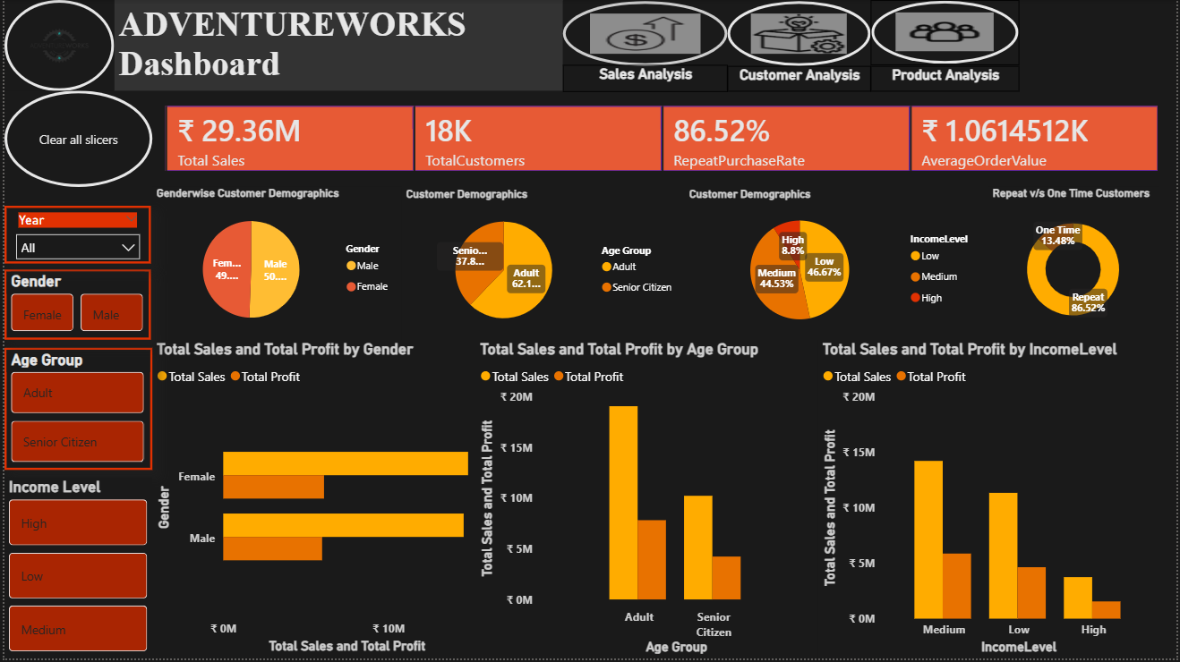
Power BI Dashboard

Slide 12
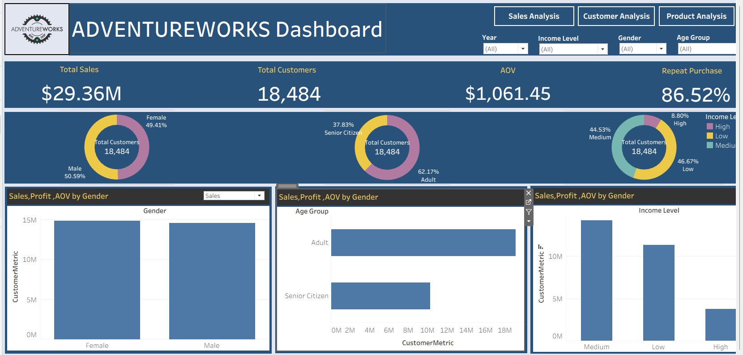
Tableau Dashboard

Slide 13
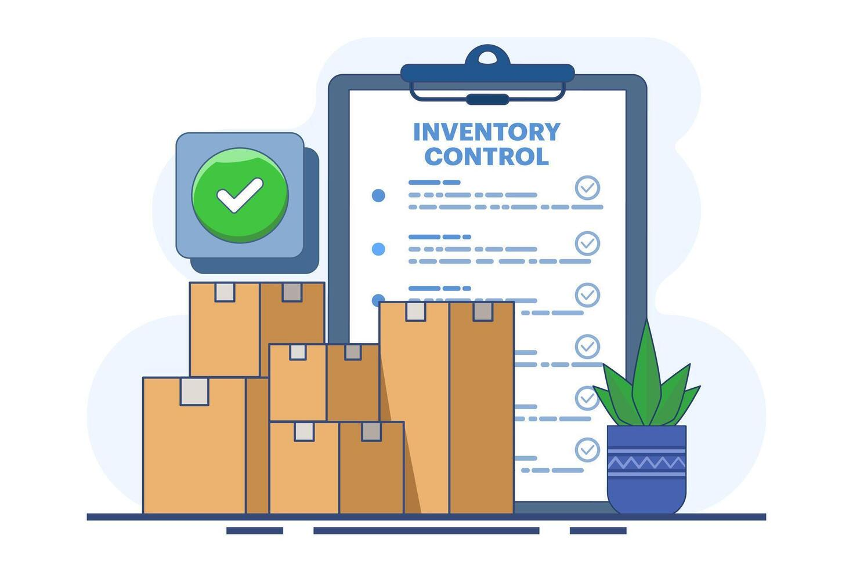
Inventory and Product Analysis
The Bikes category contributes the highest share of total sales and overall product demand across all regions.
The Mountain-200 series stands out as the top-performing product line, generating the highest revenue among individual products.
Accessories category delivers strong profit margins even with comparatively lower sales volume.

Slide 14
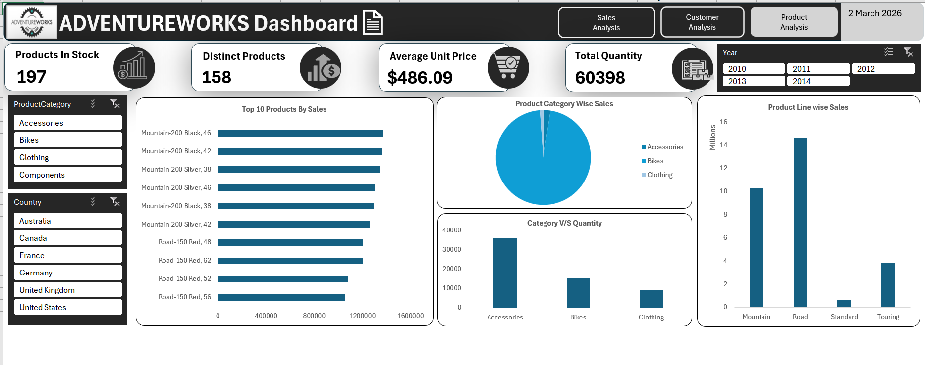
Excel Dashboard

Slide 15
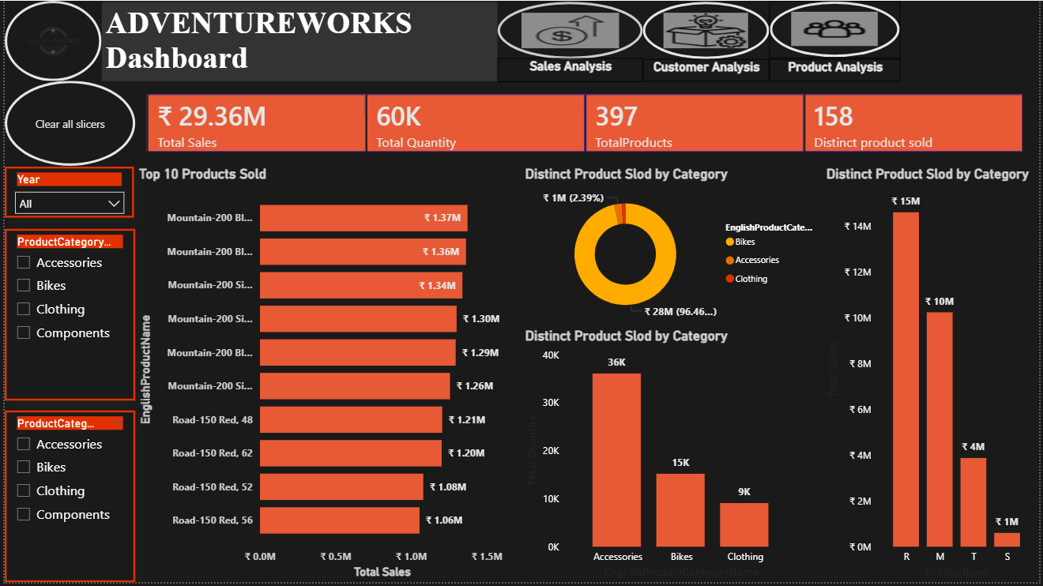
Power BI Dashboard

Slide 16
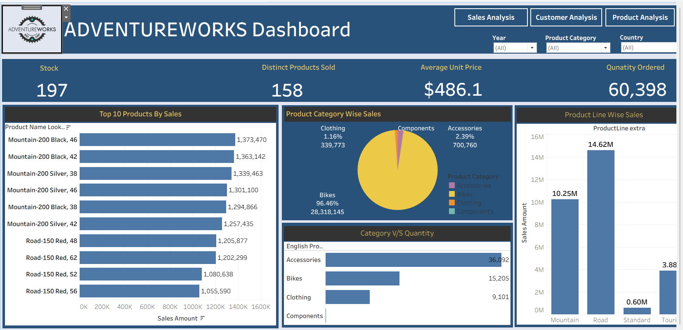
Tableau Dashboard

Slide 17

Structured Query Language
Used Joins to combine sales, customer and product tables for analysis.
Applied Aggregate Functions like SUM, COUNT and AVG to calculate key metrics.
Implemented Filters & Conditions (WHERE, GROUP BY, HAVING) for data segmentation.
Used Subqueries to derive insights like Sales Performance Analysis, Customer Behaviour Insights, Inventory and Product Analysis, Operational Efficiency.

Slide 18






Structured Query Language
Total Sales
Total Profit
Profit Margin

Slide 19





Structured Query Language
Total Orders
Total Customers
Repeat Customers

Slide 20
THANK YOU!

