Slide 1


Exploratory data analysis
Name : Aditya Kumar Pandey
Reg no : 12018602
Section : K20RU
Course code : INT 353
My Data set : Sample superstore

Slide 2
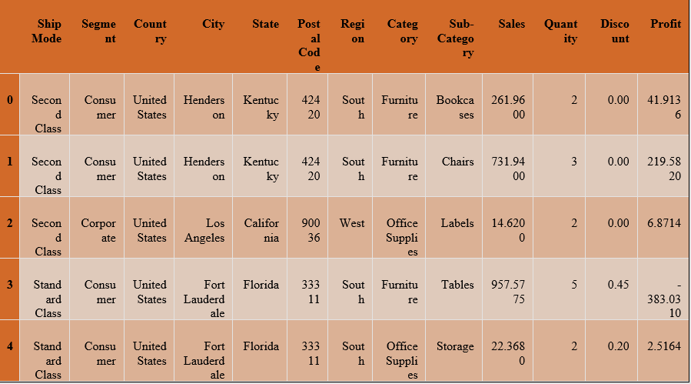
INTRODUCTION TO MY DATA SET:
I have chosen a data set from Kaggle it is about superstores in the United States, it contains 13 columns of which 8 categorical and 5 numerical columns are there.
Basically, it contains shipping mode, segment, country, city, state, postal code, region, category, sub-category, sales, quantity, discount, and profit.

Slide 3
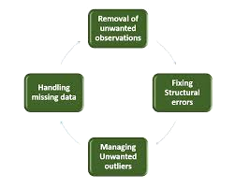
DATA CLEANING:
Data cleaning is the process of detecting and correcting (or removing) corrupt or inaccurate records from a record set, table, or database and refers to identifying incomplete, incorrect, inaccurate, or irrelevant parts of the data and then replacing, modifying, or deleting the dirty or coarse data.

Slide 4
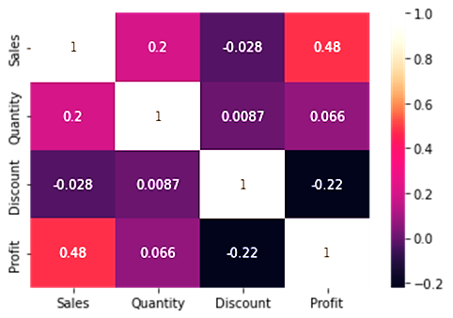
Analysis:
Basically, In analysis, I have done three main tasks those are univariate, bivariate, and multivariant:
Univariate analysis:
The analysis has to do with the help of one variable
Bivariate analysis:
The analysis has to do with the help of two variables
Multivariate analysis:
The analysis has to do with the help of more than two variable

Slide 5
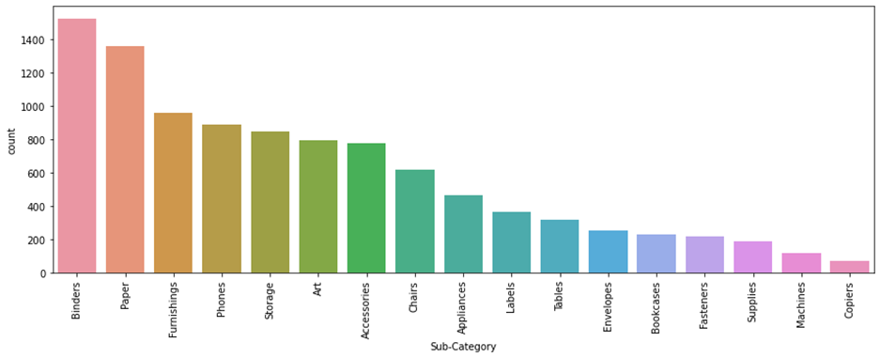
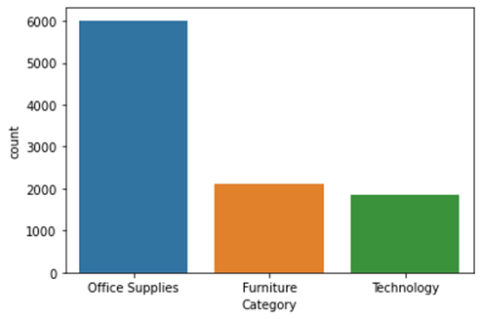
Univariate analysis:
Sales of Binders and Paper are the highest.
Sales of copies are less.
Office Supplies are the highest number in shipping.
Technology is the category number in shipping very less.

Slide 6
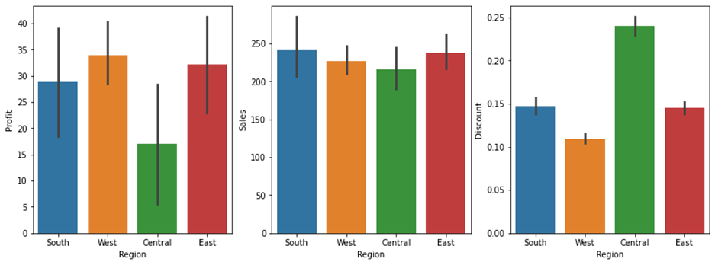
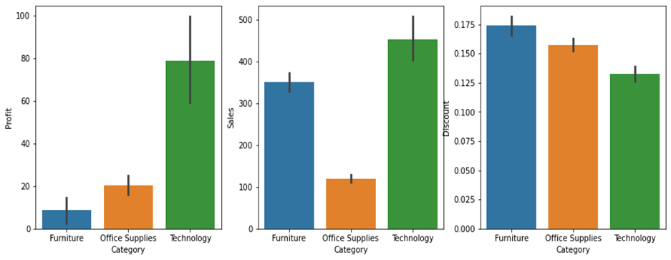
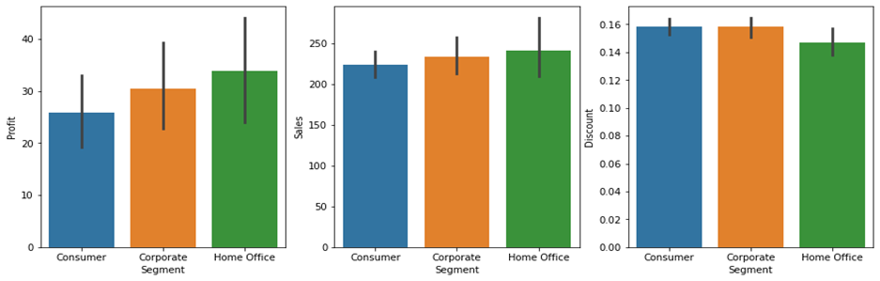
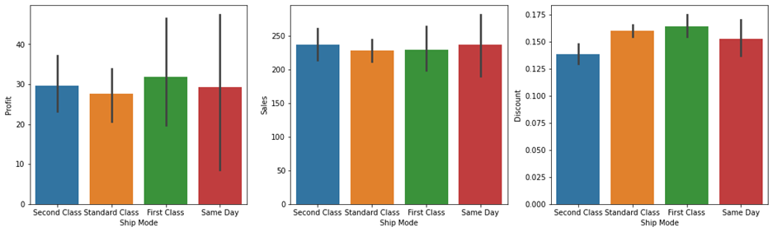
Bivariate analysis:
For each region:
For each category:
For each Segment:
For each shipping mode:

Slide 7
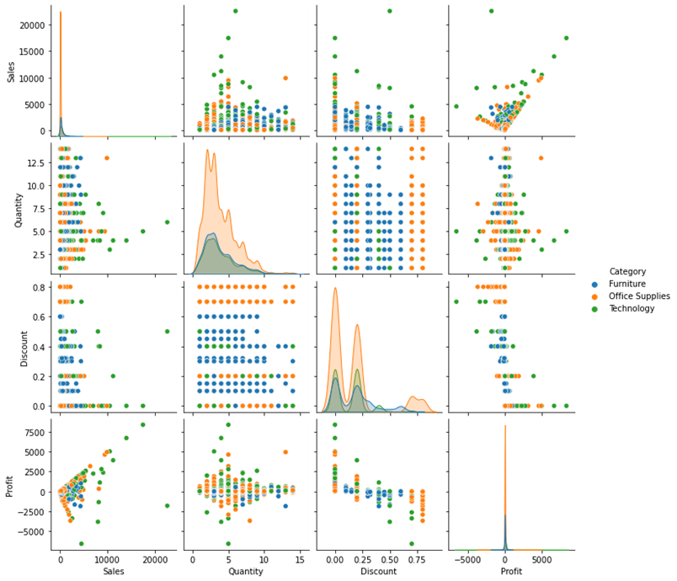
Multivariate analysis:
The Technology category is high in sales, low in discounts, and high in profit.
The Furniture category is low in profit, high in discount, and compared to office supplies high in sales.
The Office supplies category is low in sales, compared to furniture high in profit, and compared to technology high discount.

Slide 8
Predictions and Insights:
For each region:
West region has the highest profit and finds the same region has the lowest discount
South has the highest sales
Central has the lowest profit and the highest discount, maybe that is why.
For each category:
Furniture sales are high but have very low profit maybe a high discount is the reason.
For each segment:
Home Office has the lowest discount but has also the highest profit as sales
For each ship mode:
Same-day shipping has the highest sales
First class has the highest discount but also the highest profit

Slide 9
Conclusion:
Sales and Profit are not linear for most States
Central region needs more attention
High discounts sometimes cause to loss of profit
Furniture and Office Supplies have a high loss with a high discount
Office Supplies has maximum loss at 80% and 0% discount
Furniture and Technology have a maximum loss between 30% to 50%
Tables and Supplies and bookcases in the sub-category have negative profit

Slide 10
Thank You

