Slide 1
Name:-Aditya Kirankumar Patel
Enrollment Number:-CS02
Batch:-12
Branch:-Cybersecurity
TOPIC:- PID274

Slide 2
Problem ID:- Smart drones for monitoring people on factory campuses

Slide 3
Challenges Faced By companies
AI is venturing into identifying abnormal behavioural patterns by analyzing footage from drones in real-time.
We could reimagine the future with all our campuses being secured through the use of highly precise drones that can traverse fixed paths and identify outsiders, abnormal behaviours like standing for a long time at one place, health emergencies, littering around, etc. and generate alerts at a central security station.
The drone could communicate with the person under observation and fly stationary at a safe distance to ensure execution of changes suggested.

Slide 4
What are the requirements of company?
AI is venturing into identifying abnormal behavioural patterns by analyzing footage from drones in real-time.
We could reimagine the future with all our campuses being secured through the use of highly precise drones that can traverse fixed paths and identify outsiders, abnormal behaviours like standing for a long time at one place, health emergencies, littering around, etc. and generate alerts at a central security station.
The drone could communicate with the person under observation and fly stationary at a safe distance to ensure execution of changes suggested.

Slide 5
What are the expected outcomes?
A drone prototype that would traverse predefined paths at specified frequencies, analyze the footage in real-time, identify outsiders, abnormal activities, and send alerts to the central security system with high accuracy and precision on multiple types of events.

Slide 6
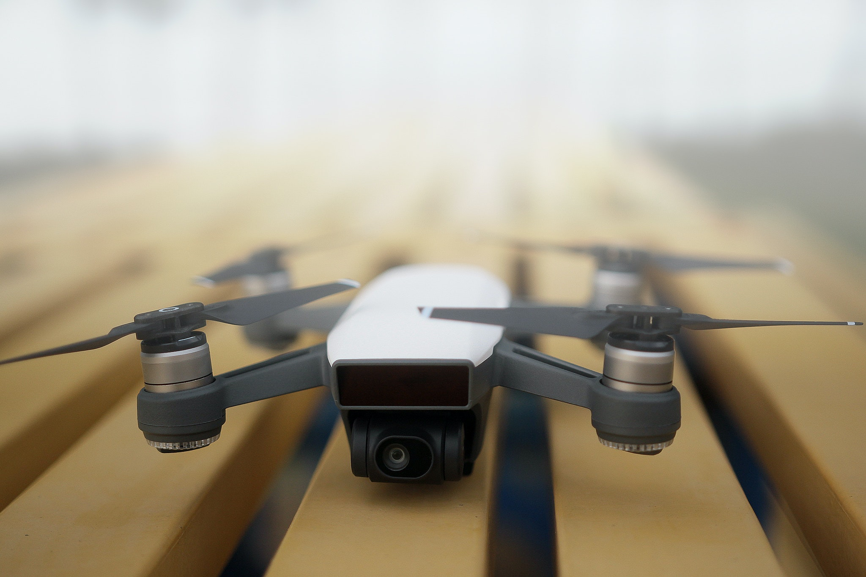
Solution that will be provided from my side
A Smart drone with High resolution camera so that a videography and picture capturing done from high altitude.
A smart drone with long battery life so that it can fly for long time and can inspect more for the betterment of factory.
A drone with communication technology which means an UAV system will be given which will make First view Person to communicate and given instruction.

Slide 7
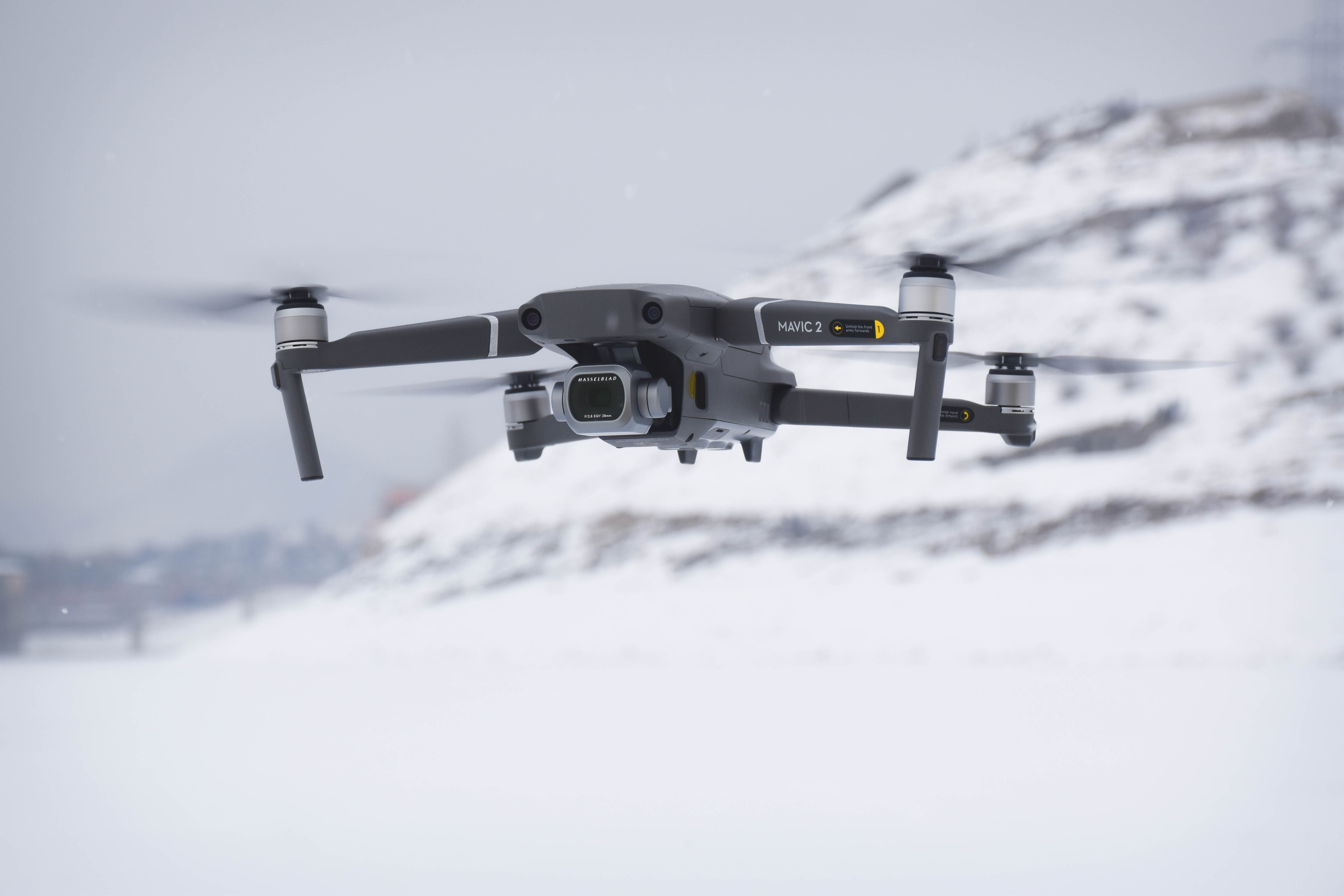
Also one more system will be given so that if any general announcement is needed to give we can connect to speakers which are placed in a factory through satellite and wi-fi so that we can directly give command to drone to make the instructions.
A smart Drone with AI based technology and software which can help to identify people’s face which we call face recognition process for that we need Rpi-4 based software and code. And these will help in keep watch on an outsiders and also help to keep check on employees who split in factory areas.
For health emergency we can also inbuilt SOS emergency system so that if an observer sees that any person in a factory is in danger or he need medical emergency than on ONE click a call can be placed in SOS system and that SOS system is directly linked to the main surveillance control room phone so that the person sitting there can talk to hospital and can get emergency help.

Slide 8
THANK YOU!!!

