Slide 1



Car Rental System Project
This presentation delves into the development of a car rental system using the MERN stack (MongoDB, Express.js, React.js, and Node.js). This project aimed to streamline the process of renting vehicles by providing users with a user-friendly and efficient platform.
by Aditya

Slide 2


Introduction
This project aimed to develop a user-friendly and efficient car rental system. The platform would provide customers with a convenient way to browse available cars, book rentals, and manage their accounts. The system would also assist administrators in managing car inventory, user accounts, and rental records.
1
Streamlined Rental Process
The system simplifies the car rental process for customers, eliminating the need for manual paperwork and in-person interactions.
2
Efficient Inventory Management
Administrators can easily manage car inventory, track availability, and handle maintenance scheduling, ensuring optimal resource allocation.
3
Secure and Reliable Platform
The system prioritizes security, safeguarding user data and transactions through robust authentication and encryption measures.

Slide 3
Project Motivation
The project was motivated by the desire to improve the car rental experience for both customers and administrators. Existing rental systems often lacked user-friendliness, efficient management tools, and robust security measures. This project aimed to address these shortcomings and provide a more comprehensive and reliable solution.
Customer Perspective
Administrator Perspective
Customers often face challenges with complex rental procedures, limited vehicle availability, and inefficient communication channels.
Administrators often struggle with manual inventory management, cumbersome data tracking, and inadequate security protocols. The project aimed to streamline administrative tasks and provide a secure platform for managing rental operations.

Slide 4


Technologies Used
The project leveraged a combination of technologies to create a robust and scalable car rental system. The MERN stack provided a comprehensive framework for developing both frontend and backend functionalities.
Frontend
React.js
Backend
Node.js, Express.js
Database
MongoDB

Slide 5

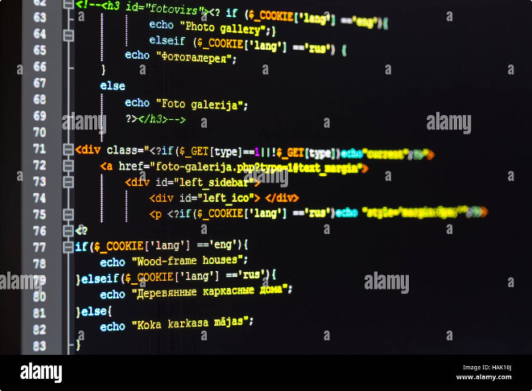
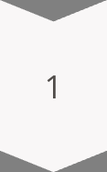
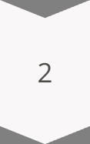
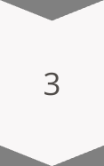
System Architecture
The car rental system architecture follows a client-server model with a three-tier structure: frontend, backend, and database. The frontend handles user interactions, the backend processes requests and interacts with the database, and the database stores all the system data.
Frontend
The frontend is built using React.js, providing a dynamic and responsive user interface for customers and administrators.
Backend
The backend, powered by Node.js and Express.js, handles user authentication, data validation, and communication with the database.
Database
MongoDB serves as the database, storing information about cars, users, rental records, and other relevant data.

Slide 6


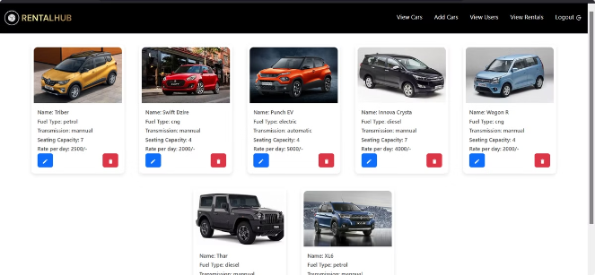


Functionalities
The car rental system provides a range of functionalities to cater to both customer and administrator needs. The system allows customers to browse cars, book rentals, view their rental history, and manage their accounts.
Admin Panel
Administrators have access to a dedicated panel where they can manage car inventory, add and edit car details, create and manage user accounts, track rental history, and handle other administrative tasks.
Customer Interface
Customers can browse available cars, view detailed information about each car, filter cars based on their requirements, select a car, book a rental, and manage their rental bookings.
Rental Management
Both customers and administrators can view their rental history, track the status of ongoing rentals, and manage any pending requests.

Slide 7

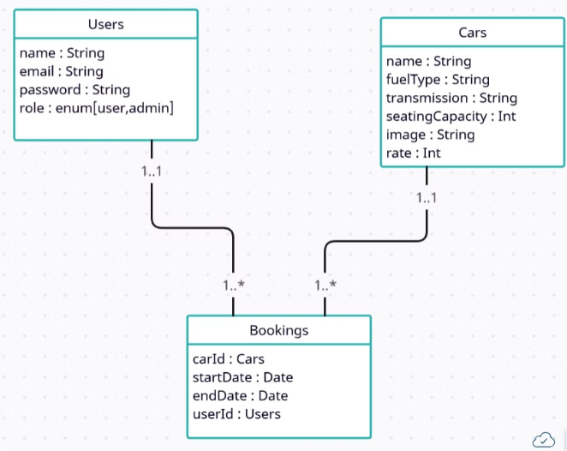
Database Schema
The database schema for the car rental system is designed to effectively store and manage all relevant data. The schema includes key tables that store information about users, cars, and rental records. These tables are interconnected through defined relationships, ensuring data integrity and efficient retrieval.
Users Table
This table stores information about all users, including their personal details, contact information, and login credentials.
Cars Table
This table stores information about all available cars, including their make, model, year, availability status, rental rates, and other relevant details.
Bookings Table
This table stores information about all rental transactions, including the customer who booked the rental, the car rented, the rental dates, and other relevant details.

Slide 8


Conclusion
The car rental system project successfully delivered a user-friendly and efficient platform for managing car rentals. The system offers a comprehensive set of features for customers and administrators, streamlining the rental process and improving overall user experience. The system leverages a robust and secure architecture, ensuring data integrity and reliability.
1
Improved User Experience
The system provides a user-friendly interface and intuitive navigation, simplifying the rental process for customers and reducing administrative overhead.
2
Enhanced Efficiency
The system streamlines inventory management, simplifies rental booking, and facilitates efficient communication between customers and administrators.
3
Increased Security
The system incorporates robust security measures to safeguard user data and transactions, ensuring a secure and reliable platform.

