Slide 1
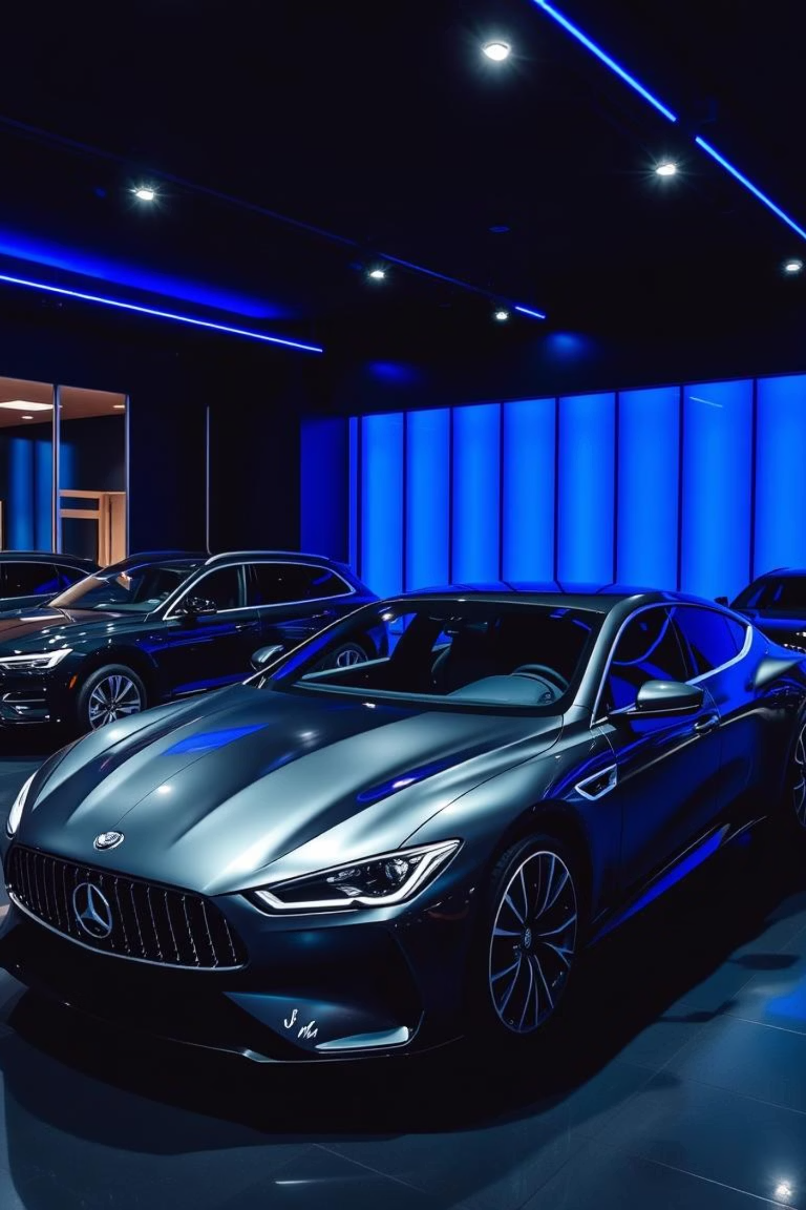
🚗 Car Sales Dashboard
Built using Tableau – Start to End Project
PRESENTED BY….
ABHIJIT SAHOO
ADITYA RAJ
RAHUL MOHARANA
SOUMYA RANJAN BEHERA

Slide 2
Project Objective
The goal of this project is to create a comprehensive Car Sales Dashboard that helps us:
Track total sales performance over time.
Analyze year-over-year growth in car sales.
Understand sales trends and patterns using dynamic charts.
Support data-driven decision making with key actionable metrics.

Slide 3
KPIs Tracked
1
2
YTD Total Sales
YTD Avg Price
Total revenue generated this year, providing a snapshot of financial performance.
Average selling price of vehicles, indicating market positioning and pricing strategy effectiveness.
3
4
YTD Cars Sold
YoY Growth
Total units sold this year, reflecting sales volume and market penetration.
Year-over-year percentage change in sales, highlighting business growth or decline.

Slide 4




Dashboard Charts
These dynamic visuals empower users to quickly identify patterns and performance insights.
Line Chart
Pie Chart
Illustrates weekly sales trends, revealing seasonality and peak performance periods.
Breaks down sales by body style and color, guiding inventory and marketing efforts.
Bar Chart
Grid Table
Compares sales performance across different regions, identifying top-performing markets.
Presents detailed company-wise sales data, offering precise comparisons.

Slide 5
What I Learned
1
Building Dashboards
From conception to creation, mastering the end-to-end dashboard development process.
2
Data Cleaning & Prep
Transforming raw data into a clean, structured format ready for analysis.
3
Meaningful KPIs
Defining and implementing key performance indicators that drive actionable insights.
Visual Storytelling
4
Using charts and graphs to communicate complex business insights clearly and effectively.
Professional Design
5
Designing interactive and professional dashboards that are both functional and aesthetically pleasing.

Slide 6
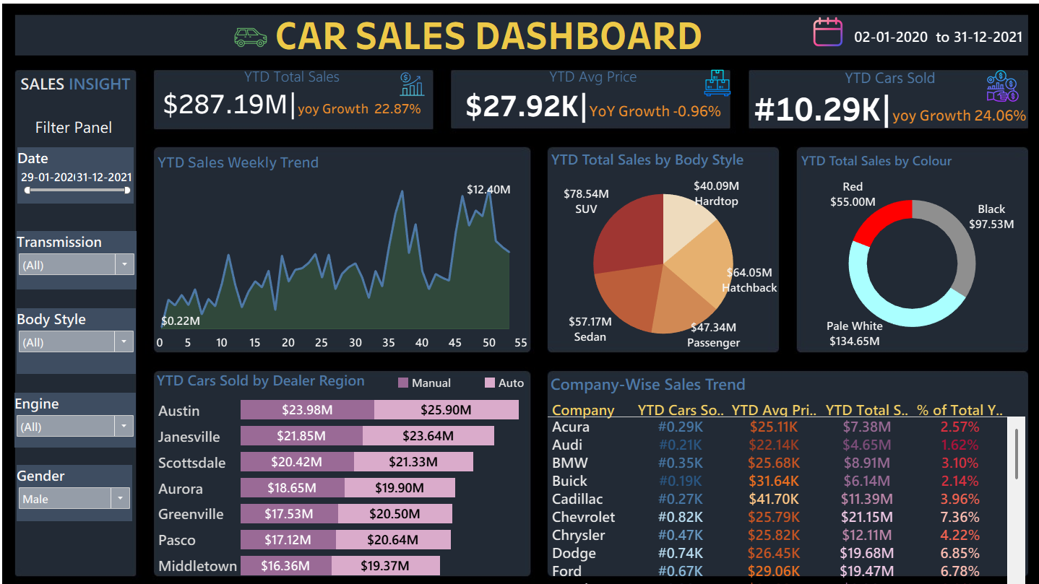

Slide 7
Thank You!
Grateful to CTTC for their constant support With special thanks to Debashish Bhanja Sir whose teaching inspired this project,and Sworup Nayak Sir whose guidance and mentorship helped shape it.

