Slide 1
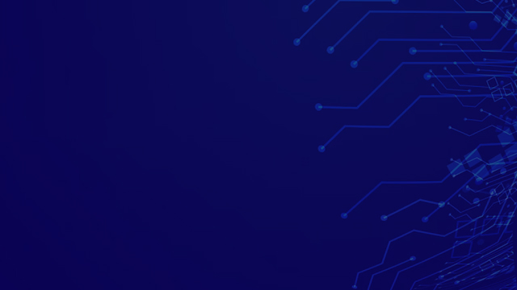
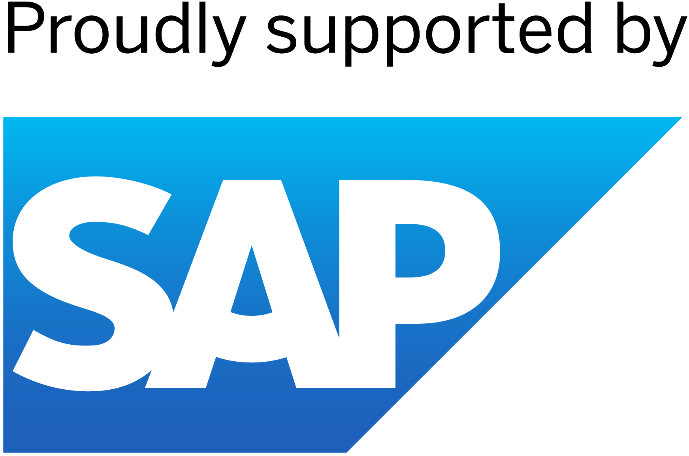
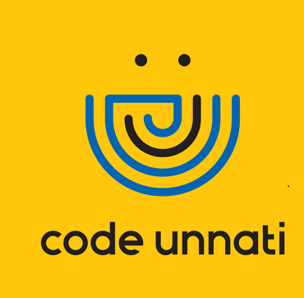
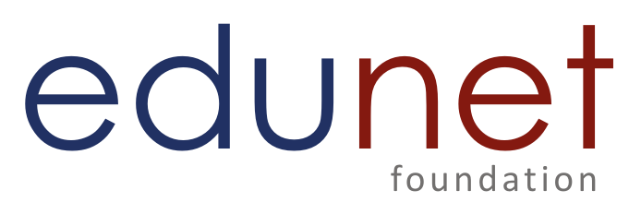
SuperStore Sales Dashboard
CU_CP_Team_4252
Team Leader Name- Divyanshu Mishra
Member 1-Aditya Raj
Member 2-Dixit
Member 3-Ankit Porwal
Member 4-Shivam Patel

Slide 2

Project Objectives
Problem Statement
Project Overview – Introduction
End Users
Wow Factor in Project
Modelling/Block Diagram/Flow of Project
Result/outcomes
Conclusion
Future Perspective

Slide 3
Problem Statement :-
The project aims to address the challenges faced by digital artists by creating a decentralized platform that leverages blockchain technology to validate and monetize their work through Non-Fungible Tokens (NFTs).
By allowing artists to upload images from their local systems and claim ownership through minting NFTs, the platform seeks to provide a secure and transparent way for artists to showcase and profit from their creations. This approach aims to democratize access to the digital art market, fostering broader participation and creativity while empowering artists to thrive in the digital age.
Notes:
Summary:
The project seeks to support digital artists by establishing a decentralized platform utilizing blockchain and Non-Fungible Tokens (NFTs) to validate and monetize their work. Artists can upload images, mint NFTs to claim ownership, and profit securely and transparently. This initiative aims to democratize the digital art market, enabling wider participation and empowering artists in the digital era.

Slide 4
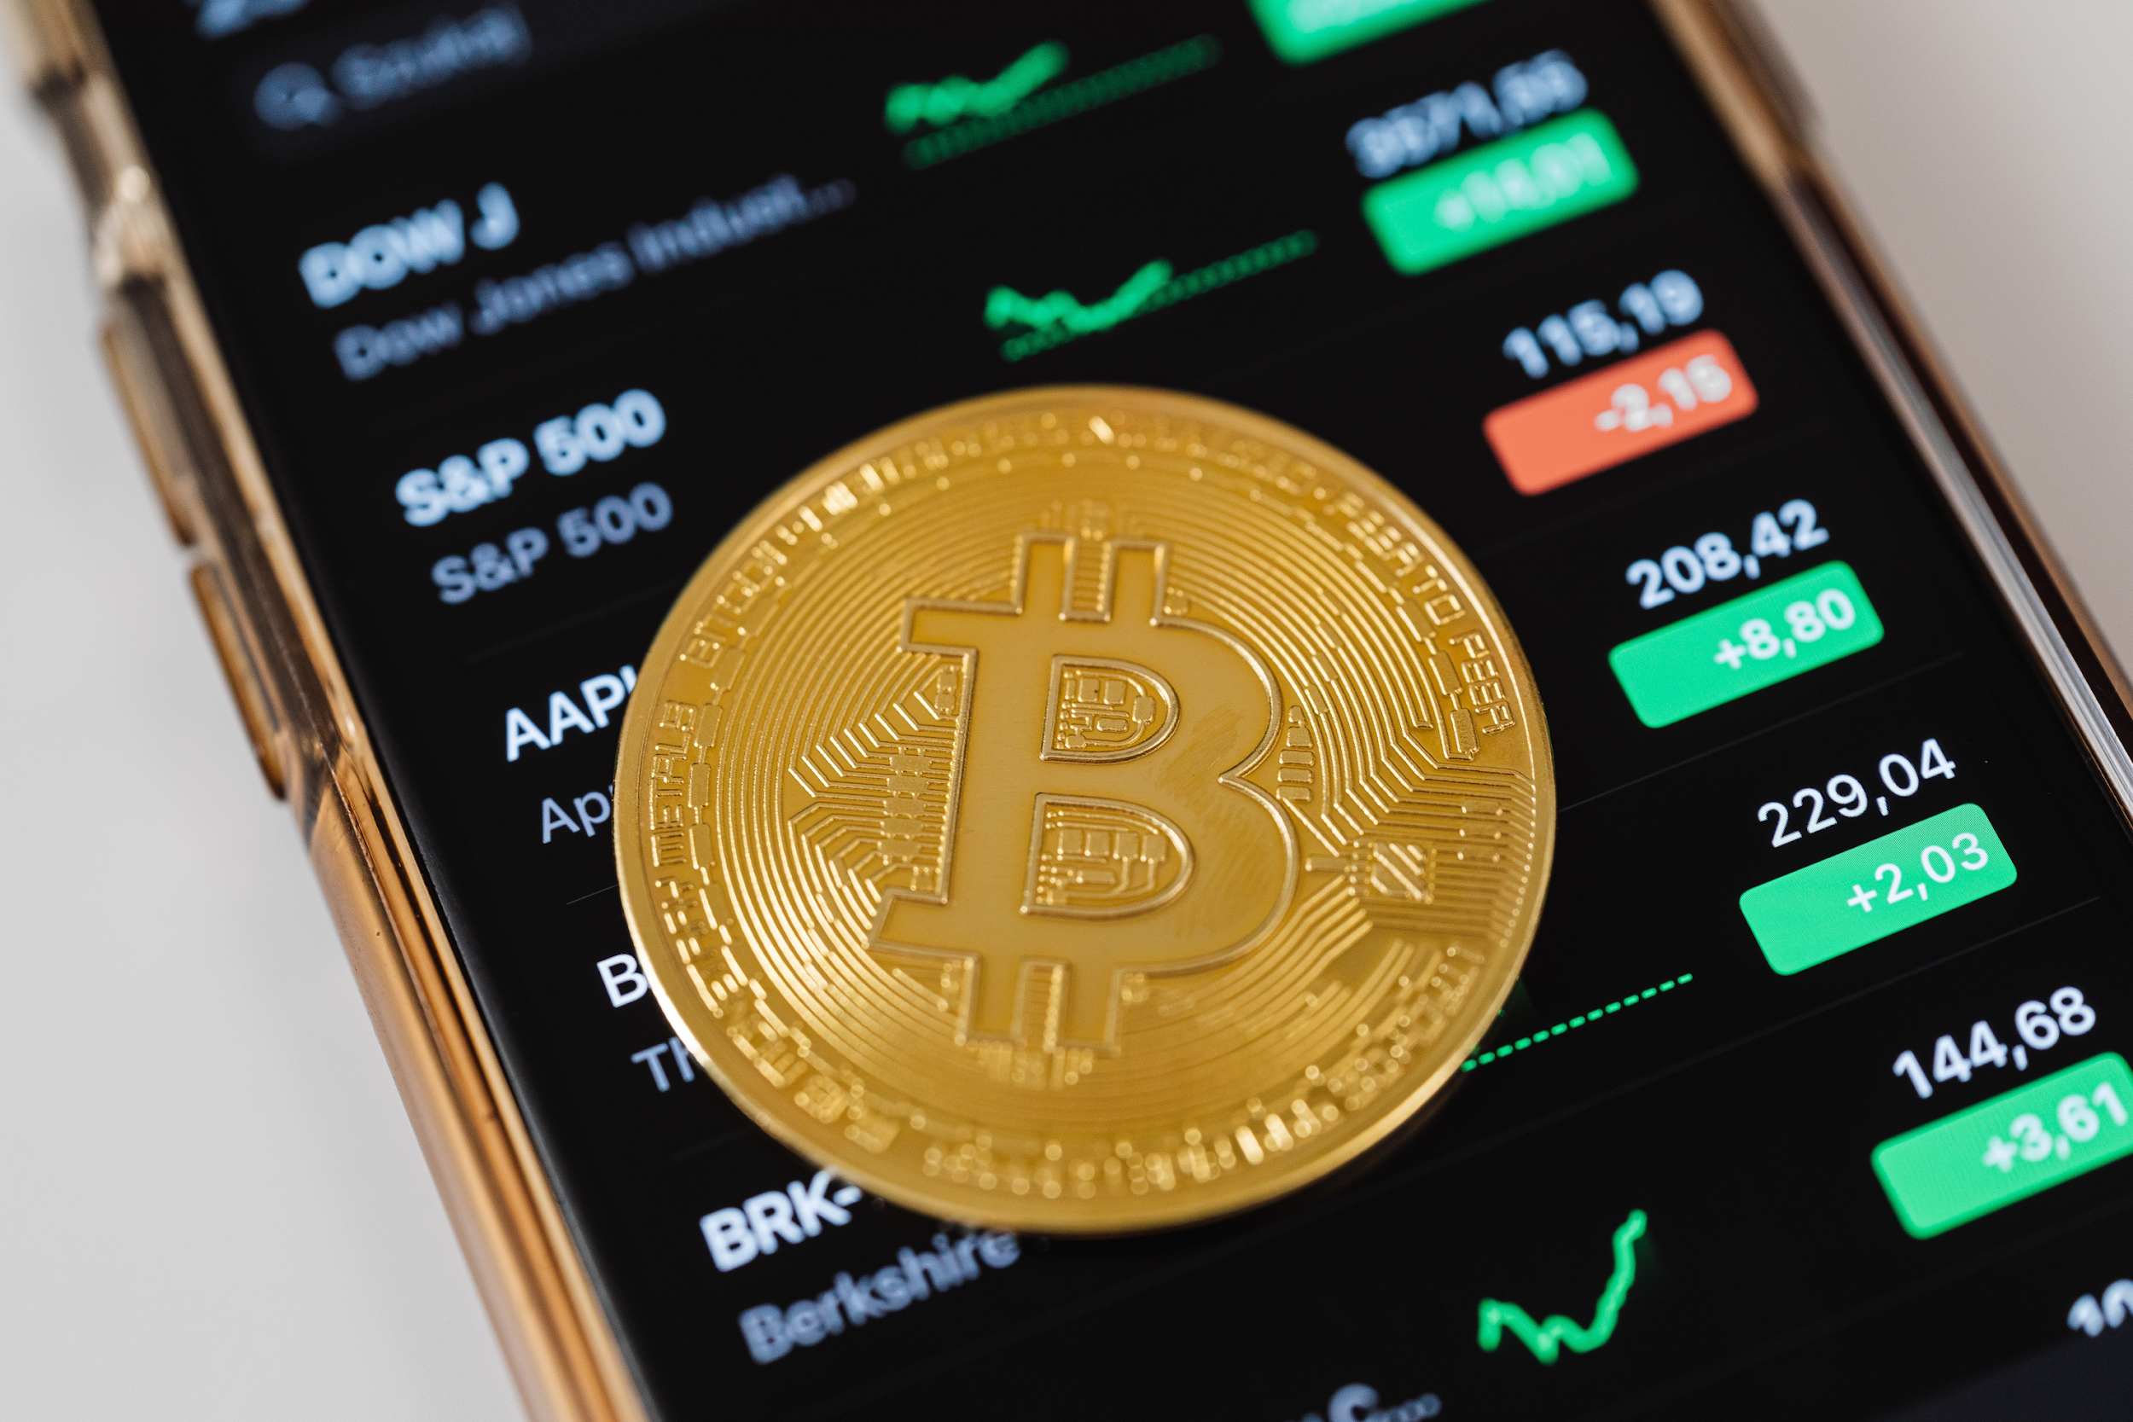
Blockchain :-
Blockchain is a decentralized and distributed digital ledger technology that records transactions across a network of computers.
It gained significant attention with the rise of cryptocurrencies, most notably Bitcoin, which was the first application of blockchain technology. However, its potential applications extend far beyond digital currencies.

Slide 5
Project Overview - Introduction
NFT MINTING DAPP
An NFT minting dapp(decentralized application) is a web application built on blockchain technology that allows users to transform digital assets into NFTs.
NFTs (Non-Fungible Tokens): These are unique digital certificates stored on a blockchain, verifying ownership of digital assets like artwork, music, image, or even virtual items in games.
DApps (Decentralized Applications): These are applications that run on a decentralized network (blockchain) instead of a single server. This eliminates central control and promotes transparency.

Slide 6
Project overview – Introduction
NFT stand for non-fungible token, which means it can neither be replace nor interchanged because it has unique properties.
TECHNOLOGIES NEEDED :
FRONTEND
ReactJS
BACKEND
Ethereum Blockchain
Hardhat
Solidity
STORAGE
Pinata, IPFS
DEPLOYMENT
Remix IDE
Vercel

Slide 7
End User
Creators:
These are the artists, musicians, or anyone with a digital creation they want to convert into a NFT. They use the dApp's features to: Upload their digital assets (images) Add details and descriptions for their NFTs Initiate the minting process, connecting their crypto wallet to pay any fees involved Ultimately, they gain ownership and control over their minted NFTs allowing them to sell, trade, or hold onto them.
Notes:
Summary:
Creators, including artists and musicians, utilize the decentralized application (dApp) to convert their digital creations into Non-Fungible Tokens (NFTs). They upload their digital assets, provide details and descriptions, and initiate the minting process by connecting their crypto wallet to pay associated fees. This process grants them ownership and control over their minted NFTs, enabling them to sell, trade, or retain them as desired.

Slide 8
Wow Factor in Solution
Democratizing Digital Art Ownership:
Highlight the challenge of owning digital art before NFTs. Anyone could copy a digital
file.
Explain how your marketplace empowers artists by creating verifiable ownership
through NFTs.
2. Community Building Features:
In addition to providing a vibrant marketplace for digital art, our platform fosters community engagement through various features.
Notes:
Summary:
Before the emergence of Non-Fungible Tokens (NFTs), owning digital art presented challenges due to the ease of file copying. Our marketplace addresses this issue by empowering artists through verifiable ownership facilitated by NFTs. This ensures that artists can confidently prove ownership of their digital creations, democratizing digital art ownership and providing a secure platform for artists to showcase and monetize their work.
Alongside offering a dynamic marketplace for digital art, our platform prioritizes community engagement by integrating a range of features designed to foster interaction and collaboration among users.

Slide 9
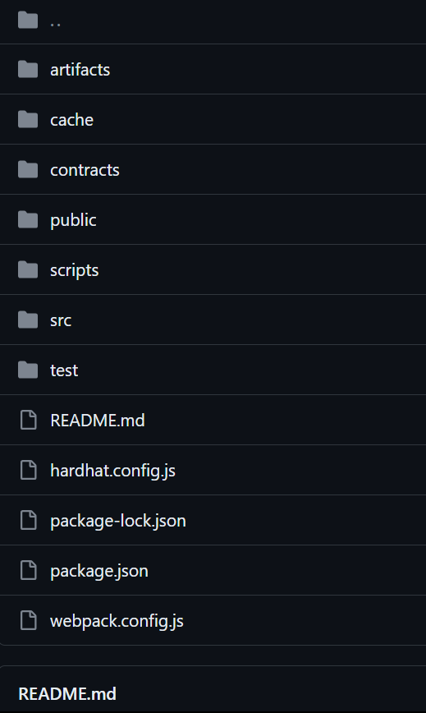
Modelling

Slide 10
Result / Outcomes
Our project is introducing people with emerging technology like blockchain. It is going to be the future for next generation.
​
Even though it’s just a basic project but it will give society an idea about emerging techs i.e; blockchain which are going to be a boom in upcoming future

Slide 11
Conclusion
We're on the cusp of a revolution in art ownership and creation! Imagine creating your own unique NFT masterpiece simply by describing it. Blockchain technology will secure your ownership and ensure authenticity, forever etching your vision onto the digital art landscape.

Slide 12
Future Perspective
Our marketplace isn't just about static digital art. We envision a future where creativity explodes into a symphony of formats: Beyond the Canvas: Imagine a world where your NFT collection transcends images. We'll seamlessly integrate videos and music NFTs, allowing artists to showcase multimedia masterpieces.
The Power of Prompt-Based Creation: Get ready to unleash your inner artist! Our revolutionary AI integration will allow you to generate unique NFTs based on simple prompts. Describe your vision, and our AI will craft a one-of-a-kind digital masterpiece.

Slide 13
Thank you...!
Notes:
13

