Slide 1
GOVERNMENT COLLEGE OF ENGINEERING,
CHHATRAPATI SAMBHAJI NAGAR
MINI PROJECT PRESENTATION
Project Team
CivicLens AI
Pathan Huzaifkhan
BT24S05F006
Shivam Atram
BT24S05F009
Government information, made easier with AI
Under the guidance of Prof. Vikul Pawar Sir
Academic Year 2026-27

Slide 2
01 | WHY THIS PROJECT
The problem we are solving
Students need information, not more complexity.
Information scattered
Eligibility confusion
Unreadable documents
Schemes, notifications, portals, and certificates are spread across many sources.
Users struggle to know which scheme may match their course, category, income, or goal.
Scanned EWS, hostel, income, and caste certificates are difficult to search or understand.
CivicLens AI brings discovery, explanation, and evidence together in one simple interface.
CivicLens AI | Mini Project | 2026-27
2

Slide 3
02 | OBJECTIVES
What CivicLens AI delivers
A focused, evidence-aware civic information assistant.
Explore government and MahaDBT schemes in one searchable directory.
Suggest potential scheme matches from a user profile.
Answer questions about uploaded PDF documents.
Use OCR for scanned or image-only certificates.
Show page-specific evidence and responsible-use limitations.
Support English, Hindi, and Marathi interfaces.
Core principle
Informational assistance, not an official eligibility or approval decision.
CivicLens AI | Mini Project | 2026-27
3

Slide 4
03 | PROPOSED SYSTEM
How the solution works
From a user question to a useful, grounded response.
1. Ask or upload
2. Retrieve evidence
3. Explain clearly
User explores schemes, asks a question, or uploads a PDF.
TF-IDF and cosine similarity rank relevant scheme or document passages.
The system returns an answer, sources, limitations, and next steps.
React + Vite frontend ? Flask API ? RAG / OCR / optional LLM
CivicLens AI | Mini Project | 2026-27
4

Slide 5
04 | ARCHITECTURE
System architecture
A modular client-server design.
Frontend
React, Vite, React Router, responsive CSS
Backend
Flask, Flask-CORS, JSON APIs
Knowledge
Curated schemes + MahaDBT catalog
Retrieval
TF-IDF + cosine similarity
Documents
PyMuPDF + temporary sessions
OCR
Tesseract + pytesseract + Pillow
Testing
Pytest, Vite build, browser smoke tests
CivicLens AI | Mini Project | 2026-27
5

Slide 6
05 | KEY FEATURES
One platform, multiple workflows
Designed for clarity and practical use.
Scheme Explorer
Guided Discovery
AI Assistant
Search, filter, view details, and browse 89 catalog records.
Use education, category, goal, and occupation preferences.
Ask questions about schemes and civic information.
PDF + OCR
Evidence First
Multilingual
Read text PDFs and scanned EWS, hostel, income, or caste documents.
Page citations, source passages, and clear limitations.
English, Hindi, and Marathi interface support.
CivicLens AI | Mini Project | 2026-27
6

Slide 7
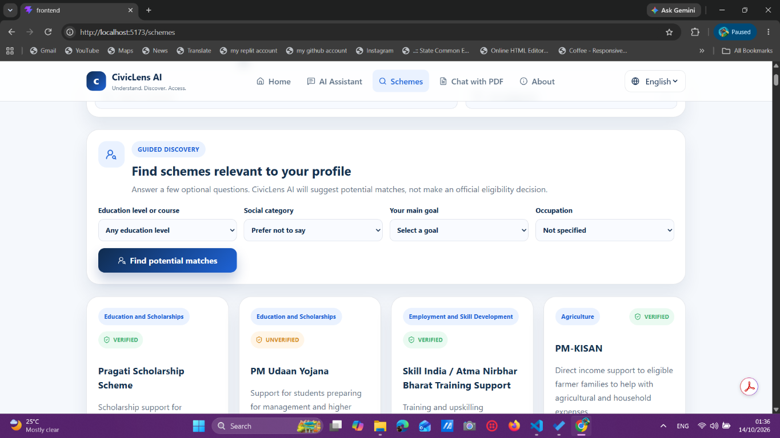
06 | LIVE DEMO
Scheme discovery
A guided profile helps users find potential matches.
CivicLens AI | Mini Project | 2026-27
7

Slide 8
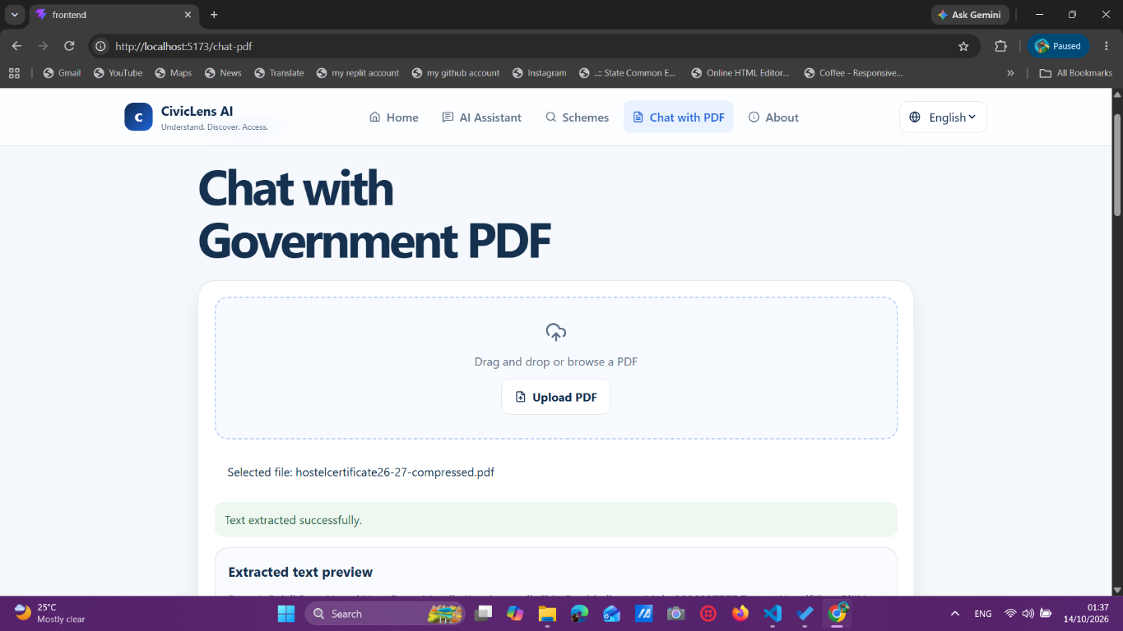
07 | LIVE DEMO
Chat with PDF and OCR
Upload a certificate, ask a question, and review page evidence.
CivicLens AI | Mini Project | 2026-27
8

Slide 9
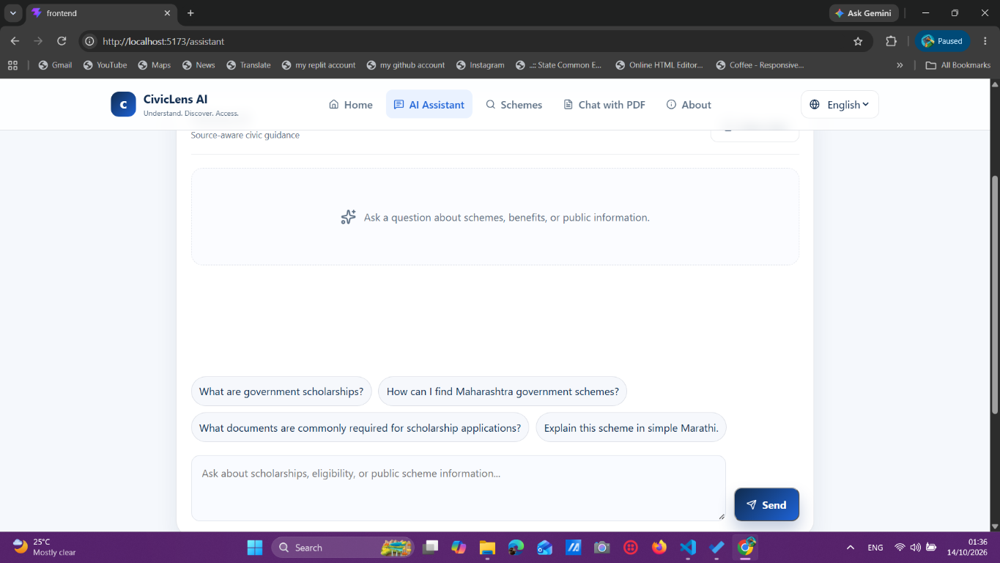
08 | LIVE DEMO
AI Assistant
Simple prompts for schemes, documents, and public information.
CivicLens AI | Mini Project | 2026-27
9

Slide 10
09 | DOCUMENT INTELLIGENCE
OCR-enabled document understanding
Scanned PDFs are converted into searchable evidence.
Detect
Render
Read and cite
Find pages with no selectable text.
Convert the page into a high-resolution image.
Tesseract extracts text; answers retain page numbers.
Example: EWS + income + caste topics detected from an uploaded certificate
CivicLens AI | Mini Project | 2026-27
10

Slide 11
10 | TRUST AND VALIDATION
Responsible design and testing
Useful answers must also be honest about limits.
Safety
Privacy
Validation
Potential matches are not official eligibility decisions. OCR may misread dates, names, and seals. Users must verify official rules.
Uploaded PDFs are processed temporarily and are not exposed as public documents.
15 backend tests passed. Frontend production build succeeded. OCR verified with Tesseract 5.5.3.
CivicLens AI | Mini Project | 2026-27
11

Slide 12
11 | TECHNOLOGY STACK
Tools used
A lightweight stack suitable for an academic project.
Frontend
React, Vite, React Router, CSS
Backend
Python, Flask, Flask-CORS
AI / Retrieval
scikit-learn TF-IDF, cosine similarity
PDF / OCR
PyMuPDF, Pillow, pytesseract, Tesseract
Provider
OpenAI-compatible optional API
Testing
Pytest, Vite build, browser verification
CivicLens AI | Mini Project | 2026-27
12

Slide 13
12 | OUTCOME
Project outcome
A complete working prototype ready for demonstration.
89
3
15
OCR
scheme records
interface languages
tests passed
scanned PDF support
CivicLens AI makes government information easier to understand, discover, and access.
CivicLens AI | Mini Project | 2026-27
13

Slide 14
13 | FUTURE SCOPE
What can come next
The foundation is ready for deeper civic assistance.
Verified, automatically updated scheme notifications and deadlines.
Hindi and Marathi OCR language packs.
Improved OCR post-processing for tables, dates, seals, and handwritten fields.
Saved schemes, document checklists, and exportable application summaries.
Accessibility, voice input, and mobile application support.
Next step
Move from a college prototype toward a verified, production-grade civic information service.
CivicLens AI | Mini Project | 2026-27
14

Slide 15
THANK YOU
Questions and Discussion
CivicLens AI
Pathan Huzaifkhan | BT24S05F006
Shivam Atram | BT24S05F009
Academic Year 2026-27

