Slide 1
HACK-O-VERSE
PROBLEM STATEMENT(07):
TO FIND THE DISTANCE OF OBJECT FROM CAMERA LENS USING SINGLE IMAGE.
TEAM NAME : OO7
TEAM LEADER NAME : NISHI KANT MANDAL

Slide 2
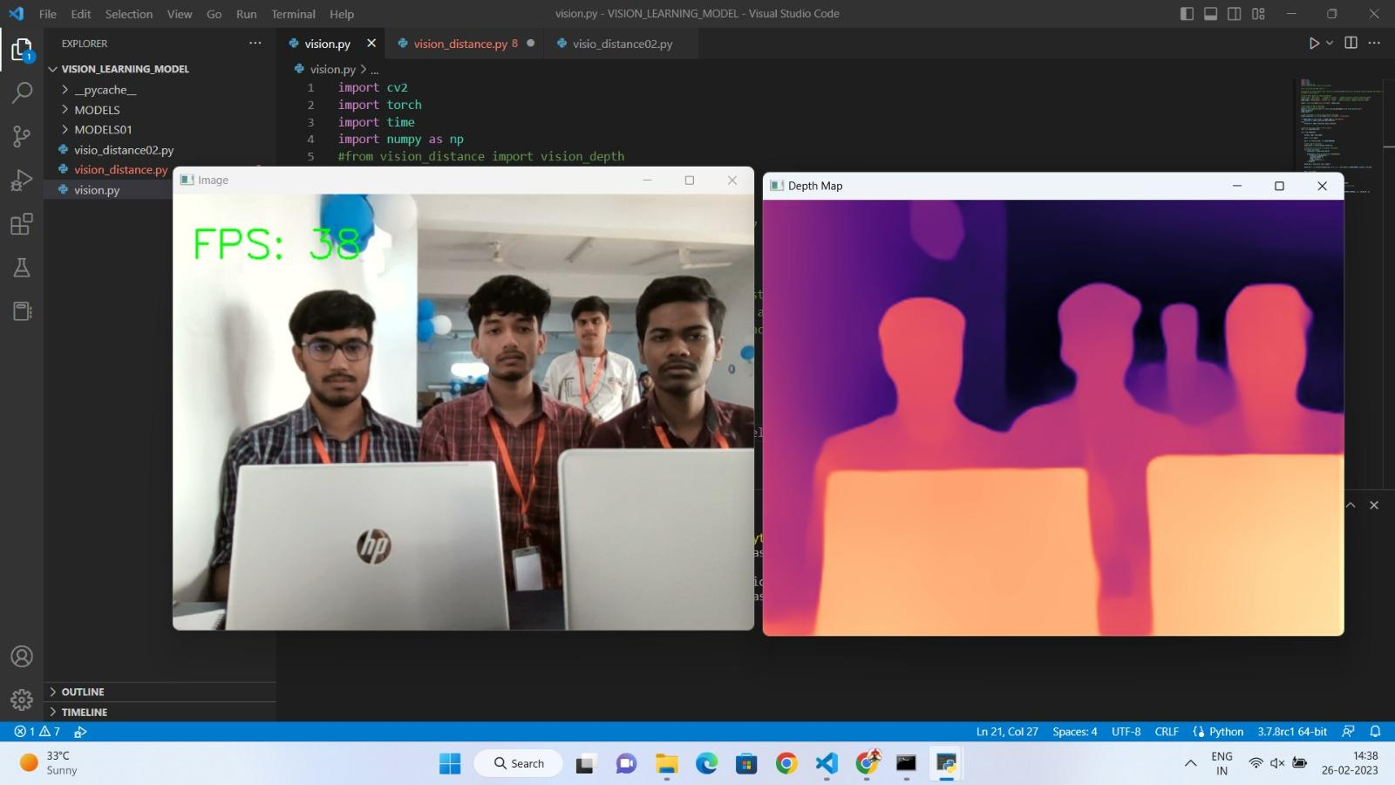
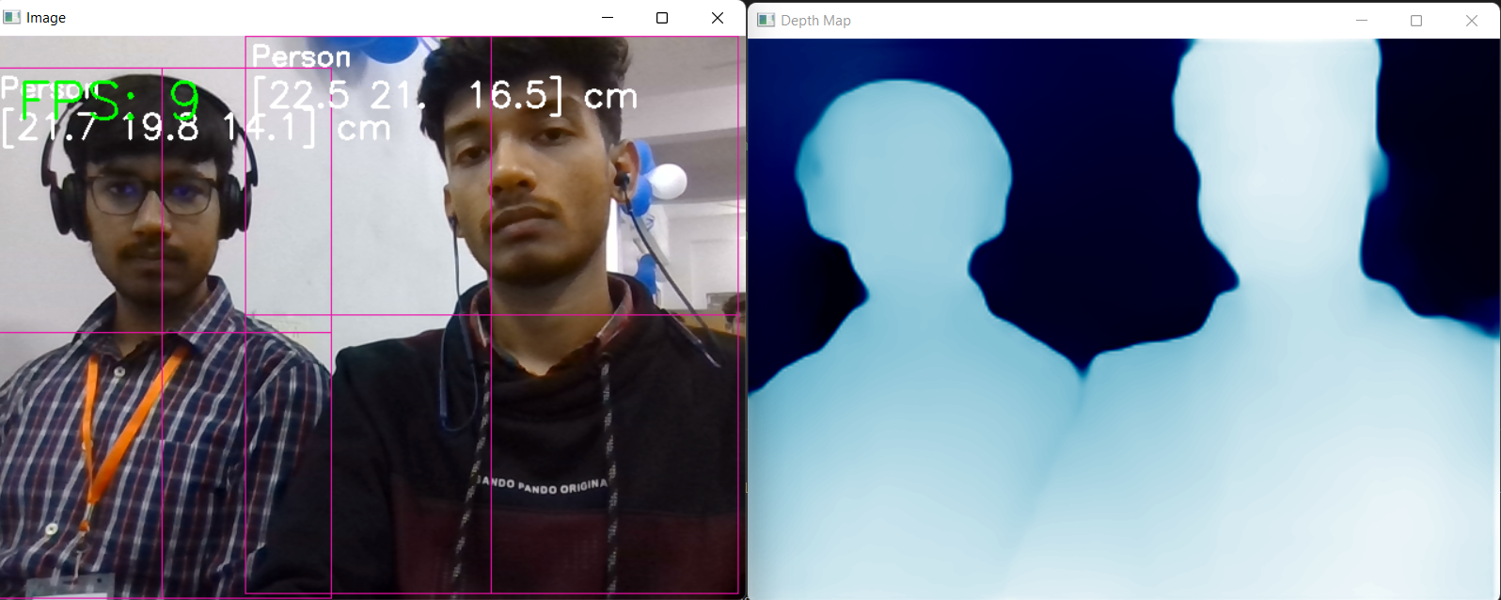
APPROACH DETAILS
First, we will use a camera to capture video of the scene we're interested in. Then, we'll use a computer program that can estimate the distance of objects in the scene from the camera, even though we're only using one camera. This is called monocular depth estimation.
To figure out if an object is big or small, we'll measure its height, width, and length using the same depth estimation technique. Then we'll compare those measurements to a threshold value to determine whether it's a big or small object.
By doing this, we'll be able to calculate the relative distance of objects from the camera.
Img 01 . While testing depth map creation
Img 02 . While testing object detection

Slide 3
DEPENDENCIES/TECHNOLOGIES
Python
Monocular depth estimation(MDE)
MiDaS neural network and its dataset
Timm
Pytorch
Open CV
Numpy
USE CASES
Whenever a car would approach into the circular range of a bigger loaded truck an alarm would go off in the car hearing which the driver would carefully drive his car away from the danger zone.
In automatic braking system of a car, the AI of the car can detect the relative distance between itself i.e. the car, and the obstacle in front of or behind it beforehand using this problem solution.

Slide 4
FLOW CHART
CALCULATION OF OBJECT DISTANCE
RINGS ALARM FOR PARTICULAR OBJECT AT PARTICULAR DISTANCE
IMAGE
MiDaS
DEPTH MAP

Slide 5
MiDaS
CALCULATION OF DISTANCE
The MIDAS (Mixture of Dense Networks for Single Image Depth Estimation) model for depth estimation is based on a deep convolutional neural network architecture. Specifically, it uses a multi-scale encoder-decoder architecture with skip connections, which is trained to predict the depth map of a given input image. The model is trained using a combination of supervised and unsupervised learning techniques, where the supervised part involves minimizing the mean squared error between the predicted depth map and the ground truth depth map, and the unsupervised part involves enforcing consistency between the predicted depth map and the input image. Overall, the MIDAS model is a state-of-the-art approach for single image depth estimation that has achieved impressive results on a wide range of benchmark datasets.
The distance is calculated under the given formula :-
d = (f*b)/(x-x’)
where,d is the distance of object from the optical centre,f is the focal length of optical lens of the webcam,b is the baseline and (x’ , y’) represents the pixel coordinates in the depth map.

Slide 6
REASONS FOR CHOOSING MiDaS
WORKS SMOOTHLY ON LOW END PROCESSOR
OPEN SOURCE
REAL TIME PERFORMANCE
ACCURACY

Slide 7
DEPTH MAPS
CNN
A depth map is a 2D representation of a 3D scene that provides information about the distance of objects from the camera. It is created using depth sensing technology, such as stereo vision or time-of-flight cameras, and can be used in applications such as 3D modeling, augmented reality, and robotics. Depth maps are typically grayscale images where the intensity values correspond to the distance of objects from the camera, with darker regions indicating objects that are farther away and brighter regions indicating objects that are closer.
CNN basically extracts features from the image layers by layer and stores these features in the form of matrix with the help of kernel(filter) , this process of layering and extracting goes on and it tries to learn hierarchy of features.
.
COMPUTER VISION
It is an area of research and development that is focussed on helping computers learn how to interpret and make sense of visual information like image. The CV develops its own algorithms and methods to recognize various things in the image like : image recognition and object recognition. Just like humans learn to recognize objects and understands the world around them through their senses such as vision.

Slide 8
Architecture: Kitty and Midas use different deep learning architectures. Kitty is based on a ResNet backbone with an encoder-decoder architecture, while Midas uses a lightweight MobileNetV2 backbone with a pyramid fusion module.
Training data: Kitty was trained on the KITTI dataset, which contains real-world driving scenes, while Midas was trained on a combination of synthetic and real-world images.
Output format: The output format of the two models is different. Kitty predicts a single depth map, while Midas produces two maps: a dense depth map and a sparse depth map with fewer details but higher accuracy.
Performance: Both models have achieved state-of-the-art performance on benchmark datasets such as NYU Depth V2 and KITTI, but Midas has been shown to outperform Kitty on some tasks, such as depth estimation for objects at close range.

Slide 9
TEAM MEMBER DETAILS
TEAM LEADER NAME : NISHI KANT MANDAL
BRANCH : CIVIL ENGINEERING
YEAR : 1ST YEAR
INSTITUTE : B.I.T. SINDRI
TEAM MEMBER 1: ARYAN KASHYAP
BRANCH: ELECTRICAL ENGINEERING
YEAR: 1ST YEAR
INSTITUTE: B.I.T. SINDRI
TEAM MEMBER 2: SANKET KUMAR
BRANCH: ELECTRICAL ENGINEERING
YEAR: 1ST YEAR
INSTITUTE: B.I.T SINDRI
TEAM MEMBER 3: PRANAV KUMAR SINGH
BRANCH: ELECTRICAL ENGINEERING
YEAR: 1ST YEAR
INSTITUTE: B.I.T. SINDRI
TEAM MEMBER 4: SOURABH PODDAR
BRANCH: ELECTRICAL ENGINEERING
YEAR: 1ST YEAR
INSTITUTE: B.I.T. SINDRI

