Slide 1


Covid-19 Data analysis and prediction using machine learnig
Under the guidance of Supervisor : Mr. Shiva Prasad Nepal
Presented by: Aditya Shah (77202324)
Module : Production Project

Slide 2
Contents
Project summary
Introduction
Problem statement
Aim and objectives
Review of literature
Review of technology
Methodology
Work plan
Product design
Implementation & Testing
Snapshot of the system
Product Evaluation
Project Evaluation
Conclusion
Limitation

Slide 3
Project Summary
An sytem for Covid-19 data visualization and prediction
Visualizing users uploaded data.
Predicting Covid-19 Cases.
Providing Concise information on Covid-19.
Live Covid-19 data Visualization

Slide 4
Introduction
What is Covid-19 Data analysis and prediction using machine learning ?
Analytical report for indepth information on Covid-19 cases.
Covid-19 Dashbord for interactive user experience.
Web app for predicting Covd-19 cases, live Covid-19 data visualization and users data visualization.

Slide 5
Problem Statement
Unreliable and fake Covid-19 data.
Lack of proper business decision making.
Unable to predict the Covid-19 cases.
Poor Data visualization.
Lack of future preventive measures regarding Covid-19.

Slide 6
Aim & Objectives
Perform data analysis and visualization using machine learning.
Visualize live Covid-19 data.
Predict the Covid-19 cases.
Generating report of user dataset.
Providing concise information on Covid-19 cases.

Slide 7
Review of literature
According to (Singhal,2020) spread of the 2019 novel coronavirus (2019-nCoV) or the severe acute respiratory syndrome coronavirus 2, the globe is facing a new public health crisis (SARS-CoV-2).
(Muhammad, 2021) Says According to the results of the model performance evaluation, the decision tree model acquired the greatest precision of 94.99 %, the sensitivity of the Support Vector Machine Model was 93.34%, and the specificity of the Naive Bayes Model was 94.30%.
(Binti Hamzah FA et al., 2020) assumes the spread of the outbreak is heavily influenced by each country's regulation and civic responsibility.

Slide 8
Review of technology
Technologies used:
Python for web app development.
Google Colaboratory for data analysis and visualization.
Google Data Studio for building dashboard.
GitHub for version control.
Figma for designing the product.
Trello for task management.

Slide 9
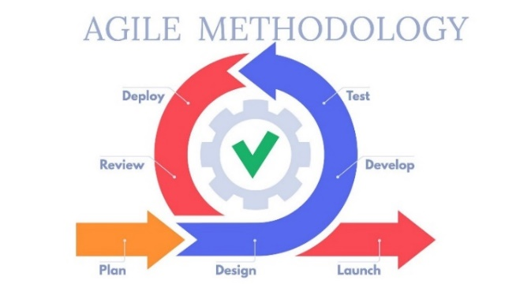
Methodology
Agile Methodology is used for product development.
New features introduced without problems.
Better than water fall and RAD methodology.
Testing were done on same place for quality assurance.

Slide 10
Work Plan
Total Time: 2 months
Project initiation: 7th May
Project Completion: 12Th July
Milestones:
Prototype Presentation: 28th May
Product development: 13th May – 6th June
Report Submission: 12th July

Slide 11
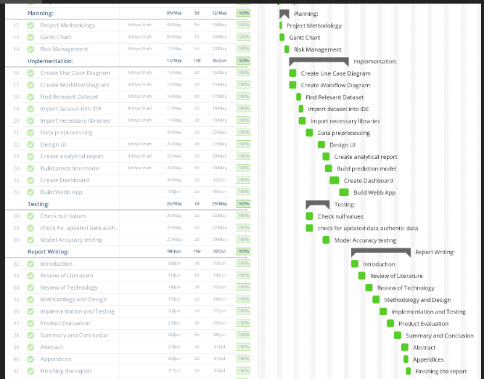
Gantt Chart

Slide 12
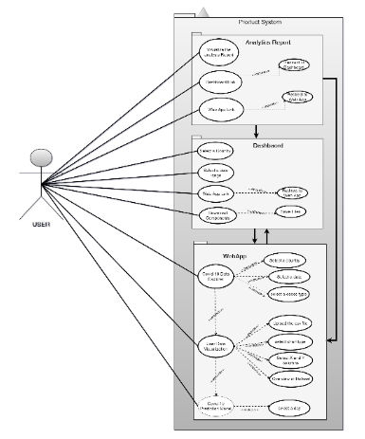
Use case diagram

Slide 13
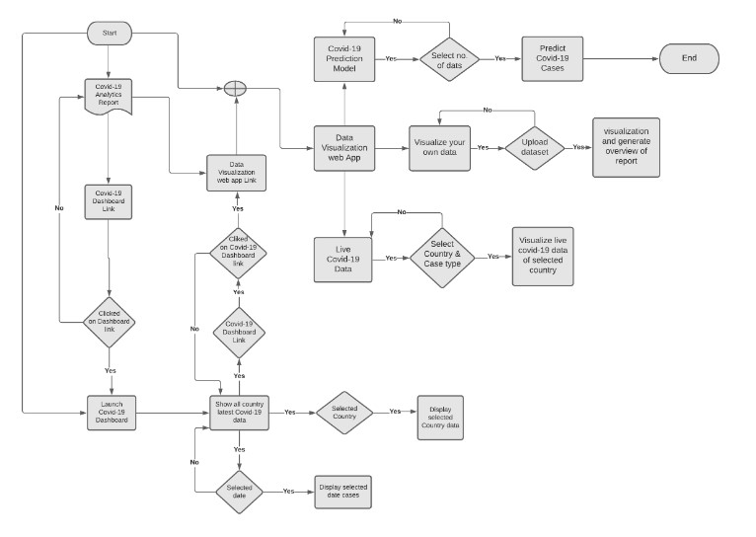
Flow Chart

Slide 14
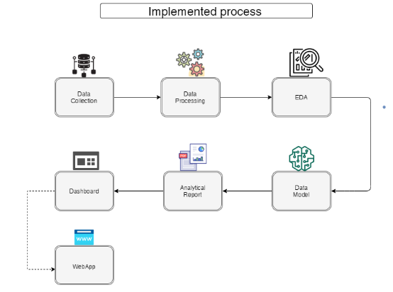
Development Process

Slide 15
Implementation
Data analysis and visualization was performed.
Overall product design was created.
Analytics report was created as per data analyis.
Dashboard was built according to wireframe design.
Web app was developed as per wireframe and design of product.

Slide 16
Testing
Black-box testing was performed.
Functionality of product was tested.
Error and quality was checked.
Bug free product was built.

Slide 17
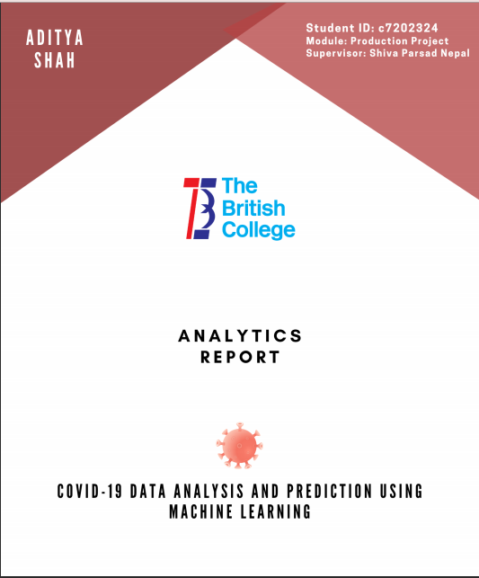
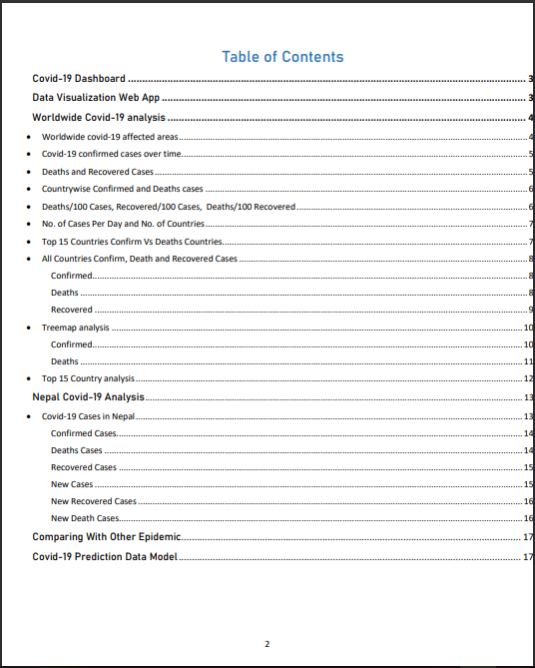
Snapshot Of The System
1. Covid-19 Analytics Report

Slide 18
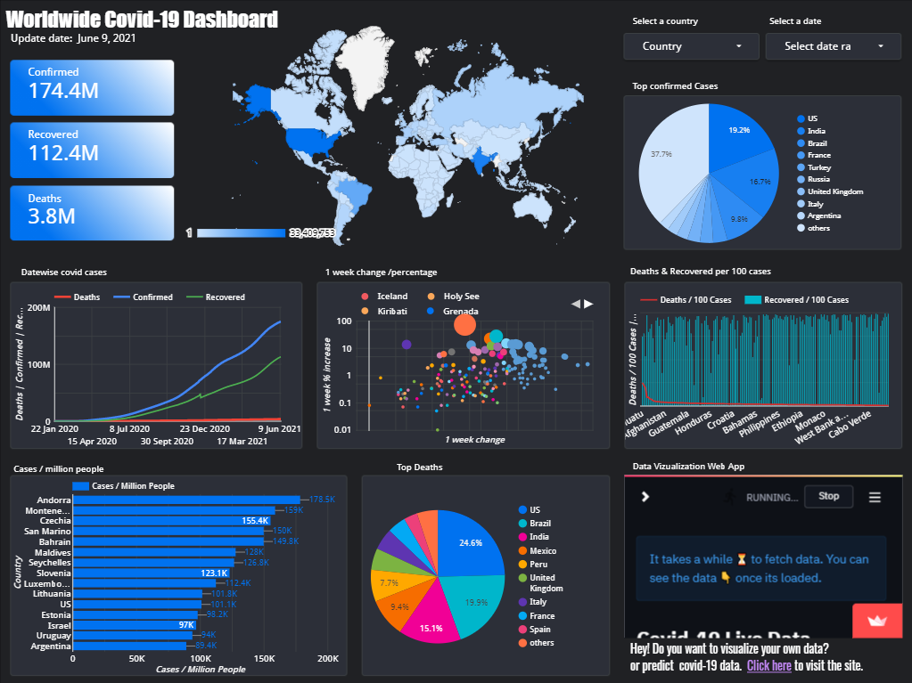
Snapshot Of The System
2. Covid-19 Dashboard

Slide 19
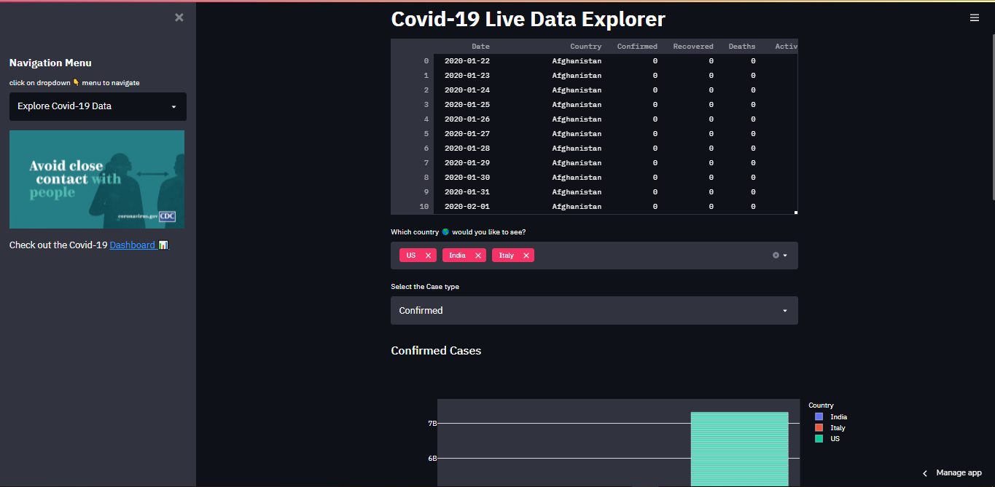
Snapshot Of The System
2. Data Visualization Web app

Slide 20
Product Evaluation
Product was evaluated according to initial plan.
Fullfills aim and objective of product.
Live Covid-19 data is visusalized.
Prediction of Covid-19 is successful.
User is able to visualize the data.
Overview report of dataset is generated.

Slide 21
Project Evaluation
Completed following agile methodology.
Risk analysis was performed.
Task management was done using Kanban framework.
Each steps of SDLC was followed.
GitHub was used for version control

Slide 22
Conclusion
Provides meaningful insight of Covid-19 data.
Visualizes live Covid-19 data.
Helps to predict the Covid-19 cases.
Assist in data visualization.
Generates overview of uploaded csv file.

Slide 23
Limitation
Requires internet connection.
Latest data is fetched lately.
Predicts the Covid-19 cases upto 5 days.
No dedicated user profile settings.
Allows only CSV file to be uploaded.

Slide 24
Thank You!

