Slide 1
Get My Parking
Get My Parking (GMP) - Company Highlights
Startup Name Get My Parking
Founders Rasik Pansare (CMO), Chirag Jain (CEO)
Headquarter Bangalore
Sector Mobile-based Parking
Total Funding INR 29.05 Crores ($4.476 Million)
Revenue INR 14 crore (2020)
Website getmyparking.com

Slide 2
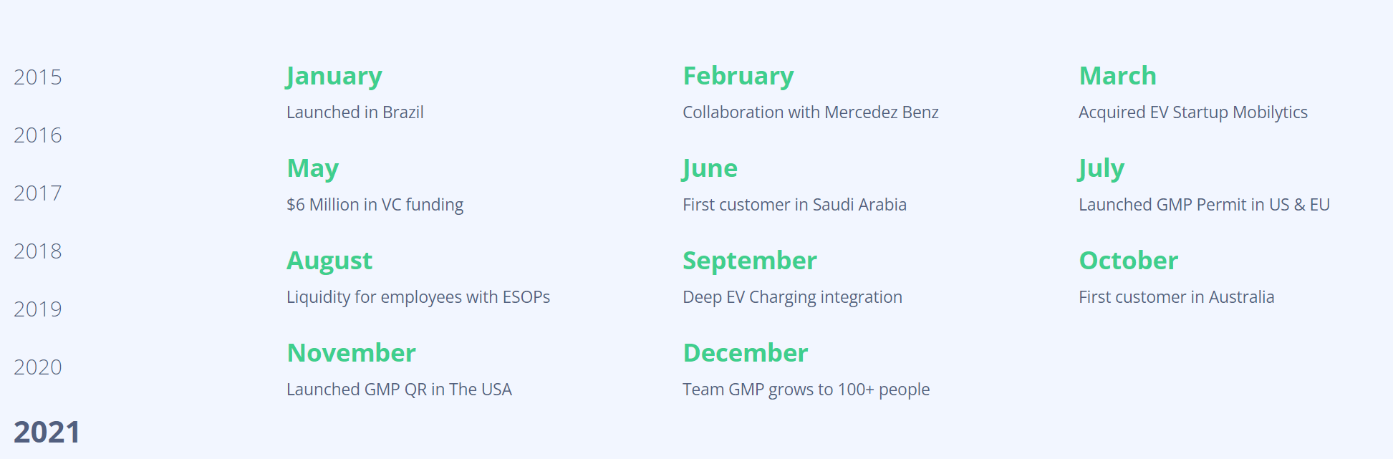

Slide 3
Venture capital is a form of private equity financing that is provided by venture capital firms or funds to startups, early-stage, and emerging companies that have been deemed to have high growth potential or which have demonstrated high growth.
Is GMP a B2C Company?
No, GMP is not a B2C company. We do not have an app or website under the name of Get My Parking for the end consumer. Our apps are white-labeled for our customers. So, in essence, we are a B2B2C company, we help our customers go B2C.

Slide 4
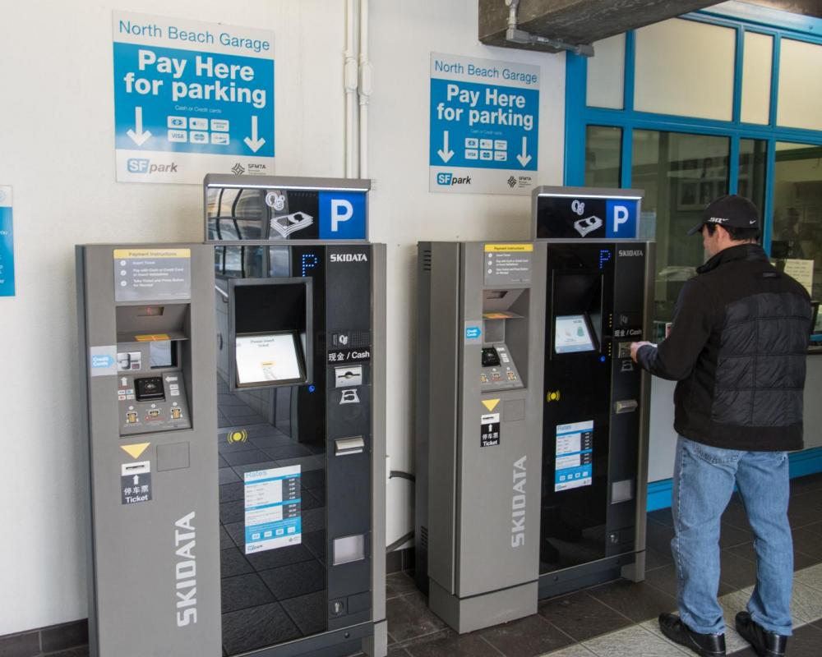
Is GMP a PARCS hardware provider? No, GMP does not sell PARCS hardware and equipment. Get My Parking is a software company. Our software solutions are unique in a way that they can integrate and retrofit any existing access control system or equipment. We are already integrated with 40+ equipment providers across the globe and adding more integrations regularly.

Slide 5
What are the benefits of the GMP Platform?
Some of the key benefits that our customers get from using our interoperable platform are:
(1) Custom-branded, consumer-facing solutions that create customer loyalty
(2) Plug-N-Play, ready-to-deploy ad cost-effective solutions
(3) Pay as you Go options for your parkers
(4) Quick, on-demand API integrations of your choice.
(5) Open additional revenue channels by upselling your parking services
(6) Retrofit your existing systems without expensive upgrades
What kind of customers do you work with?
GMP provides solutions to different kinds of customers including parking operators and property managers, parking aggregator apps, municipalities, government entities managing parking, corporate campuses, airports, universities, colleges, hospital complexes, commercial buildings and facility management companies.

Slide 6
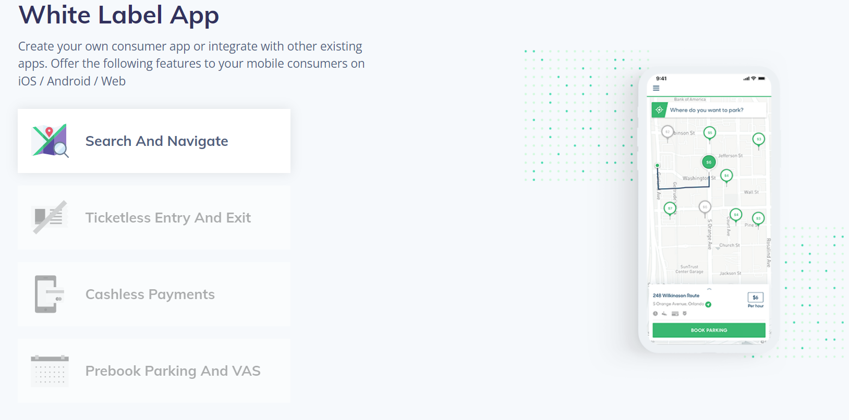
White Label App
Create your own consumer app or integrate with other existing apps. Offer the following features to your mobile consumers on iOS / Android / Web

Slide 7
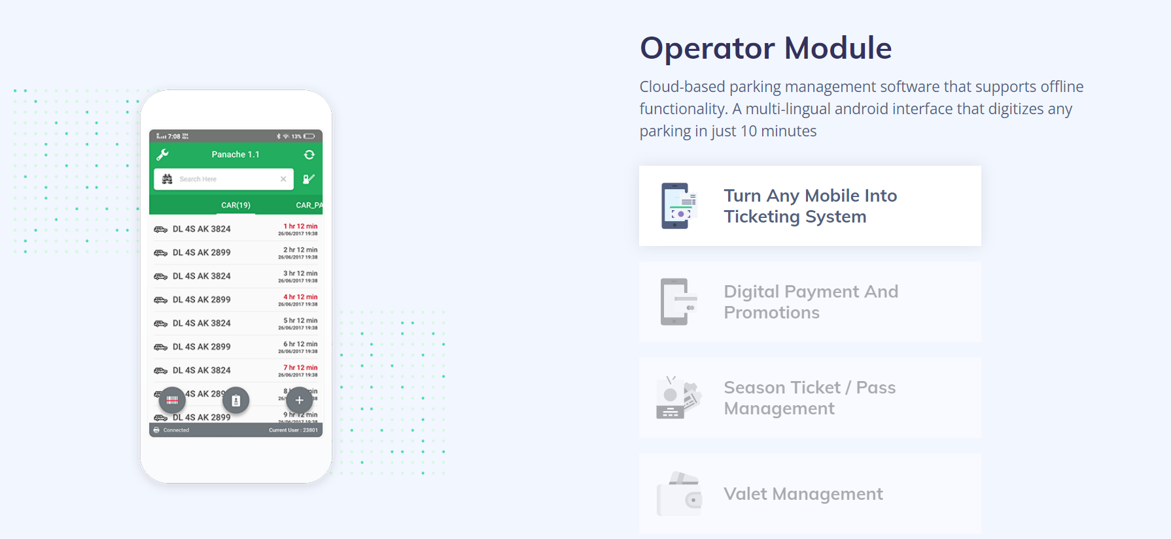

Slide 8
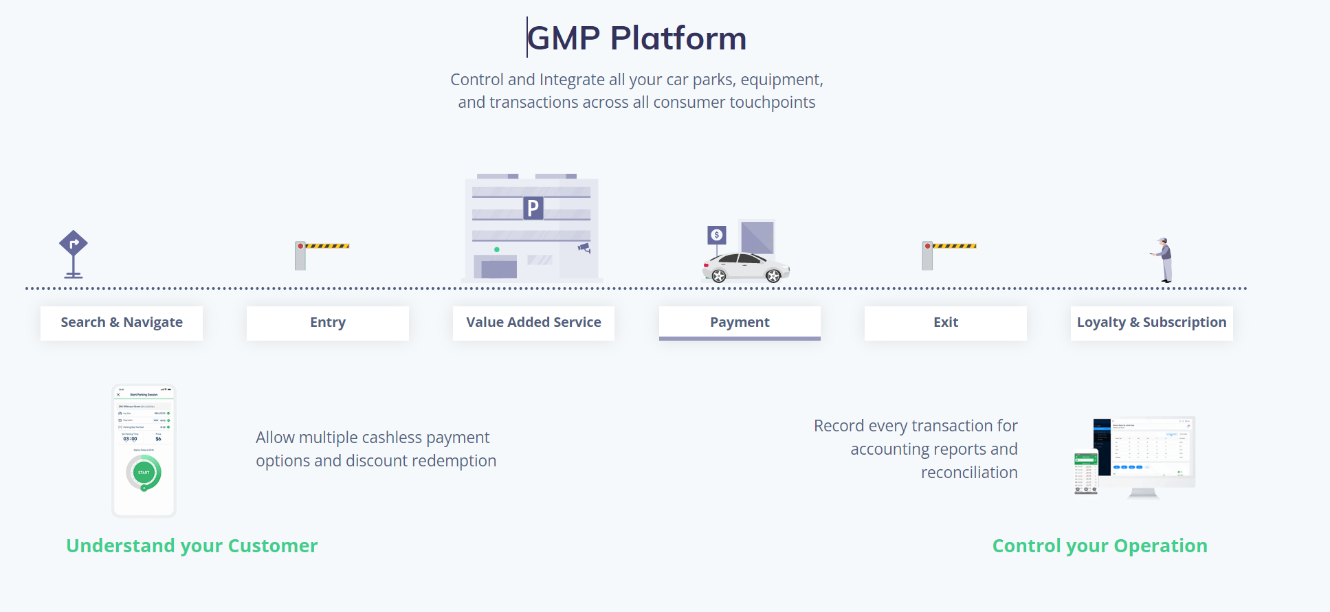

Slide 9
MyParkings
The app is IOT technology-enabled app. It is developed by Broadcast Engineering Consultants India Limited (BECIL) and South Delhi Municipal Corporation (SDMC).The people will be able to book parking slots in an online manner in areas under the jurisdiction of the SDMC. The app will help to give digital rules for authorized parking under SDMC municipal limits.

Slide 10
Startup name- MyParkings
Founders-Anurag Thakur
Headquarters- Noida, India
Founded in-2021
Competitors- Park+, FlashParking,T2 System
Partners- ICICI Bank, Paytm, Fast Tag, PinsLab, Harigo
Website-www.myparkings.com
Services & Offering:
1.EV Charging
2.Smart Technology
3.MaaS(Mobility as a Service)
Parking Slots: 150000+
Parking Locations: 450+
Features:

Slide 11
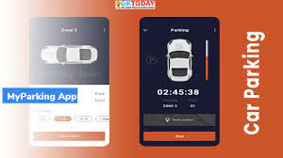
1.Mobile app
2.Automatic number plate recognition
3.QR Code
4.Advance Booking
5.Fast Tag
6.Cashback
7.Safe & Secure
8.Paperless
Company Stage-Unfunded

Slide 12
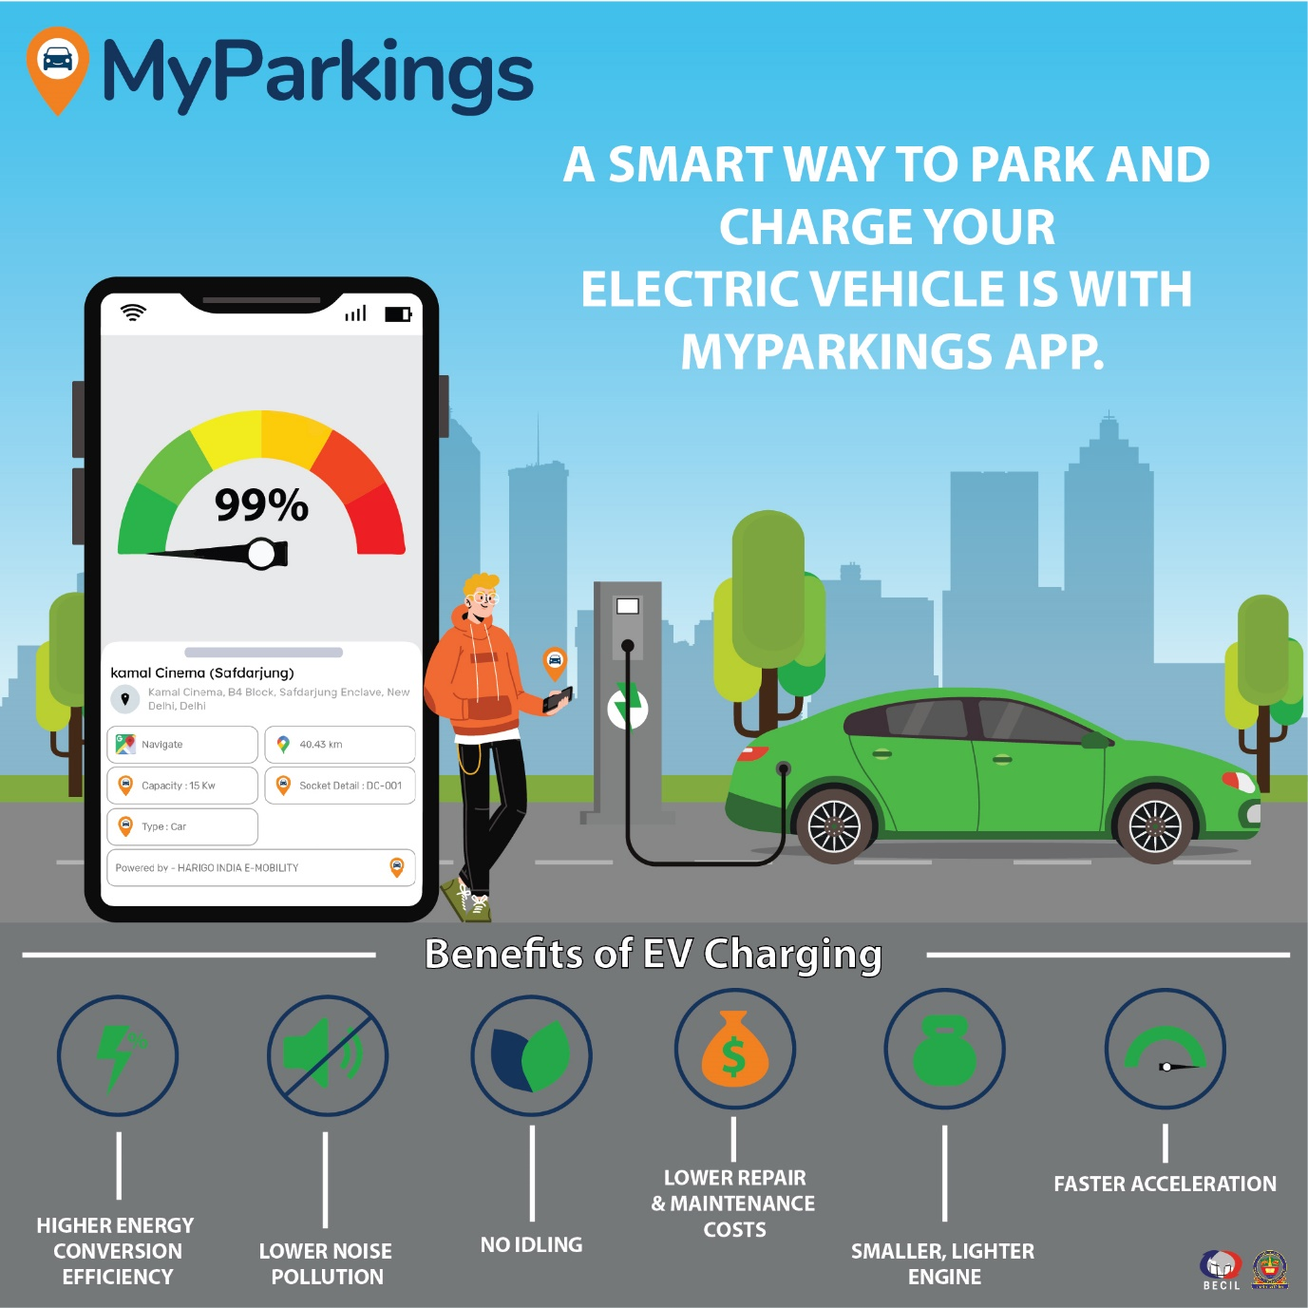

Slide 13
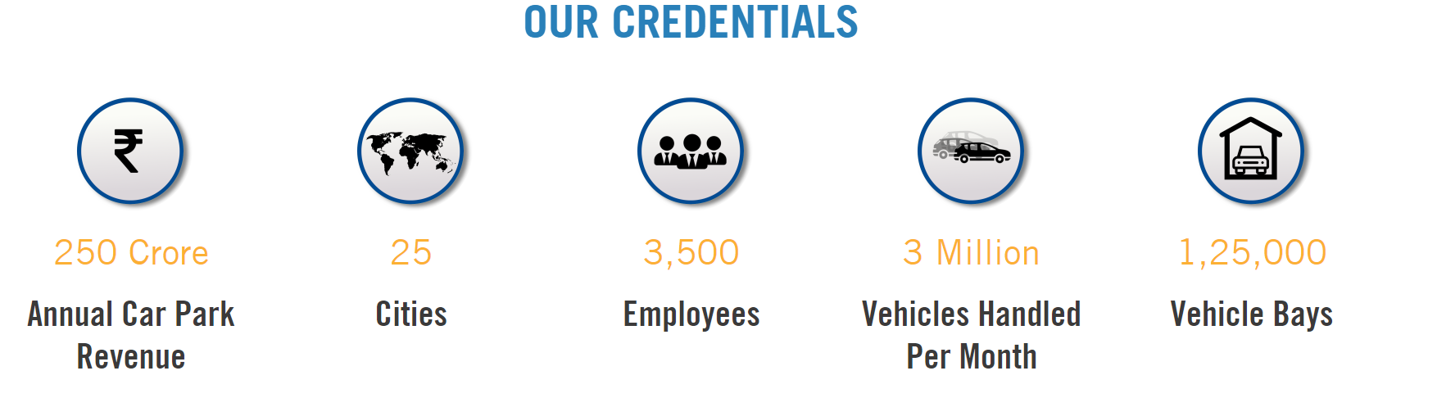
Versionx Parking

Slide 14


Slide 15
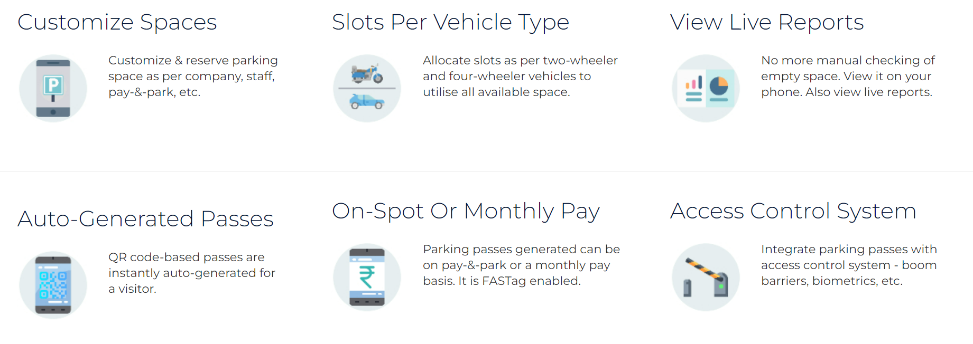
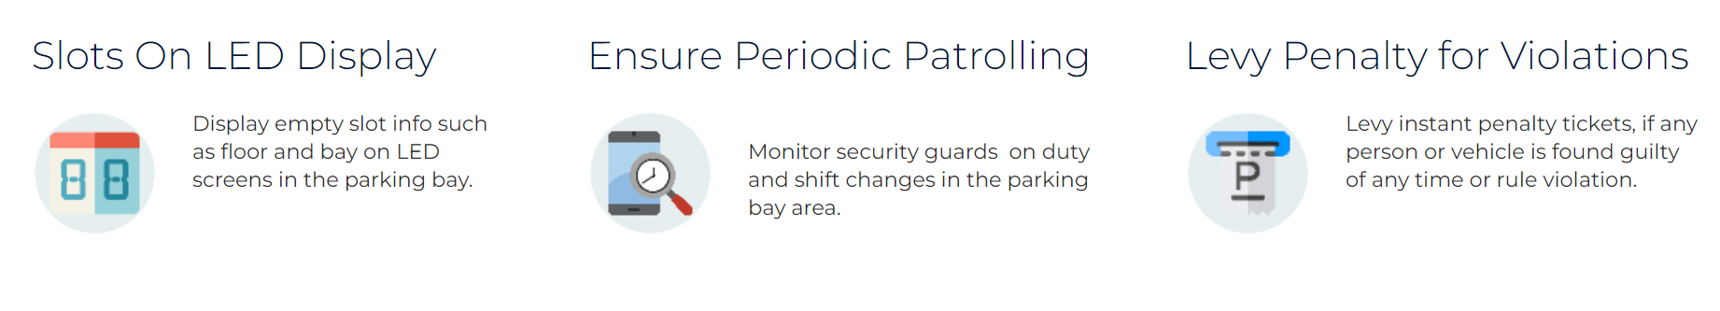

Slide 16
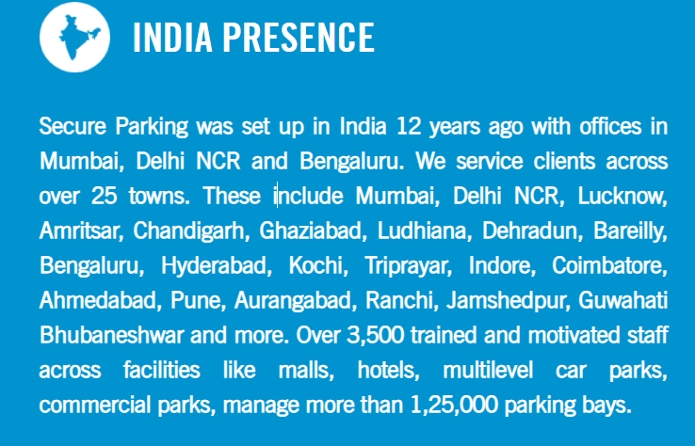

Slide 17
Parkzap
Parkzap Key Metrics
Parkzap Founders
Parkzap founders include Pranay Sharma (Co-Founder).
Founded Year
2015
Location Gurgaon, India
Company Stage Funding Raised
Valuation $45.5K as on Oct 12, 2018

Slide 18
Parkzap Latest Shareholding
Shareholders Name | Post Round Holding % | Net worth
Founder | 10.44% | 3.5L
Angel | 89.55% | 30L
Total | 99.99% | 33.5L

