Slide 1
Costumer Segmentation and Prediction

Slide 2

AGENDA
Introduction
Objective
Data Understanding
Data Preprocessing
EDA (Exploratory Data Analysis)
Model Selection
Model Evaluation
Conclusion & Recommendations

Slide 3
Introduction (Project Overview)
Focus: Segmenting e-commerce customers based on purchasing behavior using machine learning techniques.
Problem: Uniform marketing strategies fail to address diverse customer purchasing behaviors.
Approach: Apply RFM analysis and clustering techniques (K-Means, Hierarchical, DBSCAN) to segment customers based on purchase patterns.
Goal: Enable targeted marketing, improve customer retention, and optimize inventory decisions.

Slide 4


Objectives
Segment customers based on their purchasing behavior and transaction history
Identify high-value, loyal, and at-risk customer groups
Predict future purchase likelihood using historical patterns
Enable targeted marketing strategies to improve retention and revenue
If you want it more business-focused or more ML-focused, I can tune the wording instantly.

Slide 5

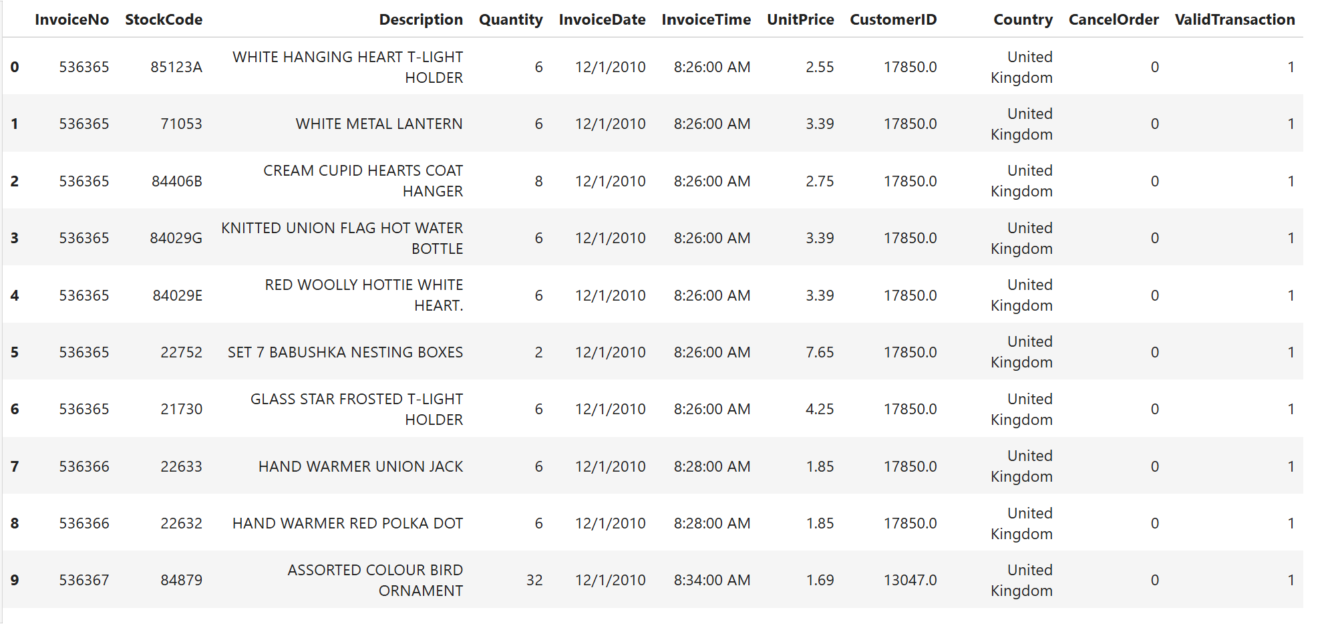
Data Acquisition
The dataset provides granular transaction-level information, allowing accurate modeling of customer value, loyalty, and purchasing patterns for effective segmentation and prediction.
Key Attributes:
Transaction details: InvoiceNo, InvoiceDate, InvoiceTime
Product information: StockCode, Description, UnitPrice
Purchase behavior: Quantity
Customer details: CustomerID, Country
Transaction flags: CancelOrder, ValidTransaction
Data Scope:
Multiple products per invoice
Repeated purchases by the same customer
International customer base (country-level coverage)

Slide 6
Model Development Process
Import Libraries
Load dataset
Explore Data
Data cleaning & Preprocessing
Handle Missing values
EDA
Visualisation
Split into Train &Test
Model Building
Model Evaluation
Interpretation

Slide 7
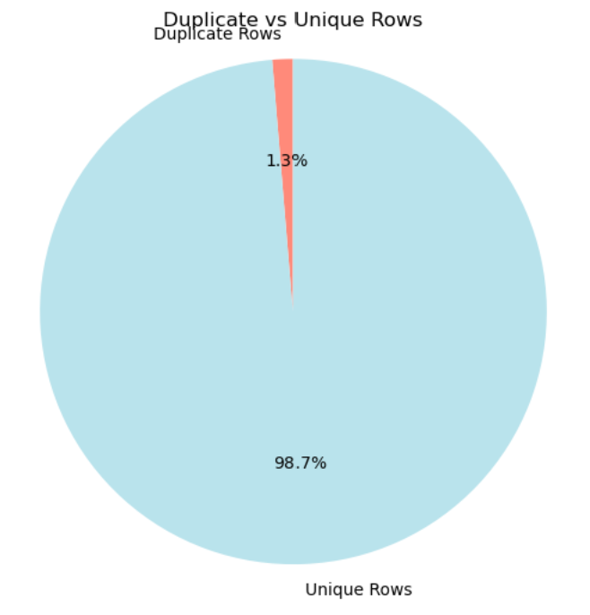
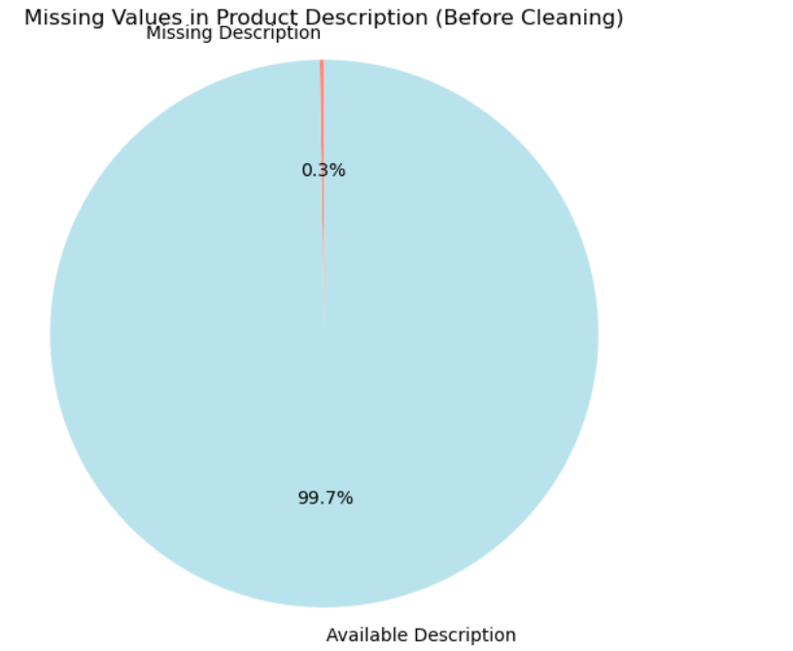
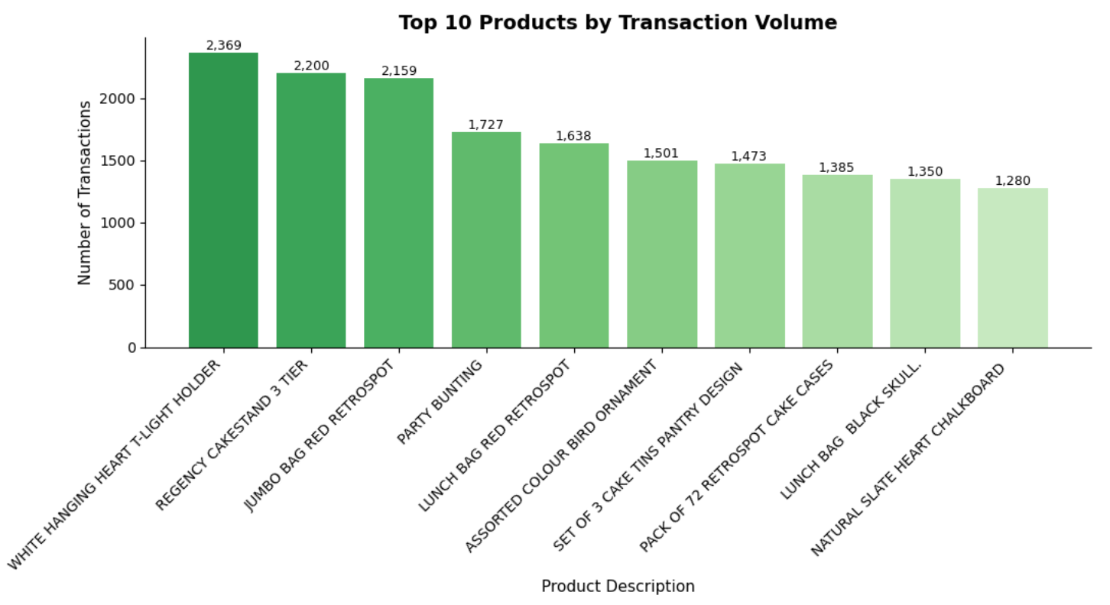
Explore Data Analysis (EDA)
The dataset is highly clean, with ~98.7% unique records and only ~1.3% duplicates.
Duplicate entries form a very small fraction, indicating good data quality with minimal redundancy.
A small set of products dominates transaction volume, indicating a clear demand concentration.
The top product significantly outperforms others, suggesting hero SKUs driving sales frequency..

Slide 8
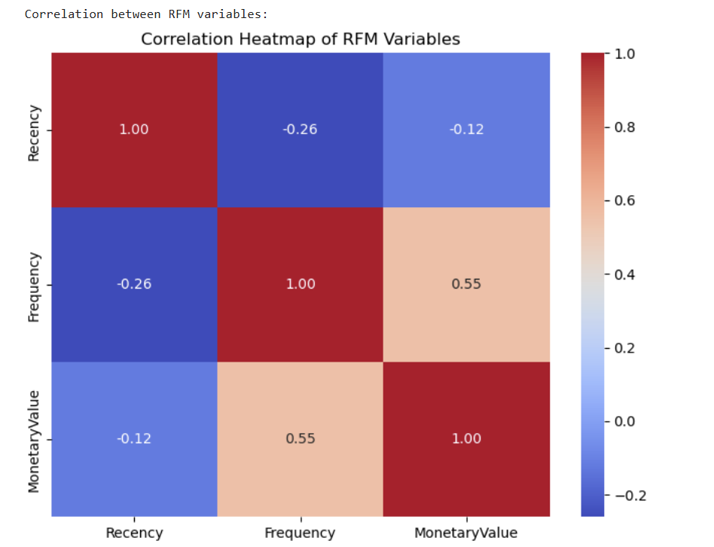
Correlation Heatmap Plot
RFM Correlation Insights
Frequency & Monetary Value (0.55): Frequent customers tend to spend more.
Recency vs Frequency (-0.26): Recent buyers are slightly more active.
Recency vs Monetary (-0.12): Recent purchase does not strongly indicate higher spend.
Key Takeaway: Low correlation confirms RFM variables capture distinct behaviors, supporting effective customer segmentation.

Slide 9
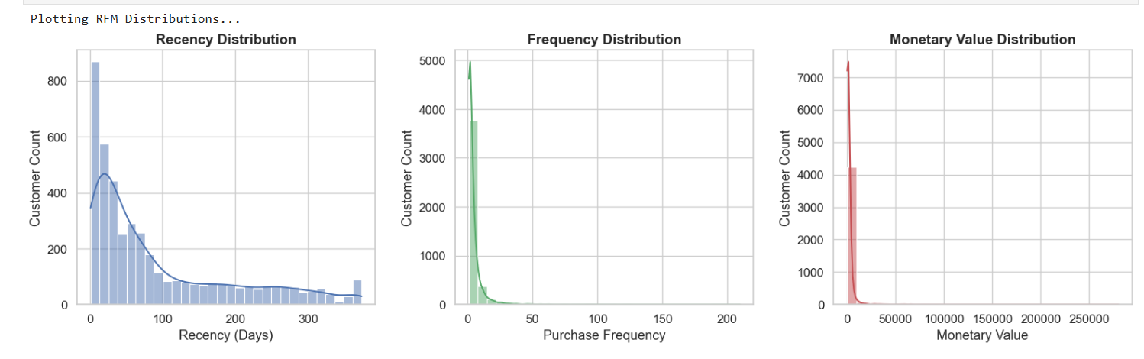
RFM Model
Monetary Value
Monetary value is extremely skewed, where the majority of customers contribute low to moderate revenue.
A small group of high-value customers drives a disproportionately large share of total revenue.
Frequency
Purchase frequency is heavily right-skewed, with most customers making few transactions.
A small subset of customers shows high repeat purchases, representing the core loyal customer base.
Recency
The recency distribution is right-skewed, indicating that most customers have made recent purchases, while a smaller group has been inactive for a long time.

Slide 10
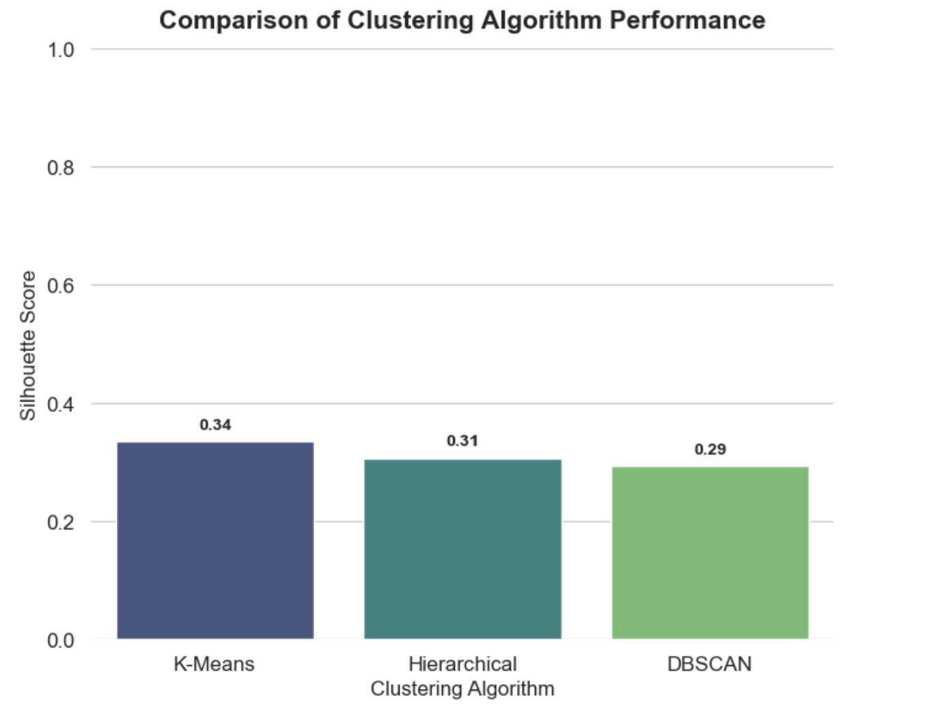

Model Selection
K-Means Clustering
Achieved the highest Silhouette Score (0.34)
Produces well-separated and compact clusters
Highly suitable for RFM-based customer segmentation
Easy to interpret and scalable for large datasets
Hierarchical Clustering
Delivered a moderate Silhouette Score (0.31)
Useful for understanding cluster relationships
Less scalable compared to K-Means for large transaction data
DBSCAN
Recorded the lowest Silhouette Score (0.29)
Effective in detecting outliers and noise
Less suitable for defining clear customer segments in this dataset

Slide 11
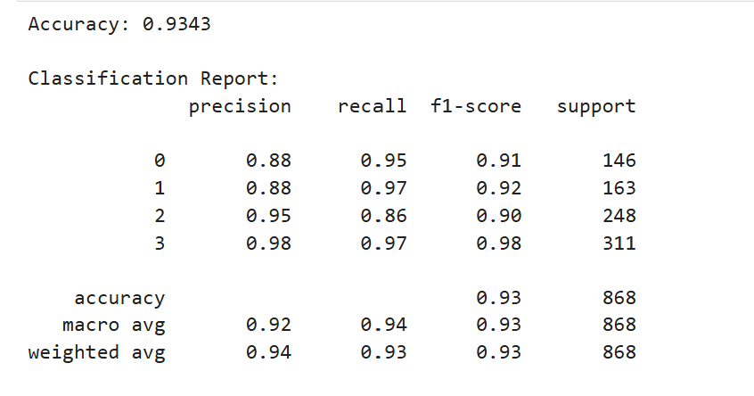
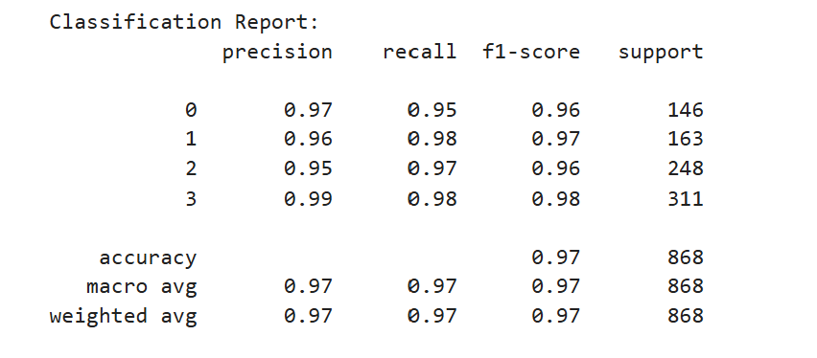
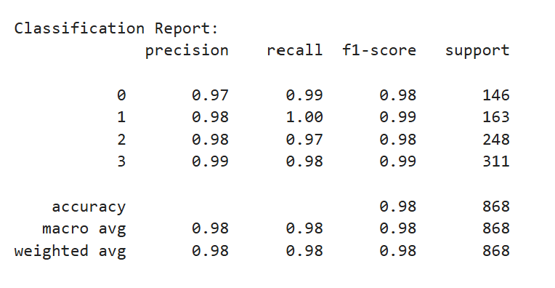
Evaluation metrics
Model Performance Comparison
Three models were evaluated using accuracy, precision, recall, and F1-score.
Model 1 (Logistic Regression) – ~93% accuracy Reliable baseline with balanced performance; lower recall for some classes.
Model 2 (Random Forest) – ~98% accuracy Highest precision, recall, and F1-score; most consistent across classes.
Model 3 (Decision Tree Classifier) – ~97% accuracy Strong and stable performance; slightly below Model 2 but better than baseline.

Slide 12
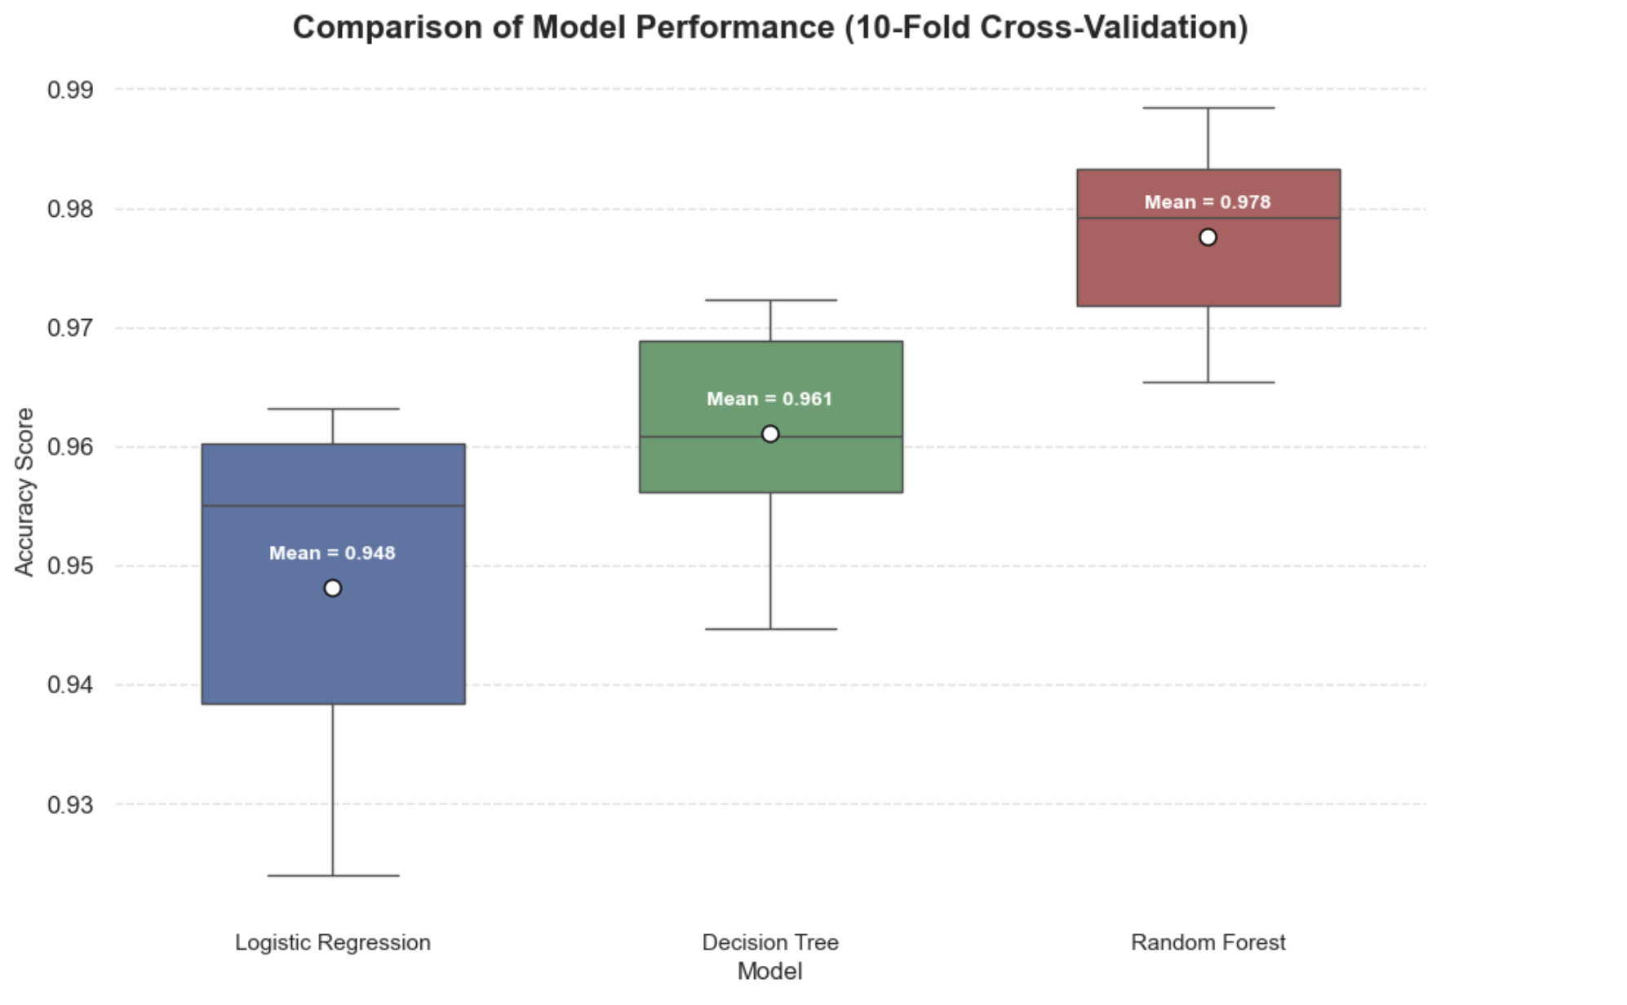
Model Comparison
Three machine learning models were evaluated using 10-fold cross-validation, focusing on mean accuracy and stability (standard deviation).
Model 1 – Logistic Regression
Mean Accuracy: 94.8%
Std. Deviation: 0.014
Serves as a strong and interpretable baseline
Slightly higher variability compared to tree-based models
Model 2 – Random Forest (Best Performer)
Mean Accuracy: 97.8%
Std. Deviation: 0.007
Highest accuracy with the lowest variance
Most robust and consistent across folds
Model 3 – Decision Tree Classifier
Mean Accuracy: 96.1%
Std. Deviation: 0.009
Good balance between performance and simplicity
Slightly lower accuracy than Random Forest, but more stable than baseline

Slide 13
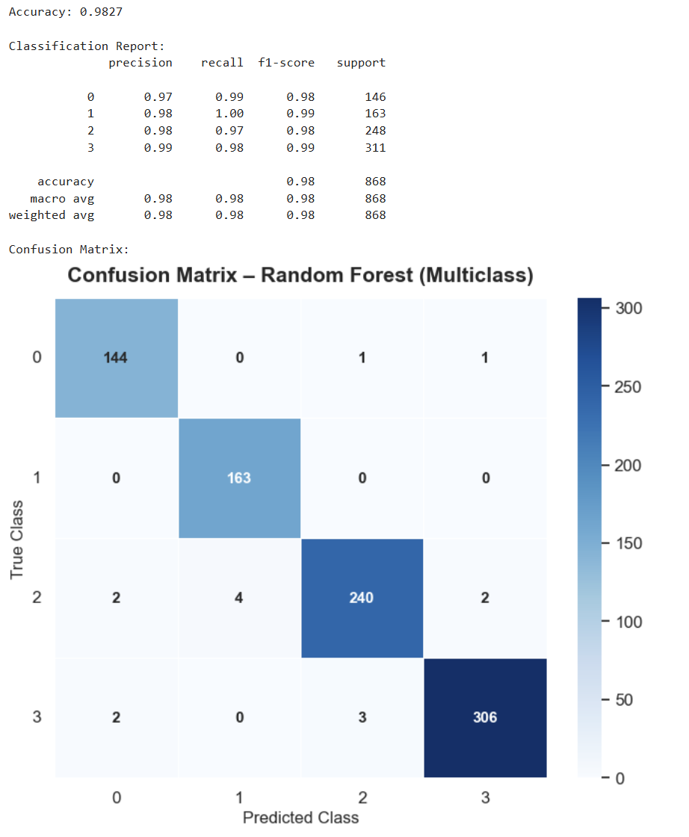
Best Model
Why this model was selected:
High Accuracy (98.27%) Indicates excellent overall predictive performance.
Strong and Consistent Recall (~0.98 across classes) Ensures most actual customer classes are correctly identified, minimizing missed predictions.
Excellent F1-Score (~0.98) Demonstrates a strong balance between precision and recall across all classes.
Robust Class-wise Performance High precision (0.97–0.99) and recall (0.97–1.00) show consistent performance with minimal misclassification.
Reliable Generalization Strong macro and weighted averages confirm stability across different customer segments.

Slide 14
Conclusion
This project leveraged machine learning to segment e-commerce customers using RFM analysis, enabling clear identification of high-value, loyal, and at-risk customer groups.
K-Means delivered the most actionable customer segments, while the Random Forest model achieved high predictive accuracy and consistent performance.
Overall, the solution supports targeted marketing, improved customer retention, and optimized inventory planning through data-driven insights.

Slide 15
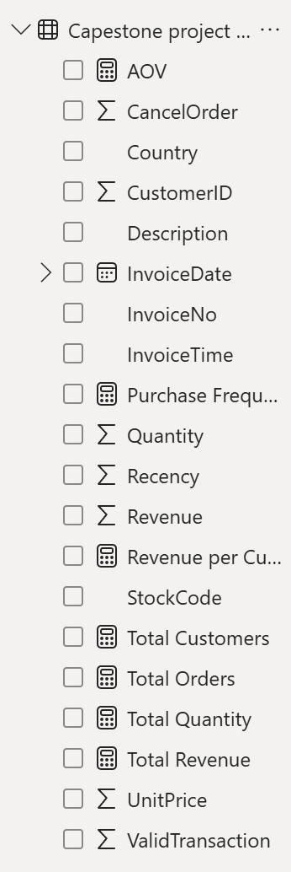
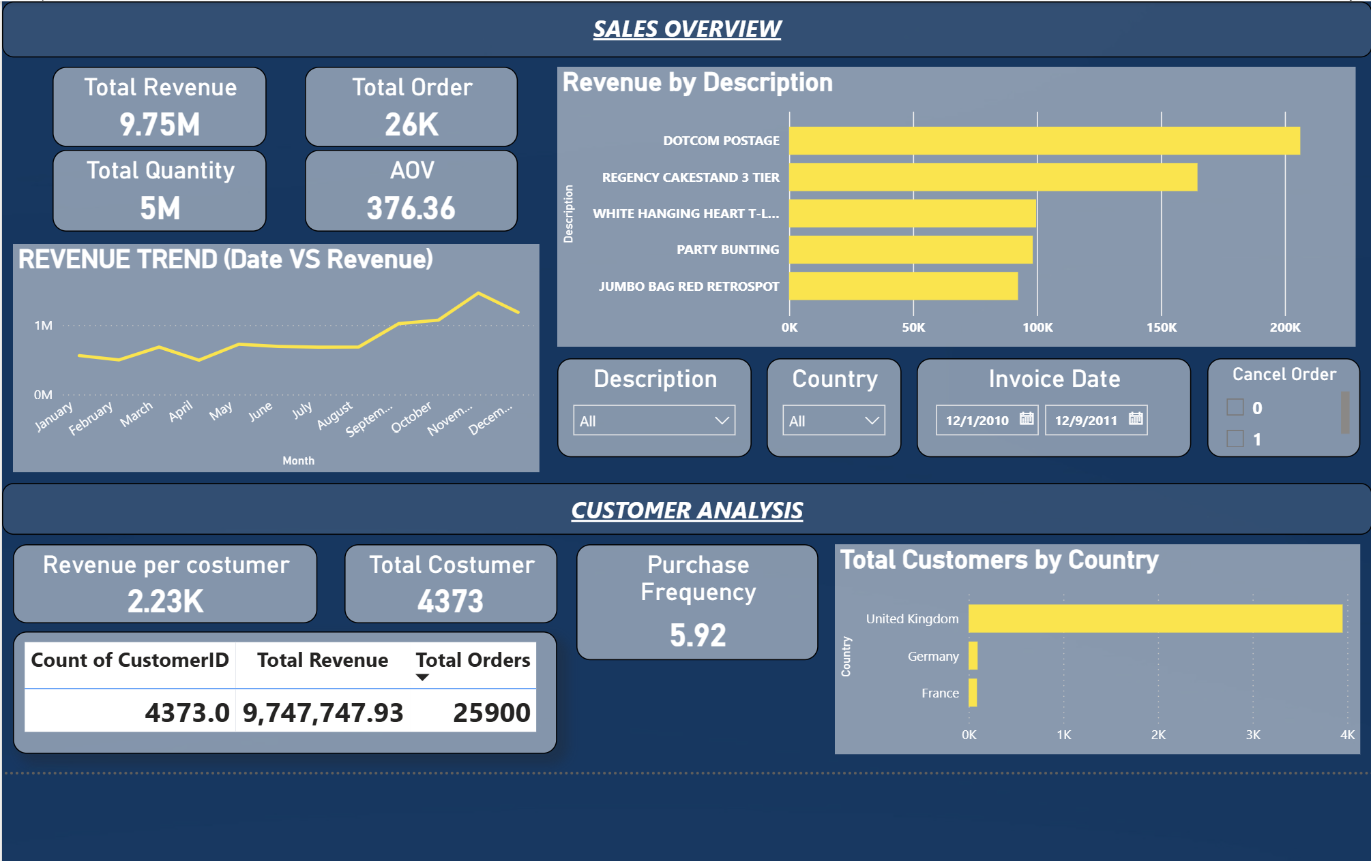
Power BI Dashboard

Slide 16
Thank You!

