Slide 1

Google’s Cyclistic Bike-Share Case Study
By: Aditya Singh
Role: Junior Data Analyst

Slide 2
Overview and Objective:
About Cyclistic
Cyclistic is a Chicago-based bike-share company with a fleet of over 5,800 bicycles and more than 600 docking stations. The service supports both recreational and commuting needs, with about 30% of riders using bikes for work commutes.
Project Objective
The Cyclistic marketing team aims to increase annual memberships by converting more casual riders into long-term members.
This project analyzes 12 months of historical ride data to identify key behavioral patterns between rider types and generate data-driven insights to support targeted marketing strategies.

Slide 3
Data Source:
Cyclistic’s 12-month ride data, split into 4 quarterly CSV files from the year 2019.
Divvy_Trips_2019_Q1.csv
Divvy_Trips_2019_Q2.csv
Divvy_Trips_2019_Q3.csv
Divvy_Trips_2019_Q4.csv

Slide 4
Tools Used:
Python (Pandas, Seaborn, Matplotlib)
Jupyter Notebook
CSV file handling
Data Cleaning & Preprocessing
EDA & Visualization

Slide 5
Process Overview:
Data Cleaning: Standardized mismatched column names across quarters.
Merging: Combined all quarters into one complete dataset.
Feature Engineering: Extracted trip duration, ride hour, day, month, etc.
Exploratory Data Analysis: Uncovered patterns using visualizations.
Insights & Recommendations: Based on rider behavior.

Slide 6
Key Business Questions Answered:
How do annual members and casual riders use Cyclistic bikes differently?
When do members and casual riders typically ride?
What are the most popular stations?
What is the average ride duration per user type?
Which days and times are most popular?
What do seasonal trends tell us?
What are the peak usage hours?
Can we predict rider type based on ride behavior?

Slide 7
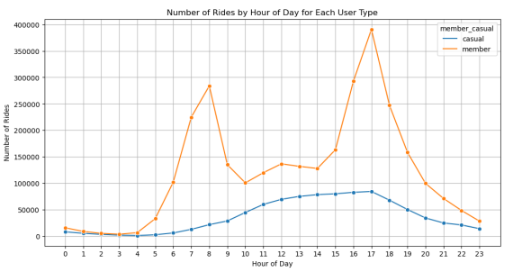
Q1) When do members and casual riders typically ride?

Slide 8
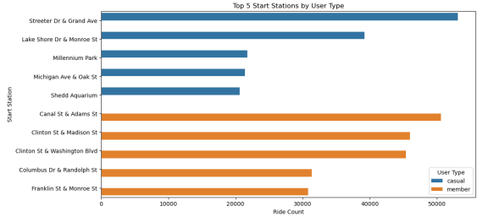
Q2) What are the most popular Start stations?

Slide 9
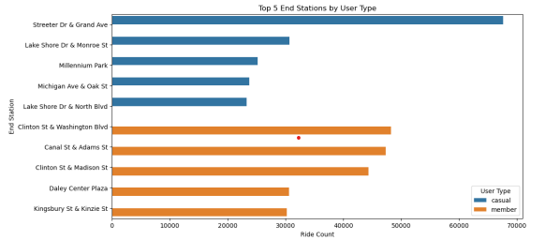
Q3) What are the most popular End stations?

Slide 10
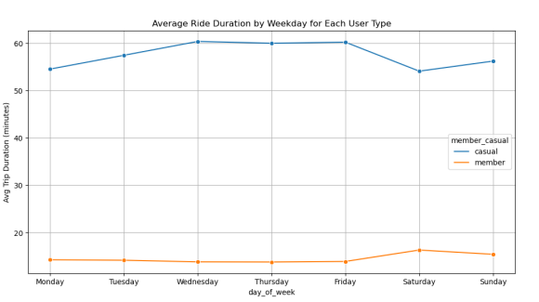
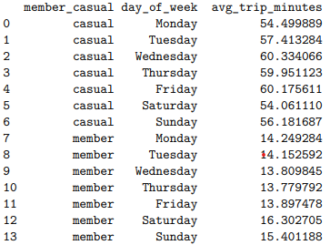
Q4) What is the average ride duration per user type?

Slide 11
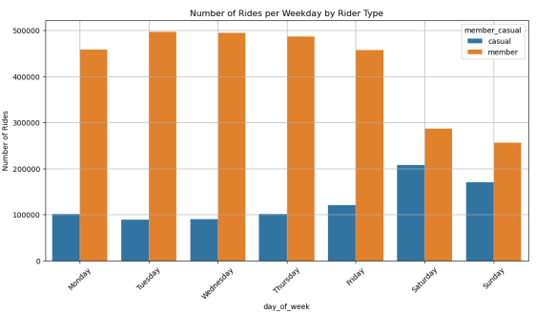
Q5) What days do riders ride the most?

Slide 12
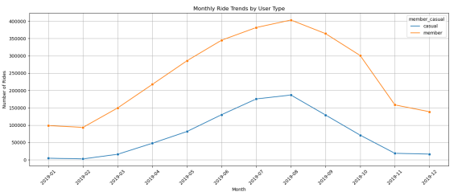
Q6) How do ride trends change month-over-month?

Slide 13
Conclusion:
Rider Type Behavior:
• Members take more frequent but shorter rides, likely for commuting or quick errands.
• Casual riders take longer rides, often during weekends or holidays — possibly for leisure or exploration.
Temporal Trends:
• Members ride more consistently during weekdays, especially during morning and evening peak hours (commute times).
• Casuals prefer afternoons and weekends, with activity peaking between 12 PM to 6 PM.

Slide 14
Conclusion:
Ride Duration:
• Casual riders consistently have higher average ride durations, which may indicate less familiarity with the system or more exploratory behavior.
Station Popularity:
• Certain stations appear frequently in both start and end points, showing high-traffic hubs — ideal for targeted promotions or better bike availability.
Seasonality:
• There is a clear rise in casual ridership during summer months, aligning with better weather and tourism.

Slide 15
Business Insights:
Opportunity to Convert Casuals to Members:
• Casual riders exhibit regular behavior patterns — especially on weekends. Targeting these users with weekend-specific “limited trial memberships” could convert them.
Fleet and Station Optimization:
• Since peak usage hours and stations are known, redistribution of bikes and staffing can be planned more efficiently.
Marketing Strategy:
• Casual riders can be targeted with experience-based offers, like guided bike tours or weekend bundle packages.
• Members can be retained by offering loyalty perks or work commute-related incentives.

Slide 16
Recommendations:
Target casual riders who ride often but haven’t converted — offer promo codes and in-app nudges to try membership for a week.
Strengthen inventory at high-demand stations during peak hours and seasons using predictive models.
Run seasonal campaigns (e.g., summer rides, holiday-themed routes) focused on casual users.

Slide 17
Limitations:
Missing values in ‘gender’ and ‘birthyear’ but does not affect our analysis.
No geolocation data available for mapping analysis.

