Slide 1
HR Analytics
By: Aditya Singh
Role: Junior Data Analyst

Slide 2
Overview and Objective:
Overview:
This project analyzes employee attrition and workforce dynamics using SQL for data exploration and Power BI for dashboarding. It uses the IBM HR Analytics Attrition & Performance dataset.
Project Objective:
The primary goal is to identify key factors contributing to employee attrition and offer data-driven insights to improve retention and employee satisfaction.

Slide 3
Dataset Overview:
The dataset contains 1,470 rows and 35+ columns about employee attributes like:
- Demographics: Age, Gender, Marital Status
- Work: Job Role, Department, Years At Company
- Compensation: Monthly Income, Monthly Rate
Satisfaction: Environment Satisfaction, Job Satisfaction, Relationship Satisfaction
- Attrition status: Yes/No
Note: No date fields (like joining/resignation dates) are available, so this is a static cross-sectional analysis.

Slide 4
Tools Used:
Data Processing - MySQL
Visualization - Power BI
Dataset - IBM HR Analytics (Kaggle)

Slide 5
Process overview:
Data Cleaning:
Dropped redundant columns: “EmployeeCount”, “Over18”, “Standard Hours”.
Feature Engineering:
- Added “AttritionFlag”: 1 if Attrition = 'Yes', else 0.
- Created “Age_group” based on age bins.
Mapped encoded values (e.g., “Education”, “JobSatisfaction”) to readable labels.
Exploratory Data Analysis:
Uncovered patterns using visualizations.
Suggestions & Recommendations:
Based on insights.

Slide 6
Key Business Questions:
How many active employees are there?
How Does Attrition Differ by Gender?
Department-wise Attrition Comparison
Attrition Risk Across Employee Age Bands
Attrition Hotspots by Role
Attrition Trends by Employee Education
How Does Overtime Impact Attrition?
Is Marital Status Linked to Attrition?

Slide 7
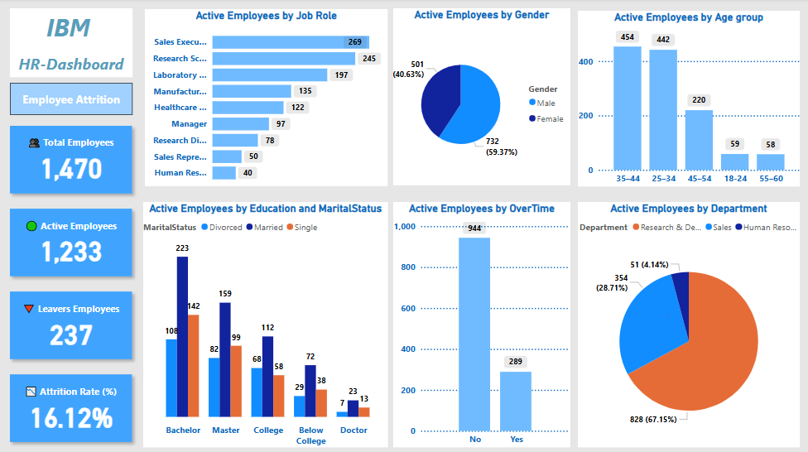
Power BI Dashboard Overview:

Slide 8
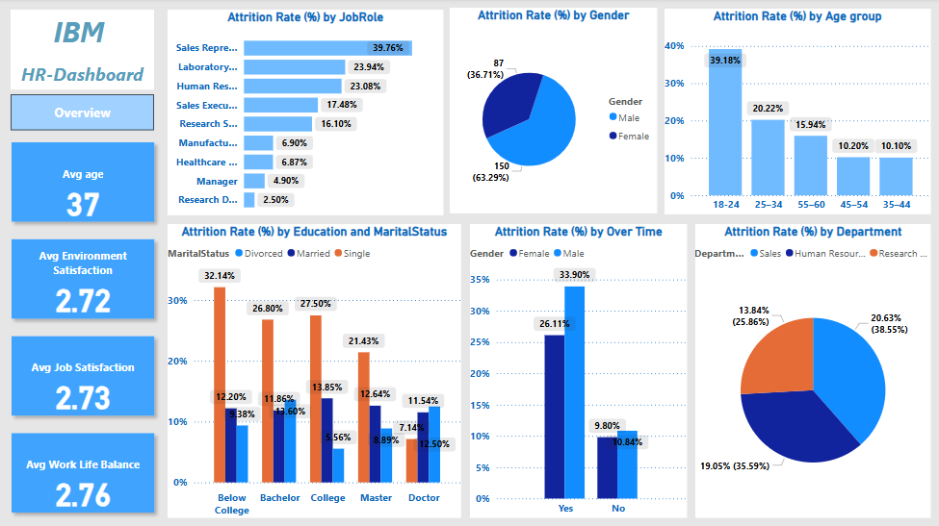
Power BI Dashboard Overview:

Slide 9
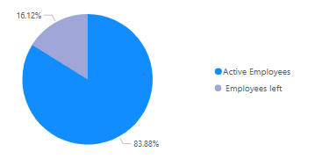
How many active employees are there?
The company has total 1470 employees, out of which 1233 employees (83.88%) are still working with the company (active) while 237employees (16.12%) are those who resigned the company or terminated by the HR .

Slide 10

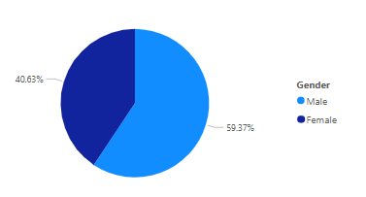
How does attrition differ by gender?
Gender wise attrition ratio of employees left the company male to female are 150:87.

Slide 11

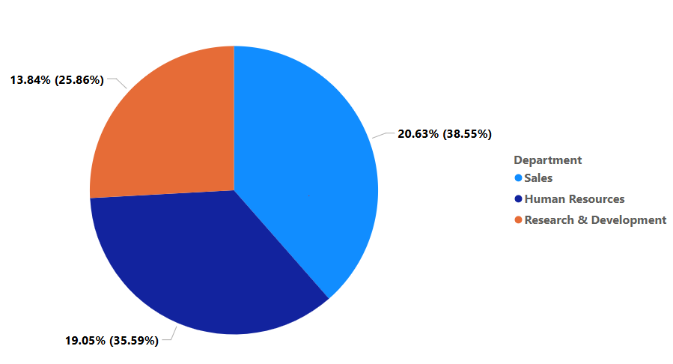
Department-wise Attrition Comparison
Sales department has maximum attrition rate (20.63%) and Research & Development department has minimum attrition rate (13.84%).

Slide 12
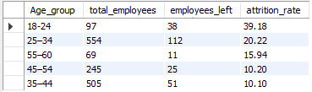
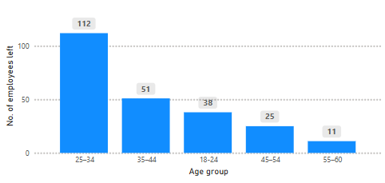
Attrition Risk Across Employee Age Bands
While the 25–34 age group had the highest number of leavers, , accounting for nearly half of all leavers. Age 18-24 had the highest attrition rate, making them the most at-risk group for turnover.

Slide 13
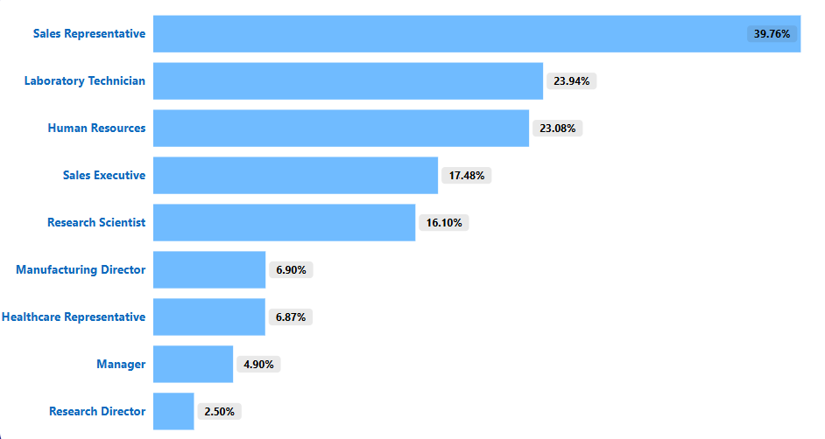
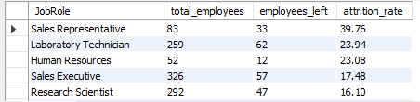
Attrition Hotspots by Job Role
Sales Representatives have the highest attrition rate at nearly 40%, significantly above all other roles. Laboratory Technicians and HR professionals also show elevated attrition rates above 23%. Leadership and technical roles, such as Managers and Research Directors, experience the lowest attrition, suggesting greater role stability.

Slide 14
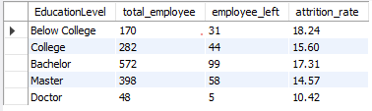
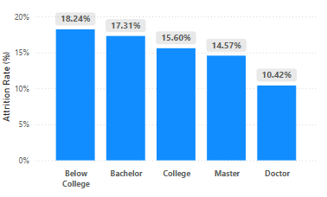
Attrition Trends by Employee Education
Employees with Below College and Bachelor degrees show the highest attrition rates at 18.24% and 17.31%, respectively. Attrition gradually decreases with higher education levels, reaching the lowest among Doctorate holders (10.42%).

Slide 15

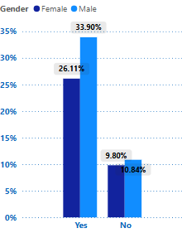
How Does Overtime Impact Attrition?
Employees who work overtime have a significantly higher attrition rate.
Male employees with overtime show the highest attrition at 33.9%, followed by females at 26.1%.
In contrast, those not working overtime have much lower attrition (around 10%).

Slide 16

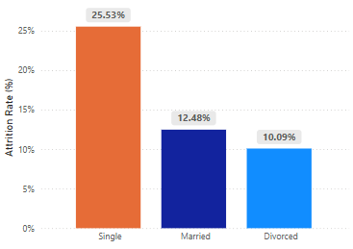
Is Marital Status Linked to Attrition?
Single employees have the highest attrition rate at 25.53%, nearly double that of married and divorced employees. Married employees show a moderate attrition rate (12.48%), while divorced employees have the lowest at 10.09%.

Slide 17
Suggestions & Recommendations:
1. By Age Group
Focus retention efforts on the 25–34 age group, which has the highest number of leavers.
Implement mentorship and career development programs for younger employees (especially 18–24) to reduce early-stage attrition.
2. By Job Role
Target Sales Representatives for retention efforts — they show the highest attrition rate (40%).
Conduct stay interviews or offer incentives for high-risk roles like Laboratory Technicians and HR professionals.
Monitor leadership and specialist roles less aggressively, as they show high stability.

Slide 18
Suggestions & Recommendations:
3. By Education Level
Attrition is highest among employees with mid-level education (Below College and Bachelor degrees).
Provide career path clarity, certification support, or role enrichment to these groups to increase retention.
4. By Overtime
Overtime is strongly linked to high attrition, especially among male employees (up to 33.9%).
Re-evaluate overtime policies, redistribute workload, and promote work-life balance, especially in operations-heavy roles.

Slide 19
Suggestions & Recommendations:
5. By Marital Status
Single employees have the highest attrition rate (25.53%), possibly due to mobility or lack of stability.
Offer tailored engagement strategies, flexible career planning, or work-from-anywhere benefits for younger/single professionals.
6. By Department
The Sales department has the highest attrition; review leadership, targets, and compensation benchmarks in this area.
Continue monitoring Research & Development, which has the lowest attrition, as a potential benchmark for other teams.

