Slide 1

ASSIGNMENT GUIDELINES
Make the changes in the PPT as you solve the parts
This file contains the template for all the parts of the project.
Check the instructions added in the note section of every slide for clarity.
Don’t move around any image or text box
If you require more/lesser elements, be careful when you copy/delete the existing ones.

Slide 2
ASSIGNMENT Name: Aditya Singh Negi
Problem Statement The sales pipeline conversion percentage at TechnoServe (a tech SaaS startup) has dropped from 35% at the end of last fiscal (FY 2017-18) to 25% at present.
Assignment Objective
Understand the problem, come up with a hypothesis for low conversions faced by TechnoServe, and analyse the dataset provided to arrive at possible solutions to increase it.
Notes:
Problem Statement

Slide 3
PART I : 1. Understanding the Problem Sales Pipeline Conversion at a SaaS Startup
Who?
TechnoServe, Pune based IT solution provider
What?
Sales pipeline conversion percentage has dropped from 35% to 25% at present.
When?
At the end of the last fiscal (FY 2017-18)
Where?
Problem among the prospective customer
How?
1. Sales and Marketing related issue.
2. Sales team is inefficient to convert potential customer into clients.

Slide 4
PART I : 2. Understanding the Problem Sales Pipeline Conversion at a SaaS Startup
Situation
What is the strength of the sales and market teams currently in company.
How much Sales Pipeline conversion rate currently?
What method/channels used for acquiring leads or business.
Problem
Is the Sales and marketing team skilled enough ?
Are there certain leads that are ineffective?
Is the right channels used for sales and marketing.
Implication
Does it affect future growth of the company?
How does this low rate conversion affect the company financial goals?
Does this also affect the market share of company?
Is there any competitor in market working in the same area?
Need-Payoff
Does the company will gain more profit and development if the problem is solved?
Will the solution make sales and marketing teams more effective?
Is there new channels to source leads?
If we able to raise/increase conversion rate, what will be use of increase revenue?
Notes:
Provide at least three questions under each branch.

Slide 5
PART II : Formulating Hypotheses Sales Pipeline Conversion at a SaaS Startup
Framework Used
Issue Tree Framework with 5 C’s Framework
Reason for using the selected framework
It is easy to cover the whole domain and it helps to identify various problems in different branches and find solution independently.
How you have used the framework here
The problem have been divided into five C’s in the framework and then again in branches using Issue tree framework.
Notes:
All the frameworks that are used should be mentioned.
A suitable reason is a must to provide here

Slide 6
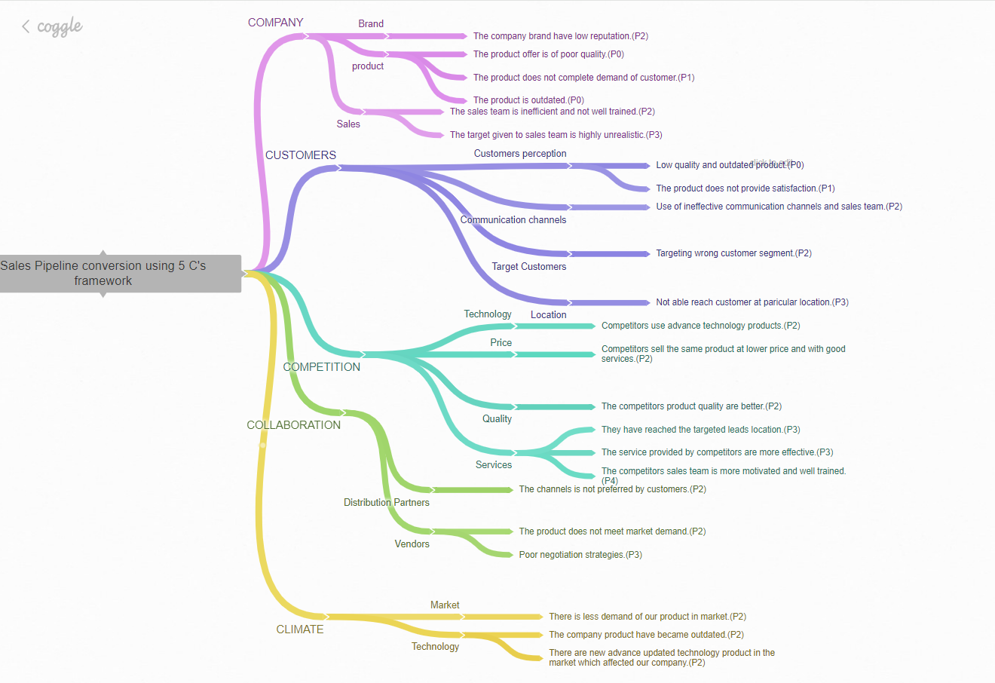
PART II : Formulating Hypotheses Sales Pipeline Conversion at a SaaS Startup
Provide the structure of the framework here
(You can attach the screenshot or multiple screenshots depending on the clarity of the image)
Notes:
Use the “download as” feature of Coggle if you are using the tool.
Provide one image with complete tree along with separate elements where the text is readable.
Copy the slide if you require more space

Slide 7
PART II : Formulating Hypotheses Sales Pipeline Conversion at a SaaS Startup
Branch 1
Low sales pipeline conversion – Company – Brand.
1. The company brand have low reputation in the market.(P2)
Branch 2
Low sales pipeline conversion – Company – Sales.
The sales team is inefficient and not well trained.(P2)
The target given to sales team is highly unrealistic.(P3)
Notes:
Each branch must follow this naming pattern: Problem – Branch 1 – Sub-branch 1 – Sub-branch 2 – …… – Hypotheses
There must be minimum 10 hypotheses in total and at least 1 in each branch.

Slide 8
PART II : Formulating Hypotheses Sales Pipeline Conversion at a SaaS Startup
Branch 3
Low sales pipeline conversion – Company – Product.
The product does not complete the demand of customer.(P1)
The product is outdated.(P0)
Branch 4
Low sales pipeline conversion – Customer – Customer perception.
Low quality and outdated product.(P0)
The does not provide satisfaction.(P1)
Notes:
Each branch must follow this naming pattern: Problem – Branch 1 – Sub-branch 1 – Sub-branch 2 – …… – Hypotheses
There must be minimum 10 hypotheses in total and at least 1 in each branch.

Slide 9
PART II : Formulating Hypotheses Sales Pipeline Conversion at a SaaS Startup
Branch 5
Low sales pipeline conversion – Customer – Communication channels.
1. Use of ineffective communication channels and sales teams.(P2)
Branch 6
Low sales pipeline conversion – Customer – Target Customers.
1. Targeting wrong customer segment.(P2)
Notes:
Each branch must follow this naming pattern: Problem – Branch 1 – Sub-branch 1 – Sub-branch 2 – …… – Hypotheses
There must be minimum 10 hypotheses in total and at least 1 in each branch.

Slide 10
PART II : Formulating Hypotheses Sales Pipeline Conversion at a SaaS Startup
Branch 7
Low sales pipeline conversion – Customer – Location.
1. Not able to reach customer at particular location.(P3)
Branch 8
Low sales pipeline conversion – Competition – Technology.
1. Competitors use advance technology products.(P2)
Notes:
Each branch must follow this naming pattern: Problem – Branch 1 – Sub-branch 1 – Sub-branch 2 – …… – Hypotheses
There must be minimum 10 hypotheses in total and at least 1 in each branch.

Slide 11
PART II : Formulating Hypotheses Sales Pipeline Conversion at a SaaS Startup
Branch 9
Low sales pipeline conversion – Competition – Price.
1. Competitors sell the same product at lower price and with good services.(P2)
Branch 10
Low sales pipeline conversion – Competition – Quality.
1. The competitors product quality are better.(P2)
Notes:
Each branch must follow this naming pattern: Problem – Branch 1 – Sub-branch 1 – Sub-branch 2 – …… – Hypotheses
There must be minimum 10 hypotheses in total and at least 1 in each branch.

Slide 12
PART II : Formulating Hypotheses Sales Pipeline Conversion at a SaaS Startup
Branch 11
Low sales pipeline conversion – Competition – Services.
They have reached the targeted leads location.(P3)
The services provided by competitors are more effective.(P3)
The competitors sales team is more motivated and well trained.(P4)
Branch 12
Low sales pipeline conversion – Collaboration – Distribution partners.
1. The channels is not preferred by customers.(P2)
Notes:
Each branch must follow this naming pattern: Problem – Branch 1 – Sub-branch 1 – Sub-branch 2 – …… – Hypotheses
There must be minimum 10 hypotheses in total and at least 1 in each branch.

Slide 13
PART II : Formulating Hypotheses Sales Pipeline Conversion at a SaaS Startup
Branch 13
Low sales pipeline conversion – Climate – Market.
1. There is less demand for our product in market.(P2)
Branch 14
Low sales pipeline conversion – Climate – Technology.
The company product have became outdated.(P2)
There are new advance updated technology product in the market which affected our company.(P2)
Notes:
Each branch must follow this naming pattern: Problem – Branch 1 – Sub-branch 1 – Sub-branch 2 – …… – Hypotheses
There must be minimum 10 hypotheses in total and at least 1 in each branch.

Slide 14
PART III A : Generating Insights Sales Pipeline Conversion at a SaaS Startup
Variable
B2B sales Medium.
Business from client last year.
Technology primary.
Client revenue sizing.
City (location).
Opportunity sizing.
Insights if any
Lead conversion from online leads is low.
Previous business from a client positively impacts the success of new opportunities.
ERP Implementation is the most common and successful technology.
Clients with more than 1M in revenue have the largest opportunity sizes.
Analyse city-specific data to identify regional trends and opportunities.
Larger client revenue sizes correspond to larger opportunity sizes.
Pattern of Insight
Surprising extreme.
Positive correlation.
Dominant trend.
Expected correlation
Regional variations
Direct correlation.
Notes:
Analyse the variables in the dataset, find the insights and mention the pattern of insights in the data. Make more copies of this slide if needed.

Slide 15
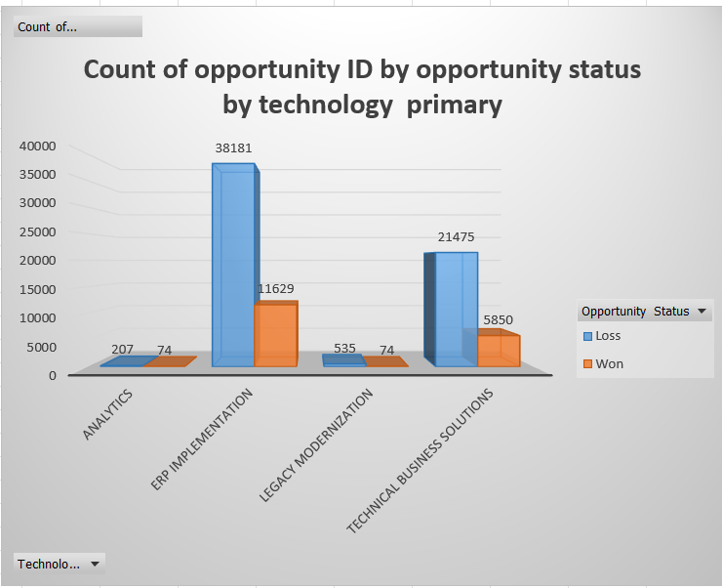
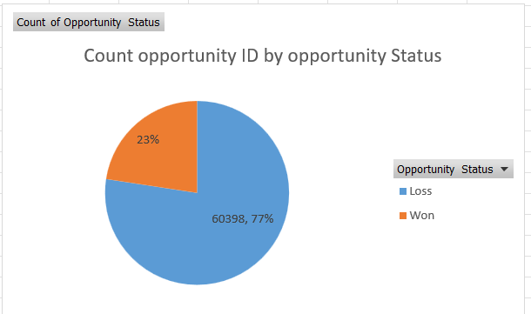
PART III A : Generating Insights Sales Pipeline Conversion at a SaaS Startup
Variable under consideration: Technology primary
ERP implementation have better conversion rate than the other category.
Notes:
For each variable that produced an interesting insight, explain you analysis bit here – the results you got from excel and the necessary visualisations. Note: it is compulsory for you to mention the results of the analysis on these variables - 'Technology Primary', 'B2B Sales Medium', 'Client Revenue Sizing', 'Opportunity Sizing' and 'Business from Client last year’.

Slide 16
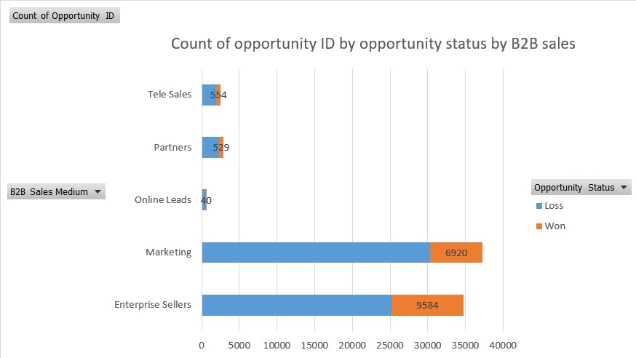
PART III A : Generating Insights Sales Pipeline Conversion at a SaaS Startup
Variable under consideration: B2B sales.
Enterprise and marketing seller have more opportunities and among this Enterprise seller have more conversion rate as compare to others.
Notes:
For each variable that produced an interesting insight, explain you analysis bit here – the results you got from excel and the necessary visualisations. Note: it is compulsory for you to mention the results of the analysis on these variables - 'Technology Primary', 'B2B Sales Medium', 'Client Revenue Sizing', 'Opportunity Sizing' and 'Business from Client last year’.

Slide 17
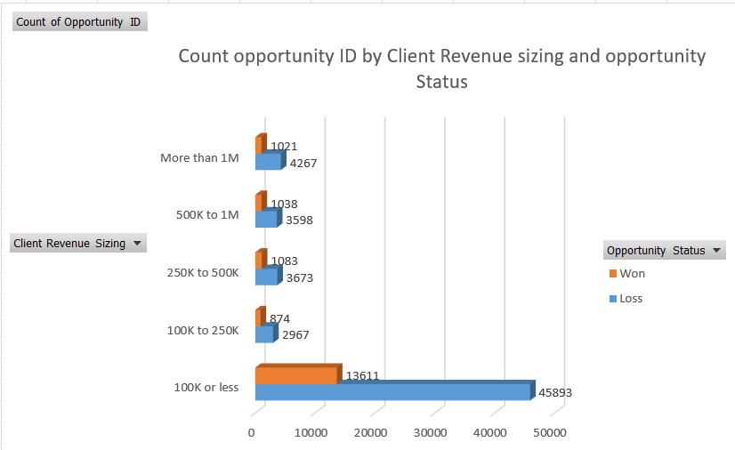
PART III A : Generating Insights Sales Pipeline Conversion at a SaaS Startup
Variable under consideration: Client Revenue Sizing.
Surprisingly there are more opportunity coming from clients who are less in revenue size (100K or less).
Notes:
For each variable that produced an interesting insight, explain you analysis bit here – the results you got from excel and the necessary visualisations. Note: it is compulsory for you to mention the results of the analysis on these variables - 'Technology Primary', 'B2B Sales Medium', 'Client Revenue Sizing', 'Opportunity Sizing' and 'Business from Client last year’.

Slide 18
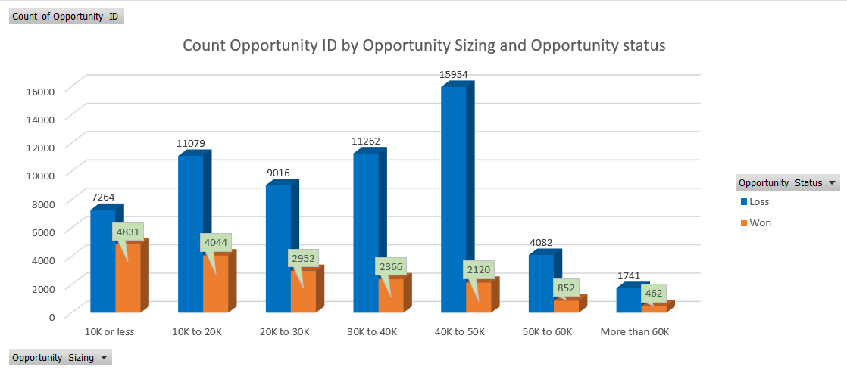
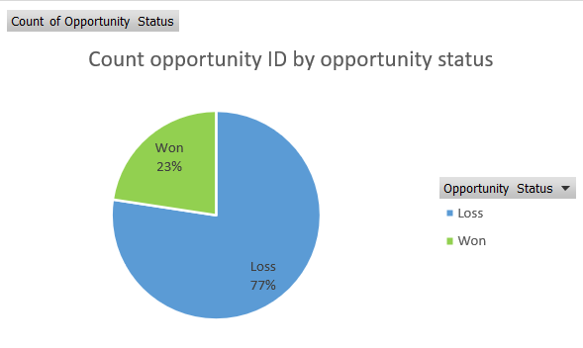
PART III A : Generating Insights Sales Pipeline Conversion at a SaaS Startup
Variable under consideration: Opportunity Sizing
The opportunity conversion rate is significantly higher in 0-30K range.
Notes:
For each variable that produced an interesting insight, explain you analysis bit here – the results you got from excel and the necessary visualisations. Note: it is compulsory for you to mention the results of the analysis on these variables - 'Technology Primary', 'B2B Sales Medium', 'Client Revenue Sizing', 'Opportunity Sizing' and 'Business from Client last year’.

Slide 19
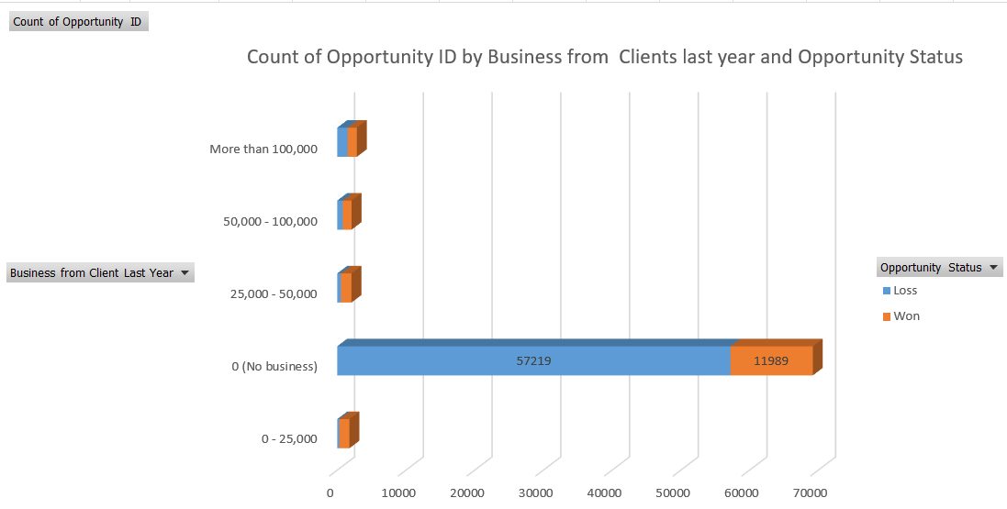
PART III A : Generating Insights Sales Pipeline Conversion at a SaaS Startup
Variable under consideration: Business from Client last year.
The conversion rate is higher for new customers.
Notes:
For each variable that produced an interesting insight, explain you analysis bit here – the results you got from excel and the necessary visualisations. Note: it is compulsory for you to mention the results of the analysis on these variables - 'Technology Primary', 'B2B Sales Medium', 'Client Revenue Sizing', 'Opportunity Sizing' and 'Business from Client last year’. Make more copies of this slide if needed.

Slide 20
PART III A : Generating Insights Sales Pipeline Conversion at a SaaS Startup
Recommendations
Company should focus on following points in order to have high conversion rate:-
ERP implementation solution offered to customer.
Enterprise Seller as B2B sales medium.
Existing Customers.
Opportunity Sizing (0-30k).
Client Revenue Sizing (100k or less).
Corresponding Insights
Type your answer here
ERP implementation have better conversion rate than the other category.
Enterprise and Marketing Seller have more opportunities and among this Enterprise seller have more conversion rate as compared to others.
The conversion rate is higher for existing customers but more opportunity for new customers.
The opportunity conversion rate is significantly higher for clients with potential revenue in 0-30k range.
Surprisingly there are more opportunity coming from clients who are less in revenue size(100k or less).
Notes:
For each recommendation explain the insights that form the reasoning for giving that recommendation. Make more copies of this slide if necessary.

Slide 21
PART III B : Presenting Findings Sales Pipeline Conversion at a SaaS Startup
Final recommendations
ERP implementation solution offered to the customers.
Enterprise Sellers as the B2b Sales Medium.
Client Revenue Sizing(100k or less).
Opportunity Sizing(0-30k).
Existing Customers.
Notes:
You are free to use the elements and boxes mentioned previously. Make sure you’re using the pyramid principle, data visualization, visual design principle and storyboarding concepts to design these slides.

Slide 22
PART III B : Presenting Findings Sales Pipeline Conversion at a SaaS Startup
Focus on ERP implementation category of solutions.
ERP implementation have better conversion rate than the other category.
Notes:
You are free to use the elements and boxes mentioned previously. Make sure you’re using the pyramid principle, data visualization, visual design principle and storyboarding concepts to design these slides.

Slide 23
PART III A : Generating Insights Sales Pipeline Conversion at a SaaS Startup
Focus on Enterprise Sellers channel as the B2B sales medium.
Most opportunities are from Marketing and Enterprise Sellers with the Enterprise sellers having better than average opportunity conversion rate.
Notes:
For each variable that produced an interesting insight, explain you analysis bit here – the results you got from excel and the necessary visualisations. Note: it is compulsory for you to mention the results of the analysis on these variables - 'Technology Primary', 'B2B Sales Medium', 'Client Revenue Sizing', 'Opportunity Sizing' and 'Business from Client last year’.

Slide 24
PART III A : Generating Insights Sales Pipeline Conversion at a SaaS Startup
Focus on Clients who have a revenue size (100k or less).
Surprisingly there are more opportunity coming from clients who are less in revenue size (100K or less).
Notes:
For each variable that produced an interesting insight, explain you analysis bit here – the results you got from excel and the necessary visualisations. Note: it is compulsory for you to mention the results of the analysis on these variables - 'Technology Primary', 'B2B Sales Medium', 'Client Revenue Sizing', 'Opportunity Sizing' and 'Business from Client last year’.

Slide 25
PART III A : Generating Insights Sales Pipeline Conversion at a SaaS Startup
Focus on clients where the revenue generated is between 0-30k range.
The opportunity conversion rate is significantly higher in 0-30K range.
Notes:
For each variable that produced an interesting insight, explain you analysis bit here – the results you got from excel and the necessary visualisations. Note: it is compulsory for you to mention the results of the analysis on these variables - 'Technology Primary', 'B2B Sales Medium', 'Client Revenue Sizing', 'Opportunity Sizing' and 'Business from Client last year’.

Slide 26
PART III A : Generating Insights Sales Pipeline Conversion at a SaaS Startup
Focus on clients who are already existing customers.
The conversion rate is higher for existing existing customers and there is opportunity unusually large from new customers.
Notes:
For each variable that produced an interesting insight, explain you analysis bit here – the results you got from excel and the necessary visualisations. Note: it is compulsory for you to mention the results of the analysis on these variables - 'Technology Primary', 'B2B Sales Medium', 'Client Revenue Sizing', 'Opportunity Sizing' and 'Business from Client last year’. Make more copies of this slide if needed.

