Slide 1
Course Registration System
Submitted By: Snehal Satre , Aditya Anantwal Under the Guidance of: Kajal Moghe mam
Department: Computer Engineering
College Name: Dr.D.Y.Patil Technical Campus Varale Talegaon ,Pune

Slide 2
Introduction
A console-based application for managing course enrollments
Developed in Java using JDBC
Connects to a MySQL database (coursedb)
Supports full CRUD operations

Slide 3
Technologies Used
Java (Core Java)
MySQL
JDBC (Java Database Connectivity)
Tools: MySQL Workbench

Slide 4
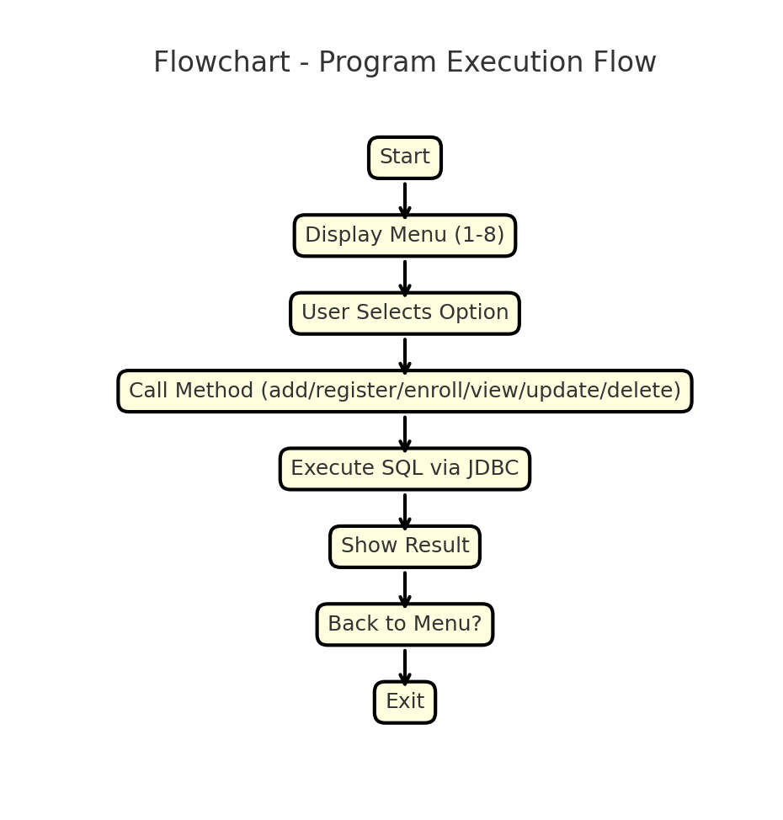
Flowchart

Slide 5
Database Tables
courses: id (PK), name, code, prerequisites
students: id (PK), name
enrollments: student_id (FK), course_id (FK)

Slide 6
Features of the System
Add and update courses
Register new students
Enroll students in courses
View all available courses
View who enrolled in which course
Delete courses
Validate IDs before enrollment

Slide 7
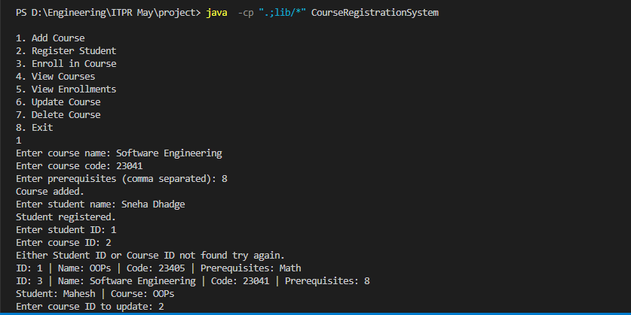
Sample Output

Slide 8
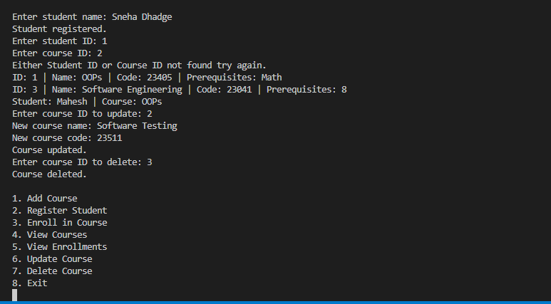
Screenshot

Slide 9
Conclusion
Working backend system for course enrollment
Demonstrates Java + SQL integration
Can be extended with GUI or web interface

Slide 10
Thank you!

