Slide 1

NATIONAL INSTITUTE OF TECHNOLOGY RAIPUR
OPTIMAL CLUSTERING AND ROUTING IN WIRELESS SENSOR NETWORK
Guided By : Submitted By:
Ms. Veena Anand B. Sumanjali(14115024)
Assistant Professor P. Aditya Siva(14115003)

Slide 2
INTRODUCTION
WSN (wireless Sensor Network)
Base Station
Sensor Node
Radio Model

Slide 3
ENERGY EFFICIENT ROUTING ALGORITHMS
Data Centric
Hierarchical
Location Based

Slide 4
CLUSTERING
Homogenous Clustering
Heterogeneous Clustering

Slide 5
PROTOCOLS IN WSN

Slide 6
KEY ISSUES IN WSN
In a general WSN, the data transfer model consists of a base station(called as sink) and sensors(called as nodes).
A base station is typically located on the boundary or beyond the network area used to sense/measure data.
The key issue in WSN is to maximize network lifetime and increase throughput, energy conservation during this lifetime.
For achieving this, different protocols are used such as LEACH,OCRSN which involve clustering and data routing.

Slide 7
PROTOCOLS
LEACH:-
Abbreviated as Low-Energy Adaptive Clustering Protocol is a hierarchical clustering protocol used for reducing power consumption in WSNs.
In Leach, the clustering task is rotated randomly among nodes based on duration and residual energy.
Direct communication is done between CH’s and BS.

Slide 8
Contd..
The operation of LEACH is divided into two phases.
Set-up phase: It involves cluster organisation, cluster head selection, and data transmission scheduling in a random way.
Steady phase: It involves data aggregation, compression and transmission to sink.
Disadvantages of LEACH:-
Not applicable for large network regions.
Does not guarantee efficient CH selection.

Slide 9
OCRSN:-
Abbreviated as Optimal Clustering and Routing in Sensor Networks is a multi-hop and multi path protocol used for energy preservation of various nodes in WSN.
Uses neighbour discovery algorithm and cluster head selection algorithm to detect and select CH’s.
These CH’s aggregate the data from all the nodes in the cluster transmits it to the sink.
Uses DRAND method which assigns different time slots to nodes for effective data transmission.

Slide 10
Contd..
The operation of the OCRSN protocol is broken up into rounds where each round involves two phases.
Set-up phase: It involves cluster organisation, cluster head selection, and data transmission scheduling in a multi-hop intra clustering manner.
Steady phase: It involves data aggregation, compression and transmission to sink in a multipath routing manner.

Slide 11
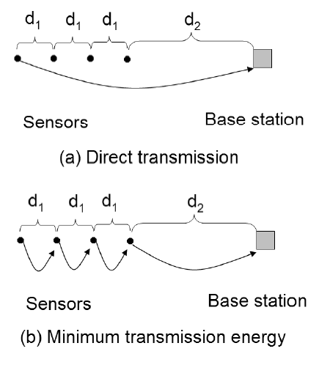
DIRECT VS MINIMUM TRANSMISSION
The amount of energy used in figure (a) can be modeled by this formula:
Eamp=k(3d1 + d2)²
Whereas the amount of energy used in figure (b) uses this formula:
Eamp=k(3d1² + d2²)

Slide 12
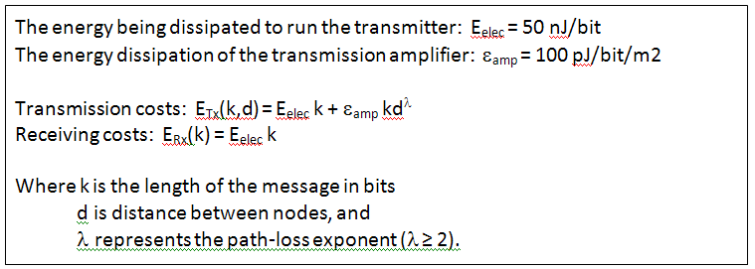
AMOUNT OF ENERGY DEPLETION
The formula for the amount of energy depletion of each node through data transfer is :

Slide 13
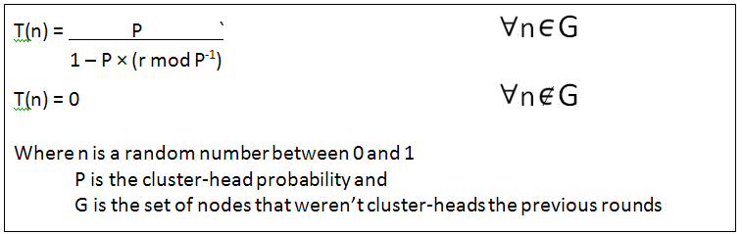
STOCHASTIC THRESHOLD ALGORITHM
Cluster-heads in a WSN can be chosen stochastically (randomly based) on this algorithm:
If n < T(n), then that node becomes a cluster-head.
The algorithm is designed so that each node becomes a cluster-head at least once for every (1/p) rounds.

Slide 14
LEACH vs OCRSN

Slide 15
INTRODUCTION
The two main issues in WSNs are energy preservation of each node and effective data transmission. To overcome these issues different protocols adopting different methods are designed.
One of the method is direct transmission method in which a node sense data from its environment and transmits it straight to base station. Ex:- LEACH protocol uses this method.
If base station is far, node energy is consumed more, so a minimum energy transmission method named Directed Diffusion was introduced that discuss data processing and dissemination.

Slide 16
Contd…
According to this, all participating nodes of network are distributed in 2-hop cluster and data is transmitted to base stations via multi hops and multipath routes.
Our proposed protocol OCRSN works on this mechanism and helps in conserving the residual energy of nodes and CH’s.
OCRSN uses a stochastic threshold algorithm for deciding cluster heads and time slot scheduling algorithm(DRAND) using TDMA method for data transmission between nodes.

Slide 17
IMPLEMENTATION OF LEACH
LEACH operations can be divided into two phases:-
Setup phase:-
During this phase, a predetermined fraction of nodes, p, choose themselves as cluster-heads.
For each node, wanting to be the cluster-head chooses a value, between 0 and 1.
This random number is compared with the threshold value in stochastic algorithm for election of CH’s.

Slide 18
Contd…
Steady phase:-
In this phase, the non-cluster head nodes starts sensing data and sends it to their cluster-head according to the TDMA schedule.
The CH, after receiving data from all the member nodes, aggregates it and then sends it to the base- station.
Each cluster communicates using different CDMA codes in order to reduce interference from nodes.

Slide 19
IMPLEMENTATION OF OCRSN
OCRSN stands for OPTIMAL CLUSTERING AND ROUTING IN SENSOR NETWORKS.
It was developed by inducing the features of multipath data transfer and multi-hop intra cluster routing.
The operation of the OCRSN protocol is broken up into rounds where each round begins with a set-up phase followed by a steady phase.

Slide 20
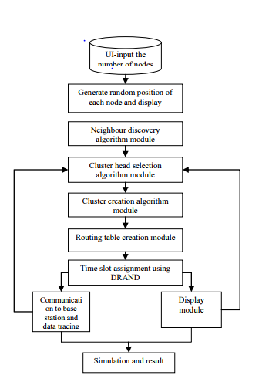
FLOWCHART FOR OCRSN

Slide 21
PHASES OF OCRSN
Setup-phase(Cluster Formation Phase):-
Initially, after the node deployment the neighbour node discovery takes place.
For each node, wanting to be the cluster-head chooses a value, between 0 and 1.
This random number is compared with the threshold value in stochastic algorithm for election of CH’s.

Slide 22
Contd…
Steady-phase(Data Transmission Phase):-
Once the clusters are created, the sensor nodes are allotted timeslots to send the data.
When a node receives data from one its neighbours, it aggregates it with its own data.
It uses a heuristic function to make this decision and the heuristic function is given by,
h = K ( Eavg / h min * t )

Slide 23
Contd…
The path with highest heuristic value is chosen or else the path with the next highest heuristic value is chosen.
After the paths are chosen, then their minimum energies are compared for efficient transmission.
It uses a energy relation to make this decision and the relation is given by,
Emin > threshold, where Emin = Eavg /const

Slide 24
SIMULATION

Slide 25
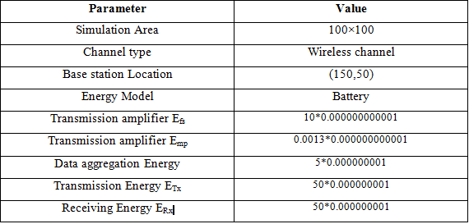
NETWORK PARAMETERS

Slide 26
COMPARISION PARAMETERS
DEAD NODES vs ROUND NUMBER (OCRSN vs LEACH)
ALIVE NODES vs ROUND NUMBER (OCRSN vs LEACH)
CLUSTER HEADS vs ROUND NUMBER (OCRSN vs LEACH)
PACKETS TO CH vs ROUND NUMBER (OCRSN vs LEACH)

Slide 27
Contd…
PACKETS TO BS vs ROUND NUMBER (OCRSN vs LEACH)
AVERAGE ENERGY OF EACH NODE vs ROUND NUMBER (OCRSN vs LEACH)

Slide 28
RESULTS

Slide 29
SIMULATION RESULTS
CLUSTER NETWORK OF OCRSN FOR 200 NODES

Slide 30
Cluster Network Of LEACH For 200 Nodes

Slide 31
Comparison of dead nodes for 100 rounds for 200 nodes in LEACH and OCRSN

Slide 32
Comparison of Alive nodes for 100 rounds for 200 nodes in LEACH and OCRSN

Slide 33
Comparison of Cluster Heads for 100 rounds for 200 nodes between LEACH and OCRSN

Slide 34
Comparison of Number of packets sent to Cluster Head for 100 rounds for 200 nodes between LEACH and OCRSN

Slide 35
Comparison of number of packets sent to base station for 100 rounds for 200 nodes between LEACH and OCRSN

Slide 36
Average Energy of each node for 100 rounds for 200 nodes between LEACH and OCRSN

Slide 37
CONCLUSION
OCRSN increases the network lifetime in comparison with LEACH.
It also improves the data transmission rate .
OCRSN is best suitable for larger networks when compared to LEACH.

Slide 38
FUTURE WORK
In this OCRN the nodes are dead after few rounds. So there is a need to improvise the protocol such that the nodes remain alive for long rounds.
Although, the residual energies are better than LEACH but they need to be improvised/updated to meet future constraints.

Slide 39
REFERENCES
[1] Rajaravivarma, V.; Yi Yang; Teng Yang; , "An overview of Wireless Sensor Network and applications," System Theory, 2003. Proceedings of the 35th Southeastern Symposium on ,16-18March-2003.
[2] W.Heinzelman, A.Chandrakasan,and H.Balakrishnan,”Enegy-efficient routing protocols for wireless microsensor networks,” in Proc. 33rd Hawaii Int. Conf. SystemSciences(HICSS).
[3]http://citeseerx.ist.psu.edu/viewdoc/download;jsessionid=7B8A54BA8FADCA65FEC87172F355B708?doi=10.1.1.206.3210&rep=rep1&type=pdf

Slide 40
THANK YOU

