Slide 1



EV CHARGING DEMAND PREDICTION
AICTE Student ID: STU685e7583362ed1751020931
AICTE Internship ID: INTERNSHIP_175040797468551b2636342
Name: Mr. ADITYAVARDHAN RAMGIRI

Slide 2

Learning Objectives
Prepare EV registration data to analyze historical trends by region and vehicle type.
Identify patterns in EV adoption to forecast future growth and charging demand.
Engineer features like lags and growth rates to enhance model accuracy.
Develop and evaluate regression models for EV adoption and charging forecasts.
Visualize results to support urban infrastructure planning.
Deploy an interactive tool for stakeholders to explore and compare county-level forecasts.
GOAL
Source :
www.freepik.com/

Slide 3
Tools and Technology used
1.Programming Languages:
Python — for data analysis, modeling, and building the app.
2.Libraries and Frameworks:
pandas — data manipulation and preprocessing.
numpy — numerical operations and feature engineering.
scikit-learn — building and evaluating regression models.
statsmodels — (optional) for advanced time series analysis.
matplotlib / seaborn — data visualization.
Streamlit — building the interactive web app for deployment.
joblib — model serialization and loading.
3.Development Tools:
Jupyter Notebook / VS Code — writing and testing code.
Git / GitHub — version control and collaboration.
4.Environment and Packaging:
pip / conda — package management.
requirements.txt — for managing dependencies.
5.Deployment:
Streamlit Cloud— hosting the interactive forecasting app online.

Slide 4
Methodology
Data Collection and Preparation Gather EV registration data by county and vehicle type; clean and preprocess for consistency and completeness.
Exploratory Data Analysis (EDA) Analyze historical trends, seasonality, and regional differences in EV adoption.
Feature Engineering Create lag variables, rolling averages, growth rates, and encode categorical data to capture temporal and regional patterns.
Model Development Train regression models using historical data to predict future EV adoption and charging demand.
Model Evaluation Assess model performance using metrics like RMSE and MAE; tune hyperparameters for better accuracy.
Forecasting and Visualization Generate future EV adoption forecasts and visualize trends to support decision-making.
Deployment Build and deploy an interactive Streamlit app allowing users to explore forecasts by county and time period.

Slide 5
Problem Statement:
As electric vehicle (EV) adoption rapidly increases, urban planners and policymakers need accurate forecasts of future EV growth to ensure sufficient charging infrastructure. Without reliable predictions, inadequate planning can lead to charging bottlenecks, causing user frustration, overcrowded or underutilized stations, and slowing sustainability efforts. This project aims to develop a data-driven regression model using historical EV registration data to forecast EV adoption and charging demand across counties in Washington State. The goal is to help planners make informed infrastructure decisions that support the transition to cleaner transportation and meet growing demand effectively.

Slide 6
Solution:
Develop a data-driven regression model to predict future EV adoption using historical registration data.
Incorporate regional (county-level) and vehicle-type data to capture adoption differences.
Forecast EV growth and charging demand over the next several years using the model.
Provide clear visualizations of forecast results to support urban planning decisions.
Build an interactive forecasting tool for stakeholders to explore EV trends by region and time horizon.
Support proactive infrastructure planning to prevent charging bottlenecks and ensure smooth EV adoption.
GitHub Repository: https://github.com/Adityavardhan12/EV/tree/main

Slide 7
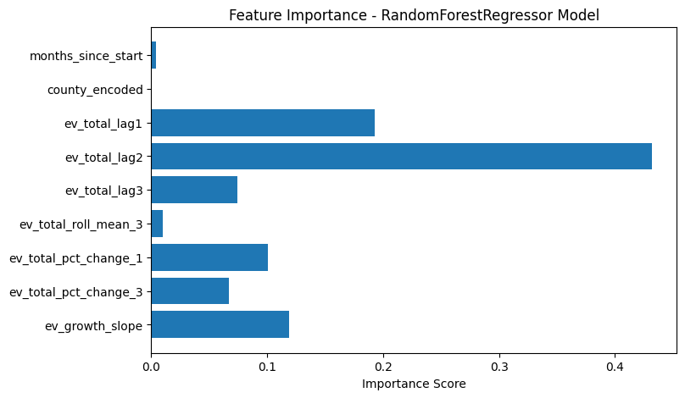
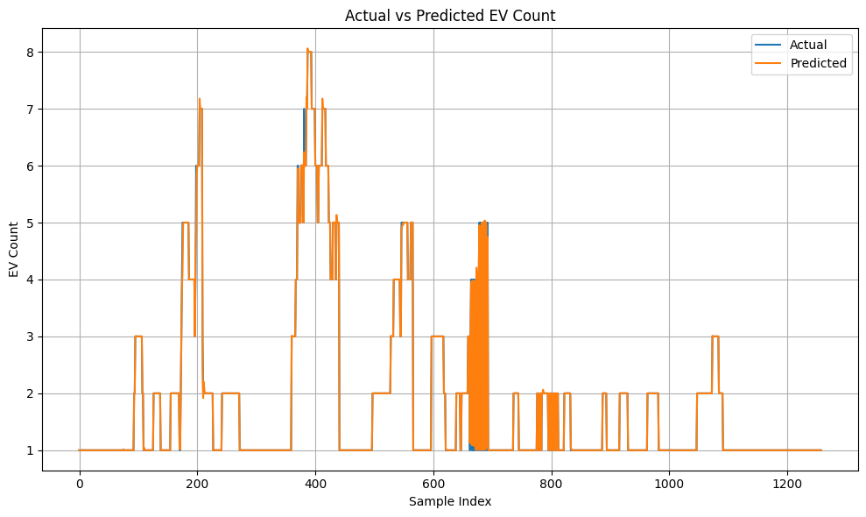
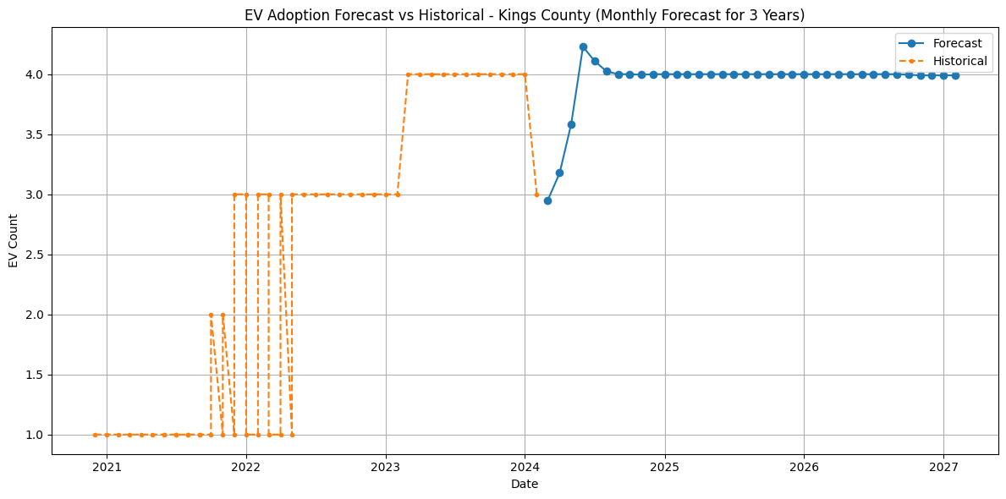
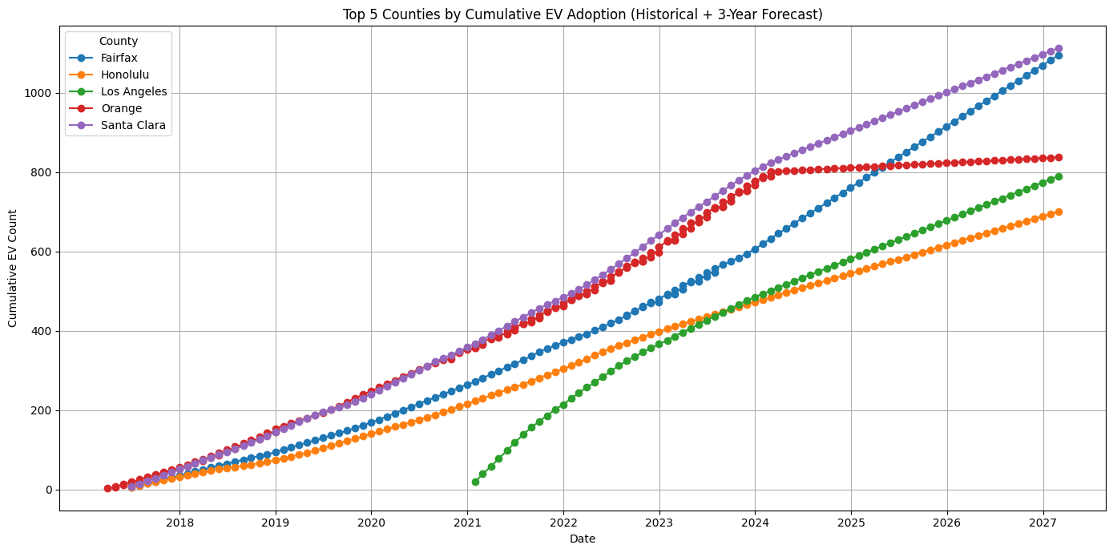
Screenshot of Output:

Slide 8
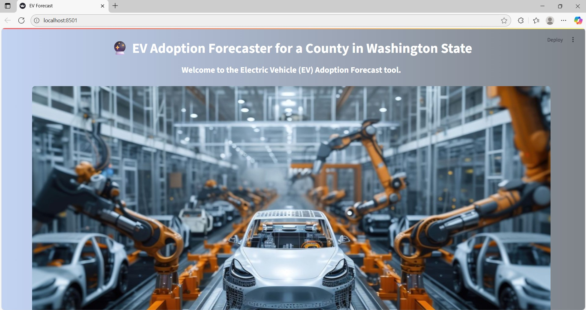
Screenshot of Output:

Slide 9
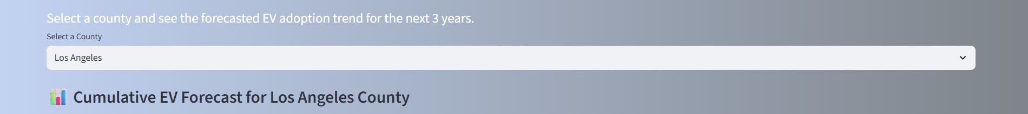
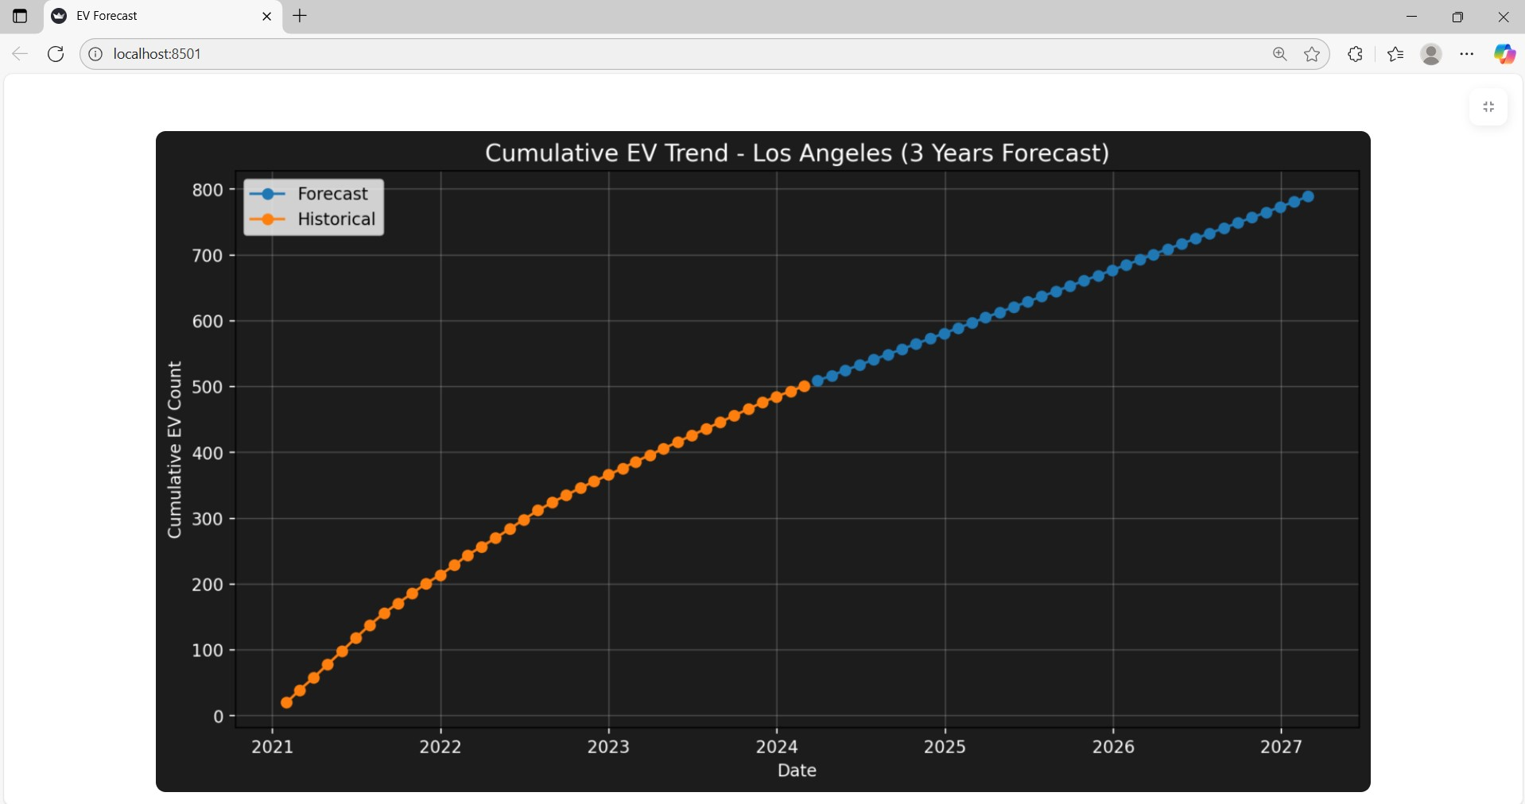
Screenshot of Output:

Slide 10
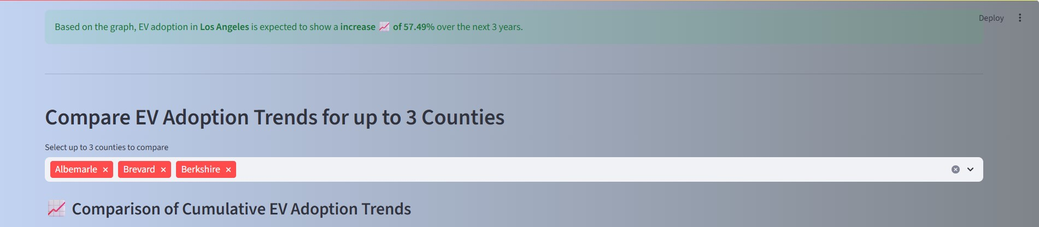
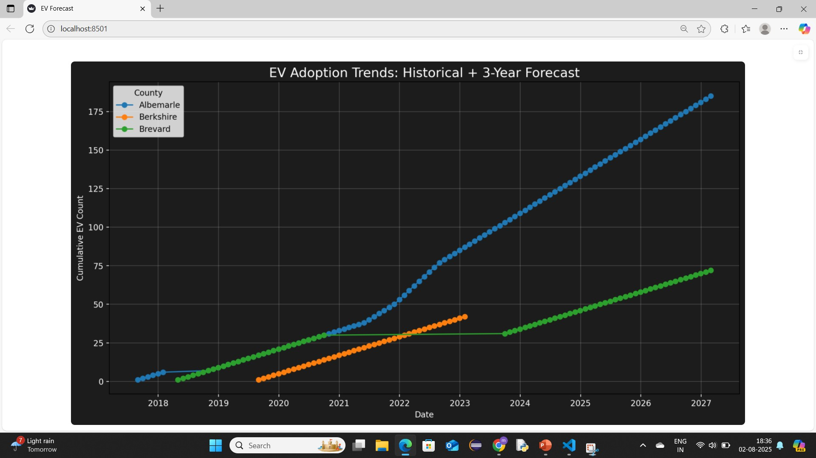
Screenshot of Output:

Slide 11
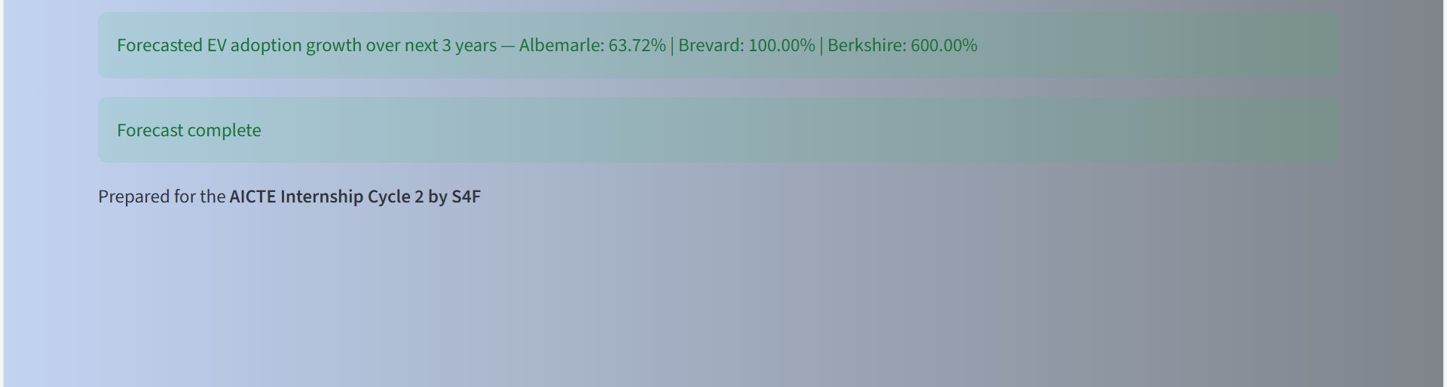
Screenshot of Output:

Slide 12
Conclusion:
A robust regression model was developed to forecast electric vehicle (EV) adoption and charging demand across Washington State counties. Utilizing historical registration data and incorporating regional and vehicle-type insights, the model offers accurate predictions that support effective planning. The deployment of an interactive forecasting tool enhances stakeholder engagement, enabling data-driven decisions that align with long-term sustainability goals. This solution facilitates proactive infrastructure planning, helping cities and counties prepare for increased EV adoption and contributing to a smoother transition toward cleaner, greener transportation systems.

