Slide 1

Augmented Reality With A Pendant Pico Projector
References
Introduction
Technologies
Applications
Tools
Benefits
Prepared By:
Aditya S Vijayvargiya
(LDRP-ITR)

Slide 2
How Humans Will Interact With The Objects ??
Applications
Tools
Introduction
Technologies
Benefits
References

Slide 3
The Main Aim is to Connect the Virtual World to the
Real World ...!!
Applications
Tools
Introduction
Technologies
Benefits
References

Slide 4
What is Augmented Reality With Pico Projector ??
In This Project both Camera and Projector Connected to A mobile Computing Device In User’s Pocket . The Projector Projects visual Information Enabling Surfaces ,Walls and Physical Object Around Us. Where as Camera Recognizes and Tracks User’s Hand Gesture. And Physical Objects Using Computer Vision Based Techniques. The Movements are Tracked by the Color Markers .
Applications
Tools
Introduction
Technologies
Benefits
References

Slide 5
Why is it called Pico-Projector?
It Contains the nano Projector Along with Other Tools Which can
Wear by Human..!!
Applications
Tools
Introduction
Technologies
Benefits
References

Slide 6
Tools Used in Project
1
Camera
2
Microphone
References
Technologies
Applications
Tools
Benefits
Introduction
3
Projector
4
Mirror
5

Slide 7
Perspectives To Understand How Tools Works?
1. Camera:
A device that will take the Gesture as a input
2. MicroPhone:
To take the Voice input in the system
3. Projector:
A Device through Which Humans can Communicate and Display the output.
4. Mirror:
The mirror performs special task in this prototype. The mirror reflects the projection of a visual information to any surface
5. Color Markers:
Color Markers Helps to Give Instructions In a Form of Gestures
References
Technologies
Tools
Benefits
Application
Introduction

Slide 8
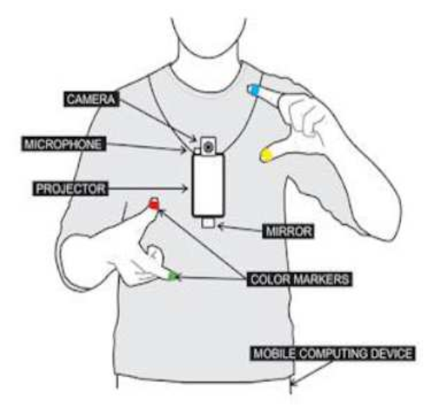
How The Project Looks Like :
References
Introduction
Applications
Tools
Benefits
Technologies

Slide 9

Technologies:
Augmented reality
Gesture recognition
Augmented reality (AR) is a term for a live direct or indirect view of a physical real
world environment whose elements are augmented by virtual computer-generated imagery
The process of recognizing the gesture (hand movements, facial-expressions , body movement etc.) is called gesture recognition and the computer interface using this method is called gesture recognition technology
References
Introduction
Benefits
Tools
Applications
Technologies
Computer vision
Radio Frequency Identification
Computer vision is a field that includes methods for acquiring, processing,analyzing,and understanding images data from the real world in order to produce numerical or symbolic information.
Radio Frequency Identification (RFID) is a means of identifying objects by interrogation a unique characteristic of the object using radio wave

Slide 10



Cost effective
Sixth_Sense_Project
Applications
References
Introduction
Technologies
Benefits
Tools
Every Information On your Gestures
Portable

Slide 11
1.Portable :
One of the main advantages of the sixth sense devices is its small size and portability. It can be easily carried around without any difficulty. The prototype of the sixth sense is deigned in such a way that it gives more importance to the portability factor. All the devices are light in weight and the smart phone can easily fit into the users pocket
2. Cost effective :
The cost incurred for the construction of the sixth sense proto type is quiet low. It was made from parts collected together from common devices. And a typical sixth sense device cost up to $300. The sixth sense devices have not been made in large scale for commercial purpose. Once that happens it’s almost certain that the device will cost much lower than the current price.
References
Applications
Introduction
Operation
Benefits
Tools
3. Every Information On your Gestures:
With help of a sixth sense device the user can easily access data from any machine at real time speed. The user doesn’t require any machine-human interface to access the data. The data access through recognition of hand gestures is much easier and user friendlier compared to the text user interface or graphical user interface which requires keyboard or mouse

Slide 12






01
02
03
Map Application
Taking Pictures
Drawing Application
References
Tools
Technologies
Applications
Introduction
Benefits
04
05
06
Making Calls
Interacting with physical objects
Getting Information

Slide 13
https://www.guru99.com/big-data-tools.html
https://www.qubole.com/blog/hadoop-vs-traditional/
https://www.sas.com/en_us/insights/analytics/big-data-analytics.html
https://searchstorage.techtarget.com/definition/big-data-storage
https://www.edureka.co/blog/big-data-analytics/
References
Tools
Applications
Introduction
Technologies
Benefits

Slide 14
Thank You!!

