Slide 1
FASHIONWAVE
FW
Retail Sales Performance Analysis
FY 2024-2025
Business Intelligence & Strategic Insights Report
Retail Store Sales Analysis | 50 Stores Across India
January 2025 – December 2026
₹2.13 Cr
Total Revenue
₹56.58 Lakh
Profit Generated
26.57%
Overall Profit Margin
50 Stores Stores Covered
Prepared by: Aditya Tripathi | FashionWave Analytics

Slide 2



PROJECT OBJECTIVES
Increase weekend sales
Improve Profitability
Optimize Discounting
Target a +15% surge in weekend sales next quarter by launching high-converting weekend campaigns, flash events, and exclusive customer loyalty perks.
Identify underperforming categories and bottom-performing store locations to eliminate profit leakage and optimize product mix.
Restructure promotional models to establish a strict discount cap (15%-20%), preventing margin erosion while maintaining sales volume.
Tracked KPIs: Total Revenue • AOV (₹4,259) • Profit Margin % • Discount Impact • Weekend Ratio

Slide 3
E X E C U T I V E D A S H B O A R D
Total Sales Revenue
₹2.13 Crore
Average Order Value (AOV) ₹4,259
Overall Profit Margin
26.57%
Weekday vs Weekend
70% : 30% Ratio
Units Sold
3.0 Units per transaction
Discount Impact
Margin drops 37.49% - 9.87%

Slide 4
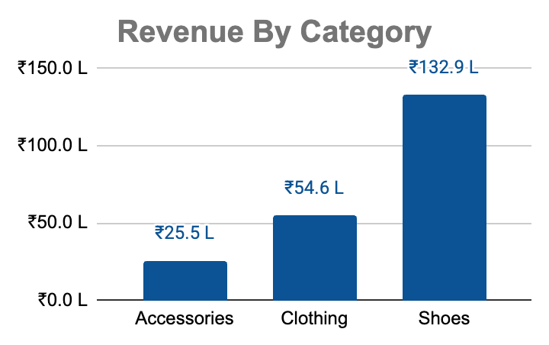
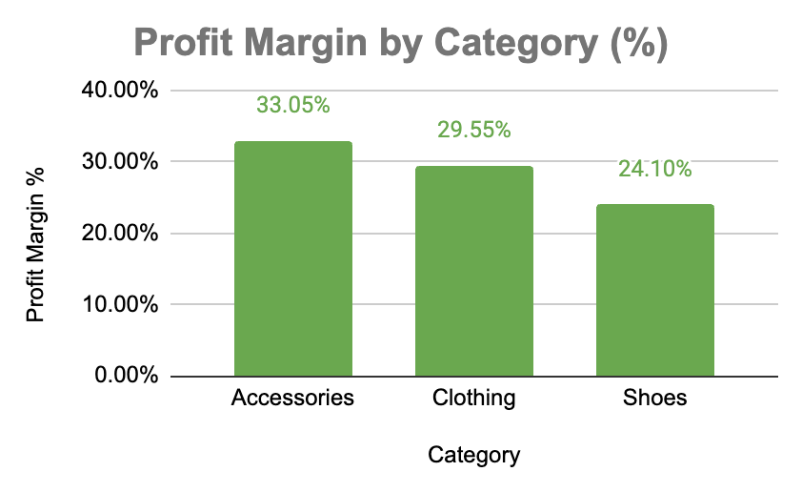



Q1. PRODUCT CATEGORY PERFORMANCE
Shoes Leads Revenue
Accessories Highest Margin
Shoes: Revenue vs Margin Gap
Contributes ₹1.33 Cr (over 60% of total revenue) with maximum unit sales (5,152 units). High volume driver.
33.05% profit margin — best in class. Scale this category with cross-selling bundles at checkout.
₹13.3 Cr revenue but only 24.1% margin. Review supplier costs and restrict deep discounting.

Slide 5
Q2: WEEKEND vs WEEKDAY SALES ANALYSIS
WEEKDAYS
WEEKENDS
₹1.49 Cr
₹64.4 Lakh
56% GAP
69.8% of total revenue
30.2% of total revenue
₹28.5L / day
₹16.1L / day
KEY OBSERVATIONS & RECOMMENDATIONS
📉 Revenue Shortfall: Weekends generate only 30.2% of total revenue, creating a 56% per-day revenue gap compared to weekdays.
🛍️ Footfall Issue, Not Margin: Profit margins remain identical (26.64% Weekday vs 26.40% Weekend). The issue is purely low weekend store footfall.
🎯 Weekend Loyalty Push: Convert window shoppers by launching "FashionWave Weekend Perks" — offer 2x loyalty points on Saturday and Sunday
purchases.
📲 Pre-Weekend Digital Alerts: Send targeted WhatsApp and SMS notifications on Thursday & Friday evenings featuring weekend-exclusive bundle deals.

Slide 6
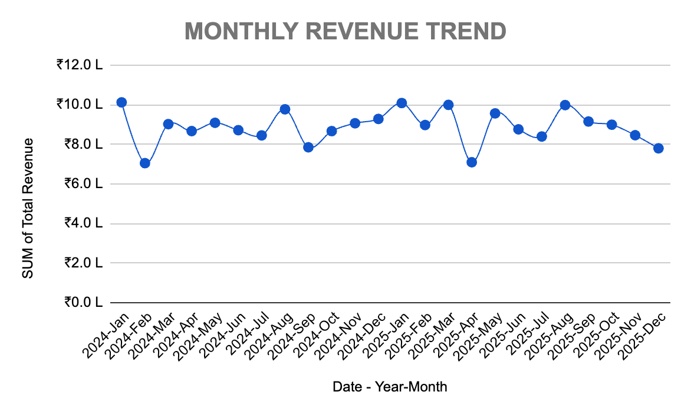
🏆 PEAK MONTHS
🥇 Jan '24 & Jan '25: ₹1.0 Lakhs
🥈 Aug '24 & Mar '25: ₹1.0 Lakhs
🥉 May '24 / May '25: ₹0.9 Lakhs
SEASONAL INSIGHT: Revenue peaks in January (Post-holiday sales) and August/March (Seasonal transitions). February and April show consistent dips (₹0.7L).

Slide 7
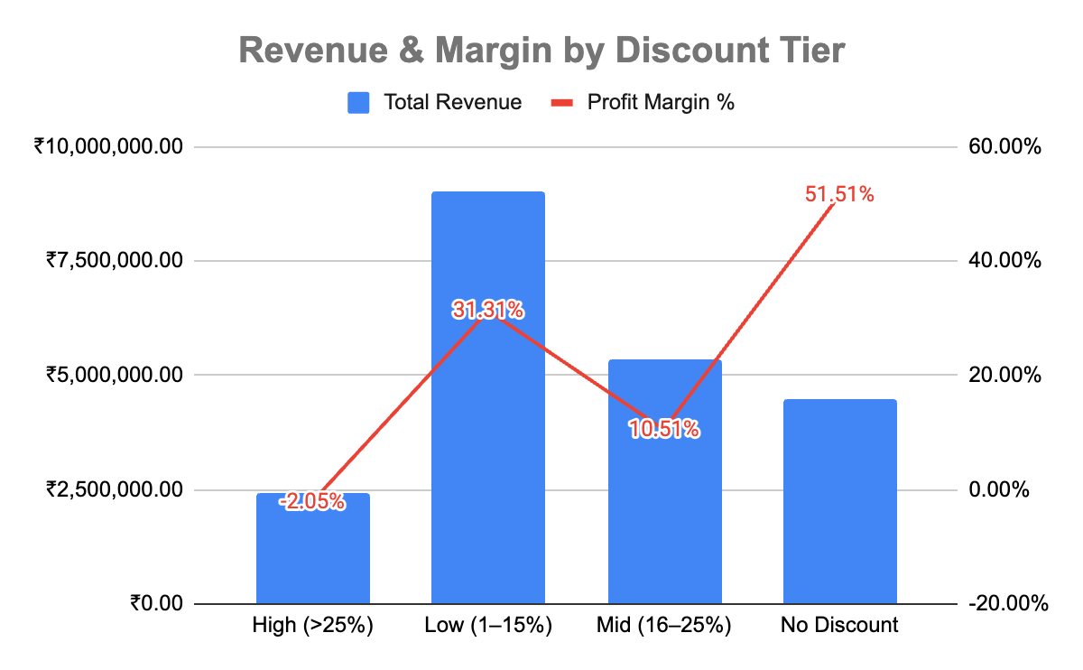
Q3: IMPACT OF DISCOUNTING ON PROFIT MARGINS
Margin Erosion Analysis
No Discount
51.51%
949 txns
Low (1–15%)
31.31%
1,973 txns
Mid (16–25%)
10.51%
1,395 txns
High (>25%)
-2.05%
683 txns
DISCOUNT POLICY RECOMMENDATION: Cap promotional discounts strictly at 15%–20% to protect a minimum 25%–30% profit margin floor. Deep discounts (>25%) destroy business value by pushing margins into negative territory (-2.05%). Transition to "Smart Incentives": Offer a 15% welcome discount for new shoppers, and loyalty points for returning customers instead of flat percentage-off deals.

Slide 8
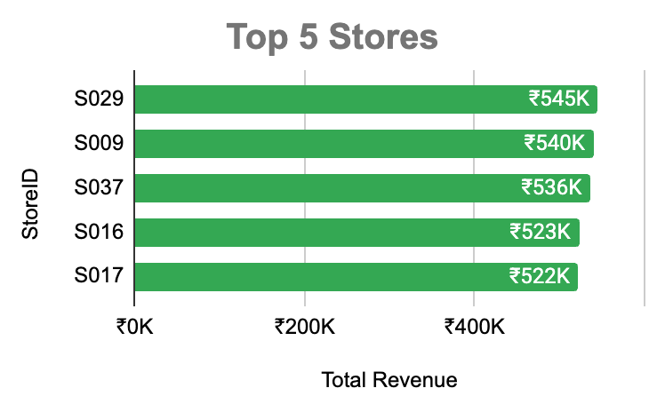
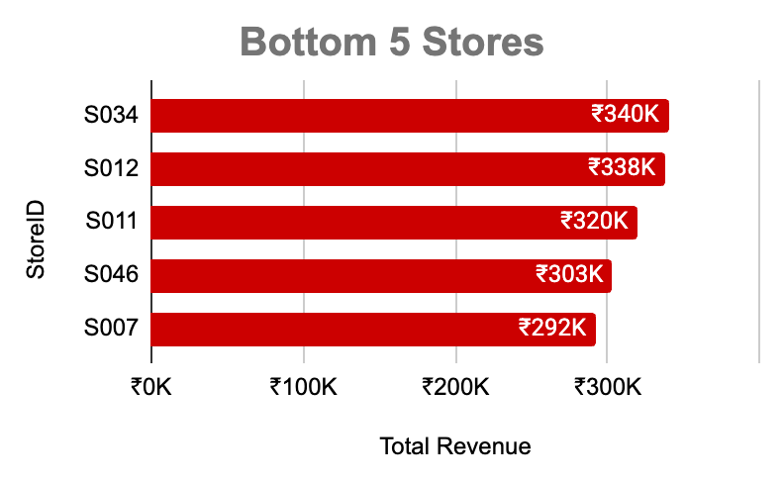
Q4: STORE PERFORMANCE — TOP 5 & BOTTOM 5
Performance Gap: Top 5 stores average ₹5.3L–₹5.5L in revenue, whereas the Bottom 5 stores generate only ₹2.9L–₹3.4L — representing a 45% revenue drop.
ROOT CAUSES & QUICK WINS FOR UNDERPERFORMERS
📍 Low Brand Visibility: Launch hyper-local digital and social media marketing campaigns for Tier-2/3 store catchment areas.
📦 Product Assortment: Expand high-demand, fast-moving SKUs to inventory-constrained outlets.
👥 Staff Turnover: Introduce monthly store incentives and customer service training programs to retain quality staff.
💳 Digital Payments: Implement QR-pay cashback deals to encourage digital adoption in regional outlets.

Slide 9


Q5: CUSTOMER SEGMENTATION & TARGETED STRATEGIES
NEW
Loyal Champions
Occasional Buyers
New Explorers
24% of customers
23.76% of customers
48.20% of customers
PROFILE:
Returning customers, Card/Digital focus, AOV: ₹4,243
PROFILE:
Seasonal returning buyers, AOV: ₹4,200
PROFILE:
First-time buyers, High AOV (₹4,287 — Highest across segments!)
BEHAVIOR:
Repeat purchases, high volume driver (₹1.01 Cr Revenue, 26.70% Profit Margin)
BEHAVIOR:
Responds well to targeted promotions during festive seasons
BEHAVIOR:
First purchase often discount-driven (14.16% Avg. Discount), ₹1.03 Cr Revenue
STRATEGY:
Exclusive VIP previews, early access, birthday rewards
STRATEGY:
Pre-festive email alerts, "Complete the Look" product bundles
STRATEGY:
15% welcome offer, follow-up engagement at Day 7, 30, 60
RECOMMENDED DISCOUNT: ≤10% max
RECOMMENDED DISCOUNT: 15%–20%
RECOMMENDED DISCOUNT: 15% Welcome

Slide 10
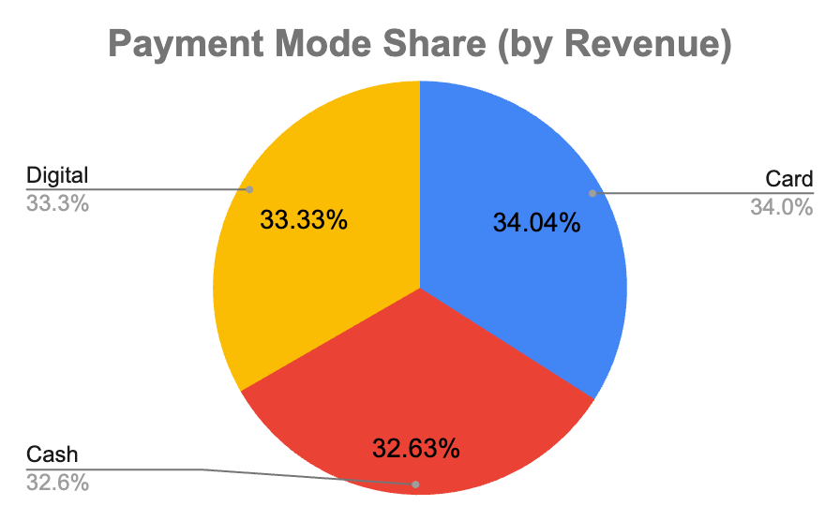
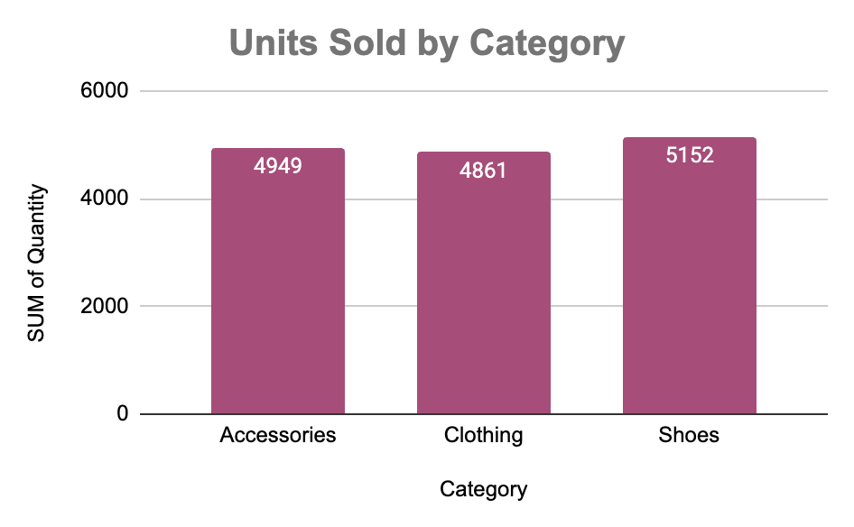

PAYMENT MODES & UNITS SOLD — CATEGORY DEEP DIVE
💳 Card & Digital Dominance (67.37%)
Cash Transition Opportunity (32.63%)
👟 Balanced Volume Across Categories
Card and Digital options together drive over two-thirds of total revenue. Partner with top banks for exclusive EMI and cashback offers on high-value purchases.
Cash transactions represent nearly a third of total sales. Introduce QR-code "Scan & Win" billing incentives to encourage conversion toward digital checkout channels.
Shoes lead total sales volume (5,152 units). Maintain continuous replenishment cycles and size/style availability for top SKUs.

Slide 11


STRATEGIC RECOMMENDATIONS
QUICK WINS (0–3 months)
LONG-TERM (3–12 months)
Launch "Weekend Flash Sale" every Saturday 11am–2pm with 10% extra on trending items.
Build a real-time Power BI dashboard tracking KPIs by store, category, daily.
WhatsApp + SMS campaigns Thu/Fri to drive weekend footfall across 50 stores.
Deploy AI-based replenishment: predict stock needs 4–6 weeks in advance.
Introduce "FashionWave Gold" loyalty points: 2x on weekends and festive season.
Bank partnership for 0% EMI on ₹3,000+ purchases — drives AOV uplift.
Cap Shoes discounts at 15% to recover lost margin (currently high discount segment).
Expand Accessories online (highest margin category) via own app + Myntra/Ajio.
Give bottom-10 stores targeted ad budget for hyperlocal Google/Meta ads.
Store manager quarterly performance reviews with P&L accountability per store.

Slide 12
FW
FASHIONWAVE
THANK YOU
Prepared by: Aditya Tripathi
₹2.13 Cr
Total Revenue
₹56.58 Lakh
Profit Generated
26.57%
Overall Profit Margin
50 Stores Stores Covered

