Slide 1













Slide 2

Clock

Slide 3
Clock

Slide 4

Date

Slide 5

Temperature

Slide 6

Weather

Slide 7

Memento

Slide 8

Atmospheric Pressure

Slide 9

Screen Saver

Slide 10

Currency Standards

Slide 11

Notifications

Slide 12

Timer

Slide 13
Stopwatch

Slide 14

Now Playing

Slide 15

ETS2 Gauge

Slide 16

Brightness & Dimming

Slide 17

Wi-Fi & Access Point

Slide 18

Account & Authentication

Slide 19

Compatibility

Slide 20


Bill of Materials (BOM)

Slide 21
Bill of Materials (BOM)

Slide 22

Setting Up ETS2 Speed Integration

Slide 23
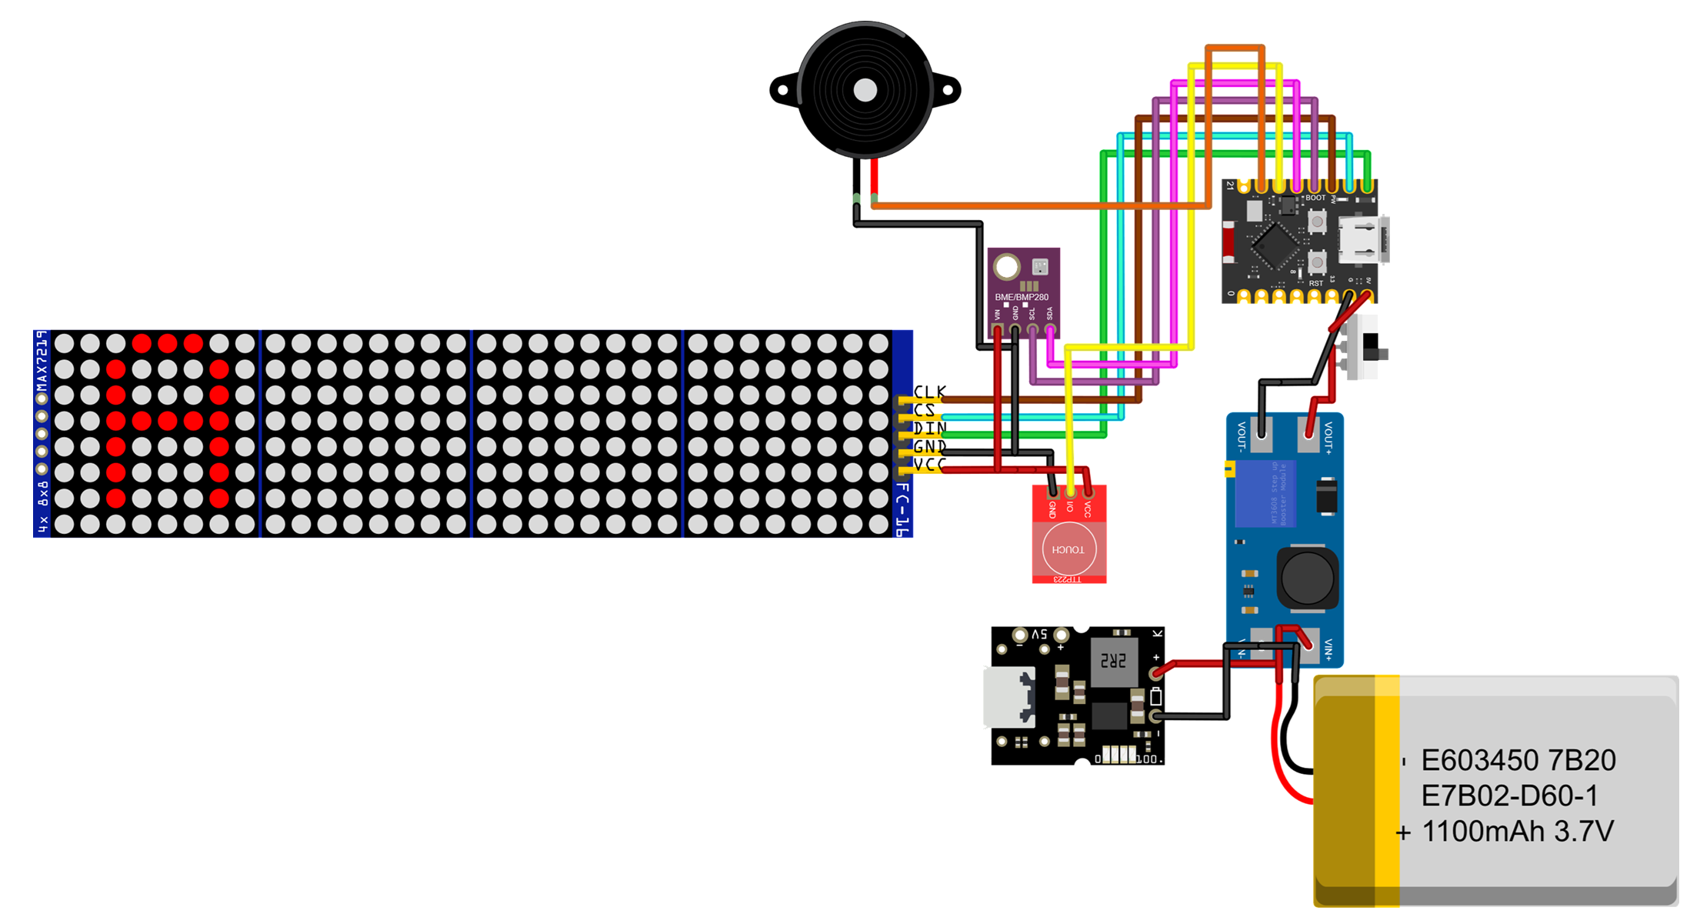


Buzzer
Esp32
8x32 FC-16
Switch
Boost Convertor
Battery
Touch Sensor
Charging Module
Notes:
Charging Board

Slide 24
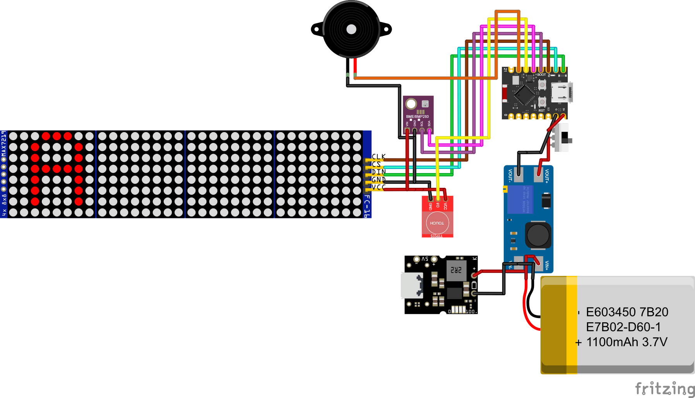

Slide 25
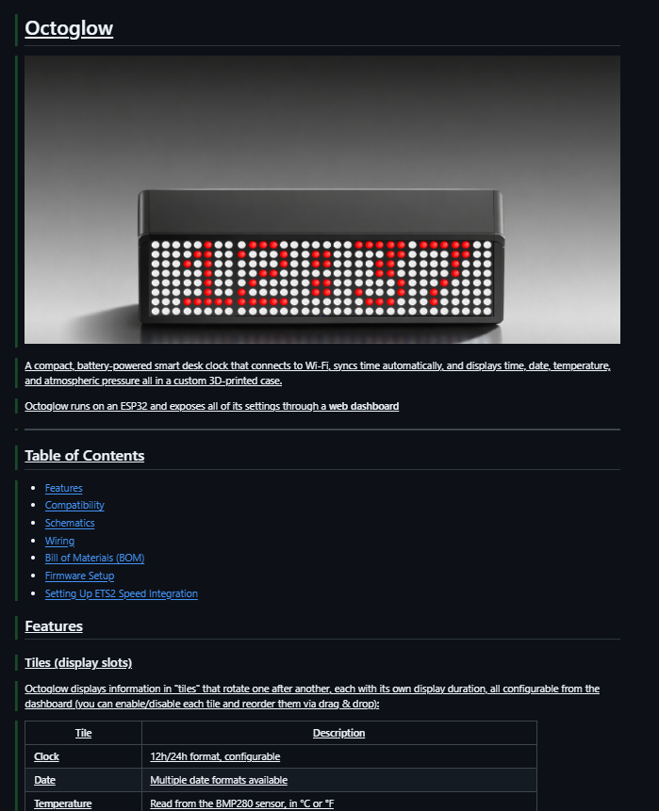
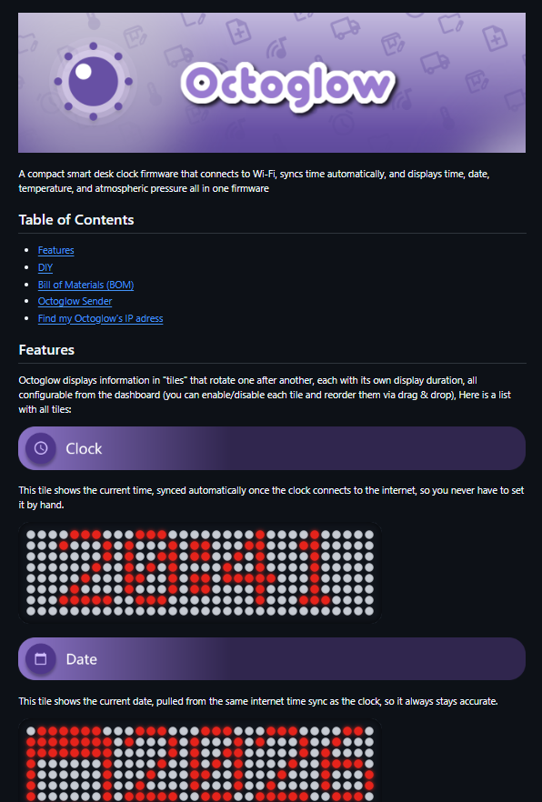

Slide 26
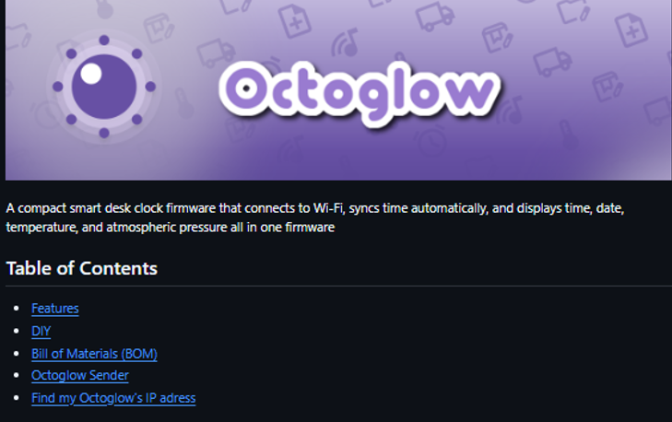
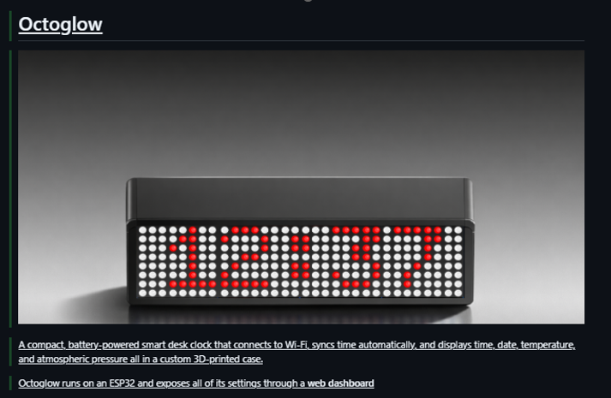
Devlog 1 : Remaked the readme

Slide 27



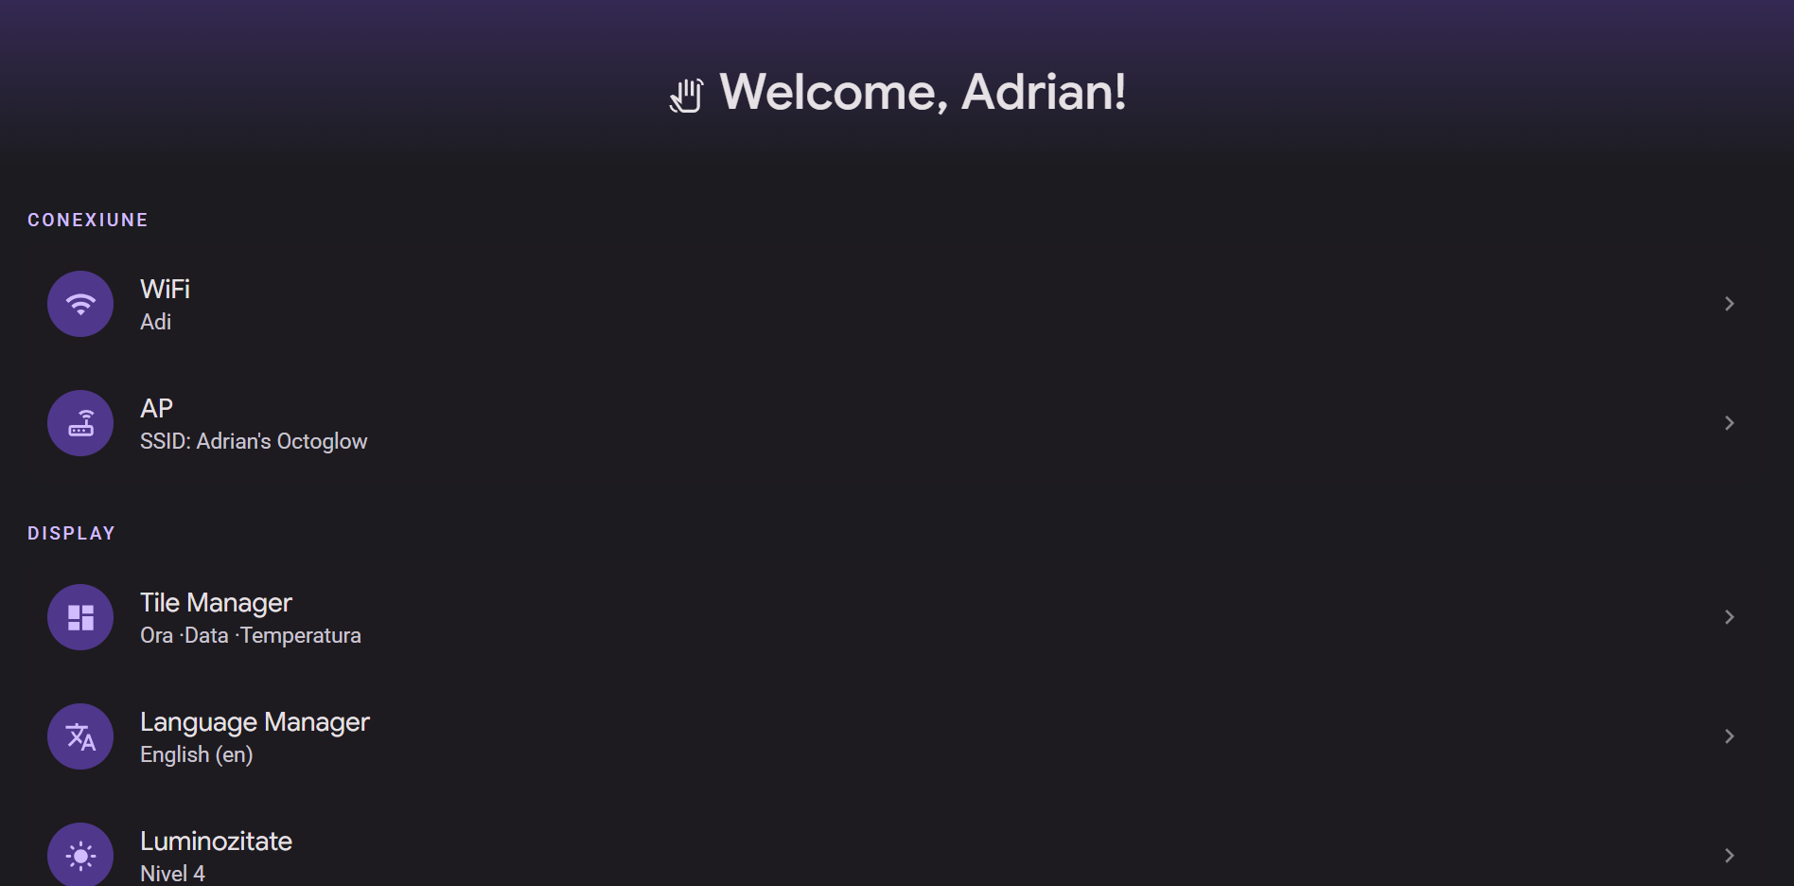

Octoglow

