Slide 1
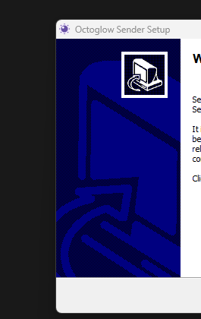
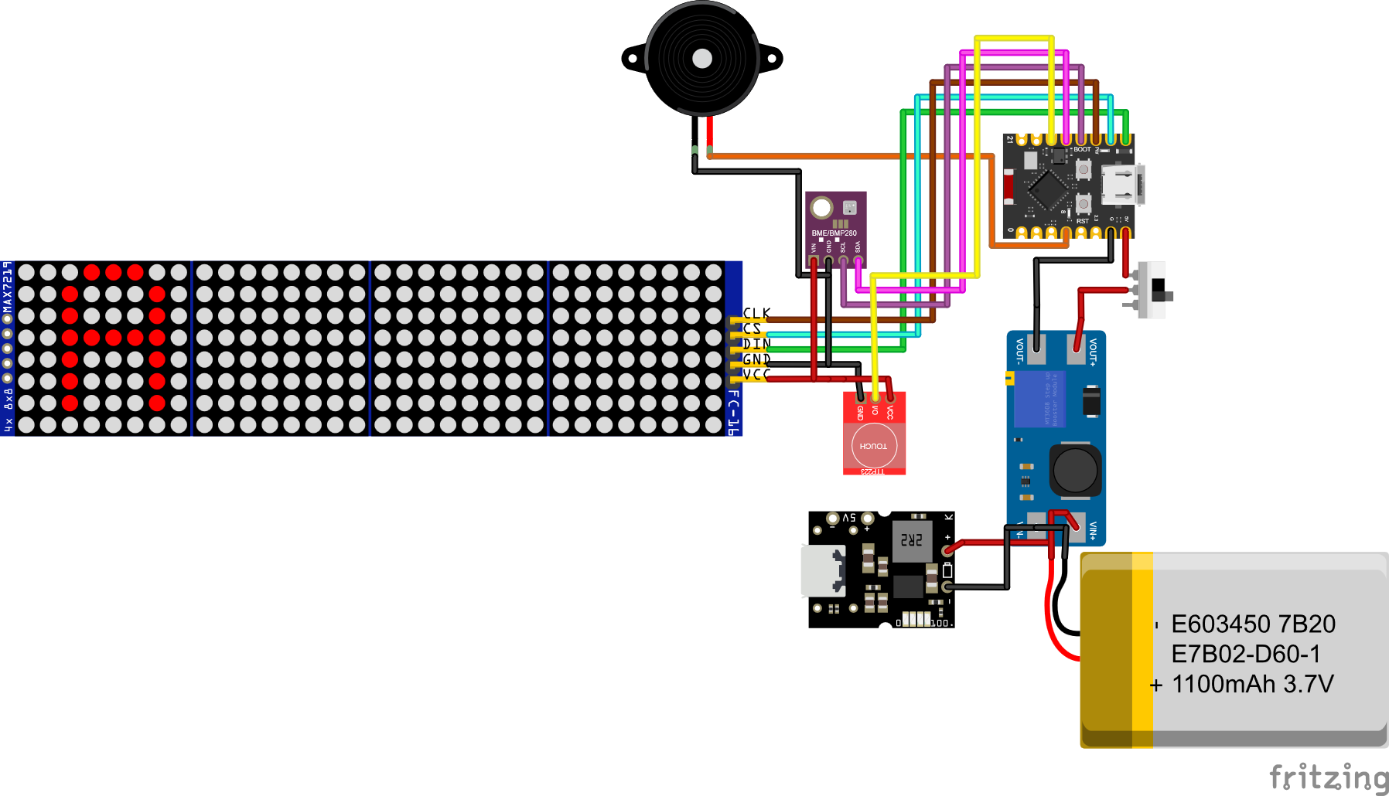













Slide 2
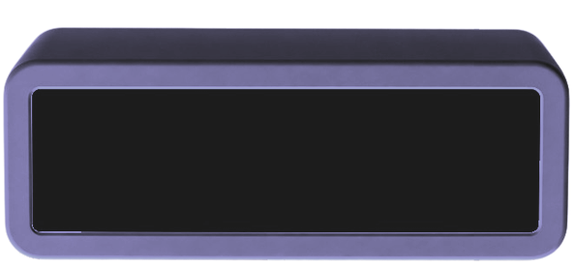





Slide 3

Clock

Slide 4
Clock

Slide 5

Date

Slide 6

Temperature

Slide 7

Weather

Slide 8

Memento

Slide 9

Atmospheric Pressure

Slide 10

Screen Saver

Slide 11

Currency Standards

Slide 12

Notifications

Slide 13

Timer

Slide 14
Stopwatch

Slide 15

Now Playing

Slide 16

ETS2 Gauge

Slide 17

Brightness & Dimming

Slide 18

Wi-Fi & Access Point

Slide 19

Account & Authentication

Slide 20

Compatibility

Slide 21


Bill of Materials (BOM)

Slide 22
Bill of Materials (BOM)

Slide 23

Setting Up ETS2 Speed Integration

Slide 24


Buzzer
Esp32
8x32 FC-16
BMP280
Switch
Boost Convertor
Battery
Touch Sensor
Charging Module
Notes:
Charging Board

Slide 25
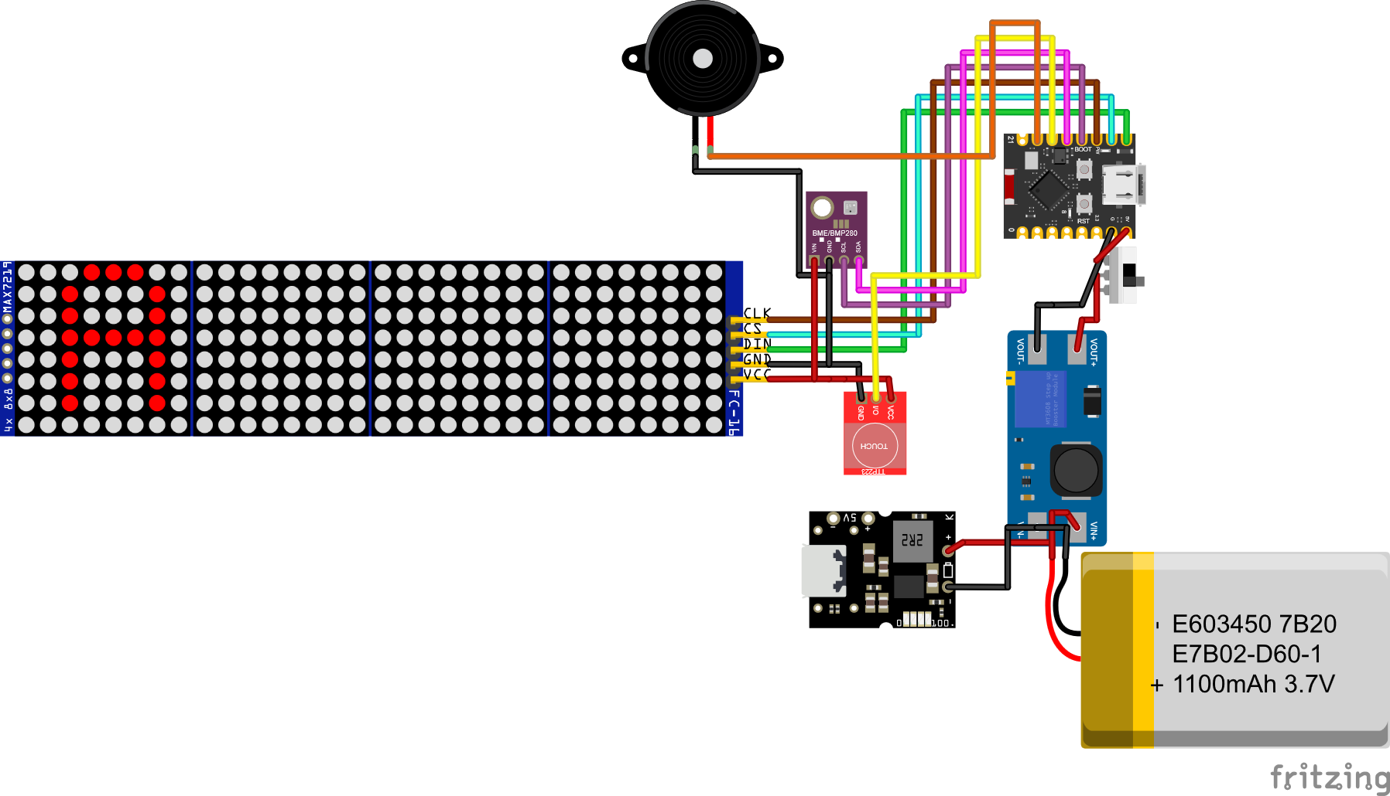

Slide 26
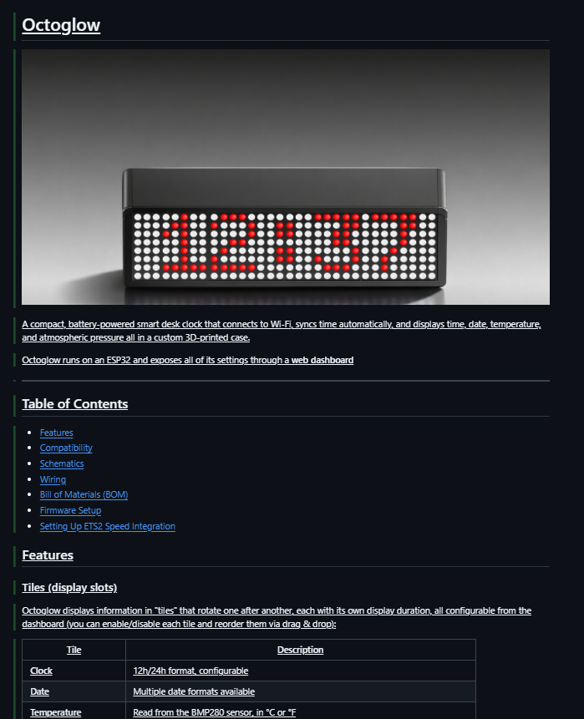
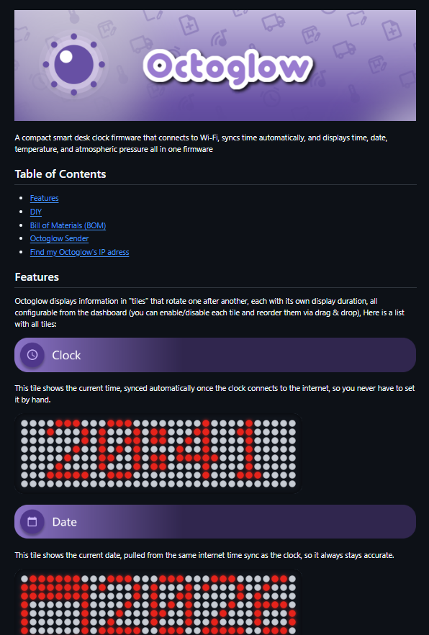

Slide 27
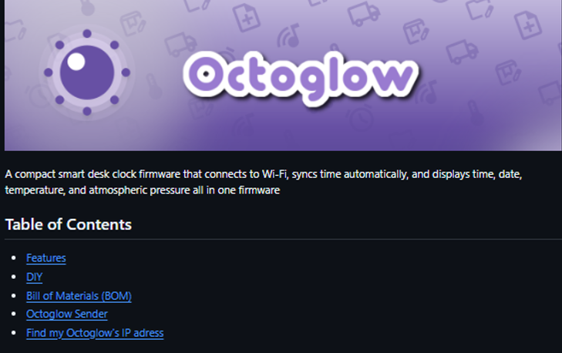
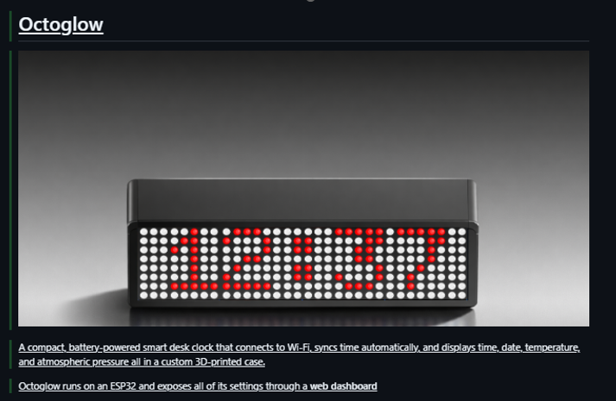
Devlog 1 : Remaked the readme

Slide 28



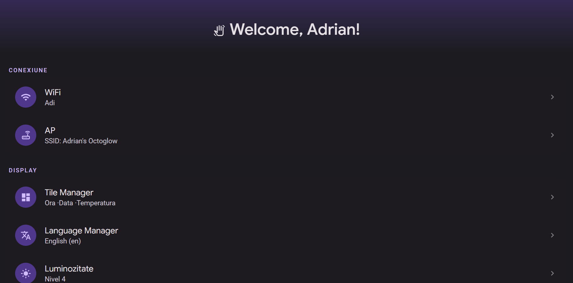

Octoglow

Slide 29








